Slide 1
FEANTSA
Working together to end homelessness in Europe
FEANTSA Health and Homelessness
Study Visit to neunerhaus, 8-9 May 2023
Simona Barbu
Policy officer

Slide 2
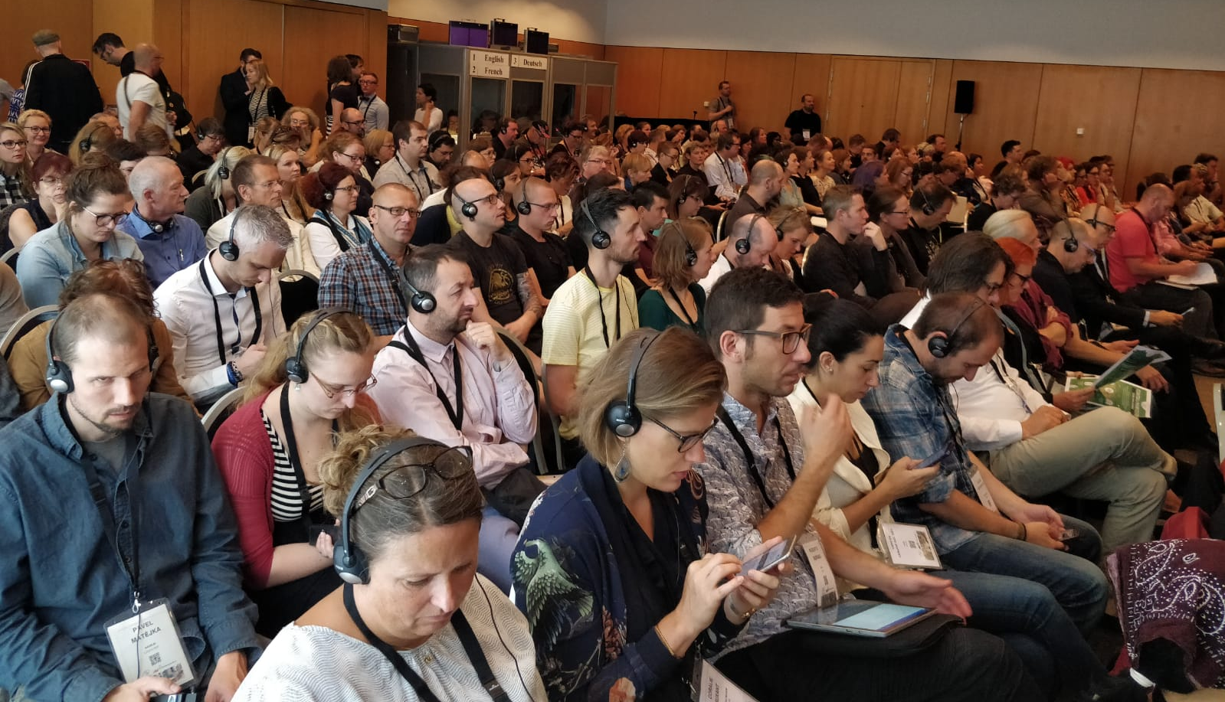
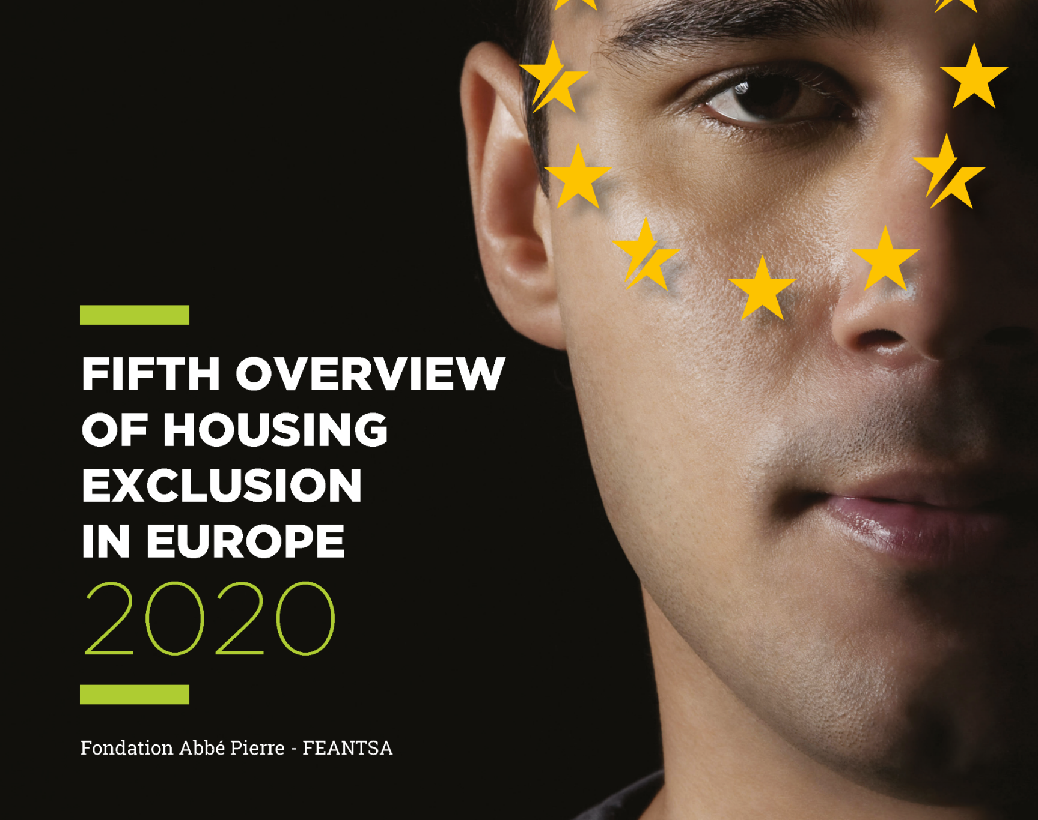
What is FEANTSA?
European coalition to end homelessness in Europe
130+ members across Europe (EU + EFTA + UK)
Our Work
Research
Learning, expertise & knowledge
Advocacy
Awareness raising

Slide 3
FEANTSA coordinates three different platforms in the area of housing:
Housing First Europe Hub →promotes Housing First in Europe
Housing Solutions Platform→ works to find innovative solutions for affordable housing
Housing Rights Watch→ promotes the right to housing in Europe
And a fourth one focused on research: the European Observatory on Homelessness

Slide 4
Homelessness in Europe
Homelessness is increasing
FEANTSA estimates at least 700,000 homeless on any given night in the EU; up 70% in 10 years
24 out of the 27 EU MS report that homelessness has increased over the last decade
Homelessness looks likely to increase as a result of the COVID 19 crisis and the ongoing cost of living crisis
Homelessness is changing
Women, families with children, migrants, young people increasingly represented
Evidence from some MS of increasing duration
Most MS’ policies have been inadequate
Predominant focus on temporary accommodation & support
FEANTSA-FAP Annual Overview of Homelessness & Housing Exclusion in Europe
©Juan Lemus / Arrels Fundació

Slide 6
Governance, Work Programme and Way Forward for the European Platform On Combating Homelessness
2022-2024
Data collection (European-wide counting initiative, EC (Eurostat), pilot module first results in 2024, developing a proposal for a common monitoring framework).
Mutual learning of good practices (with Members of the Platform and invited experts, policy-makers and practitioners, European Award – FEANTSA, dedicated EaSI-funded call for proposals, EU wide campaign, a website, a Policy Toolkit).
National, Regional and Local Authorities will promote the prevention of homelessness; support policy measures with adequate funding.
Promote the use of EU funding

Slide 7
European Commission's role
The European Commission's Directorate for Health and Food Safety (DG SANTE) supports the efforts of EU countries to protect and improve the health of their citizens and to ensure the accessibility, effectiveness and resilience of their health systems.
This is done through various means, including by
proposing legislation
providing financial support
coordinating and facilitating the exchange of best practices
health promotion activities

Slide 8
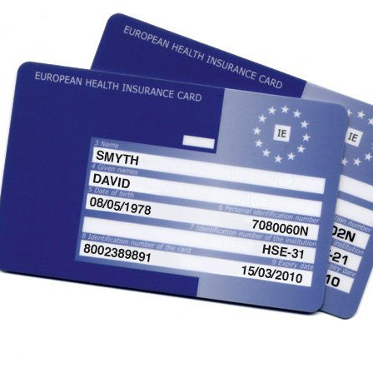
Health priorities 2021-2027
The European Health Union
Strategic Plan 2020-2024 of the Commission's Directorate-General for Health and Food Safety
Initiatives
Crisis preparedness
European Health Emergency Preparedness and Response Authority (HERA)
Europe Beating Cancer plan
A comprehensive approach to mental health
European Health Data Space

Slide 9
EU4Health
EU4Health programme 2021-2027 – a vision for a healthier European Union
The EU4Health programme was adopted as a response to the COVID-19 pandemic and to reinforce crisis preparedness in the EU.
Health is an investment and, with a €5.3 billion budget during the 2021-27 period, the EU4Health programme is an unparalleled EU financial support in the health area.

Slide 11
Subthemes COVID 19 & homelessness Peer support in health settings Cancer Mental health HIV Climate change Mortality

Slide 12
How do we work
Membership
FEANTSA members +
European Platforms working on health inequalities
European Commission - DG SANTE
The European Parliament (Special Committees on Cancer, on COVID 19 lessons learnt)

Slide 13
Simona Barbu
Policy officer
simona.barbu@feantsa.org
www.feantsa.org
Thank you!

