Slide 1
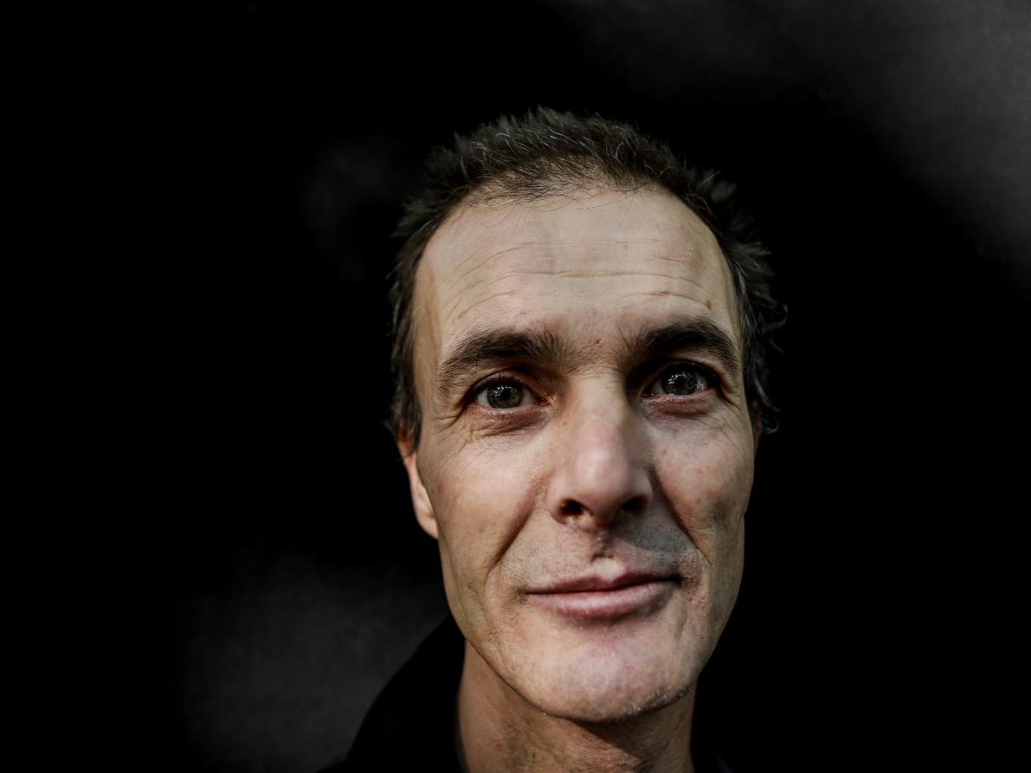

37.117 homeless people in Spain
There is a solution

Slide 2
WHO ARE WE?
HOGAR SÍ

Slide 3
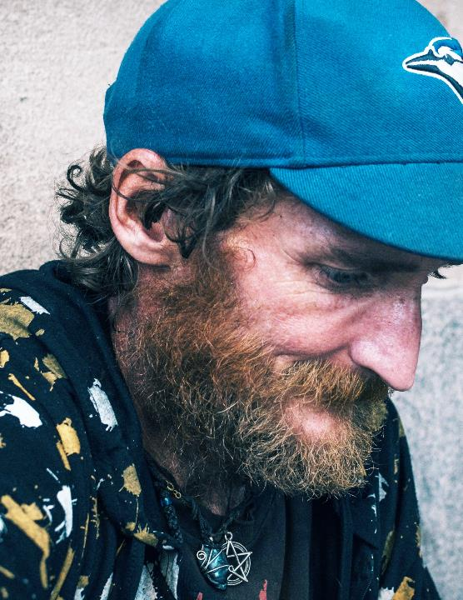


OUR GOAL
HOGAR SÍ works to ensure that no one lives on the street.
HOGAR SÍ is a social initiative entity created in 1998. We are nonprofit, independent and plural.
We firmly believe that eradicating homelessness is possible.
In Alliance with

Slide 4
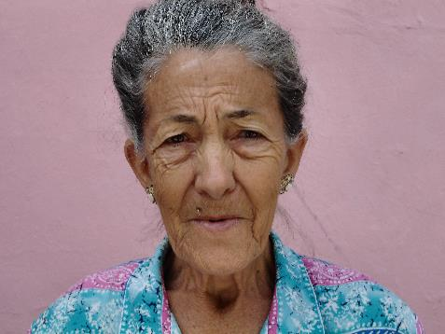
OUR VISION
We aim for a society in which no one is forced to sleep rough.
We believe in collective responsibility to generate solutions to eradicate homelessness. We need to shift the general mindset that identifies homelessness as an individual problem to a new one that address this phenomenon as a problem of the whole society.
We are committed to impact the social agenda and to generate knowledge and innovation.
We respect people's autonomy, and we trust in their capacity to build their own life project in a context that recognizes and guarantees their rights.
WE EMPOWER PEOPLE TO BECOME AUTONOMOUS, WE TRUST THEM

Slide 5




OUR WORK
LIVING ON THE STREET IS A VIOLATION OF HUMAN RIGHTS
RIGHT TO HOUSING
ACCESS TO HEALTH
RIGHT TO EMPLOYEMENT
NO MORE HATE CRIMES
HOUSING YES.
HOMELESSNES IS MAINLY A HOUSING PROBLEM
LIVING ON THE STREET IS INCOMPATIBLE WITH GUARANTEEING THE RIGHT TO HEALTH
A HOME TO GAIN ACCESS TO EMPLOYMENT
HATE CRIMES OF APOROPHOBIA MUST BE BROUGHT TO LIGHT, COMBATED AND PERSECUTED
WE DO NOT WANT TO MANAGE HOMELESSNESS, WE WORK TO ERADICATE IT

Slide 6

OUR SOLUTIONS FOR HOMELESNESS
RIGHT
TO HOUSING
RIGHT
TO HEALTH
RIGHT
TO EMPLOYMENT
Housing First
Housing for Autonomy
Housing for health recovery
Labor development and training
Prospecting and intermediation
Social economy
RESEARCH AND EVALUATION
COMMUNICATION AND ADVOCACY
INTERNATIONAL APPROACH

Slide 7




HOMELESS PEOPLE IN SPAIN
77%
23%
Chronicity
40% +3 years in a situation of homelessness
Health
44% have a bad perception of their health
Safety
37.117
homeless people**
50,4% have been hate crime victims
Lack of shelter
45% is out of the homeless attention system
  *Source: Instituto Nacional de Estadística 2022
  ** Source: estimation from the Estrategia Nacional Integral para Personas Sin Hogar 2015-2020

Slide 8
HEALTH AND HOMELESSNESS
DID YOU KNOW…
The homelessness care system in Spain has traditionally been emergency-based. 69% of the accommodation places are hostels and other collective centers. ​
30% suffer from serious illnesses.
More than 30% of them have attempted suicide.
They have a life expectancy of 30 years less than the average.
Living on the street, you do not have access to a transplant or chemotherapy treatment.
​
In Alliance with

Slide 9
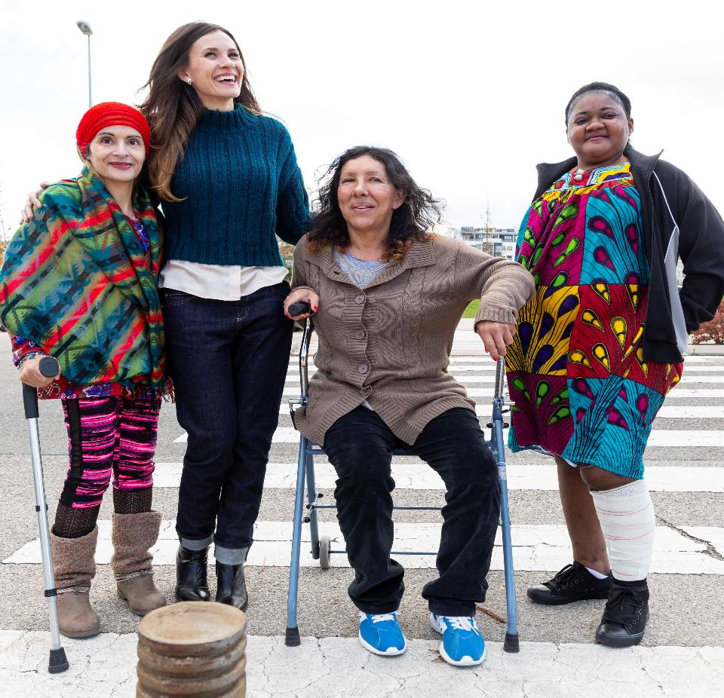
Street kills.

Slide 10
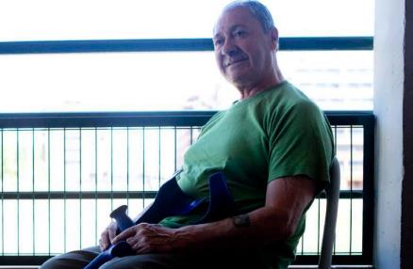
OUR SOLUTIONS TO HOMELESSNESS: HOUSING FOR HEALTH RECOVERY
WHAT DOES IT CONSIST OF
TO WHOM IT IS ADDRESSED
Access to shared housing with 24-hour care
Specialized response, combining social intervention and healthcare support
Prevention and health promotion, with a focus on adherence to treatment
Normalized use of the public health system
Focus on improving the housing situation
Person-centered planning
Recovery
(Traumatologies, oncologic processes and surgical interventions.)
Chronic diseases
(Cardiovascular, respiratory, infectious diseases, diabetes and nephropathies.)
Palliative care
(Oncological diseases)
60 %
26,5 %
13,5 %
WHAT IS THE IMPACT (6 months)
Over 90% show adherence to medication regimens
Decrease in emergency room visits and days of hospitalization
65.5% of clients feel their health has improved
50% improve their housing situation at discharge
In Alliance with

Slide 11



HOUSING FOR HEALTH RECOVERY
In Alliance with
Homelessness directly affects the PHYSICAL AND MENTAL HEALTH of those who suffer from it.
PROBLEM 1
People affected by homelessness do not find it possible to stay in the care network when they need social and health care.
PROBLEM 2
It leaves people who suffer health problems in a homeless situation and do not recover and return to the health system; or it lengthens hospital stays unnecessarily at a high economic cost.
PERFIL
medical convalescence
palliative care
chronic disease
The program offers a socio-health solution to these problems, ensuring the recovery of people in the normalized public health system and reducing the high economic and human cost to the system.
The program undergoes an EVALUATION process, both in terms of the impact of the project on LIVING CONDITIONS and its ECONOMIC EFFICIENCY.
In Alliance with

Slide 12
HOUSING FOR HEALTH RECOVERY
In Alliance with
WHERE WE ARE
86 positions
oriented to health care in Madrid, Andalusia and Murcia. Our project serves people from all regions
60 places in Madrid
14 places in Murcia
12 places in Andalusia
POSITIONS:
We believe that the program should be part of the public service portfolio, as is the case in Madrid, the first community to support this program.
It´s the only way to guarantee the sustainability of the service.
Cost-effective
Significant improvement in the state of health and quality of life of the program's users.
In Alliance with

Slide 13
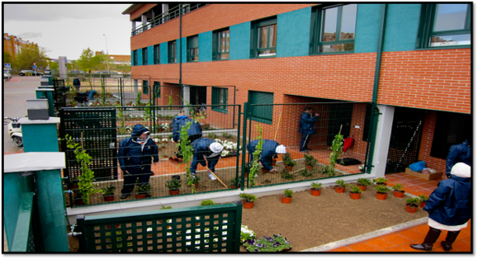
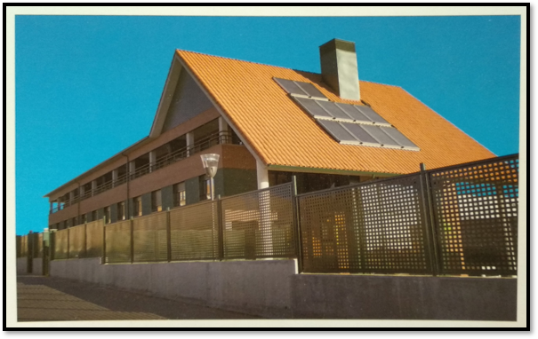
HOUSING FOR HEALTH RECOVERY
In Alliance with

Slide 14
HOUSING FOR HEALTH RECOVERY
In Alliance with
A space of security, rest and stability to ensure medical convalescence, in order to support the restoration of the person's health and accompany the initiation or progress of his or her social integration process.
An environment based on respect, comfort and support. Improved health and a higher level of care for people.
Support 24 hours a day, Monday through Sunday, to people who, due to health problems, cannot be autonomous in their recovery.
Coordination with health centers (outpatient or inpatient), allowing the person to exercise their rights in accessing the corresponding treatments.
Coordination with the network of resources for the homeless and with community social services. and community social services.
A space of comfort, security and stability in times of palliative care for homeless people with the possibility of outpatient treatment. of outpatient treatment. Accompaniment in the end-of-life process, based on the principles of security from the principles of safety, dignity and stability.
In Alliance with

Slide 15






OUR SOLUTIONS TO HOMELESSNESS
In Alliance with
Improvements in quality of life in all areas. A perception of safety at the end of the program of 4.6/5 points and a reduction in dependence for basic activities of daily living and autonomous management of their medication.
Improvements in general life satisfaction. The most marked improvements related to physical and psychological health: 50% had a possible depression at entry and, after the intervention process, this proportion drops to 15.6%.
Improved residential situation at exit. 1 out of every 3 persons entering the program exits to independent housing.
Improvement of administrative situation.
Improvement in the economic situation at exit. The proportion of clients with no income dropped from 71.7% to 62%. The average income and the proportion of clients accessing a benefit or wage income also increased, compared to the initial situation.
Cognitive decay is perceived in 1 out of every 3 clients on entry. This figure is reduced to almost 1 in 5 clients at exit.
The program is cost-effective
Net annual savings per user, taking into account the health costs of the program: 27,216 euros user/year.
In Alliance with

Slide 16

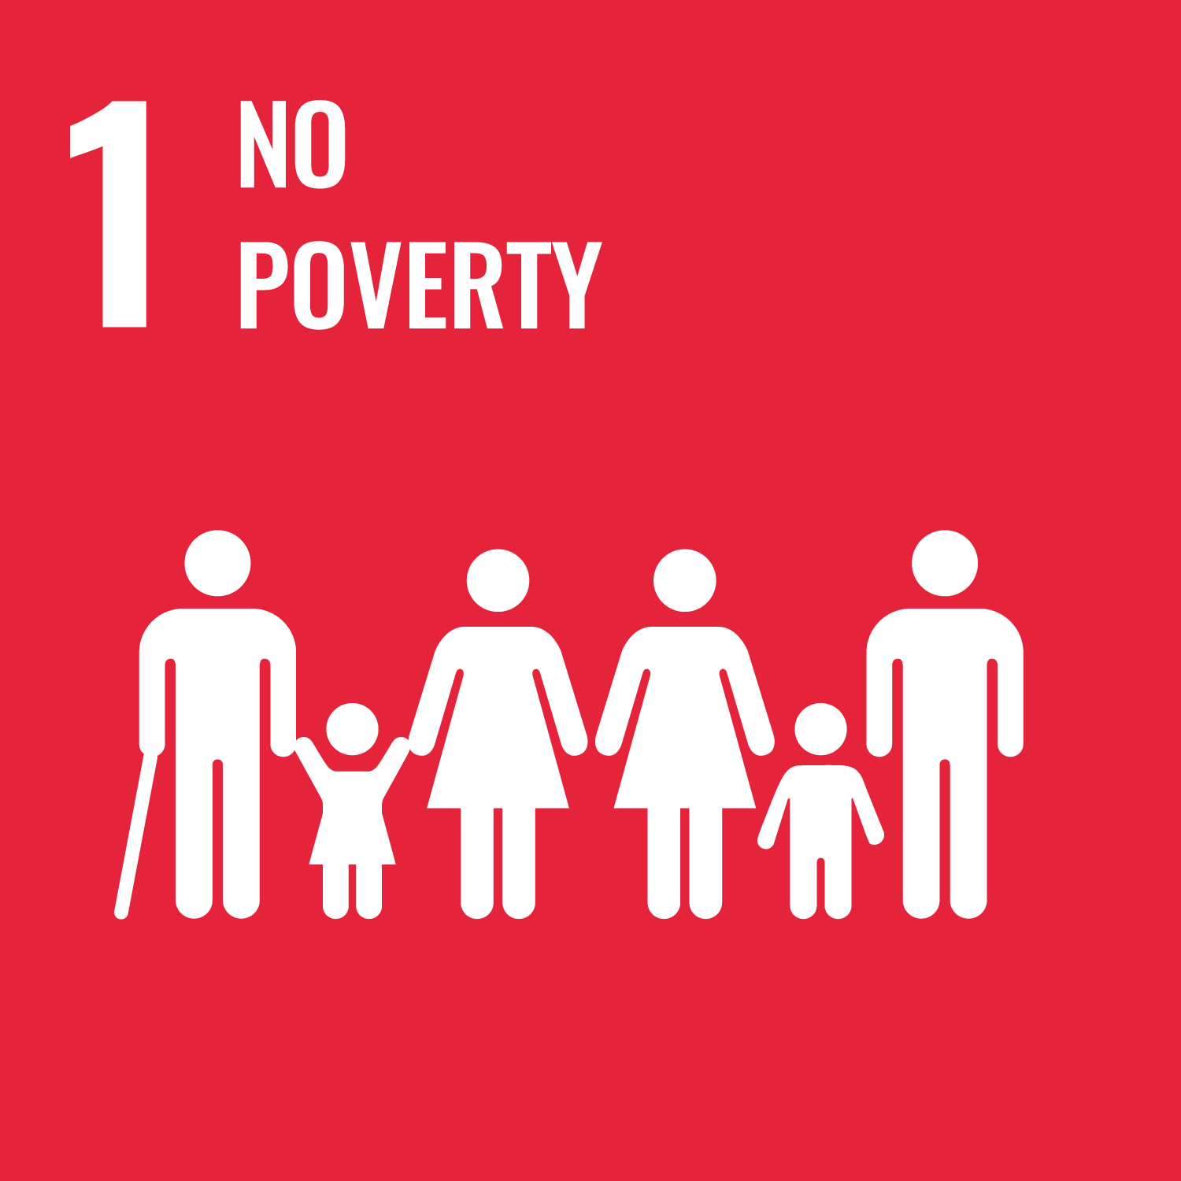





THANK YOU
www.hogarsi.org

