Slide 1
Learning About Europe’s Biggest Ethnic Minority - The Roma
Module 5: Good practices and projects supporting Roma mobile EU citizens experiencing homelessness
This material has been prepared by Marina Csikós
(csikosmarina1993@gmail.com) in the context of PRODEC project.
April 2023
Notes:
Hello and welcome to our newest tool for professionals supporting destitute EU migrants.
This is the fifth and last training module on Roma history and culture, presenting you with Good practices and projects supporting Roma mobile EU citizens experiencing homelessness.
We hope you find the following slides useful and inspiring for your work.

Slide 2
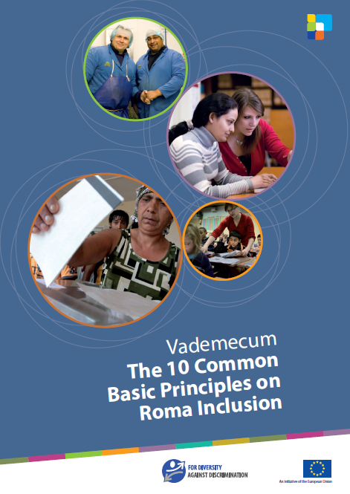
The 10 Common Basic Principles of Roma Inclusion
The 10 Common Basic Principles on Roma Inclusion is a tool for both policy-makers and practitioners managing programmes and projects. Distilled from the experience of successful policies, they provide a framework for the successful design and implementation of actions to support Roma inclusion.
Notes:
To begin with, we underline that any good practice should be informed by principles that allow for successful and meaningful design and implementation. In the case of initiatives developed to support Roma, this set of Principles was drafted by the Directorate-General for Employment, Social Affairs and Inclusion (European Commission). The document was presented for the first time at the meeting of the European Platform for Roma inclusion in Prague on the 24th of April 2009. On the 8th of June 2009, the Council of Ministers in charge of Social Affairs annexed the Principles to their conclusions and invited Member States and the Commission to take them into consideration.
In the following slides, three of these principles will be explained further in detail.
What is the EU platform for Roma inclusion?
The platform is an open and flexible environment organised by the Commission and the rotating EU Presidency at the request of the Council, in which key actors – EU institutions, national governments, international organisations, NGOs, and experts can interact and formulate strategic advice for decision-makers on the effective inclusion of Roma aspects into European and national policies. It is not a formal body, but rather a process driven by participants. The EU Presidency plays a particularly important role as the link to national governments and to the Council of the EU.

Slide 3
The 10 Principles are:
1 Constructive, pragmatic and non-discriminatory policies
2 Explicit but not exclusive targeting
3 Inter-cultural approach
4 Aiming for the mainstream
5 Awareness of the gender dimension
6 Transfer of evidence-based policies
7 Use of European Union instruments
8 Involvement of regional and local authorities
9 Involvement of civil society
10 Active participation of the Roma
Notes:
The 10 Common Basic Principles on Roma Inclusion is a tool for both policy-makers and practitioners managing programmes and projects in the EU member States. The principles provide a checklist on how policies should be designed and implemented on Roma inclusion.
For more information on the different principles:
https://op.europa.eu/en/publication-detail/-/publication/7573706d-e7c4-4ece-ae59-2b361246a7b0

Slide 4
Notes:
In the next few slides, we will learn more about three principles, but you are more than encouraged to have a look at all 10 principles and start to think about how you can use them during your work.
The first principle we look at is Pricinple 2: Explicit, but not exclusive, targeting of the Roma is essential for inclusion policy initiatives. It implies focusing on Roma people as a target group, but not to the exclusion of other people who share similar socio-economic circumstances. This approach does not separate Roma-focused interventions from broader policy initiatives. In addition, where relevant, consideration must be given to the likely impact of broader policies and decisions on the social inclusion of Roma people.

Slide 5
Notes:
Principle 5 focuses on the awareness of the gender dimension in all policy areas. Roma inclusion policy initiatives need to take account of the needs and circumstances of Roma women. They address issues such as multiple discrimination and problems of access to health care and child support, but also domestic violence and exploitation.

Slide 6
Notes:
Last but not least, we look at Principle 10, which is about active participation of Roma in all stages of policy making and implementation.
The effectiveness of policies is enhanced by the involvement of Roma people at every stage of the process. Roma involvement must take place at both national and European levels through the input of expertise from Roma experts and civil servants, as well as by consultation with a range of Roma stakeholders in the design, implementation and evaluation of policy initiatives. It is of vital importance that inclusion policies are based on openness and transparency, and tackle difficult or taboo subjects in an appropriate and effective manner. Support for the full participation of Roma people in public life, stimulation of their active citizenship and development of their human resources are also essential.

Slide 7
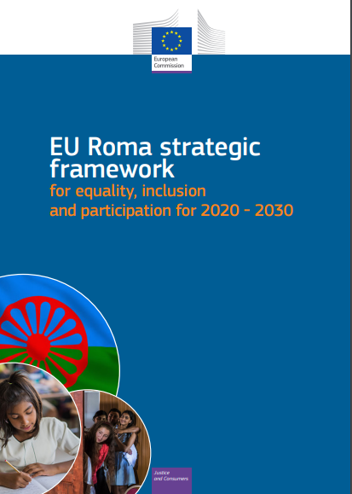
EU Roma Strategic Framework for equality, inclusion and participation 2020-2030
This is the continuation of the previous strategic framework which ran from 2010 to 2020 in most of the EU member States
The framework intends to address Roma inequality within the EU by focusing on equality, inclusion, and participation as horizontal objectives with measurable targets, oriented to change our mindset, combat prejudices, and fight antigypsyism and discrimination
Core areas are: education, employment, housing and health
Capital objectives are: effective equality, Roma people’s effective and meaningful participation, and socio-economic inclusion fighting persisting poverty rates
Setting up of the Roma Civil Monitor in order to build the capacity of Roma and pro-Roma NGOs and monitor the implementation of national Roma strategies on grassroot and national levels
Notes:
When it comes to EU policy-making and policy measures on Roma inclusion, one of the most comprehensive EU policy document is the EU Roma Strategic Framework for Equality, Inclusion and Participation 2020-2030. The EU Roma strategic framework aims to give all Roma the opportunity to realise their full potential.
The previous EU framework 2011-2020 had had limited positive impact in the living conditions of Roma. Extremely high levels of poverty, discrimination, and unequal access to education, employment, health, and housing opportunities demonstrate a still too wide inequality gap in comparison with the overall population, which has worsened with the impact of COVID19.
The framework intends to address Roma inequality within the EU through focusing on equality, inclusion, and participation as horizontal objectives with measurable targets, oriented to change our mindset, combat prejudices, and fight antigyspsyism and discrimination.
Education, employment, health and housing remain core areas to be targeted by Member States through their National Roma Strategies, but three capital objectives are now included to be monitored and taken into action by MS: effective equality, Roma people’s effective and meaningful participation, and socio-economic inclusion fighting persisting poverty rates.
The establishment of quantifiable targets per key area, and the inclusion of a two-yearly follow-up process to measure the specific progress made by Member States, are significant steps forward that will surely press Member States to efficiently invest in Roma, and reduce inequality and poverty rates.
For more information, please visit:
https://ergonetwork.org/wp-content/uploads/2020/12/Guidelines-to-Member-States-NRFs-2020.pdf
https://commission.europa.eu/strategy-and-policy/policies/justice-and-fundamental-rights/combatting-discrimination/roma-eu/roma-equality-inclusion-and-participation-eu/national-roma-strategic-frameworks-commission-assessment-and-implementation-reports_en

Slide 8
Good practices to support mobile EU Roma living in homelessness – Good Practice 1
Fondazione Casa della Carità, in partnership with Ce.A.S - The Solidarity Village
Using integrated approach to support mostly Roma families whose informal settlements were regularly demolished
Developing a support model together with the families based on their needs
Developing specific programmes in parallel to the housing programme: a programme to support children and the schools they attended to facilitate learning Italian; literacy and Italian courses for women; and support for adults into vocational training
Why is it a good practice?
Reflecting on the local circumstances of the Roma
Active participation of the Roma in designing the model
Mobilizing their own capacities
Tackling other, but very much related, issues in parallel: supporting the education of the children, teaching them Italian language, etc.
Notes:
After providing a brief overview about the different EU approaches to the inclusion of the Roma, the following slides we will present good practices on working with migrant and homeless Roma. The good practices were identified in different countries across Europe, and we hope to see these transferred and scaled up.
The Solidarity Village (Casa della Carità) started as a pilot project in 2005 and has been running continuously since then. It responds to the needs of Romanian Roma families who migrated to Italy and are living in homelessness and poor housing (informal settlements). By providing the families with free or very low-cost housing solutions, Casa della Carità aims at promoting their social, working, and housing inclusion.
As the informal settlements they were living in were often demolished, many people, including families with children, were left in the streets. That was the moment when Casa della Carità initiated its work with Roma families, starting by housing 17 families and developing a model to support them, which was defined together with the families based on their needs.
At present, the Solidarity Village project guarantees integrated support to all families and develops together with them tailor-made measures that aim at promoting their social, economic, and housing inclusion. Starting with the offer of long-term housing, families are supported through an integrated approach in the fields of work, education, health, and language learning. Several Roma women were trained to become cultural mediators over the years, and they now collaborate with the project occasionally.
Since 2005, 106 families (over 400 Roma) have been welcomed by the Solidarity Village project and have now reached economic and housing independence. Over 70% of the families in the project exited homelessness and obtained housing (either in public-supported housing, with a tenancy or buying a house).

Slide 9
Good Practice 2
DIOGENES: “Médiation Interculturelle” - Intercultural mediation
Informing homeless Roma about their rights
Building up a relationship, listening and supporting them in their own life choices
Helping with job applications, enrolling children in school, accessing healthcare, informing people about their rights, and supporting them in procedures to access their social rights
Why is it a good practice?
The activities are organised around people’s needs in a holistic manner
DIOGENES also takes on an “awareness-raising role” by mediating with the authorities and working to break their stereotypes about mobile EU citizens (e.g., Roma people who are often discriminated against and stigmatised)
The intercultural mediators come from the same communities, and they speak the same languages as the beneficiaries, respectively Romani, Romanian, and Polish
Notes:
The second good practice is a project implemented by the Brussels-based homeless service provider DIOGENES since 2003. The main purpose of this action is to support destitute mobile EU citizens to achieve inclusion in the Belgian society and open access to their rights while in Belgium.
Polish and Roma intercultural mediators meet mobile EU citizens on the streets of Brussels on a daily basis, to inform them about their rights, to develop a relationship, and to listen and support them in their own life choices. The activities are organised around people’s needs in a holistic manner; support being offered to people in all areas of life where they consider they need help.
In the first six months of the project, 110 people were reached for the first time, and 276 interventions were made (including guidance and other kinds of support). The number of people reached increases every week and there are several activities in place to raise awareness on Roma culture and identity among public authorities.
The cultural and language aspects of the project are very important; therefore, DIOGENES recommends transferring them to other cities. Involving people who come from the same communities and who have similar understandings and perceptions is a strength of the project.

Slide 10
Good Practice 3
Roma Support Group – Advice and Advocacy
Focusing on supporting Roma mobile EU citizens to successfully settle in the UK
Supporting them to access the welfare system, housing, education, health services, and regularising their immigration status
Developing community champions - participation and empowerment of members of the communities
Providing opportunities for people to meet decision makers, local authorities, and public services
Why is it a good practice?
Building confidence within the community
Developing multidisciplinary approach to tackle several kinds of problems
Involvement of Roma professionals
Building relationships betweent the Roma mobile EU citizens and the decision-makers
Notes:
The next good practice is from the UK. Roma Support Group (RSG) is an advice and support charity providing direct assistance to Roma migrants to help them successfully settle in the UK, since 1998. The RSG Advice and Advocacy project was designed in 2010 to meet the needs of Roma migrants in the UK. This project is now the core of the activities of the Roma Support Group, and it was created in response to the observation that existing services from local authorities, charities, etc., were not accessible for Roma migrant communities.
Support is provided to access the welfare system, housing, education, health services, or migration status. Furthermore, the project is aimed at building confidence in the community, in order to be able to navigate the system independently. This is done through training for Roma communities and supporting Roma people to become community champions. RSG creates opportunities for people to meet decision makers, local authorities, and public services, so that the community champions have the chance to learn how to do advocacy and to make the voices of the communities they represent heard.
Regarding staff, professionals are multilingual and many of them have a Roma background themselves. These two factors are very important to ensure that the community is represented, to establish trust, and to reduce barriers for people.
During 2020, 2,218 Roma refugees and migrants were supported: 80% had reduced poverty through debt management and were able to access the welfare system; 53% of beneficiaries were prevented from homelessness; and 27% of beneficiaries had improved their employability skills. There has also been an improvement within mainstream services on their knowledge about the particularities of Roma EU migrants and the support they need.

Slide 11
Good Practice 4
Fundación Secretariado Gitano (FSG)
Following an integrated approach, work is done in the areas of employment, education, health, housing, participation, and antidiscrimination
Opening access to mainstream services and not to “parallel/Roma-only” services
Accompanying families to access rent subsidies or mainstream social housing, managed by local and regional authorities
Why is it a good practice?
Using integrated approach
Mainstreaming Roma into social services
Helping to access social housing
Staff periodically receiving training about the history and culture of
Roma migrants, how to overcome administrative barriers, etc.
Notes:
As a fourth good practice we are presenting the work of Fundación Secretariado Gitano (FSG). Fundación Secretariado Gitano has been working in Spain since the 1960s. The teams focused on non-Spanish Roma families are located in the cities of Burgos and Oviedo (north), Valencia (east) and Catalonia (north-east). These initiatives target Roma families coming from Eastern European countries (mainly Romania) to advance their social inclusion. Following an integrated approach, work is done in the areas of employment, education, health, housing, participation, and antidiscrimination.
The number of non-Spanish Roma supported by FSG is circa 800, comprising all the four projects in several Spanish regions. FSG focuses on opening access to mainstream services and not to “parallel/Roma-only” services. This ensures the inclusion of Roma people in society and increases awareness among public servants. The approach and the methodology of all interventions are the same, but the focus may change from one region to another. Regarding support with housing, FSG cannot offer accommodation to Roma migrants, but instead accompanies families to access rent subsidies or mainstream social housing, managed by local and regional authorities, so they are able to apply for a vacant housing slot.
It is important for the success of the projects that the staff has a good knowledge of the languages spoken by beneficiaries – in this case, of Romanes, Romanian, or Bulgarian – and that it includes people from the same communities. The staff periodically receives both internal and external trainings, on the history and culture of Roma migrants, information about local resources, how to overcome administrative barriers, and so forth. They are very flexible and understand well the migration process and discrimination that people have experienced, which translates into building trust relationships more quickly.

Slide 12
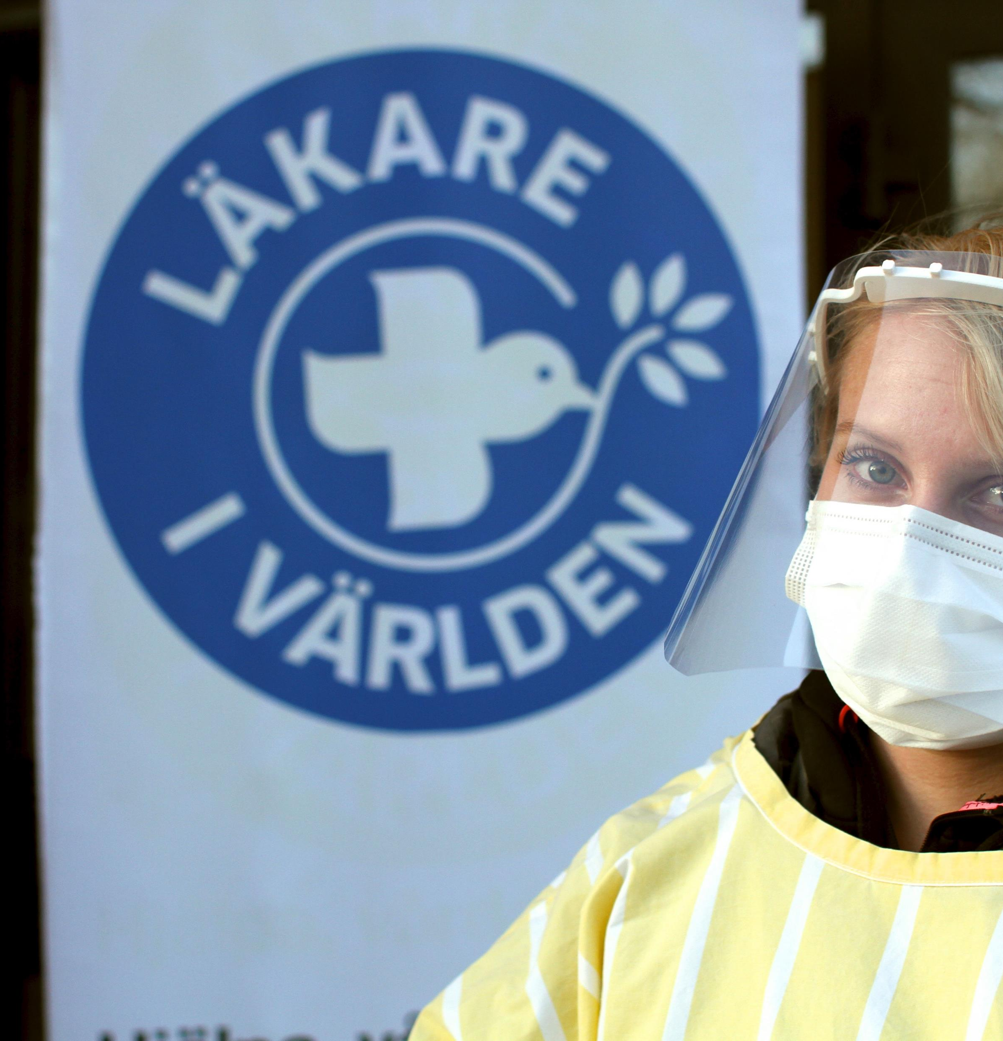
Good Practice 5
Médecins du Monde (MdM) Sweden
Providing healthcare services to vulnerable groups, especially EU citizens lacking health insurance
Performing advocacy to achieve equal access to healthcare for their target populations.
Providing psychosocial support and legal counselling
Advocating for including mobile EU citizens in the legislation which enables access to health services for undocumented migrants
Why is it a good practice?
Lack of access to healthcare is a concerning issue among Roma EU mobile citizens
The staff members have multicultural and multilingual backgrounds
Building relationships with the authorities, showing them that it is possible to reach vulnerable people
Notes:
Last, but not least, we are look at a Swedish example. MdM services in Sweden are open for all migrants, offering a combination of medical health support, psychosocial support, and legal counselling. Estimates are that one third to one fourth of the people met are EU citizens. In 2020, 300 (from a total of 1400 beneficiaries) EU citizens were supported, most of them being Roma from Romania.
The ultimate goal of MdM is to get everyone included in the public health system. In Sweden, the law grants undocumented citizens the same access to healthcare as asylum seekers since 2013, but not to mobile EU citizens. Therefore, MdM started focusing on EU mobile citizens lacking the European Health Insurance Card (EHIC), to ensure basic access to healthcare. In Skone region (Malmo), policy makers have granted mobile EU citizens access to health care services equally to undocumented citizens, but still there is a lack of knowledge among medical staff on this possibility.
This good practice is already implemented in 8 cities in Sweden where MdM has offices, after initially starting in Stockholm. Building relationships with the authorities, showing them that it is possible to reach vulnerable people, and sharing good practices with them are all equally important to ensure the success of the project.

Slide 13
Resources
The 10 common basic principles on Roma inclusion
EU Strategic Framework for equality, inclusion and participation
FEANTSA – 16 Good practices to support mobile EU citizens living in homelessness

Slide 14
Thanks for reading! for further questions or comments please contact us at simona.barbu@feantsa.org
Notes:
This is the end of the series of modules “Learning about Europe’s biggest ethnic minority - The Roma”.
We hope you enjoyed learning about Roma history and culture and that you have the chance to apply this knowledge into your work.
Thank you for reading our training modules! You can find all the modules on FEANTSA’s website (insert link).

