Slide 1
Learning about Europe’s Biggest Ethnic Minority - The Roma
Module 4: Roma in migration - experiencing poverty and homelessness
This material has been prepared by Marina Csikós
(csikosmarina1993@gmail.com) in the context of PRODEC project.
April 2023
Notes:
Hello and welcome to the fourth module about Europe’s biggest ethnic minority, the Roma.
In the previous training module, we learned about the intersectional oppression of Roma women and LGBTI.
In this module, we are going to look at the situation of Roma who choose to exercise their right to free movement and travel between EU member states. Particularly, we will provide an overview of experiences of poverty and homelessness in this context and discuss policies which lead to these situations.

Slide 2
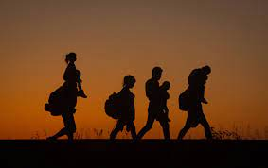
Migration waves of the Roma after 1956
1956 & 1968: Roma from Hungary and Czechoslovakia seek refuge after the Uprising
1960-1970: Foreign Roma workers arriving to Europe from Yugoslavia
Notes:
During the Hungarian Uprising in 1956, 150,000 people fled Hungary. Among them were many Roma, particularly Lovara families, who were received mainly in Austria. The arrival of Russian tanks in former Czechoslovakia in 1968 (Prague Spring) caused a wave of emigration as well, mainly to Austria or to Sweden.
At the beginning of the 1960s, some Western European countries started to cover their need for – mainly manual – professionals by recruiting foreign workers. As a consequence of this, about 100,000 people willing to work, mainly as unskilled workers, migrated to Western Europe. Roma were also part of this migration wave, mostly from the poorer regions of Serbia, former Yugoslav Republic of Macedonia and Bosnia Herzegovina. Italy, Austria, Germany, France, and the Netherlands were the main countries of destination.

Slide 3
Migration of the Roma after 1989
Escaping racism to Western European countries and the United States after the fall of the Berlin Wall
Asylum-seekers from Bosnia-Hercegovina (1991-1995) and Kosovo (1998-1999)
Enlargement of the European Union (2004-2007) – supposed increase in human trafficking
Notes:
The early 90s have been marked by interethnic conflicts for the Roma communities in Eastern Europe. While in former Czechoslovakia acts of violence against the Roma were committed mainly by skinheads, in Romania, Roma were targets of pogrom-like acts of violence. On 12 June 1990, Roma were the victims of rampaging mine workers that had been called into the capital by President Iliescu in order to end the protest against the old political guard. Quarters of Bucharest inhabited by Roma were attacked and the aggressors beat up the inhabitants and destroyed their property. Similar things happened from then on in several towns all over Romania, where ethnic Hungarians and Romanians attacked their Roma neighbours with open violence. In the period between 1990 and 1995 alone, 30 such acts of violence were registered, which in some cases even caused deaths.
In the 1990s, up to half a million people fled the chaos of war in former Yugoslavia. Even though the number of Roma among the refugees is not known, it is highly probable that there were many Roma among them. Ten thousand Roma fled the war in Bosnia-Herzegovina from 1991 to 1995, and demanded political asylum in Austria, Italy, Sweden, Great Britain, Germany and Switzerland. Many fled because they were afraid of becoming trapped by the conflict or because they lived in the areas that were fought over. The Roma were rejected by both sides. Additionally, some of the Bosnian Roma were Muslims, and thus threatened once more.
While Eastern European Roma were initially welcome by receiving countries this not only evaporated after the fall of the Berlin Wall in 1989, but it also tends to be forgotten in European collective historical narrative. Hundreds of thousands of Roma made use of existing European and American asylum provisions, to escape the recrudescence of racism and the very real repression of Roma in post-communist societies.

Slide 4
EU Mobile Roma after 2004 enlargement
The term EU mobile Roma refers to mobile EU citizens of Roma ethnicity exercising their right to free movement.
A large percentage are citizens of Romania, Bulgaria, and Slovakia
Migration often driven by poverty in their own country; economic and social discrimination, including barriers to the labour market
Notes:
After the EU enlargement in the early 2000s, many nationals with Roma background from the new Member States migrated to Western Europe in search of better economic opportunities and to escape from discrimination.
According to FRA’s Roma Survey 2021 in 10 EU countries (Bulgaria, Czechia, Greece, Spain, Croatia, Hungary, Italy, Portugal, Romania, Slovakia) 80% of the Roma interviewed were at risk of poverty compared to an EU average of 17% in general. More specifically, the vulnerability of EU mobile Roma is impacted by at least six identified factors which relate to their countries of origin: (a) low levels of education and literacy, (b) lack of access to basic needs, adequate health care, social security and housing, (c) limited experience in formal work, (d) extreme poverty, (e) lack of official identity documents, and (f) the structural problem of antigypsyism. Since they often live in vulnerable situations, Roma also face a high risk of trafficking in human beings - in particular of children.
While it is important to recognise the diversity of EU mobile Roma and the fact that many, especially those with formal education, do not experience obstacles in finding employment in the EU, many Roma also tend to be made more vulnerable and more likely to be at risk of poverty and social exclusion in host countries than other EU mobile citizens. According to Eurocities’ report “Roma inclusion in cities: Mapping of the situation of Roma in cities in Europe”, their situation is generally also worse than that of the respective national Roma population in the host countries where they settle. Furthermore, when Roma migrate, they are more likely to end up living in homelessness as they are prone to discrimination and are denied access to housing. Low chances of employability as a consequence of low levels of education often leave Roma exposed to work exploitation in the informal sector. In addition, anti-Roma discrimination and hate-speech against Roma have increased in destination countries.

Slide 5
Why do Roma migrate? Economic reasons intertwined with structural discrimination
No, it is not because migration is in their “blood” or “nature,” it is related to:
Centuries-long structural discrimination which pushed most Roma to structural poverty
Using freedom of movement within the EU to improve living conditions
Breaking the cycle of poverty – hope for better education for their children
Notes:
Emigration appeals to Central and Eastern European Roma because many of their marginalised communities suffer deep structural poverty. Structural racism has a key role in creating and maintaining inter-generational poverty among the Roma people, which is difficult to break out from (as was explained in the first module).
Detailed and disturbing studies by the Fundamental Rights Agency (FRA), UNDP, and World Bank (e.g. on housing and health) reveal continuous discrimination and deteriorating conditions in Roma employment, living conditions, and health. In 2011, about 90% of Roma surveyed in CEE and other countries had an income below the national poverty threshold, and about 40% of the children lived in households struggling with malnutrition or hunger. Over half of those surveyed lived in segregated areas in dwellings falling far below minimum housing standards. A 2009 FRA report concluded that “poverty and racism are the main factors ‘pushing’ Roma to leave their countries of origin.” Due to hopelessness when it comes to their economic situation, many Roma people choose the difficult situation to migrate to Western countries for better opportunities.
Opening the borders between European countries has dramatically changed how people approach their future and it allowed for easier movement between countries as well as, of course, increased access to the labour market. Free movement gave citizens the great opportunity to travel and try to establish a new life in different countries, and Roma were among the first to take up this chance. Beside the obvious reasons for migration, such as structural discrimination that eventually causes poverty and the opportunities given by free movement within the EU, there is another important reason behind the migration of Roma. According to Roma researchers who engage with the topic of migration, Roma people migrate to the West in order to break the cycle of poverty and bring better educational and working opportunities for their children.

Slide 6
Escaping hate crimes and hate speech A range of hate crimes targeting Roma across OSCE countries: assault, property damage and murder, involving the use of explosives, firearms or Molotov cocktails; particularly worrying incidents have been arson attacks against Roma homes (ODIHR 2021).
Picture source: https://ergonetwork.org/2019/01/hate-speech-by-bulgarian-deputy-prime-minister
Notes:
Since 2007 a significant factor driving Roma migration has been a dramatic increase in hate crimes and speech in some parts of Europe. Although Roma are not the only victims, they are the main target in CEE countries. The most extreme example is that of Hungary. In 2007, only 24 Hungarian Roma sought asylum in Canada. However, that number jumped to 1,990 in 2011 in response to a series of murders, assaults, and media attacks targeting Roma communities.
Mainstream politicians frequently tap into the phenomenon of racial hatred in order to win votes, cynically exploiting the space created by the racist discourse of extremists. While generally more cautious with their words, these politicians nevertheless convey similar messages in coded form, such as alleging damage to the economy caused by welfare dependency. For example, in 2012 the Czech prime minister declared that “the state does not help scroungers who abuse benefits”. But even mainstream politicians can be brutally outspoken. A former Czech mayor was elected to the senate after evicting Roma families from his town, proudly describing this as ‘the removal of an ulcer’. He went on to become deputy prime minister and, having built a political career on racially abusing Roma, was later elected chair of the senate subcommittee on human rights and equal opportunities. Another example comes from Bulgaria where the deputy prime minister made inciting statements against Roma: http://www.errc.org/news/bulgarian-government-set-for-sweeping-victory-in-eu-elections-after-anti-roma-violence
ODIHR's annual reporting on hate crime has presented a range of hate crimes targeting Roma. Assault, property damage, and murder, involving the use of explosives, firearms or Molotov cocktails have featured in these reports. Among the particularly worrying incidents reported to ODIHR have been arson attacks against Roma homes. (Source: https://hatecrime.osce.org/anti-roma-hate-crime)

Slide 7
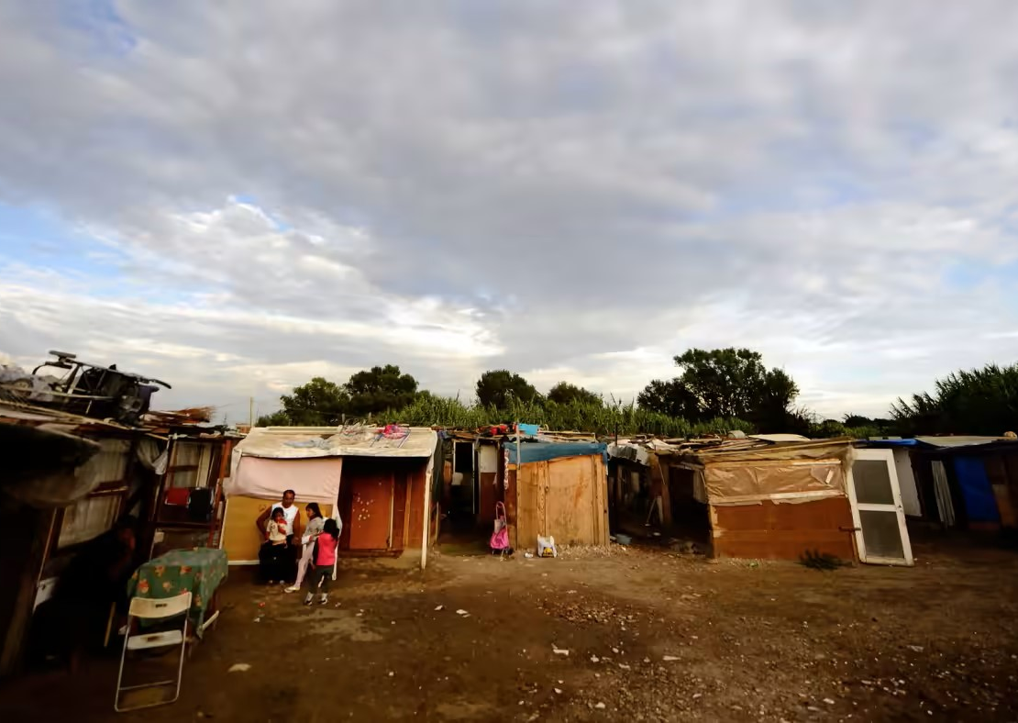
Challenges faced in the host countries
Access to social rights is difficult (lack of permanent address, lack of regular employment, discrimination)
Hate speech and hate crime also in Western EU states (targets of politicians, criminalised begging, ethnic profiling by police, expulsions and entry bans)
Notes:
While migration seems to be one of the options for Roma and other communities to create better opportunities for themselves, unfortunately it is not always positive and straightforward. Because of several factors, many individuals or even entire families end up experiencing destitution as well as homelessness.
As we discussed in previous modules the historical and systematic discrimination of the Roma, we can see that they also face discrimination when accessing basic social rights: such as accessing a permanent address or having a regular job. Due to racial discrimination, many migrant Roma have difficulties with renting out apartments and setting up a permanent address for themselves and their families. Experiencing discrimination when applying for rental housing is an integral struggle for migrant Roma, which makes their situation fundementally worse as a migrant in host countries. (For more information on discrimination when accessing housing in Finland.)
Migrant Roma face very similar issue in the employment field. A study conducted in Spain shows that while Roma are willing and able to work, they remain in precarious working places: dustmen (25% of the population), cleaning personnel (13,4%), and unskilled workers in the agricultural sector (9.8%). The rate of temporary work is also extremely high: 83.3% of employees have a temporary contract. See the report here.)
Unfortunately, people tend to ignore conversations about hate-crimes and hate speech against Roma in the West and portray the West as more progressive than the Easteren European countries. However, more and more study reveals a different situation: according the FRA’s survey “Roma and Travellers in six countries” shows that almost half of Roma and Traveller respondents (44%) say that they experienced hate motivated harassment in the 12 months before the survey. In 2016 this number was 30% lower, which clearly demonstrates the increase of hate motivated harrasment in the West. The survey was carried out in the Netherlands, Belgium, France, Ireland, Sweden, and the United Kingdom.
You can find more information about hate crimes against Roma and Travellers here.)

Slide 8
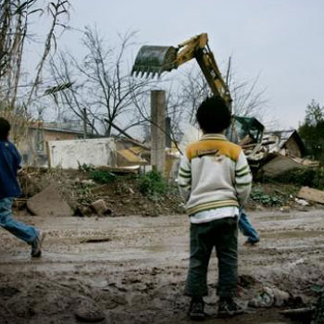
Challenges faced in the host countries
Roma living in informal living places face repeated evictions and attacks.
Lack of awareness and understanding of the history and culture of Roma communities in Europe.
Source: https://romea.cz/en/uncategorized/italy-forced-evictions-still-continue
Notes:
Forced evictions of Roma are one of the most visible and most widespread expressions of antigypsyism in Europe today. Marginalised Roma are frequently targeted for forced eviction in a disproportionate way which does not take into account the specific needs of vulnerable communities. In the case of France, for instance, the European Court of Human Rights (ECtHR) has, in a long-awaited judgement, ordered France to pay more than €40,000 in compensation to six Romanian Roma who were evicted from their homes in 2013. The European Roma Rights Centre (ERRC) supported the Roma EU citizens to take their case to the French courts and eventually all the way to the European Court where they finally received justice.
More about the case here. Another forced eviction case from Italy is decribed here.
People living in informal living places are also highly exposed to discrimination and physical attacks, while repeated evictions interrupt schooling and health care. In general, the living conditions are very bad in these locations, as found previously by Amnesty International.
Beside the everyday racism and oppression migrant Roma face in Europe, there is another important thing that contributes to their marginalization and that is the lack of awareness and understanding of Roma history and cultures. In general, we can say that even though Roma were and still are integral part of the European history, there is a lack of acknowledgement of their contribution to the development of European societies. History books misrepresent or totally exclude historical events that had great influence on Roma and reinforce racial and gendered stereotypes about Roma women and men.
For more information, you can read this article: https://www.coe.int/en/web/commissioner/-/time-to-cure-amnesia-about-the-history-of-roma-in-europe

Slide 9
Homelessness among Roma
Roma rough sleepers face multiple discrimination in public spaces
Lack of social support due to existing prejudices even within social workers
Lack of cultural sensitivity
Notes:
Rough sleeping is one of the most visible signs of homelessness, which can also cause severe consequences to the lives of Roma living in these conditions. These consequences can be: worsening of health condition, lack of access to hygiene, no legal status and health insurance due to precarious residence status, and so forth.
As discussed earlier, it is crucial to emphasize again the role of racism and structural discrimination in explaining migration and destitution, as well as homelessness among Roma. The lack of rights and opportunities to enjoy basic living conditions for Roma should be understood as a consequence of the discrimination they have been facing in their origin country as well as in the host country.
While there are many examples of civil society organisations that support Roma who are experiencing homelessness, it is also true that the existing prejudices in society are transferred sometimes into social work when interacting with Roma, which could further worsen people’s situations.
Generally speaking, there is a need for more cultural sensitivity among non-Roma social workers when working with Roma homeless people, to avoid situations such as male social worker approaching female Roma homeless, or treating language barriers in an unkind manner.

Slide 10
Criminalisation of begging
Legislation that makes it illegal to sleep, sit, or store personal belongings in public spaces
Ordinances that punish people for begging in order to move people who are poor or homeless out of a city or area
Public health ordinances related to public activities and hygiene (e.g., public urination) regardless of whether public facilities are available
Prohibition of removing items from rubbish or recycling bins
Privatisation of public spaces and introducing private security services with the aim of excluding homeless people and other groups
Notes:
Banning begging is gaining importance amongst policy makers as a way to ‘solve’ problems associated with homelessness and poverty.
Criminalising homelessness opens the door to police, policy makers, and others wishing to push poor people out of public spaces and to claim that ‘homelessness’ has been solved. In fact, this only means that homeless people who beg are simply forced onto the margins of society and become ‘invisible’, a situation which makes them more vulnerable (as they are unable to access services) and, of course, does not deal with the root causes of homelessness.
While bans on begging are already controversial, whether they come in the form of local government regulations, laws, or national policies, it is crucial to recognise that banning begging punishes people who have few or no other options to earn money. Those people who do beg are not doing so by choice but out of necessity, and some of them may be even coerced into begging. Laws against forced begging or begging with children are in principle well intentioned, but they must be accompanied by appropriate and sufficient support services if further destitution wants to be avoided.
Begging has been wrongfully connected to Roma culture, for a very long time. This explanation ignores once again the history of oppression and discrimination that Roma have experienced in the past and ongoing to this day and how this translates to inequalities in all aspects of people’s lives. At the same time, many of those targeted by the anti-beginning measures explained above have proven to be Roma.

Slide 11
Criminalisation practices – The case of Denmark
Article 3 (4) amended the Public Order as follows:
“In places with public access, it is prohibited to establish and stay in camps which are capable of creating discomfort in the neighbourhood.”
---
“Roma occupation must be stopped. They exploit us, they are harassing us, and they ruined street image with garbage and excrements”.
Notes:
Since 2017, changes in the Danish Penal Code have contributed to increasing criminalisation of the presence of homeless people in public spaces. Strongly condemned by civil society, the inhumane policies introduced restrictions on sleeping rough and increased punishment for begging. Article 3 (4) amended the Public Order and stated that “In places with public access, it is prohibited to establish and stay in camps which are capable of creating discomfort in the neighbourhood.” Under section 197, begging became illegal and punishable with prison up to 6 months without a warning, when the offense has been committed in a pedestrian street, at stations, in or near supermarkets, or in public transport.
It has also been openly stated, and confirmed by practice since then, that the aim of these policies was targeting non-Danish citizens living on the streets: from 94 convictions under paragraph 197, 91 were non-Danes. (See FEANTSA statement “FEANTSA strongly denounces the criminalisation of homeless people in Denmark”, 2022).
In Denmark, politicians have used anti-Roma hate speech when discussing the new legislative proposals in the Parliament referring to a ‘Roma law’ when discussing measures to prohibit sleeping rough. Media reported politicians saying that “Roma occupation must be stopped. They exploit us, they are harassing us, and they ruined street image with garbage and excrements”.
Furthermore, research in the area underlines that “The preparatory works to these rules reveal that the camp prohibition was intended to primarily affect migrants of a Roma ethnic origin experiencing homelessness in Denmark”. The former mayor of Copenhagen, Frank Jensen, urged the Parliament to adopt legislation that would solve the problems of ‘Roma people’ living on the streets and creating insecurity.

Slide 12
Thanks for reading! for further questions or comments please contact us at simona.barbu@feantsa.org
Notes:
This is the end of the fourth module.
We hope you found it interesting and that this will help you in your work with destitute Roma mobile EU citizens.
Thank you for reading our training modules! You can find all the modules on FEANTSA’s website (insert link).

