Slide 1
Learning About Europe’s Biggest Ethnic Minority - The Roma
Module 3: Intersectional Oppression Experienced by Roma women and LGBTI
This material has been prepared by Marina Csikós
(csikosmarina1993@gmail.com) in the context of PRODEC project.
April 2023
Notes:
Hello and welcome to our newest tool on Roma history and culture, designed for professionals working to protect and promote the rights of destitute mobile EU citizens, among which many have a Roma background.
This third module focuses on Intersectional Oppression Experienced by Roma women and LGBTI people among the Roma communities.
We hope you will enjoy the modules and find this tool useful!

Slide 2
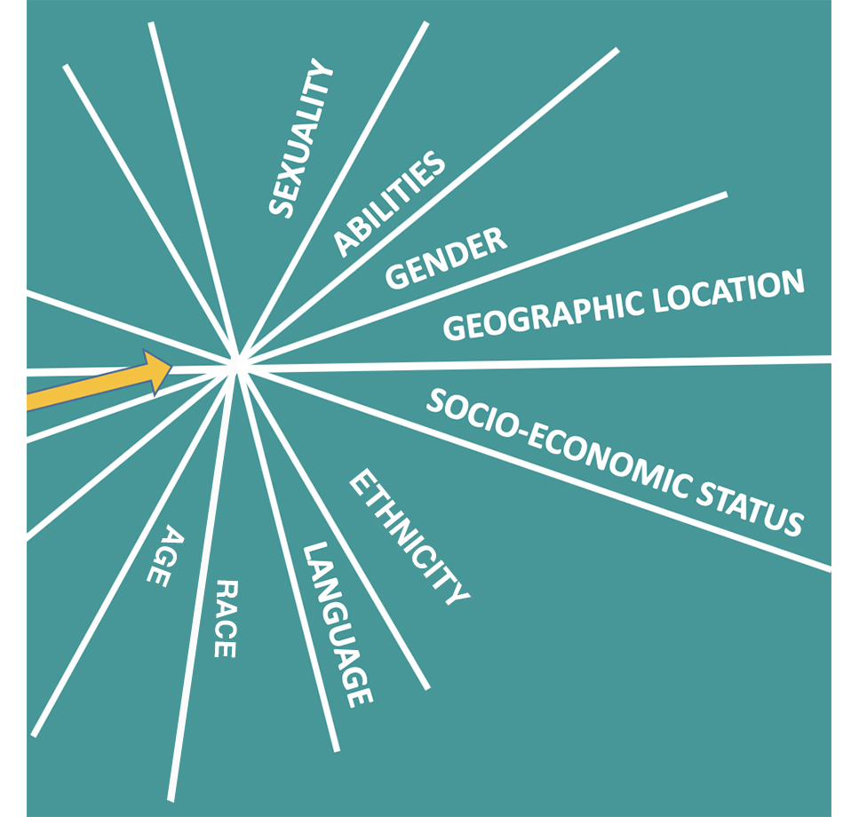
Intersectionality
Intersectionality as a concept existed even before Kimberlé Crenshaw coined the term in 1989
Focused on the oppression of black women within society: both as being black and women
Developed to a widely used concept and methodology to think about all kinds of oppressions and their relationships, consequences, and manifestations
Notes:
Even before Kimberlé Crenshaw coined the term, black women scholars, activists and artists were articulating the multiple discriminations they faced within the white feminist movement and black civil rights movement. Scholars such as bell hooks and Gloria Anzaldua had been writing about the intertwined oppression women of color were facing due to their gender, race, religion, and sexuality.
Intersectionality as a term was developed by black feminist scholar Kimberlé Williams Crenshaw in 1989 “Demarginalizing the Intersection of Race and Sex: A Black Feminist Critique of Antidiscrimination Doctrine, Feminist Theory and Antiracist Politics.” While the theory began as an exploration, primarily of the oppression of black women within society and the intersecting layers of different forms of oppression, today the analysis has expanded to include many more aspects of social identity. Identities most commonly referenced in the fourth wave of feminism include race, gender, sex, sexual orientation, class, ability, nationality, citizenship or religion. Despite being coined in 1989, the term Intersectionality was not widely adopted by feminists until the 2000s and has only grown in popularity since that time.
It has become a widely used concept to explain the complex oppression people face on the basis of religion, gender, race, ethnicity, age, sexual orientation, geographical location, physical and mental ability, etc. Intersectionality is also used as a methodological tool to address the different needs of marginalized groups in policy, social work, education, etc.
Picture: http://genderedinnovations.stanford.edu/terms/intersectionality.html

Slide 3
Why is intersectionality relevant to Roma women and LGBTI?
Heterosexual Roma women are the targets of anti-Roma racism and patriarchal/sexist oppression due to their ethnicity and gender
Roma LGBTI people are the targets of anti-Roma racism, homophobia and, in the case of Roma lesbians or trans women, of patriarchal/sexist oppression as well
There is a lack of acknowledgment of the multiple discriminations these groups face
Using intersectionality helps us to understand the complex experiences of Roma women and LGBTI people when it comes to discrimination, and to find solutions to the issues they face
Notes:
By using the intersectional approach, Romani women respond to the limitations of ‘ethnicity’ but also to the limitations of ‘gender’ as exclusive categories. Intersectionality has helped make people aware of, and reflect on, the hybrid structures of inequalities Romani women face.
When it comes to political and social mobilisation, intersectionality helps Roma women from different backgrounds (age, class, sexuality, religion, etc.) to make connections with each other, and create a diverse space reflective of the diversity of the Roma women.
More resource on Roma women/LGBTI and intersectionality
https://cps.ceu.edu/publications/policy-studies/missing-intersectionality
https://www.facebook.com/watch/live/?ref=watch_permalink&v=1654804474690858
https://crs.ceu.edu/index.php/crs/article/download/119/76
https://eriac.org/wp-content/uploads/2021/12/Mate-Dezso-2017-The-First-Sparks-of-the-Romani-LGBTQ-Movement-Centre-for-Higher-Education-and-Equity-Research-CHEER-School-of-Education-and-Social-Work-University-of-Sussex-pp.1%E2%80%936.pdf

Slide 4
Intersectional oppression in practice: Education of Roma women
Roma girls attend primary school in higher numbers than Roma boys, but still below the average of the general population
Unacceptable high percentage of early school leaving: 66% for Roma men - 71% for Roma women
Between the age of 16 - 24 years: 72% of Roma women are neither working nor attending education or training
Questions:
What happens in the primary school system so that early school leaving becomes higher among Roma girls?
What are the consequences of early school leaving?
Source: Fundamental Rights Agency (2019) Second European Union Minorities and Discrimination Survey: Roma women in nine EU Member States
Notes:
When it comes to the Roma, education is extremely important for increasing social and economic mobility. Roma boys and girls suffer significantly from a lack of access to the same quality of education as the majority of children. Although the share of Roma girls attending primary school is usually higher than that of Roma boys in the nine countries of the FRA survey from 2019, it is still below that of the majority population (only 81% on average).
For Roma girls, the problem arrives later on, such as when they reach their teenage years. The FRA report shows that in the nine countries analysed, 66% of Roma boys between 16 and 24 neither attend secondary school nor get any form of employment (NEET), but the situation is worse for Roma girls at 71%. Some of the possible reasons for such a high number may include: dropping out of the school system too early, low quality education, school segregation, early marriage and early pregnancy, disadvantaged economic backgrounds, etc.
For example, the European Roma Rights Center found out that Roma pupils are heavily overrepresented in Hungarian ‘special schools’, mostly due to systematic racism. These are schools for students with special educational needs, such as those with disabilities, with learning and behavioural difficulties, and with socioeconomic disadvantages. It is also common practice that, in different European countries, Roma students for many years have been medically misdiagnosed (due to antigypsyism, language barriers, and cultural indifference, among other things) and sent to such special schools when it was not necessary.
Resource: http://www.errc.org/uploads/upload_en/file/hungary-red-written-comments-5-april-2013.pdf

Slide 5
Roma women and employment
Only 16% of Roma women were employed in 2019 in the EU
Early school dropout has a great influence on Roma women’s opportunites in the labour market
Lack of education will increase the risk of unemployment or precarious working conditions
Both structural and situational racism are common obstacles for Roma women to find jobs
Facing racial and gender-related discrimination at workplaces
Gender and racial pay gap
Notes:
There is a strong relationship between educational opportunities and employment. If a person does not have access to quality education, dropped out of school, or studied in segregated classes, it is probable he/she will have less chance of obtaining a well-paid, secure job.
Since Roma girls are more likely to drop out of school than other students, the issue of unemployment and unhealthy working conditions are common experiences for them when they step into the labour market. According to the 2019 FRA survey mentioned in the previous slide, across the nine countries 34% of Roma men were employed, while only 16% of Roma women were. This is illustrative of the reality of many Roma women in Europe when it comes to employment.
The low percentage of working Roma women can be explained by many interrelated factors. The poor quality education that most Roma girls receive in schools, school segregation, and lack of cultural sensitivity and diversity, among other factors, affect career opportunities for many Roma young women.
Starting with the difficulty in finding jobs, Roma women in many European countries also usually suffer from excessive commuting to the workplace, being disrespected and discriminated due to their gender and ethnicity, working in unhealthy conditions, and receiving lower wages than their male peers for the same job.

Slide 6
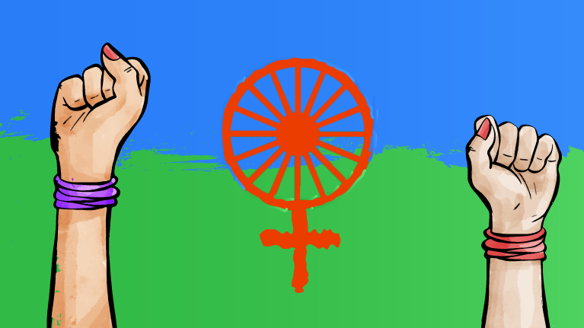
Other striking issues
Low and distorted representation of Roma women in the media, history, art, etc.
Discrimination within the healthcare system: e.g.,forced sterilizations
Excluding the participation and needs of Roma women from the mainstream feminist movements
COVID-19 pandemic has just worsened the situation!
Notes:
More about forced sterilization of Roma women:
http://www.errc.org/press-releases/united-nations-hungary-coercively-sterilised-romani-woman
http://www.errc.org/news/coercive-sterilisation-of-romani-women-inhuman-and-degrading-treatment-but-not-discrimination-according-to-the-echr
http://www.errc.org/reports-and-submissions/coercive-and-cruel-sterilisation-and-its-consequences-for-romani-women-in-the-czech-republic-1966-2016
Exclusion of Roma feminists from mainstream feminism:
https://www.kaleamenge.org/en/no-room-for-roma-feminism-in-white-feminism/
https://www.opensocietyfoundations.org/voices/roma-feminists-navigate-tricky-terrain-ethnic-stereotypes
Picture: European Roma Rights Centre

Slide 7
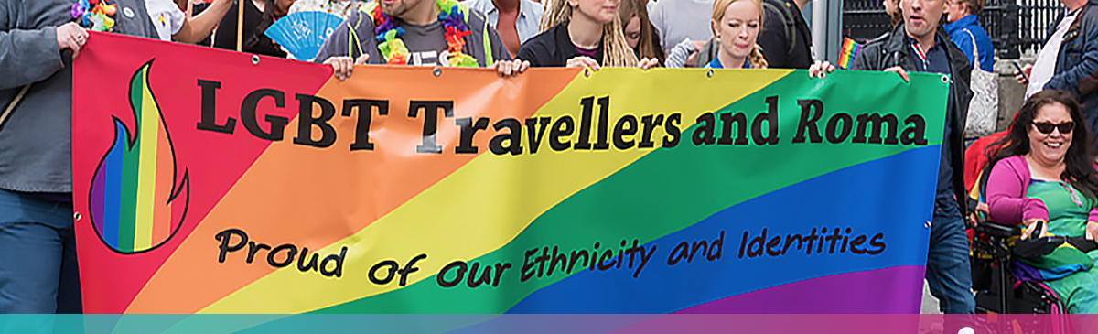
Roma LGBTI
Being minority within a minority – exclusion, violence and mistreatment
FRA EU-LGBTI II survey (2020) showed the continuous harassment of LGBTI: 58% have faced harrasment, 14% have reported hate-motived crimes to the police; Roma LGBTI face harassment on multiple grounds
Notes:
Roma LGBTIQ people are an internally displaced minority within a minority. There are still a significant number of Roma for whom the LGBTIQ identity is totally unacceptable. In many cases, coming out as LGBTIQ is still punished with expulsion from both one’s family and one’s community. The way some members of Roma communities perceive LGBTIQ people does not differ significantly between European countries, this may be due to the influence of general perceptions in society towards LGBTIQ communities, which in some parts of Europe continue to be highly negative.
The Fundamental Rights Agency’s EU-LGBTI II survey has showed that in 2019, a majority of respondents (58%) said that they experienced over the past five years harassment in the form of offensive or threatening situations at work, on the street, on public transport, in a shop, on the internet, οr anywhere else, including offensive or threatening incidents of a sexual nature. Though data on Roma LGBTIQ are scarce, it is very probable that among these respondents many were of Roma origin, particularly since these two groups face a high level of discrimination in general in societies.
Read stories of double discrimination among Roma LGBTIQ in Romania: https://www.vice.com/en/article/yw3zpg/roma-lgbt-people-talk-about-the-challenges-of-facing-double-discrimination
Picture: https://gcn.ie/lgbt-ireland-traveller-pride-week-awareness-training/

Slide 8
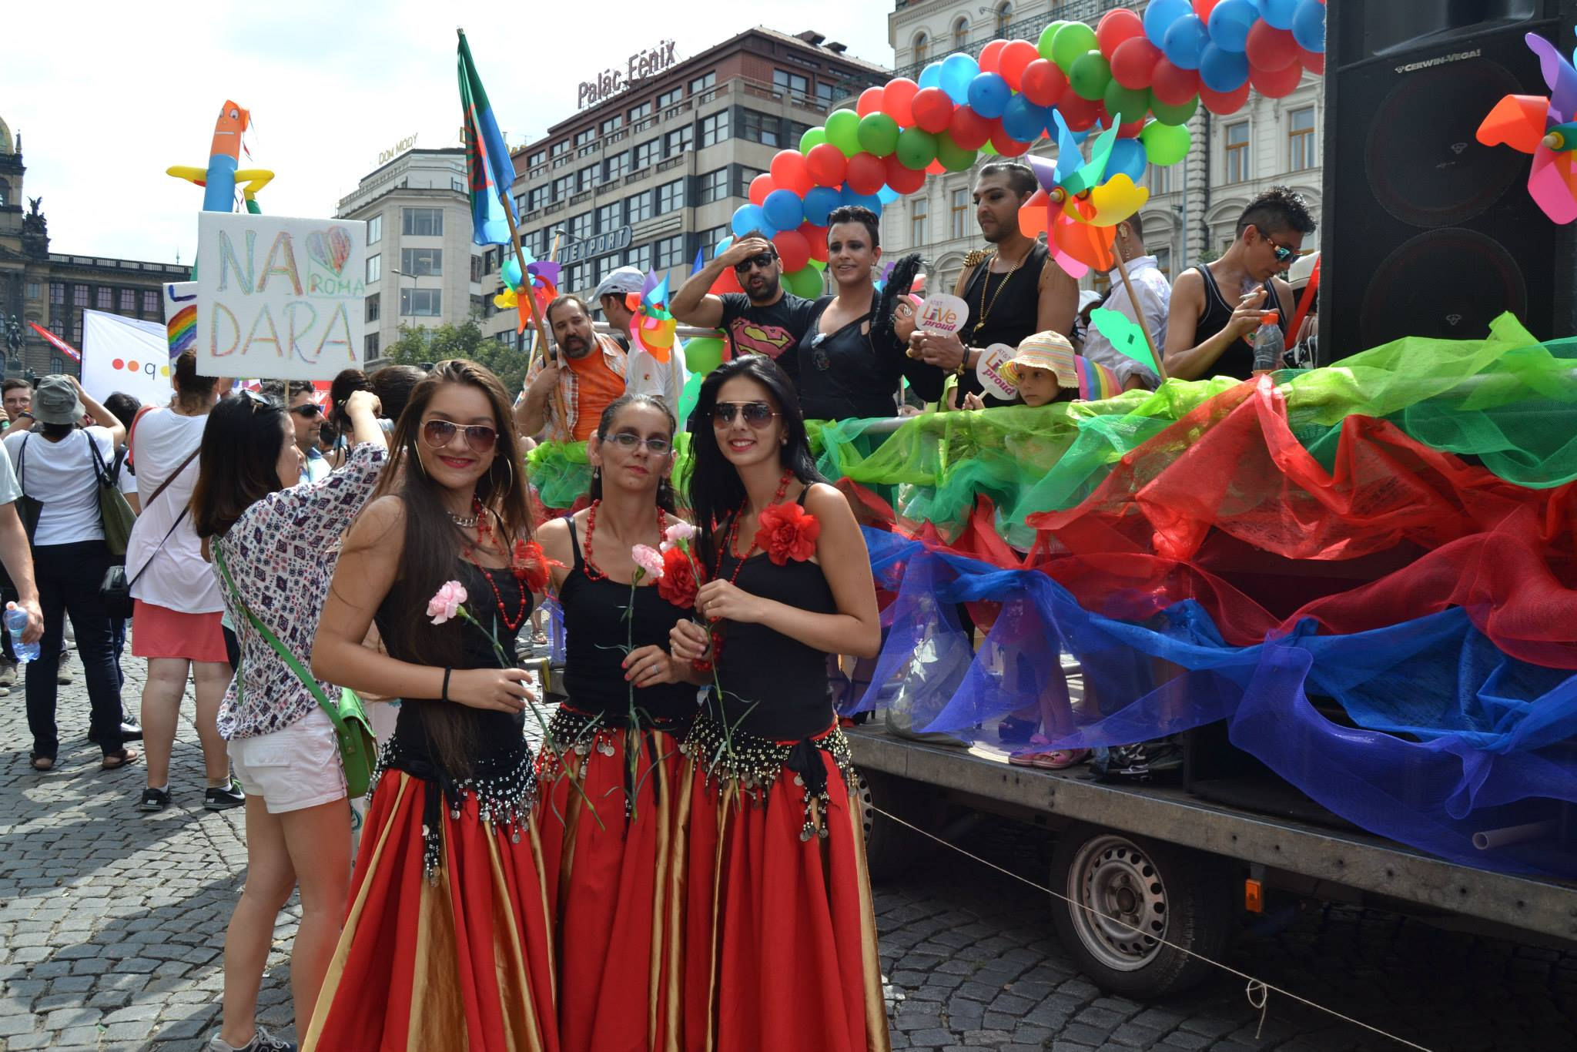
Roma LGBTI people
There is no institutional data (EC,FRA, CoE,etc.) avaliable specifically on Roma LGBTI
ARA ART – The Roma LGBTIQ minority and its status in selected EU countries (2021) provides some insights
Roma LGBTI people are more vulnerable to experience homelessness and to human trafficking
Notes:
Unfortunately, until today there has been no representative data avaliable either by FRA or other institutions on the situation on Roma LGBTI people in Europe. To fill this gap, ARA ART (a Roma LGBTIQ civil society organization in the Czech Republic) in 2021 has published the first systematic research study on Roma LGBTIQ people within the European Union. The research provides both theoretical and practical information about the multiple/intersectional discrimination Roma LGBTIQ people face within public authorities and the civil society.
Some of the key findings of the research are:
To different degrees, across the whole V4 block (Czech Republic, Slovakia, Hungary and Poland) – a backlash against human rights, women’s rights and minority discourse has been chipping away at legal protections for ethnic, sexual and gender minorities.
LGBTIQ Roma represent a particularly vulnerable group, especially during the COVID-19 pandemic, due to experiencing multiple disadvantages and discrimination at the intersection of anti-Roma racism, homophobia and transphobia. However, national healthcare systems and the majority of CSOs do not take into account the specific needs of LGBTIQ Roma.
Due to their exclusion and discrimination, Roma LGBTI people are more vulnerable to becoming homeless, and also to becoming victims of human trafficking. Since being LGBTI is still a taboo in most European countries, Roma LGBTI people many times are abandoned by their families which, especially when it occurs at an early age, can lead to homelessness. Therefore, the protection of Roma LGBTI people is extremely important and requires special attention.
Here you can find more information about vulnerability to human trafficking as an LGBTI person: https://www.ohchr.org/en/statements/2022/05/forcibly-displaced-lgbt-persons-face-major-challenges-search-safe-haven
Picture: Ara Art

Slide 9
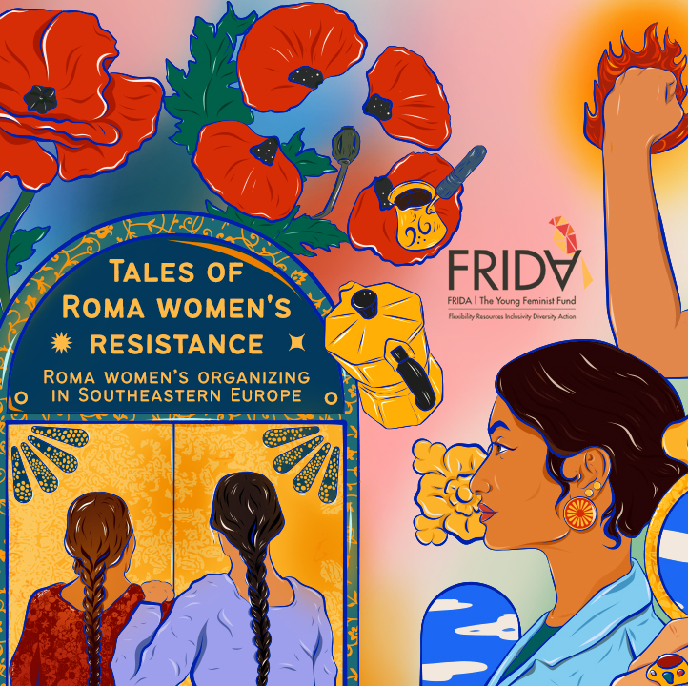
Resistance of Roma women and LGBTI
The emergence of Roma women and LGBTI scholars, activists, artists – changing and challenging existing racist/sexist narratives
Growing Roma women and LGBTI civil society – Tackling intersectional discrimination from the grassroot level
Notes:
Gender inequality has become a major focus of contemporary debates in recent years throughout the world. The approximately 6 million Roma women in Europe know all too well about the impact of gender inequality. Roma women face multiple and intersectional discriminations – as women, members of a stigmatised ethnic minority, being at higher risk of social exclusion and poverty – which have pushed them to creatively challenge patriarchal and racialised oppression.
The every-day struggle of Roma women has become a focal foundation for the gradual emergence of Roma feminism as a movement against injustice. The voices of Roma women – tales of resistance and survival, as well as solidarity and pride – become a source of inspiration and a point for reflection for contemporary debates in Europe. Romnia (Romani women) have therefore become the forefront of a new revolution, drawing power from their own communities and their transnational solidarity networks.
Read the “Tales of Roma Women’s Resistance” publication from FRIDA here: https://youngfeministfund.org/tales-of-roma-womens-resistance/

Slide 10
Some outstanding Roma women and LGBTI persons you should know about
Ceija Stojka – writer, artist, singer, activist and Holocaust survivor
Katarina Taikon – leader of Romani civil rights movement in Sweden
Nicoleta Bitu - human and women’s rights activist
Dr. Margareta Matache – scholar, lecturer at Harvard Univeristy
Notes:
Ceija Stojka is a famous Austrian writer, artist, singer, activist, and survivor of the National Socialist concentration camps of Auschwitz, Ravensbrück, and Bergen-Belsen. She was born on May 23, 1933 in Kraubath an der Mur in the province of Styria (Austria). After the war, she was a marketer by trade. At the end of the 1980s she became engaged in the Austrian Romani movement and in Holocaust education initiatives. Her first autobiography, Wir leben im Verborgenen: Erinnerungen einer Rom-Zigeunerin (1988), was the first writing by a Romani person in Austria to relate the horrific torture under National Socialism.
Katarina Taikon (Katharina Maria Taikon, Katarina Taikon-Langhammer, 1932–1995) was a Kaldarash Romni and a prominent activist and leader of Romani civil rights movement in Sweden. Through political activism, media campaigning and writing, she raised awareness about the conditions in which Roma were living and their lack of access to education and housing, among other issues.
Nicoleta Bitu has been active in the field of human and women’s rights for over 25 years, and at the forefront of the European mobilisation of Romani women activists and of advocacy for the rights of Roma. She has been a leading scholar on publishing about Roma women from an intersectional perspective. A recognised and published expert in her field, she has worked for Romani CRISS, the Open Society Foundations, the Council of Europe, the European Commission and Romano ButiQ.
Dr. Margareta (Magda) Matache is a Lecturer on Social and Behavioural Sciences at the Department of Social and Behavioral Sciences, Harvard T.H. Chan School of Public Health, and the Director of the Roma Program at the FXB Center for Health and Human Rights, Harvard University. Her research focuses on systems of oppression, with a focus on anti-Roma racism.

Slide 11
Some outstanding Roma women and LGBTI persons you should know about
Vera Kurtic – radical feminist activist, author of Džuvljarke- lesbian existence of Roma women, a study focused on non-heterosexual Romani women
Dezso Mate – scholar and researcher, one of the first in raising awareness about Roma LGBTI people to the mainstream public
The list is fortunately growing!
Notes:
Vera Kurtić is a Romani radical feminist activist from Serbia. She is the Executive Coordinator of Women Space, based in Niš, Serbia, and one of the founding members of the Romani Women Network of Serbia. She also co-founded an informal international Romani LGBT Network, set up the Campaign Month of Roma women activism, and authored Džuvljarke- lesbian existence of Roma women, a study focused on non-heterosexual Romani women.
Dezso Mate has a PhD in Interdisciplinary Sociology from the Eotvos Lorand University. Currently he is a postdoctoral researcher at The Institute for Advanced Study in the Humanities – Das Kulturwissenschaftliche Institut Essen (KWI). Dezso conducts research on the situation of Romani people in Europe and anti-Roma racism with a special focus on LGBTQ+ rights.

Slide 12
E-Romnja – The change Roma women in Romania have been waiting for
Fighting for dignity, respect and integrity of Roma women
Intersectional approach: there is no democracy without the participation of women
Working on developing grassroot initiatives that tackle different issues: empowerment of Roma girls and women, sexual and reproductive health, fighting against patriarchal oppression
Advocating for local budget redistribution
Making sure that Roma women are appropriately represented in media, public space and political agendas
For more information: https://e-romnja.ro/en/
Notes:
E-Romnja is a Romanian registered association founded in 2012 by a group of activists that fight to put the problems of Roma women on the public agenda. E-Romnja fights for the respect, integrity, and dignity of Roma women, its objective being to reflect the reality and diversity of the lives of Roma women. Their approach is intersectional, and they believe that no democracy can exist without women’s participation. They believe in people’s involvement in the development of the communities to which they belong.
They carry on diverse and complex activities focused on three directions:
Community development – grassroots activities in three Roma communities from Romania
Advocacy for local budget redistribution so that the problems faced by Roma communities are taken into account and resolved, and the financing of programs that address the needs and issues of Roma women;
Watchdog – to ensure that the Roma women rights are observed, that the images of Roma women are realistically represented in the media, public space, and on the agenda of politicians.

Slide 13
ARA ART – Young, Roma and LGBTI
First CSO working specifically with Roma LGBTIQ people
Their aims are:
To improve the information available to crucial stakeholders about the position of LGBTIQ people of Romani origin in selected countries
To raise awareness and information about LGBTIQ people of Romani origin
To strengthen EU policies which affect Roma LGBTIQ
For more information: https://www.araart.cz/en/
Notes:
ARA ART deals with artistic creation and organizing cultural events with a social dimension. Apart from general cultural and social activities, ARA ART specialises in the Roma LGBT+ minority and the issue of multiple discrimination.
The aims of ARA ART are:
To improve the information available to crucial stakeholders about the position of LGBT+ people of Romani origin in selected countries
To raise awareness and increase the amount of information available to the public about LGBT+ people of Romani origin
To strengthen the European call for national-level policies on the integration of Romani communities in the Member States, so such policies reflect the needs of the diverse composition of the groups representing the population of Roma
To increase advocacy for applying an intersectional approach to combating discrimination against LGBT+ people of Romani origin
To consolidate and to expand the functionality of the International LGBT+ Roma Platform

Slide 14
The International LGBT+ Roma Platform
ARA ART: organizer of the first international Roma LGBT+ conference, which resulted in the Prague declaration (2015) and the first Roma LGBT+ platform.
Aims of the Platform:
Reflecting on the need of mediating and sharing a deeper knowledge of the Roma LGBT+ status in the EU
Providing better information and drawing attention to this group of population as well as its supporting structures
Strengthening interventions in order to implement direct measures against the Roma LGBT+ discrimination within national policies
Creating a space for sharing information, experiences and well-established practise
Notes:
ARA ART has organised the first international Roma LGBT+ conference, which resulted in the Prague declaration (2015) and the first Roma LGBT+ platform.
The Roma LGBT+ platform has as main objectives to:
reflecte on the need of mediating and sharing a deeper knowledge of the Roma LGBT+ status in the EU
provide better information and drawing attention to this group of population as well as its supporting structures
strengthen interventions in order to implement direct measures against the Roma LGBT+ discrimination within national policies
create a space for sharing information, experiences and well-established practise

Slide 15
Resources
RomArchive
Second European Union Minorities and Discrimination Survey Roma women in nine EU Member States (2019)
ARA ART
E-Romnja
Exploratory study The situation of discrimination against Roma and LGBTI+ Roma in Romania 2021 (Centre for Legal Resources in partnership with UCTRR – Civic Union of Young Roma from Romania, MozaiQ LGBT Association and ACTEDO – Equality and Human Rights Action Centre)

Slide 16
Thanks for reading! for further questions or comments please contact us at simona.barbu@feantsa.org
Notes:
We have reached the end of this module.
In the next module, we will go into detail about the situation of Roma who exercise their right to free movement.
Thank you for reading our training modules! You can find all the modules on FEANTSA’s website (insert link).

