Slide 1
Learning About Europe’s Biggest Ethnic Minority - The Roma
Module 2: The role of the Roma civil society in upholding Roma rights
This material has been prepared by Marina Csikós
(csikosmarina1993@gmail.com) in the context of PRODEC project.
April 2023
Notes:
Hello and welcome to the second module on the Roma civil society in Europe.
In the previous training module, we learned about the history of Roma and discrimination against Roma in Europe in the past as well as in current times.
In this module, we are going to look at the role of the Roma civil society in upholding Roma rights.

Slide 2
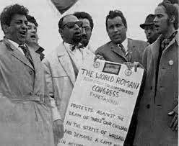
First World Romani Congress
First significant transnational event bringing Roma civil rights activists, scholars, and artists together
Organised on the 8th of April 1971, in Orpington (near London)
Attended by 23 representatives from 10 European countries and observers from Belgium, Canada, India and the United States
Five sub-commissions were created to examine social affairs, education, war crimes, language, and culture
Adoption of the Roma flag and the Roma anthem “Gelem, Gelem”
Rejection of the term “g*psy”, deciding to use “Roma” instead
Notes:
The first World Romani Congress took place in London on the 8th of April 1971 and it was attended by 23 Roma representatives from ten countries (Czechoslovakia, Finland, Norway, France, Great Britain, Germany, Hungary, Ireland, Spain, and Yugoslavia), with observers from Belgium, Canada, India and the United States. Five sub-commissions were created to examine issues related to social affairs, education, war crimes, language, and culture. Here, the representatives have come together to work on strengthening Roma political mobilisation. Common terms and symbols were agreed upon – a difficult task considering the diversity of the communities reunited.
At the congress, the green and blue flag from the 1933 conference of the General Association of the Gypsies of Romania, with the addition of the red, sixteen-spoked chakra, was reaffirmed as the national emblem of the Roma people, and the song “Gelem, Gelem” was adopted as the Roma anthem. Usage of the word “Roma” (rather than variants of “g*psy”) was also accepted by a majority of attendees; as a result, the International g*psy Committee (founded in 1965) was renamed the Komiteto Lumniako Romano (International Roma Committee).
Image: Participants at the first World Romani Congress, held in London 1971, singing the anthem “Gelem, gelem” (with words by Jarko Jovanović, white coat). Jan Čibula (far left) later became the first President of the International Romani Union and Grattan Puxon (far right) played a key role in setting up the second congress. Walsall, 1971. Behind (l and r) are Ladislav Demeter, Vanko Rouda and Juan de Dios Ramirez. (from Acton / Klímová 2001, p. 159)

Slide 3
April 8 – International Roma Day
The 8th of April was declared to be the International Roma Day in 1990. This day draws attention to the discrimination against Roma people all over the world. This day also emphasises and celebrates Roma history, culture, language, and the great diversity of Roma people.
Notes:
Check this video and see how young Roma celebrate the Roma Day:
https://www.youtube.com/watch?v=zhiEiCfECws
ERRC has raised awareness about the discrimination Roma people face during and after Covid-19 pandemic:
https://www.youtube.com/watch?v=mB7UlU0-gPo

Slide 4
The Romani Flag
Notes:
The Romani Flag adopted at the congress carries various significance.
The blue colour simbolizes the connection with spirituality and the higher self. It also has connections with the nomadic lifestyle Roma communities have been practicing since their first arrivals to Europe. ​The green colour symbolises a connection with the nature and the importance of taking care of each other as a community.
The red sixteen-spoked chakra symbolise the connection of Roma with India and the Indian culture. Moreover, it has also reference to the caravans Roma people have been living in for centuries, and which certain groups even continue to do so today.​

Slide 5
The Roma Anthem
Original
Gelem, gelem, lungone dromensa Maladilem bakhtale Romensa A Romale, katar tumen aven, E tsarentsa bahtale dromensa?
A Romale, A Chavale
Sas vi man yekh bari familiya, Mudardas la e Kali Legiya Aven mansa sa lumnyake Roma, Kai putardile e Romane droma Ake vriama, usti Rom akana, Amen khutasa misto kai kerasa
A Romale, A Chavale
I went, I went on long roads I met happy Roma O Roma, where do you come from, With tents happy on the road?
Roma, O Romani youths!
I once had a great family, The Black Legion murdered them Come with me, Roma from all the world For the Roma, roads have opened Now is the time, rise up Roma now, We will rise high if we act
O Roma, O Romani youths!
Notes:
The Roma anthem ‘Gelem, gelem’ is inspired from the lived experiences of Roma in the Nazi concentration camps during the Second World War, simultaneously calling for an uprising of the Roma people. ‘Opre Roma’, the Romani words translating to ‘Arise, Roma’ are used for celebrations and commemorative days related to Roma history.
https://www.romarchive.eu/en/music/romani-anthem-microcosm-diversity/
Here you can listen to the Roma anthem: https://www.youtube.com/watch?v=TH-5pEHNoCM

Slide 6
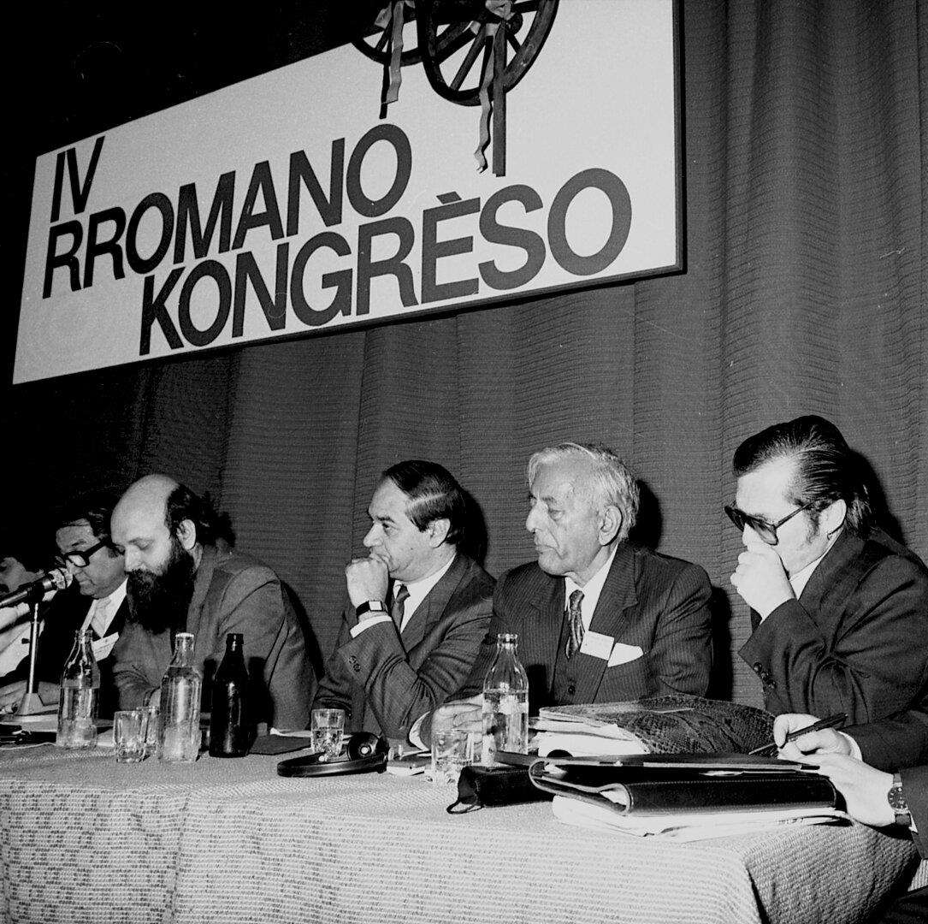
The legacies of the following World Romani Congresses
1978 - Establishment of International Romani Union
1981 - Roma are recognised as a national minority of Indian origin
1981 - First international discussions about the Porajmos, the Roma Holocaust
1990 - 8th April to be declared as the International Roma Day
Notes:
Following the First World Romani Congress, Roma representatives continued to organise and build structures for realising Roma rights. The second Congress was held in Geneva (Switzerland) in April 1978 and attended by 120 delegates from 26 countries. The International Roma Committee was transformed into the International Romani Union. A third Congress was held in Göttingen (West Germany) in May 1981, with 600 delegates and observers from 28 different countries. The Porajmos –Roma holocaust- was a main topic of discussion as well.
In 1990, the fourth Congress was held in Serock, Poland with 250 delegates attending. Here, the International Day of the Roma was established on April 8, in honour of the first World Romani Congress meeting in 1971.
In October 2008, the seventh Congress was held in Zagreb (Croatia) with the participation of almost 300 delegates from 28 different countries. The Roma Nation Building Action Plan, a document which outlined plans for the development of Romani nationalism and representation, was put forward.
The ninth Congress was held in Riga, Latvia in August 2015. It was attended by approximately 250 delegates from 25 countries.
Picture: RomArchive

Slide 7
Civil Society Organisations - Realising Roma rights
Notes:
The First Romani Congress had a significant role in the further development of Roma civil rights movements both in international and national levels. After 1971, a rapid change began in terms of estabilishing different national and transnational intiatives that aimed to fight for Roma justice.
In the following slides, different Roma civil society organisations will be presented from different fields and their approaches to fighting against discrimination explored.

Slide 8
Legal litigation for Roma Rights – The European Roma Rights Centre
An international public interest law organisation engaging in a range of activities aimed at combating anti-Romani racism and human rights abuse of Romani people
Activities include:
Strategic litigation: ERRC has taken over 1000 legal cases relating to Roma rights.
Research and public policy: publishing research on different human rights issues related to Roma.
International advocacy: Launch of ERRC Roma Rights Defenders: large volunteer network to support the work of ERRC.
Human rights training: providing training opportunities for Roma activists.
Notes:
The European Roma Rights Centre (ERRC) is a Roma-led, international public interest law organisation engaging in a range of activities aimed at combating anti-Romani racism and human rights abuse of Romani people. The approach of the ERRC involves in particular strategic litigation, research and public policy, International advocacy, as well as human rights training.
Since its establishment, the ERRC has taken over 1000 cases relating to Roma rights, and currently has over one hundred cases pending in national and international courts. The ERRC's legal work takes different forms, including the provision of direct legal representation and support to Romani litigants. The ERRC also submits complaints before international bodies, such as the European Court of Human Rights and UN treaty bodies.
The ERRC publishes research on a broad range of issues affecting the Roma community, engaging with a wide variety of methods - including working with a broad network of lawyers, journalists, research partners, monitoring bodies and relevant subject specialists. In some instances, the ERRC plays a supporting role for research happening at a local level or creates research reports that review relevant secondary literature.
In 2016 the ERRC became a Roma-majority organisation, and in 2018 launched the ERRC Roma Rights Defenders, a large volunteer network who contribute to the ERRC and its various projects. This includes a broad range of activities including campaigning, field work and online organising.
An important part of the ERRC's work involves the provision of training and educational projects for Roma activists.
Website: http://www.errc.org/

Slide 9
Roma CSOs advocating at EU level - ERGO
A network of more than 30 Roma and pro-Roma organisations from all over Europe
Founded on the philosophy of active citizenship, shared responsibility and grassroots empowerment
They bridge the gap between grassroots realities and policy-making
They advocate for better policies and policy implementation on national and European level, organise public campaigns, build the capacity of Roma activists and provide spaces for networking and mutual learning
Notes:
ERGO Network mobilises and connects grassroots, national and international organisations and individuals who share a set of core values to create the courage, capacity and opportunities to:
Combat antigypsyism and Roma poverty;
Strengthen Roma civil society participation in decision-making at grassroots, national and European level.
Commit governments and European institutions to effective social inclusion and anti-discrimination policies, standards and funds for Roma.
Values:
ERGO Network champions adherence to democratic values of diversity, solidarity, intersectionality, dialogue, equality, justice, and inclusion. They emphasise the realisation of equality of rights, including the right to dignity and opportunity to define one’s own identity.
Their guiding principle is that achieving equality, and social and political participation for Roma is a shared responsibility of majority populations and Roma. ERGO promote a culture of self-determination and active participation in the public domain, resist paternalism and tokenism, and encourage critical reflection.
Website: https://ergonetwork.org/

Slide 10
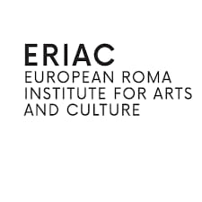
Arts, Culture and the fight against discrimination - European Roma Institutute for Arts and Culture (ERIAC)
Striving for the recognition of Roma arts and culture
Based in Berlin and Belgrade, but most of the inititatives are transnational
Goals: Increasing the self-esteem of Roma and to decrease negative prejudices among society
Serves as an international creative hub to support creative ideas across borders, cultural domains and Romani identities
Notes:
ERIAC has a unique and single mandate as a transnational, European-level organization for the recognition of Roma arts and culture. The European Roma Institute for Arts and Culture e.V. (ERIAC) is a joint initiative launched in June 2017 by the Council of Europe, the Open Society Foundations, and the Roma Leaders’ initiative. Its mission is to increase the self-esteem of Roma and to decrease negative prejudices of the majority of population towards the Roma through arts, culture, history, and media.
ERIAC acts as an international creative hub to support the exchange of creative ideas across borders, cultural domains and Romani identities, promoting Romani contributions to European culture and talent, success and achievement, as well as to document the historical experiences of Romani people in Europe. ERIAC is both a communicator and public educator, to disseminate a positive image and knowledge about Romani people for building mutual respect and understanding.
The main long-term aims of ERIAC are:
To educate and inform the non-Roma population about Roma arts and culture and to help creating understanding, tolerance, and mutual respect between Roma and non-Roma communities;
To raise awareness among European institutions, policy-makers, and stakeholders about the role of Roma arts and culture and to build up a broad partnership across Europe (and beyond) for support of Roma arts, culture, and communities.
Website: https://eriac.org/

Slide 11
Economic Justice - Roma Economic Development Initiative
Focusing on developing tools to increase vulnerable communities’ economic empowerment
Scale up micro, small, and medium-size companies by identifying, investing, and supporting those with a potential to add jobs and multiply the benefits to the community.
Nurture entrepreneurship in young Roma generation so that they may become a catalyst for boosting economic development.
Building the capacities of Roma investment professionals capable to work for the first Roma Investment Fund.
Advocate for Roma entrepreneurs by establishing business clubs, associations, and cooperatives aimed to improve the business environment and funding opportunities.
Notes:
Roma Economic Development Initiative is an ecosystem builder focusing on developing tools to increase vulnerable communities’ economic empowerment. They initially built a non-profit organisation in Romania (2016) and set-up a financial institution in Luxembourg (2018), a recycling company in North Macedonia (2020), and several business clubs in the region (2017-2020). They also train young Roma to work in banks in the region. REDI reached out to more than 2500 entrepreneurs active in vulnerable communities and offered close to 35000 hours of business development support, consulting, and advocacy.
Led by a team of young Roma professionals from different European countries, REDI aims to provide access to affordable finance for Roma entrepreneurs in Central and Eastern Europe and the Balkans, and provide technical assistance for a selected pool of entrepreneurs to help increase their expertise and skills. It is the first-ever institution dedicated to facilitating funding for start-ups and businesses among the Roma people, leveraging their ground presence and institutional relationships.
The mission of REDI is to economically empower Roma communities by promoting existing entrepreneurs and their businesses using business development services, coaching, and access to finance. To achieve this mission and vision, REDI is outreaching to Roma communities and helping them to develop and grow their communities from within, support them to connect across borders, and voice out their interests. REDI links Roma entrepreneurs operating in their communities with the mainstream business environment.
Website: https://redi-ngo.eu/

Slide 12
Empowerment of Young Roma – Phiren Amenca International Network
A network of Roma and non-Roma volunteers and voluntary service organizations creating opportunities for non-formal education, dialogue, and engagement in order to challenge stereotypes and racism.
Main areas of work:
Voluntary service: giving Roma and non-Roma young people the opportunity to learn about new cultures, acquire new skills, learn languages.
Non-formal education: Educating young people about Roma history and human rights issues which concern young Roma people specifically.
Networking and advocacy: Mainstreaming young Roma through EU policies.
Notes:
Volunteering & voluntary service
Phiren Amenca believes that volunteering is a powerful tool of social change, as volunteers dedicate their time and energy to contribute to society. Based on national and international voluntary service programs, the Phiren Amenca network creates opportunities for young Roma and non-Roma to live and engage in local communities and projects for up to one year. Activities may be related to sport, social inclusion, arts and culture, environmental and human rights.
Voluntary service organizations in the Phiren Amenca network are European and North American non-profit bodies sending and/or hosting these young adults, and providing support for them.
Non-formal education
The experience of voluntary service can both stimulate and challenge young people through encountering new cultures, languages, people, and ideas. Phiren Amenca network wants to support and encourage volunteers in this learning experience through seminars on intercultural learning, conflict management, Roma history and cultures, civil rights activism, as well as discrimination, mechanisms of exclusion, antigypsyism, and extremist movements today.
Dialogue and engagement
They believe that we need an active dialogue and engagement in society to strengthen trust, mutual understanding and respect between Roma and non-Roma. Phiren Amenca volunteers share a passion to learn and engage for our common mission to challenge stereotypes and racism.
Website: https://phirenamenca.eu/

Slide 13
Notes:
On the occasion of Romani Language Day, which is on the 5th of November every year, the ERRC has prepared this great one-pager to teach Roma and non-Roma people about some basic Romani phrases.
Image: European Roma Rights Center

Slide 14
Common words in Roma language that you should know
Me sem rom – I am Roma
Opre Roma – Roma Rise
Devlesa – God
Sastipen - Health
Lachho dives - Good day
Sar san? Sar sijan? Sar si sogodi? - How are you, how is everything?
But Bersh Angle – Happy Birthday
Nais tuke – Thank you!

Slide 15
Thanks for reading! for further questions or comments please contact us at simona.barbu@feantsa.org
Notes:
This is the end of the second module.
We hope you enjoyed learning about the civil society movements of Roma, and that this will help you in your work with destitute Roma mobile EU citizens.
In the next module, we will explore the intersectional oppression faced by Roma women and LGBTIQ people.
Thank you for reading our training modules! You can find all the modules on FEANTSA’s website (insert link).

