Slide 1





FEANTSA FORUM
2023 : United in time of crisis
Adèle Croisé
Fédération des acteurs de la solidarité
Governing the right to accomodation for asylum seekers in France

Slide 2
Fédération des Acteurs de la Solidarité
présentation
Fédération des acteurs de la Solidarité, Federation of Solidarity Stakeholders, (FAS) is a network of over 900 associations and structures that welcome and support people in precariousness situations. It is made up of a National federation and 13 regional federations through French territory.
FAS fights against exclusions, promotes global social support and exchanges between all actors in the social sector.
.
2
FEANTSA FORUM 2023

Slide 3

Concerns & stakes in an European perspective
  UE Reception Directive 2013/33/EU
  France's condemnations by CJEU & CEDH
  Ukraine's impact
2
FEANTSA FORUM 2023

Slide 4

Concerns & stakes in France
  Immigration topic
  Future asylum and immigration law
  Housing first access
2
FEANTSA FORUM 2023

Slide 5

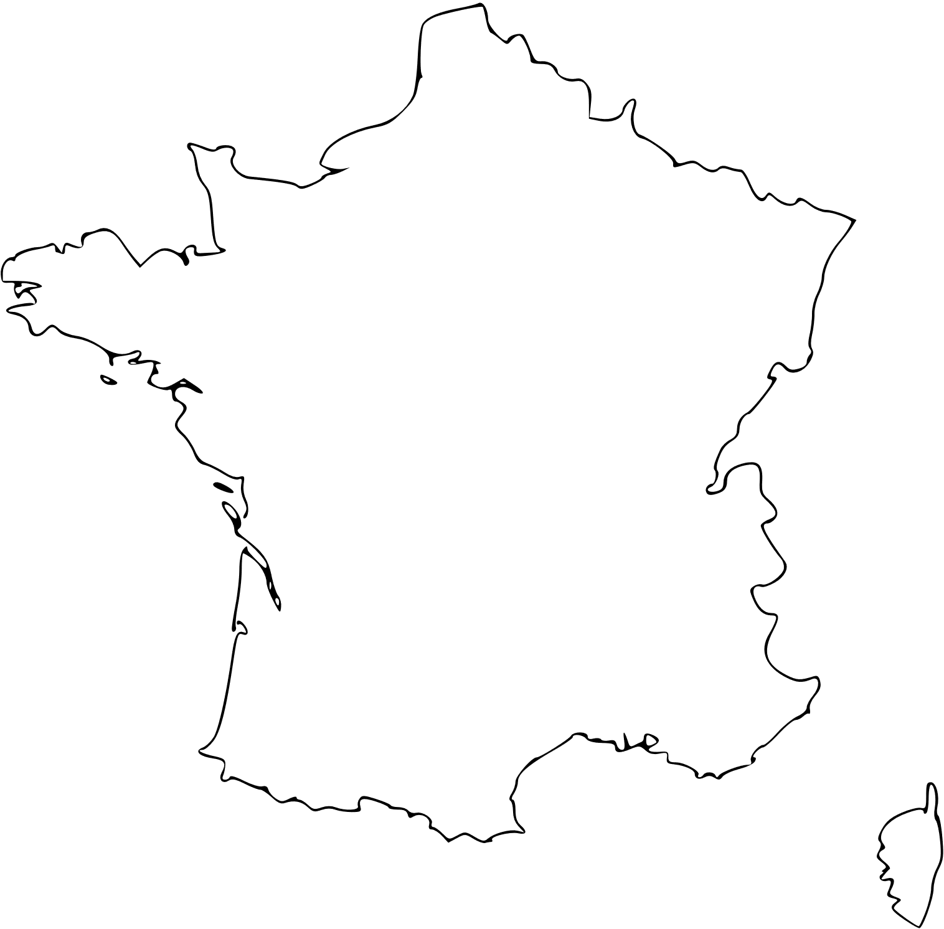




National reception plan's presentation
Interior Ministry
&
General Management of Foreigners in France (DGEF)
AMIF
Paris
French Office for Immigration and Integration (OFII ) 31 in France
2
FEANTSA FORUM 2023

Slide 6
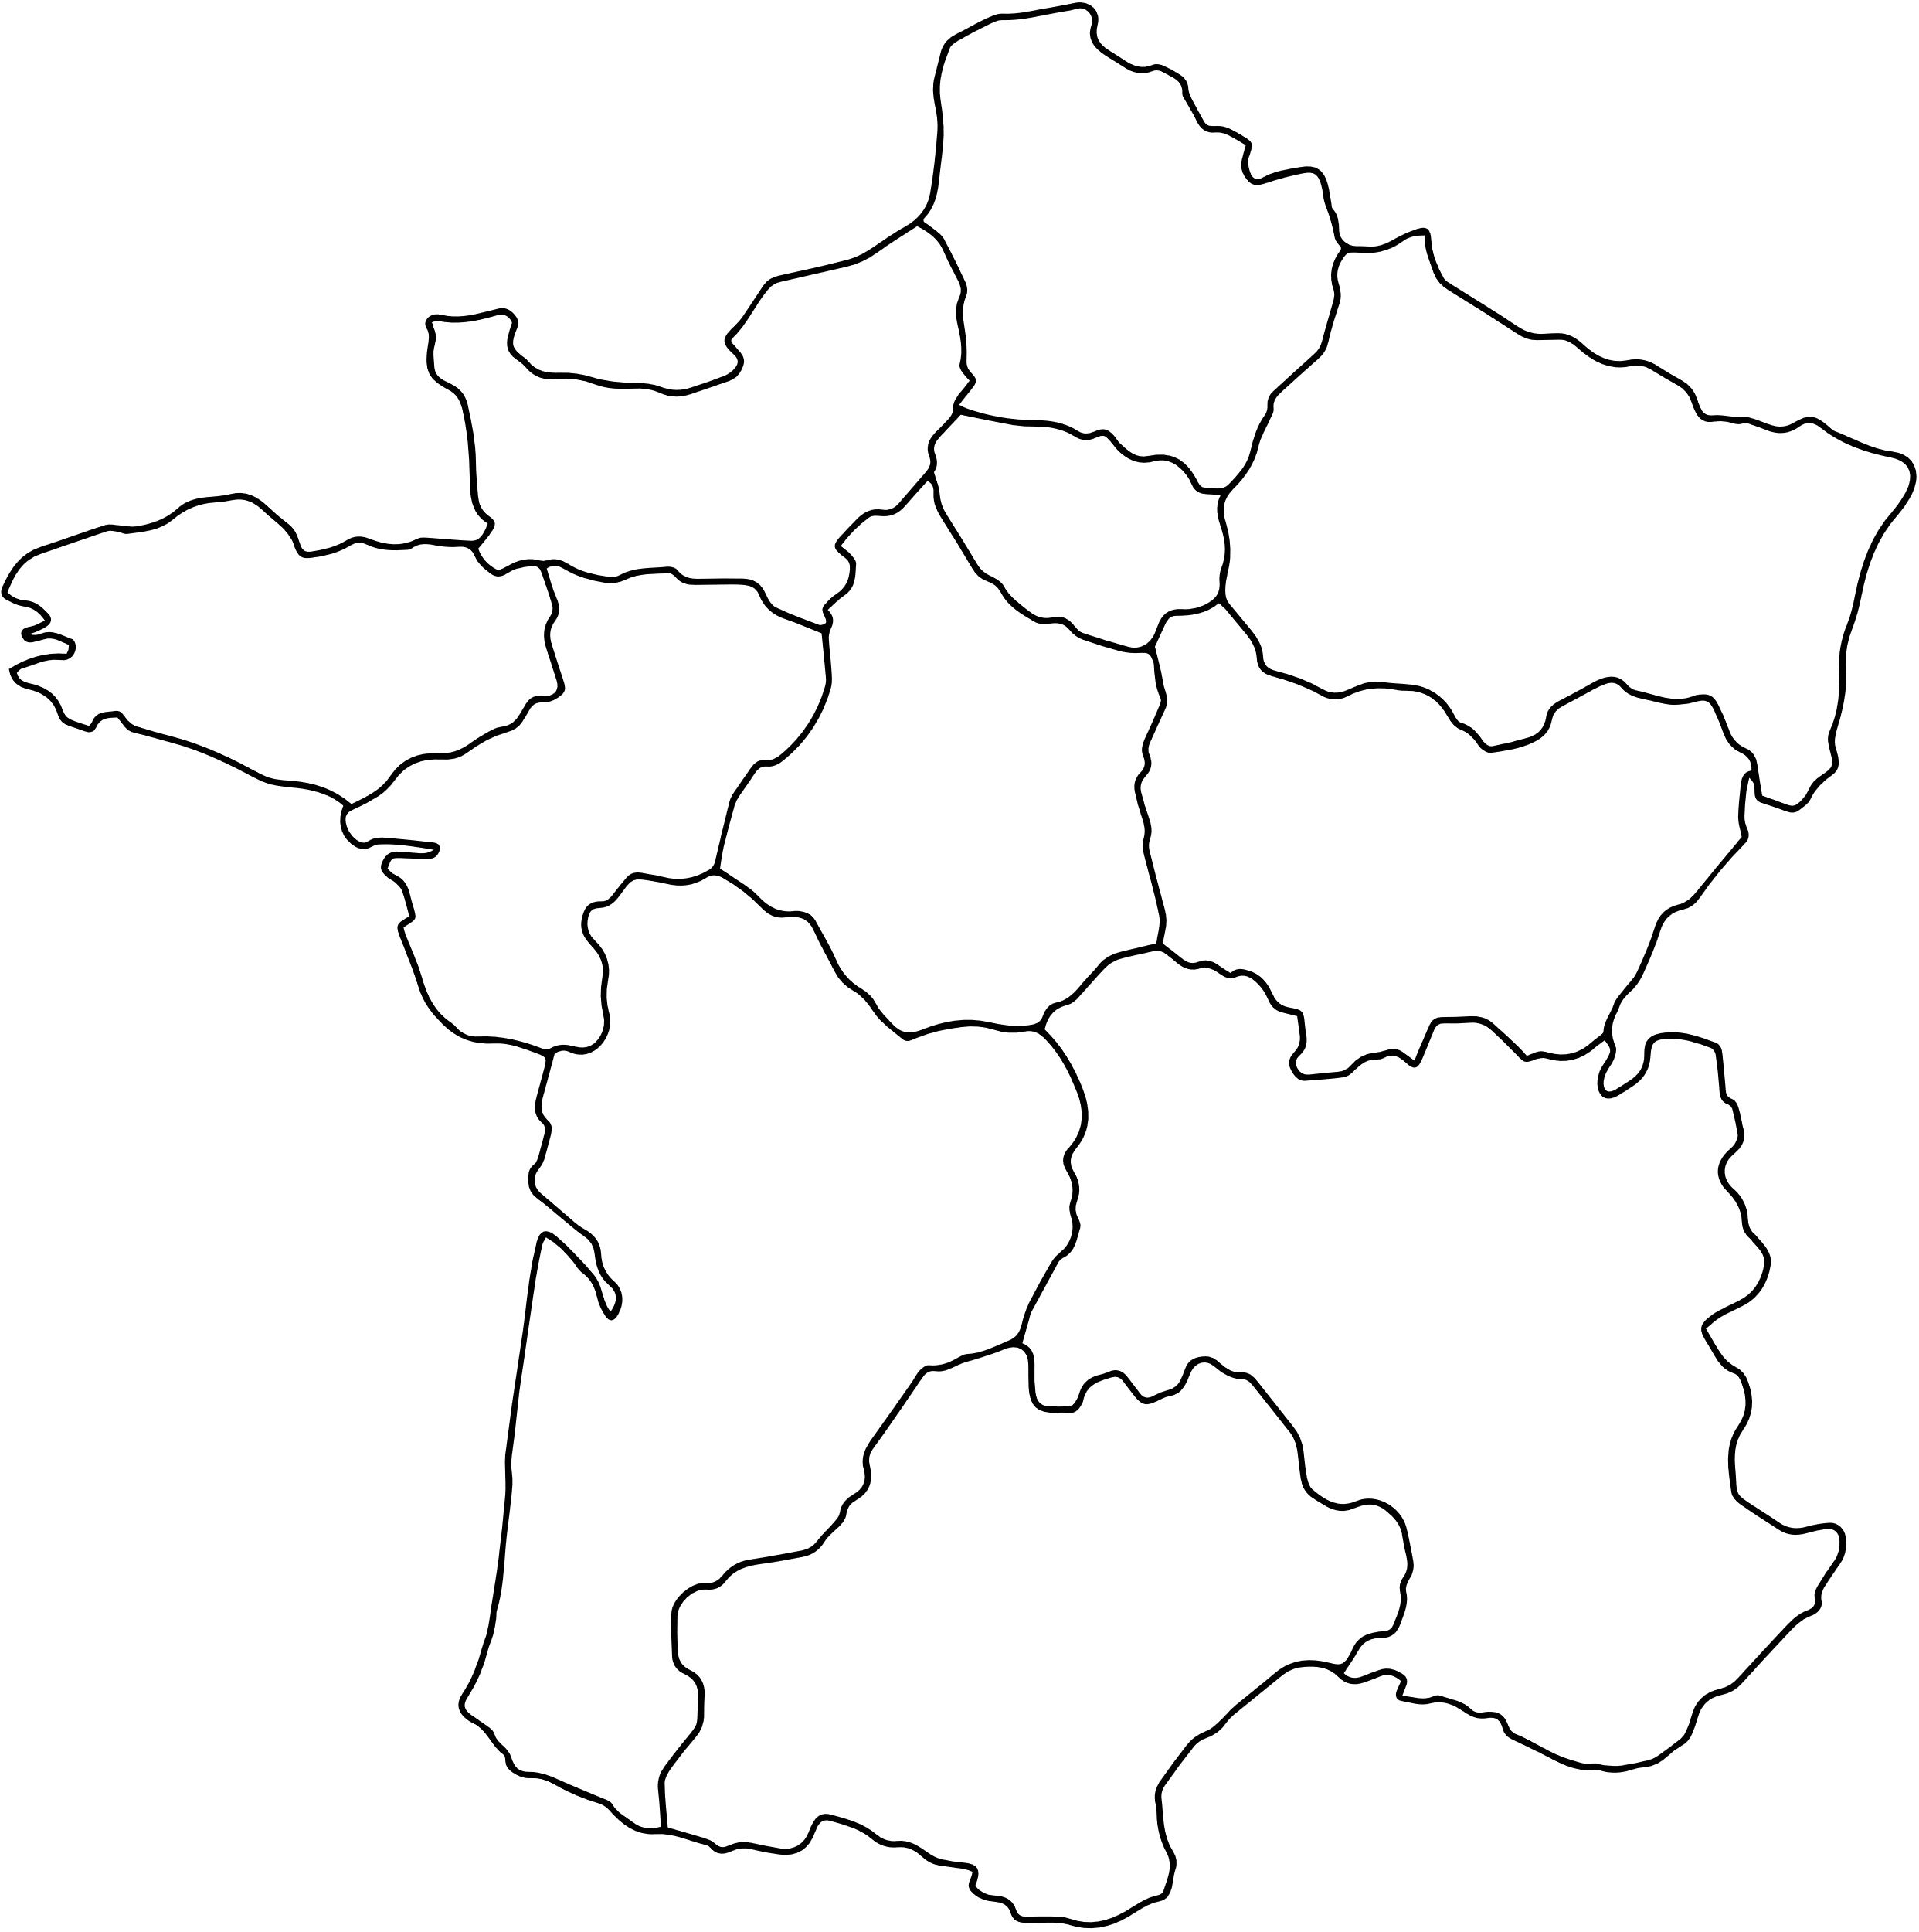
National reception's plan by region
TOTAL AMOUNT
119 732 accomodation places
137 046 asylum claim recorded in 2022
1 in 2 asylum seekers are not accommodated
National solidarity principle
6%
5%
13%
22%
Regional
Distribution
4%
4%
6%
12%
6%
8%
8%
3
FEANTSA FORUM 2023

Slide 7















Journey of an asylum seeker in France’s reception system
GUDA
Entry into territory
SPADA
OFII
Material reception conditions
OFII software's administrator
DN@ lists all free accomodation places
FEANTSA FORUM 2023
4

Slide 8
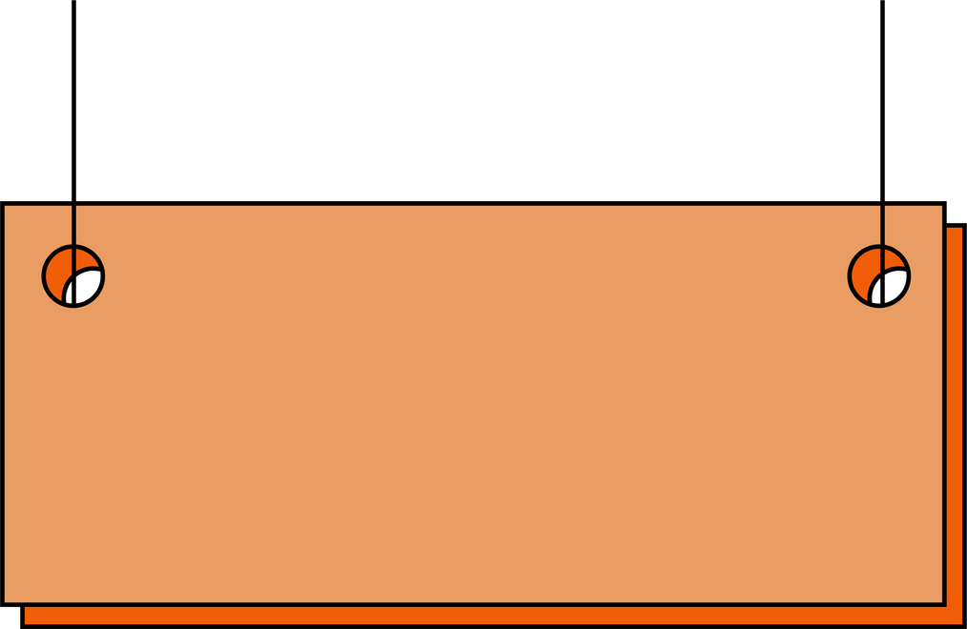


Different places of accomodation and social support
Average lenght of stay : 473 days
Occupancy rate : 97.1%
CAES
6 622 places
20%
26€
PRAHDA
5 351 places
= 5%
Global social support
Asylum application
CADA
49 242 places
30%
21€
HUDA
47 599 places
37%
18€50
6

Slide 9





Yes, accomodation is ok
No accomodation
115
Personal solutions
Informal living
spaces
Solidarity spaces
5 days to go to
accomodation
if no, loss of
Material reception
conditions
Emergency
Accomodation
5

Slide 10
Fédération des Acteurs de la Solidarité's
Advocacy
  Accomodation and assistance for each asylum seeker
  Increased accomodation's places for asylum seekers and refugees
  Long term vision about asylum system
  Inter-ministery department approach in our political public system about immigration and asylum
  Unconditional reception approach for all
  Procedure's simplification
2
FEANTSA FORUM 2023

Slide 11
Fédération des Acteurs de la Solidarité
Advocacy Actions & Strategy
  Bringing migration's actors together in our Federation to follow immigration's political policies
  Keep up about operations all around France
  Working with all FAS network and members to build our advocacy
  Improving our Parliamentary's advocacy
  Developing our institutional's advocacy
2
FEANTSA FORUM 2023

Slide 12
THANK YOU
Adèle Croisé
Fédération des acteurs de la solidarité
2
FEANTSA FORUM 2023

