Slide 1
Preventative Measures against Homelessness and Housing Exclusion
Professor Peter Mackie
Cardiff University, Wales, UK
02/06/2023

Slide 2
Aim
To identify effective preventative measures and draw out cross-cutting lessons on enablers and barriers to implementation. Also, briefly discuss prevention during crises such as the evolving cost-of-living crisis.
Important caveats
Prevention interventions are poorly defined and there is an absence of rigorous evaluations in Europe.
A selected review of literature and my knowledge of the field.
Not an overview of prevention practices across Europe (see Baptista and Marlier, 2019).

Slide 3
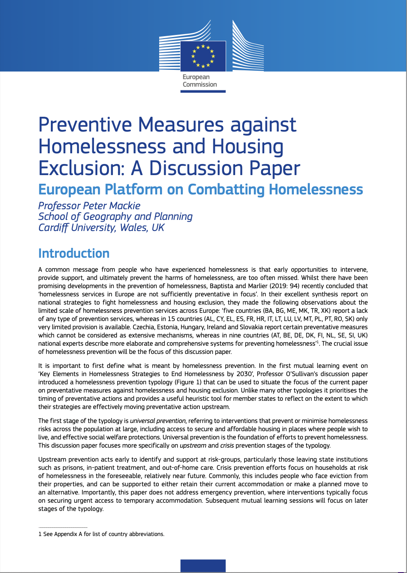
Contents
Context
Defining homelessness prevention and the focus of the presentation
Upstream prevention
Institutional settings
Screening tools
Crisis prevention
Evictions prevention
Other forms
Systematic change
Prevention during crises
Enablers and barriers to prevention
Conclusion

Slide 4
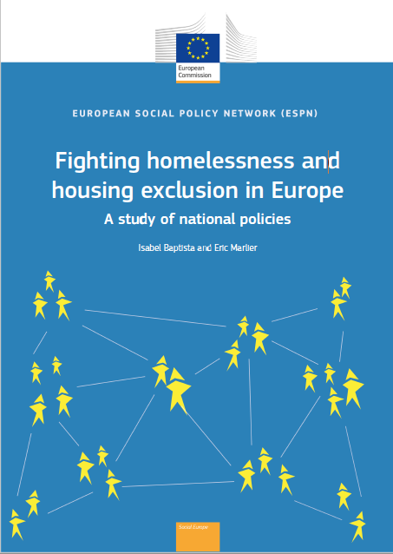
‘A common message from people who have experienced homelessness is that early opportunities to intervene, provide support, and ultimately prevent the harms of homelessness, are too often missed.’
Homelessness services in Europe are not sufficiently preventative in focus (Baptista and Marlier, 2019: 94)
5 countries report a lack of any prevention services.
15 countries report very limited provision.
5 countries reported preventative measures which cannot be considered as extensive.
9 national experts described more elaborate and comprehensive systems for preventing homelessness.
Context

Slide 5
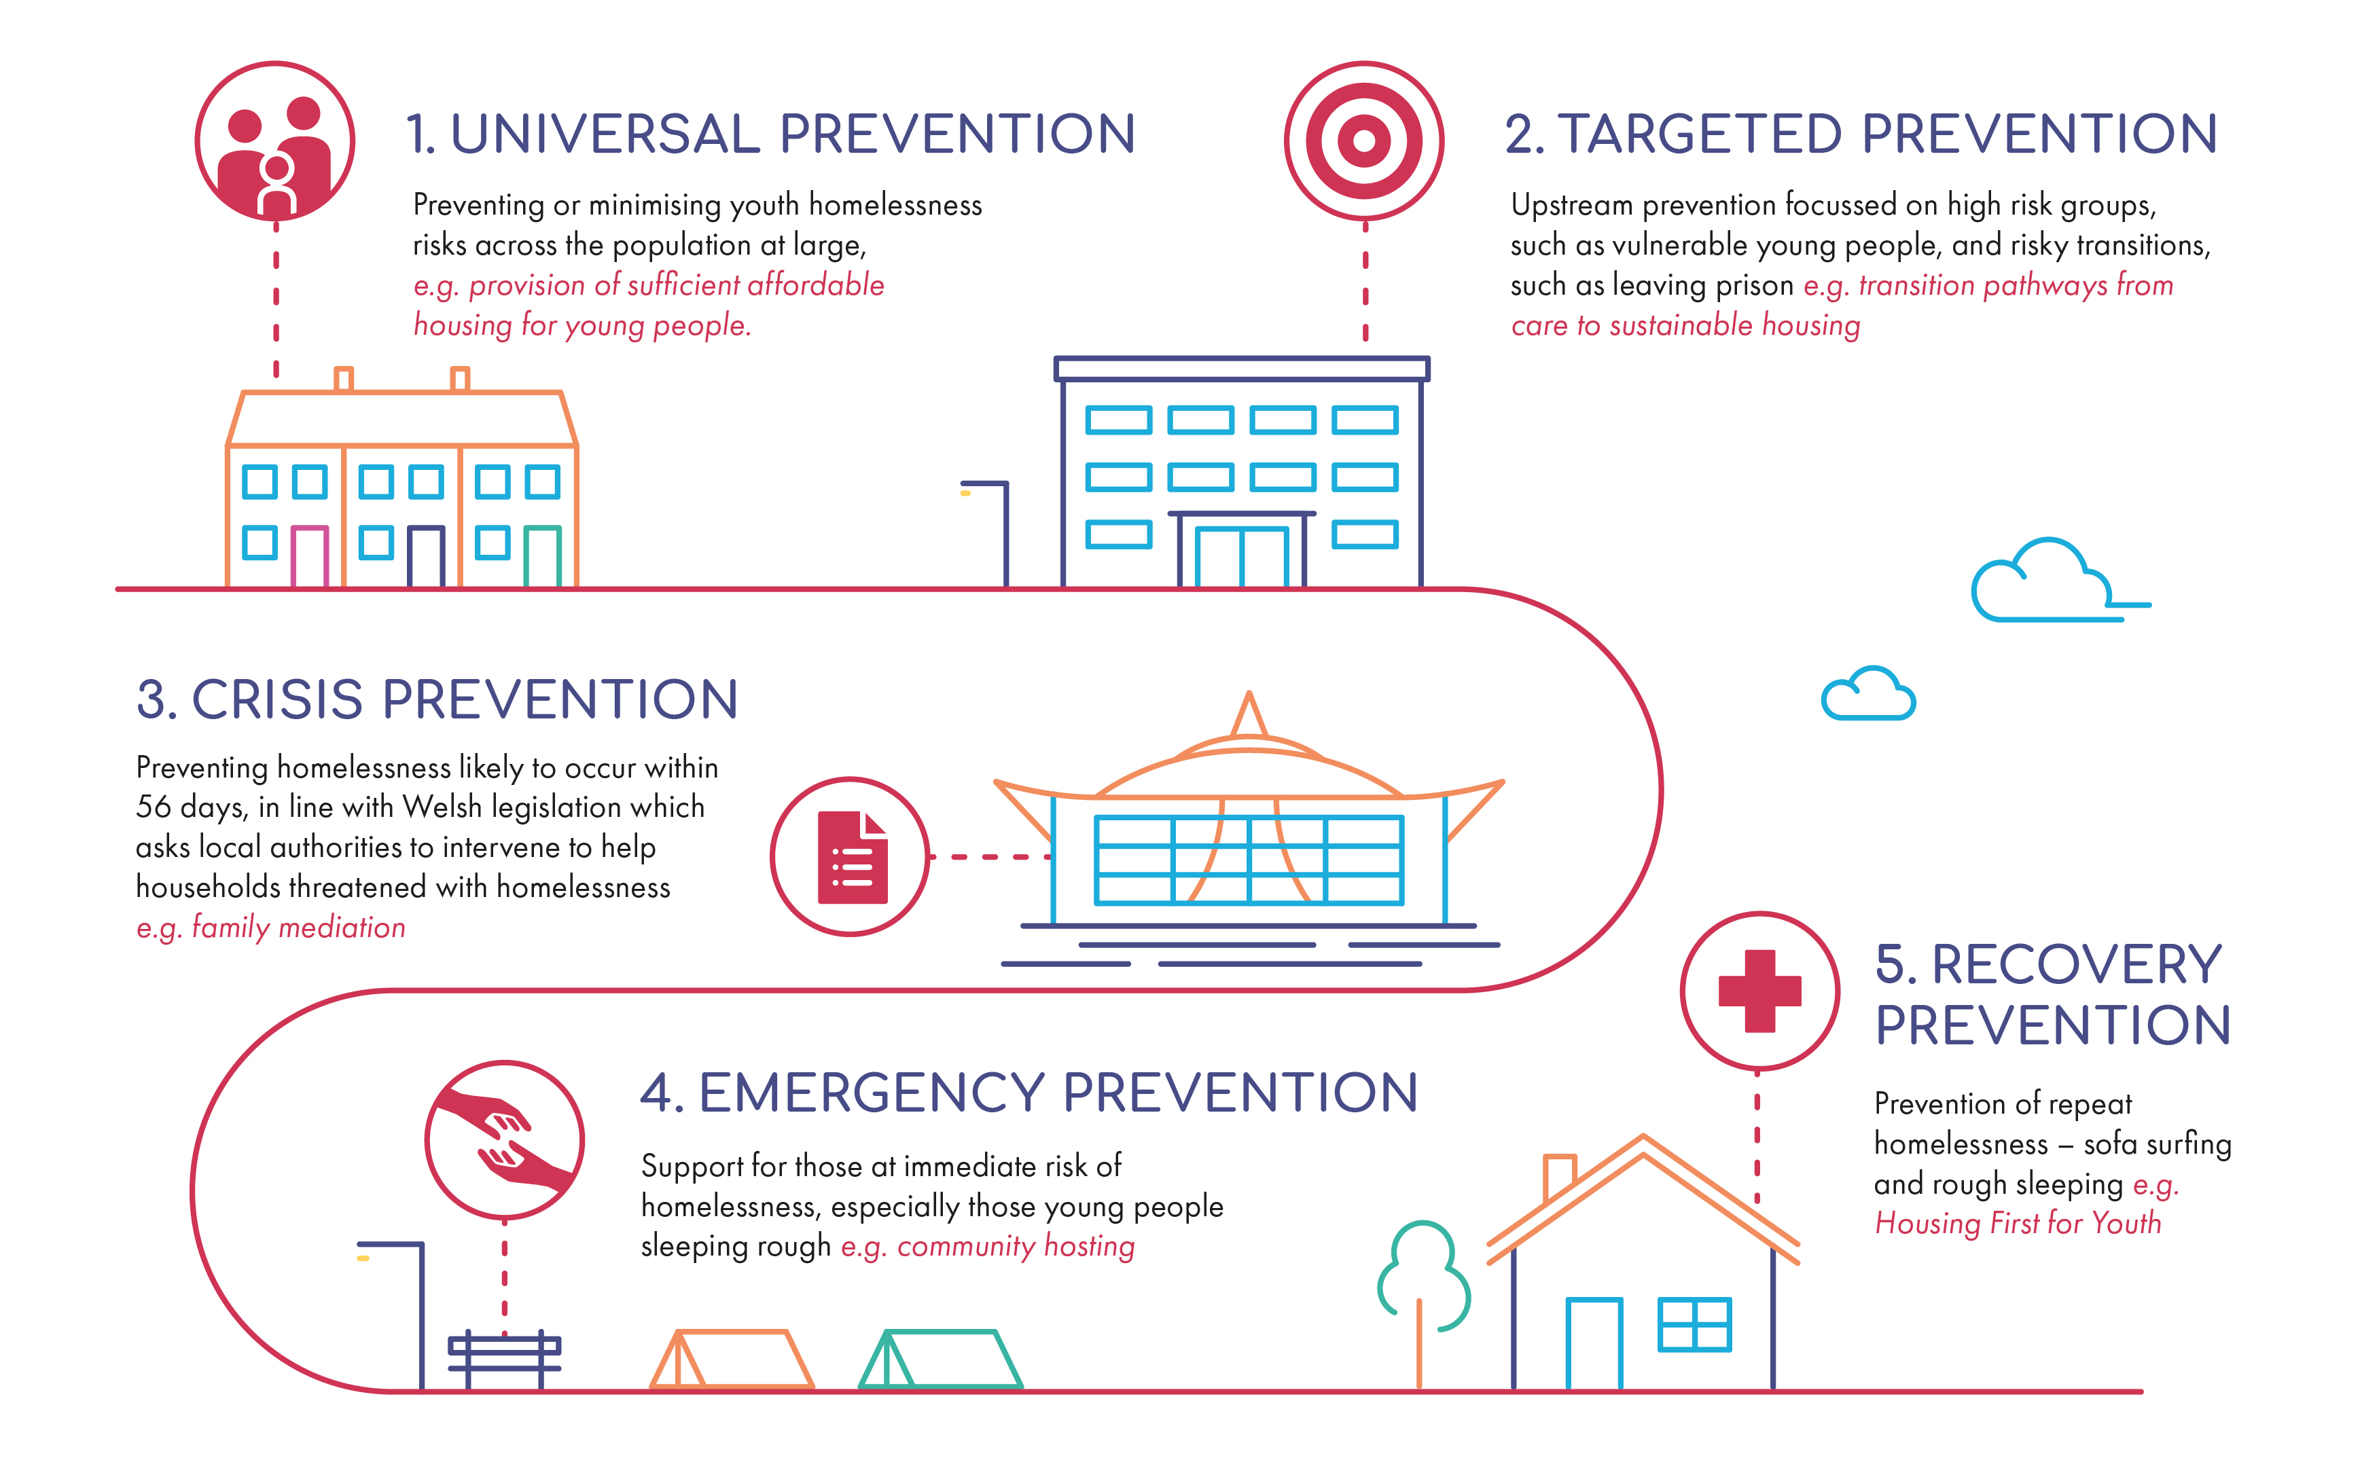
Defining prevention
UPSTREAM
Preventing or minimizing homelessness across the population at large
Early-stage prevention focused on high-risk groups, such as vulnerable young people and risky transitions, such as leaving prison
‘Universal prevention is the foundation of efforts to prevent homelessness. This presentation focuses more specifically on upstream and crisis prevention stages of the typology.’
Preventing homelessness likely to occur within a foreseeable time period
REPEAT
Prevention of repeat homelessness
Support for those at immediate risk of homelessness, especially rough sleeping

Slide 6
Defining prevention
UPSTREAM
Preventing or minimizing homelessness across the population at large
Early-stage prevention focused on high-risk groups, such as vulnerable young people and risky transitions, such as leaving prison
Preventing homelessness likely to occur within a foreseeable time period
REPEAT
Prevention of repeat homelessness
Support for those at immediate risk of homelessness, especially rough sleeping

Slide 7
Upstream prevention - institutional settings
‘The Lisbon Declaration on the European Platform on Combatting Homelessness aims to work towards a situation where no one is discharged from any institution (e.g. prison, hospital, care facility) without an offer of appropriate housing.’
A systematic review of discharge programmes for individuals at risk of experiencing homelessness (Hanratty et al, 2020) concluded programmes improve housing stability, albeit the evidence base is limited.
They found key variation in the timing and duration of transitional support.
Arguably the best evidenced discharge programme is Critical Time Interventions (CTIs). However, effective cooperation from prisons can be problematic, often due to due to lack of capacity to plan ahead.
Both Denmark and Finland have a clear strategic emphasis on meeting the needs of these populations. The principle is that housing should be secured whenever the client is met in the service system (Pleace, 2017).

Slide 8
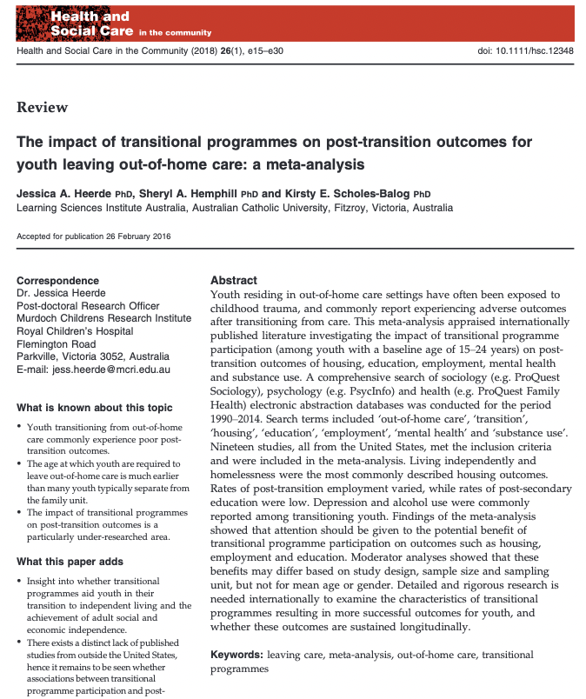
Upstream prevention - institutional settings (ageing out of care)
A meta-analysis of 19 studies of transition programmes, all from the United States, found incredibly mixed findings (Heerde et al, 2018).
In some contexts, even with support, becoming homeless was normal.
One particularly notable approach which is gaining considerable traction across Europe, is Housing First for Youth (immediate access to housing with no-preconditions etc).
Positive pilots in Scotland, whilst Finland provides an example where Housing First for Youth is delivered at scale through the Finnish Youth Housing Association.
Emerging recent work on chosen families.

Slide 9
Upstream prevention - screening tools
Oneview Data analytics approach in Maidstone Borough Council uses linked administrative data to predict risk and prompts early intervention.
The Geelong Project (Australia)/Upstream Project (Canada, US, Wales) uses a screening survey with children in school to identify risk of homelessness, primarily due to emerging conflict at home. Supports help to prevent reaching crisis point.
During health checks with veterans, the Homelessness Screening Clinical Reminder (USA) asks two questions about homelessness risk. Support referrals are then made.

Slide 10
Crisis prevention - evictions
Interventions can be grouped into three main categories (Kenna et al, 2016):
Legal requirements to notify authorities of an eviction. E.g., Austrian courts required to inform authorities of imminent evictions, and Belgian courts must similarly inform Public Centres for Social Welfare. The PCSW is then required to investigate how it can support the household.
Short-term financial assistance is available in many European countries, though it is often not compulsory. In Chicago, those who received a one-off benefit of $1,000 were 76% less likely to experience homelessness within six months than those who did not (Evans et al, 2016).
Legal support, advice and representation, along with landlord-tenant mediation. Legal advocacy for lower income tenants in New York City’s Housing Court reduced eviction orders by 77% compared to instances where no legal advocacy was available (Seron et al, 2001)
‘An array of interventions centre on households at high risk of homelessness in the near future… These crisis prevention interventions predominantly focus on evictions... The Lisbon Declaration states evictions should be prevented whenever possible and no one should be evicted without assistance for an appropriate housing solution, when needed.’

Slide 11
Crisis prevention - other forms
Beyond evictions, relationship breakdown and domestic abuse are key experiences that place individuals (perpetrators and victims) and families at high risk of homelessness
In the context of relationship breakdown, young people have been the focus of attention, and the most common intervention is family mediation.
Outside of legal responses to domestic abuse, such as injunctions, an increasingly used accommodation-based crisis prevention response is sanctuary schemes.
We lack robust evaluations of interventions in this area of prevention.

Slide 12
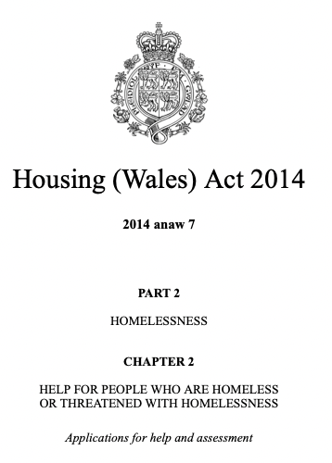
Crisis prevention - systematic change
The Housing (Wales) Act 2014 requires earlier preventative action and extends meaningful assistance to all households, irrespective of any perceived vulnerability.
Keystone of the legislation is a duty on local authorities to take ‘reasonable steps’ to prevent homelessness for those at foreseeable risk.
Statutory guidance sets out interventions that local authorities ought to have in place.
Positive impacts, with nearly 70% of all prevention assistance recorded as successful.

Slide 13
Prevention during crises
‘Crises such as the conflicts in Syria and Ukraine, the Covid-19 pandemic, and potentially the current cost-of-living crisis, create particular housing challenges.’

Slide 14
Prevention during crises
Two main lessons from the pandemic (Pleace et al, 2021):
Countries using temporary supported accommodation that offers people their own rooms/apartments and homelessness strategies that are inclusive and lean towards housing-led responses were more resilient.
Eviction bans proved crucial in preventing new entries into homelessness.
Responses to the inflow of Ukrainian refugees have been reactive, relied upon private households, and enacted few pre-planned responses:
Impacts on hosts and refugees are still emerging and there are questions about mid-longer term responses as the conflict becomes protracted.

Slide 15
Enablers and barriers to prevention
Effective universal prevention: ‘internationally, no level of coordination, evidence-led practice or comprehensiveness of response has been found that counteracts the effects of insufficient affordable, adequate homes’ (Baptista et al, 2022: 14).
Political will and resources: Achieving a significant shift in responses, often with high upfront investment and an upheaval of prevailing systems, requires political will.
Systematic integration: There are many preventative services, but a paucity of integrated and comprehensive prevention-focused systems limits their impact.
Collaboration and buy-in between public bodies: The failure to effectively engage public bodies in homelessness prevention is a key limitation on upstream interventions
Equal/equitable access: If all other enablers are in place, efforts to prevent homelessness will still fail unless there is equal/equitable access to support.

Slide 16
Conclusions
In a discussion focused on upstream and crisis prevention, it is important to forefront that effective universal prevention must be the foundation of any strategy to end homelessness.
However, there is also an urgent need to reorient homelessness responses towards upstream and crisis prevention, and away from emergency response.
The message from people who have experienced homelessness is that early opportunities to intervene, provide support, and ultimately prevent the harms of homelessness, are too often missed.
The key contribution of this presentation and accompanying paper should be to challenge member states to reflect critically on the extent to which their strategies are prevention-oriented and to swiftly make progress on this agenda.

Slide 17
Thank you Diolch yn fawr

