Slide 1
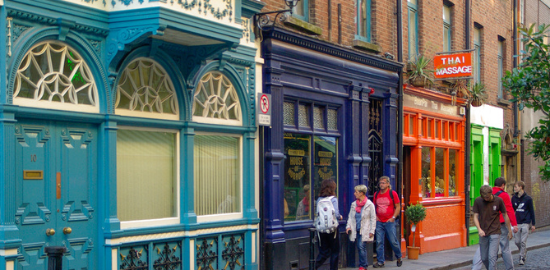
Housing for Migrants & Asylum Seekers during crisis periods- “Everyone In” in London
FEANTSA POLICY CONFERENCE 2022
Towards a Vision for Ending Homelessness

Slide 2
GLA Covid-19 hotels
Background
Specialist support to migrants in hotels
Learning and challenges
Next steps
2. Other GLA work on supporting homeless migrants
What will we cover

Slide 3
What is the GLA? Context in London
In March 2020- Everyone In starts using commercial hotels as self-contained accommodation to save lives: Greater London Authority and London Boroughs with funding and support from central government
People came from the streets, from winter shelters and some hostels- Everyone regardless of their immigration status
A significant number of people were non-UK nationals with immigration advice needs
Background
Notes:
50% of r/s are non-UK in London/ London and South East represent about 50% of rough sleepers in the country
The Lancet confirmed that during the first wave, 266 deaths were avoided, with 1,164 hospital and 338 ICU admissions also avoided.
Some 37,000 people were brought in off the streets according to Government estimates in England. GLA alone brought in about 3000 people up to 2022

Slide 4
Immigration advice in hotels
EUSS coordinated referrals
Funded Immigration advisers
Legal Aid pilots
Specialist holistic migrant support
Immigration link workers
Training and resources
Escalation of pending immigration applications
Support for migrants in hotels

Slide 5
High numbers of non-UK nationals with unclear or limited status needing accommodation and specialist support
Importance of early immigration assessments and dedicated casework BUT limited capacity
Importance of specialist knowledge on supporting homeless migrants
Unprecedented collaboration: all levels of government, health, immigration, etc.
Coordinated pathways of support- ensuring informed decisions
Impact of the current welfare and immigration rules
When the right support is available outcomes are possible
Learnings and challenges
Notes:
More on learnings: Kerslake_Commission_Final_Report_21.pdf (usercontent.one)

Slide 6
Hotels have been closing as exceptional funding has ended and hotels have returned to normal activity
Majority of those remaining in accommodation have been non-UK nationals with unclear or limited entitlements
Mitigation options and continued support for those still working on their immigration case but needing more time.
Awareness built on importance of immigration advice, specialist support and accommodation- without support for migrants it will not be possible to end rough sleeping
Next steps

Slide 7
Other GLA work on supporting homeless migrants
Upcoming/ongoing projects:
Immigration Advice for Rough Sleepers Fund/ potential future funding on IA
Holistic Assessment Service
Roma Rough Sleeping Team
Training programme
Routes Home -recommissioning of new non-UK service
2. Working with the sector and relevant government departments (HMAP)
Notes:
Summary of GLA’s work on migrant homeless: Migration and homelessness | London City Hall
Learning Gathered from Immigration Advice for Rough Sleepers Fund | Homeless Link
Roma Rough Sleeping Service - St Mungo's (mungos.org)
Supporting non-UK nationals: London homelessness and migrant sectors training programme | Homeless Link
Routes Home - St Mungo's (mungos.org)-

Slide 8
THANK YOU
FEANTSA POLICY CONFERENCE 2022
Towards a Vision for Ending Homelessness

