Slide 1
Spotlight on Danish Homelessness Strategy
FEANTSA POLICY CONFERENCE 2022
Towards a Vision for Ending Homelessness

Slide 2
Making the Shift
The Danish National Strategy on Housing First
The Home for All Alliance

Slide 3
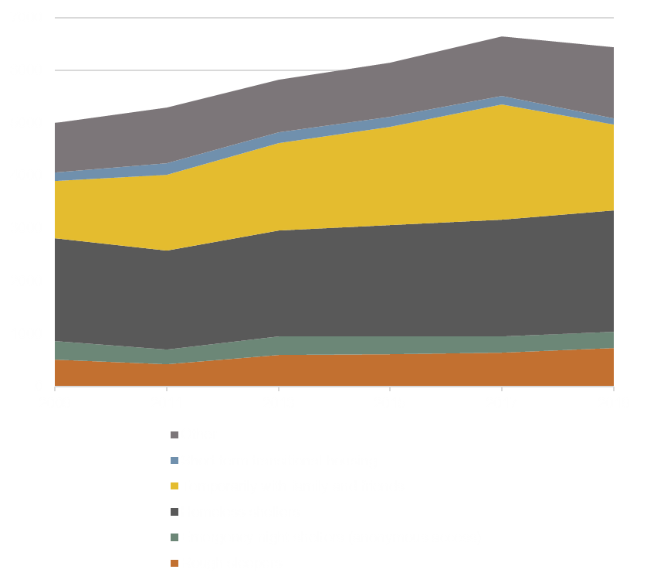
Homeless citizens week 6 (week of counting) in 2019
Counts of people living in homelessness every second year since 2009
The latest count shows a total of 6.431 people living in homelessness

Slide 4
National Strategies in Denmark
Level: 1 2009-2013
The national homelessness strategy
17 municipalities
Method testing and development in a Danish context
Level 2: 2014-2016
25 municipalities
Implementation of Housing First and supported housing
A youth project
Level 3: 2016-2019
≥25 municipalities
Dissemination and implementation of Housing First in even more municipalities
Testing of transitional housing for young people
Level 4: 2018-2021
≥25 municipalities - A National Action plan to combat homelessness
- Social Investment Initiatives
- Housing First for youth
Level 5: 2021-
New political agreement on
more affordable housing for people in homelessness and people at risk of homelessness
rearrangement of the economic incentive structure for the municipalities, to support the full implementation of Housing First in Denmark
- ongoing implementation. Affordable housing will be available before new demands are made on social support.

Slide 5
Perspectives from the field
Proper and sufficient support
A shift of a system not only shelter system
Securing resources from shelters
Affordable housing
Better solutions for all groups

Slide 6
In 2020 the National Board of Social Service carried out a survey about the barriers to the full implementation of Housing First:
Only 8 pct. of the target group is meet by an Housing First-method
Some of the barriers for full implementation of Housing First are:
relevant housing available to homeless citizens
cooperation across relevant subject areas internally in the municipalities and across sectors
knowledge of the Housing First approach as an effective approach
the political and managerial prioritization of the Housing First approach in the municipalities and at national level
financial incentive for the use of the Housing First approach
Learning points and
barriers

Slide 7
New political agreement
Ambition and goals
To reduce the number of homeless citizens significantly
To eradicate long-term homelessness

Slide 8
Key elements in the new political agreement
Providing more affordable housing
Rearrangement of the economic incentive structure for the municipalities, to support the full implementation of Housing First in Denmark
Today the state reimburses 50 pct. of local expenses on shelters. Over the coming years this will be turned around - so that the state instead will reimburse the Housing First support methods.
A new and more holistic approach – the spread of housing First
A Task Force to support the municipalities in there reorientation of practice

Slide 9
How to secure …
Key points from the shelter system
Adequate support and a good transition
Shelters as an acute safety net
The resources from the shelter system
Support for the transition of the shelter system
An analysis of the capacity of shelters:
Do we have an appropriate number of shelters and accommodations, for the right target groups and with the right geographical location?

Slide 10
The
importance
of an
involving process
Collaboration is key
The new stategy is the result of significant preparatory work with an involving process across all stakeholders in the homelessness area.
It has helped to qualify the strategy and has provided co-ownership among the stakeholders
Establishing a national partnership of central stakeholders will ensure a systemic monitoring of the progress of the transition, and a continued co-ownership of the common goal.

Slide 11
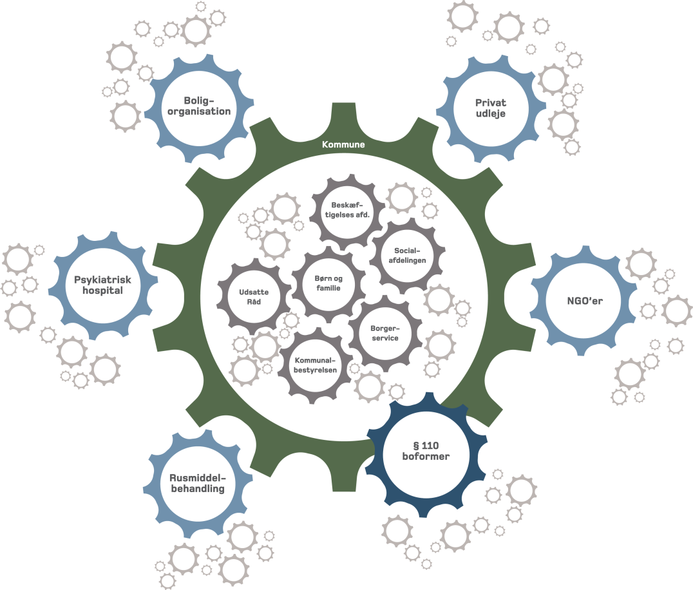
Key issues
A strong and successful implementation og Housing First needs:
Systematic practice of offering people in homelessness social support according to the specialized support methods included ind the Housing First approach
Systematic provision of housing for the effort
Organization and cooperation between relevant actors

Slide 12
Questions
The Home for All Alliance
Thank you for listening!

