Slide 1

Inclusion Health in a Hospital: Why, What, How
Clíona Ní Cheallaigh
  Consultant in General Medicine and Infectious Diseases
  Associate Professor, Dept of Clinical Medicine, TCD
  Clinical Lead, Inclusion Health Service

Slide 2
Why: What is social exclusion

Slide 3


Slide 4
MinoritisedEthnicity
Race
Poverty
Foster
Care
Gender
Addiction
Low education
Homelessness
Sexual Orientation
Prison

Slide 5
The cycle of adversity
In Utero
Early Childhood
School
Experiences
Early Adulthood
Parenthood
Ageing/death
Family
Community

Slide 6
Poverty
Social Exclusion

Slide 7
Why: The Case of Need

Slide 8
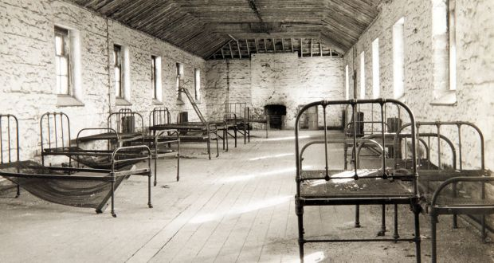

Slide 9

Clíona Ní Cheallaigh et al. BMJ Open 2017;7:e016420
©2017 by British Medical Journal Publishing Group
Notes:
Age of unscheduled medical admissions.

Slide 10


Women
Men
Standardised mortality ratios for deprivation groups in England*, IMD1 – IMD10 (1 = expected rate of death)
IMD
*Deaths by underlying cause, deprivation decile areas, 5 year age groups and sex, England and Wales, 1981 to 2015 Populations by deprivation decile areas, 5 year age groups and sex, England and Wales, 2001 to 2015

Slide 11

Slope Index of Inequality (SII)

Slide 13
Women 11.9 (95% CI 10.4–13.3; I² 94,1%)
Men 7.9 (95% CI 7.0–8.7; I² 99.1%)
IMD

Slide 14
Cliff Edge of Inequality

Slide 15
Why: What do doctors do?

Slide 16
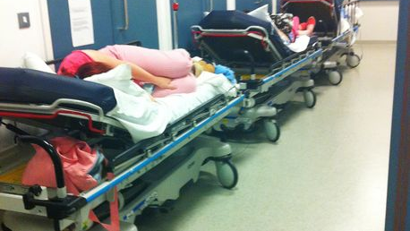

Slide 17


Slide 18


Slide 19


Slide 20
What: Inclusion Health in the Hospital

Slide 21
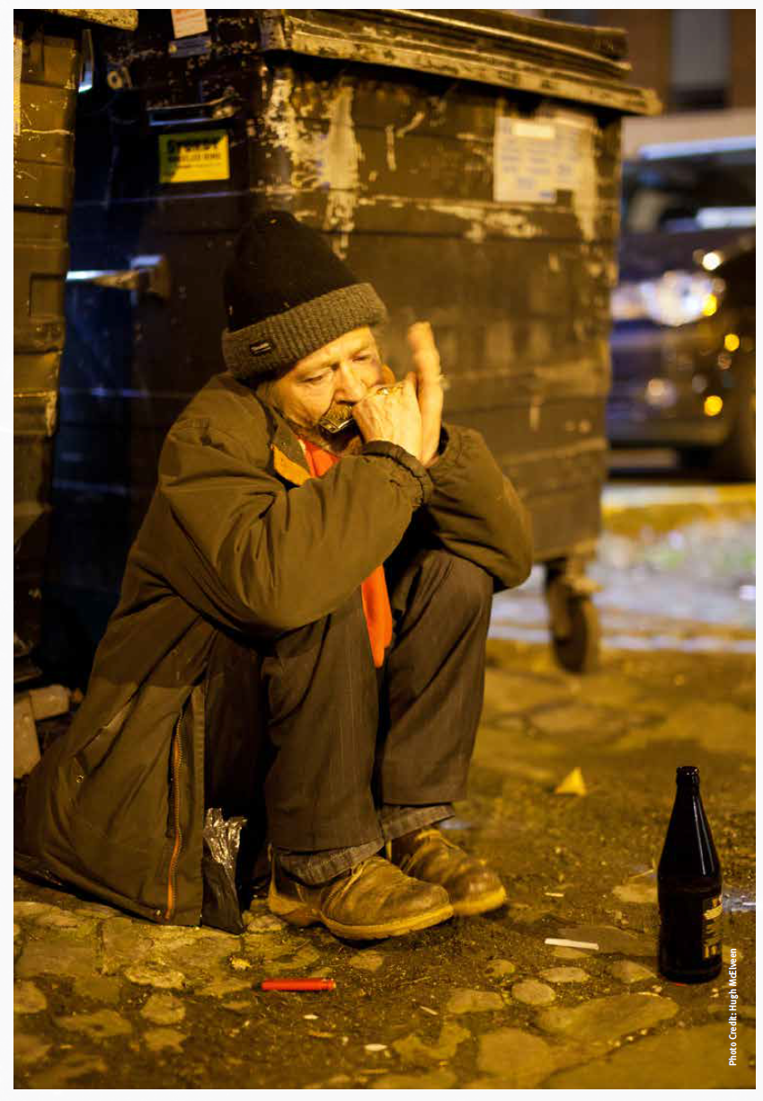

What’s the same?
Inpatients, outpatients, consults

Slide 22


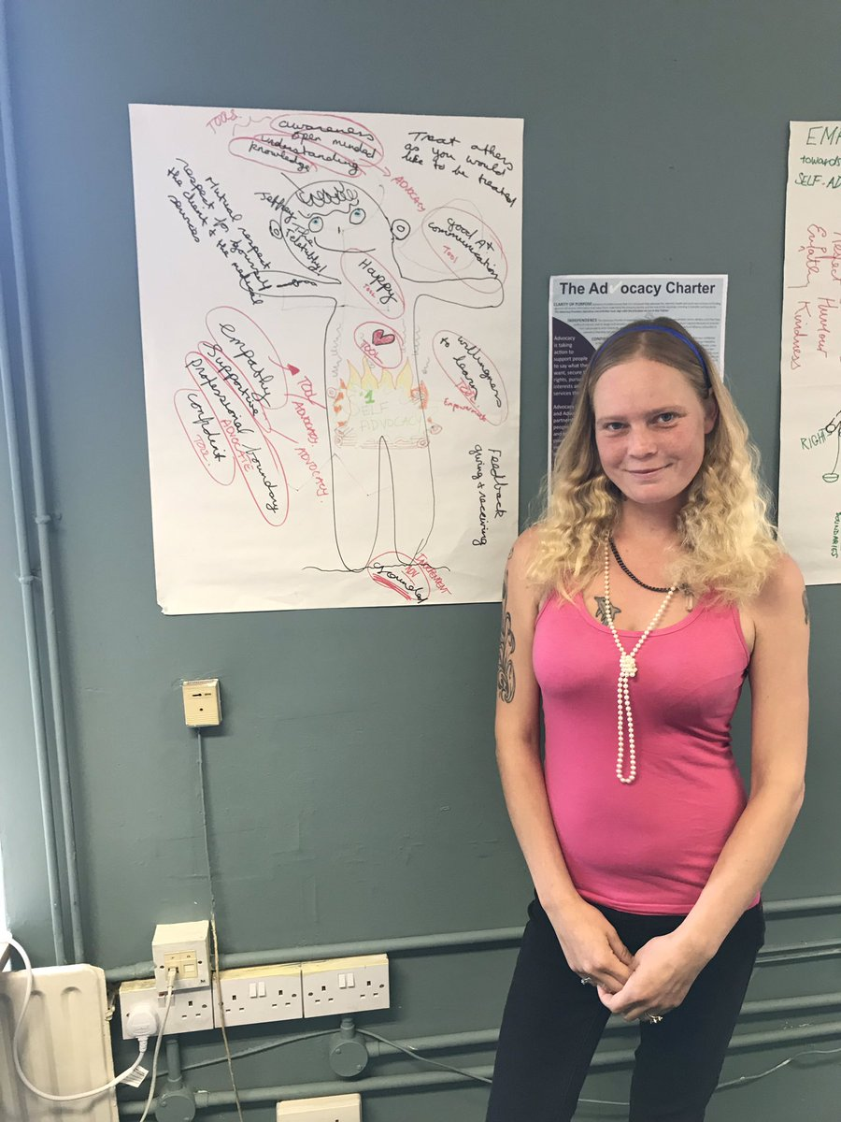
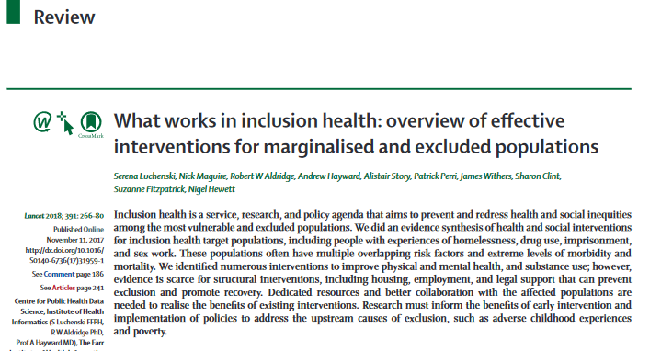
What’s different?
Continuity of care

Slide 23
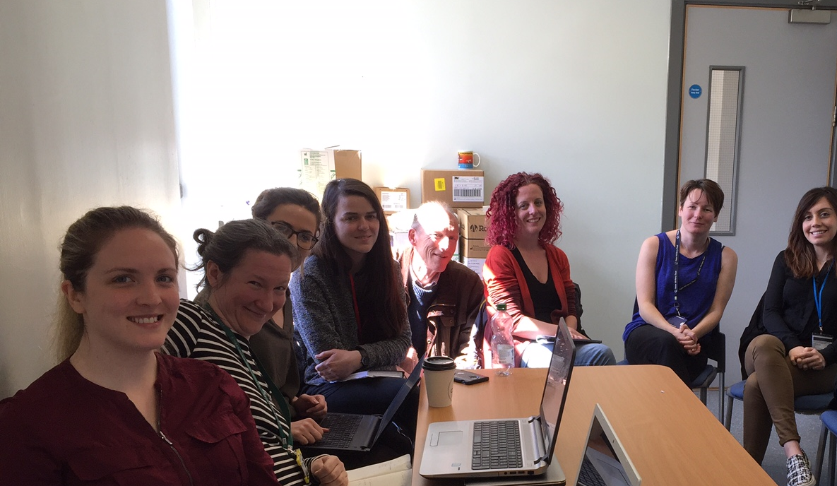
Weekly Case Management Meetings
SJH
MQI
Dublin Simon
De Paul
McVerry
HealthLink
Coolmine
Local Authoty
Safetynet
MMUH
Housing First
What’s different?
20-30 cases per week
Gaps, blocks, solutions, support

Slide 24
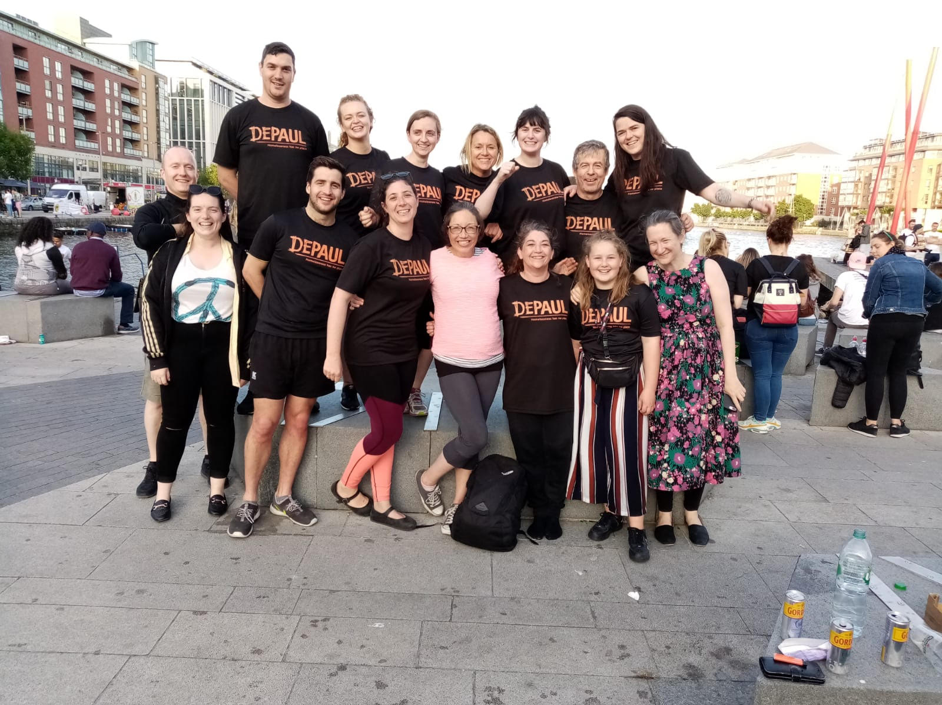


Slide 25

What’s different

Slide 26

What’s different

Slide 27
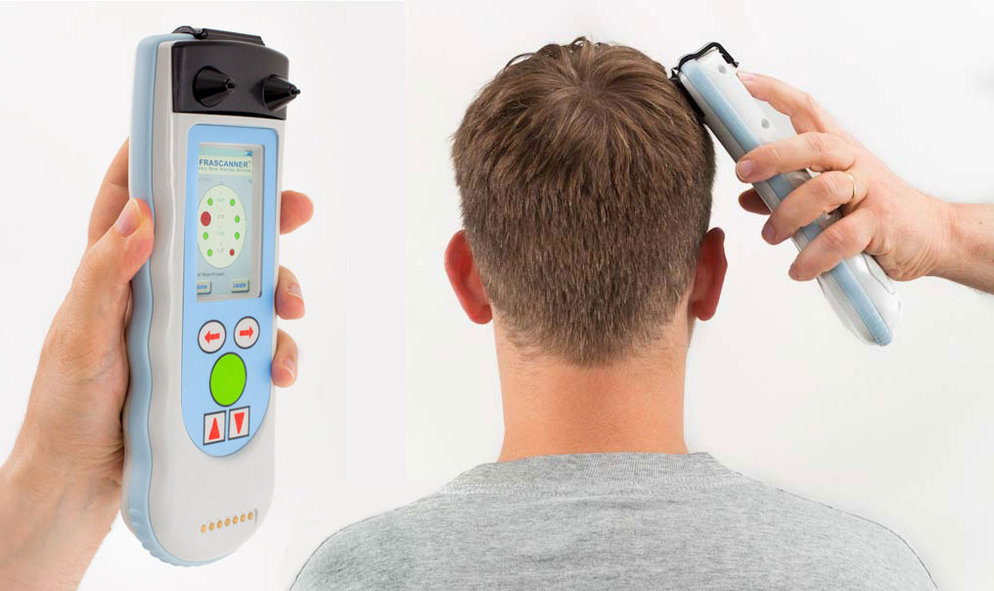

Do they Deserve?
DESERVOMETER®
Find out Now
Point of care eligibility testing for all your clients

Slide 28
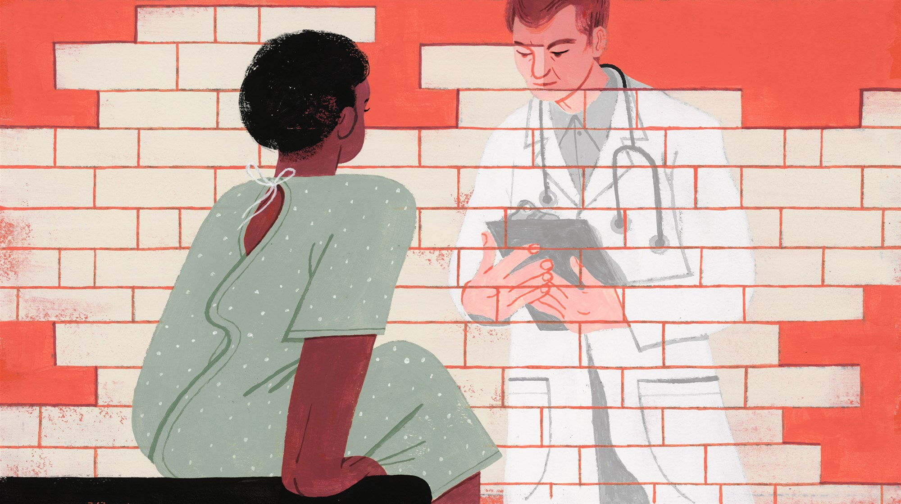

Slide 29
Outcomes

Slide 30
Outcomes

Slide 31
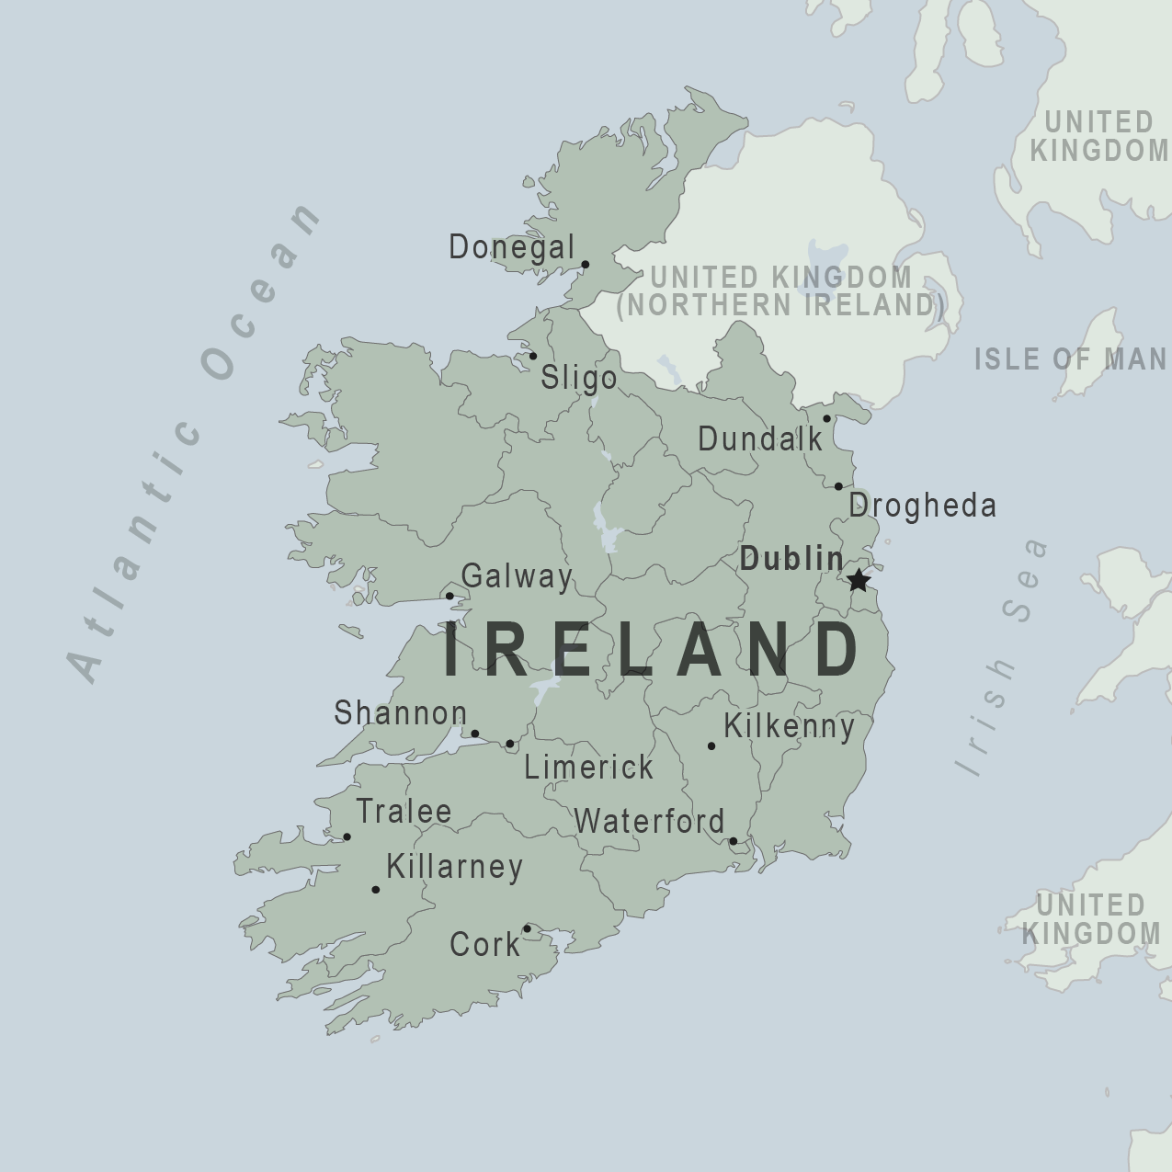

Slide 32
How can you get one?

Slide 33


Slide 34


Slide 35


Slide 36
Rights-based approach

