Slide 1
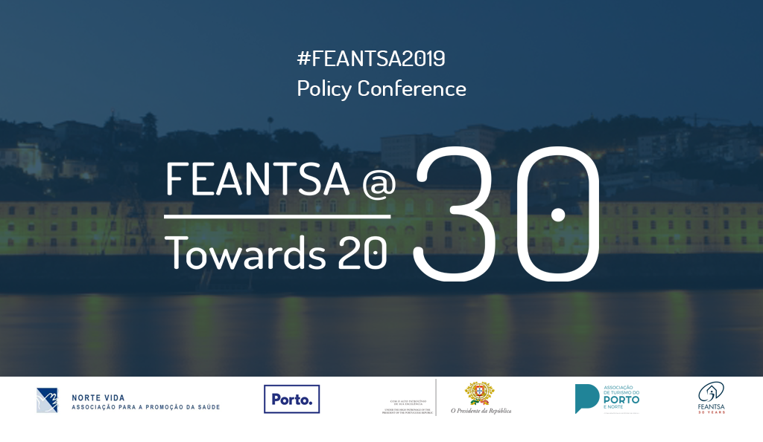

Slide 2
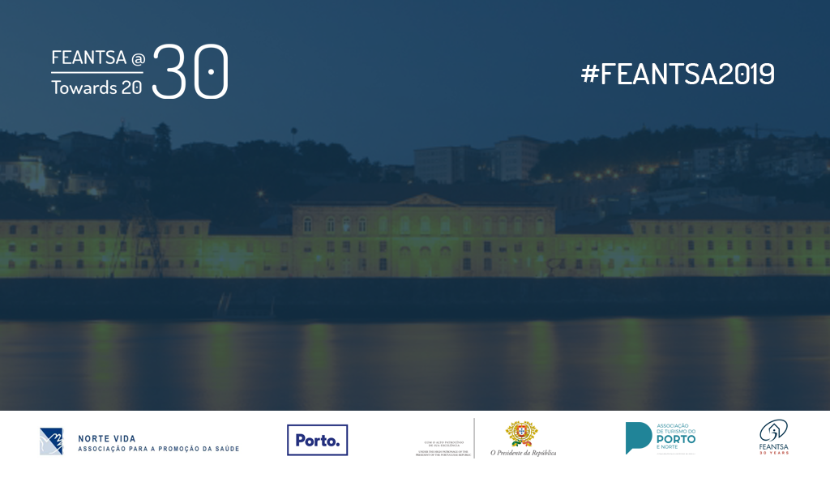
Homeless people who consume alcohol and/or drugs:
Spotlight on (Northern) Portugal
Kerstin Hoffmeister
Drug and Alcohol Interventions Division of the Public Northern Health Administration (DICAD/ ARS Norte, I.P.)

Slide 3

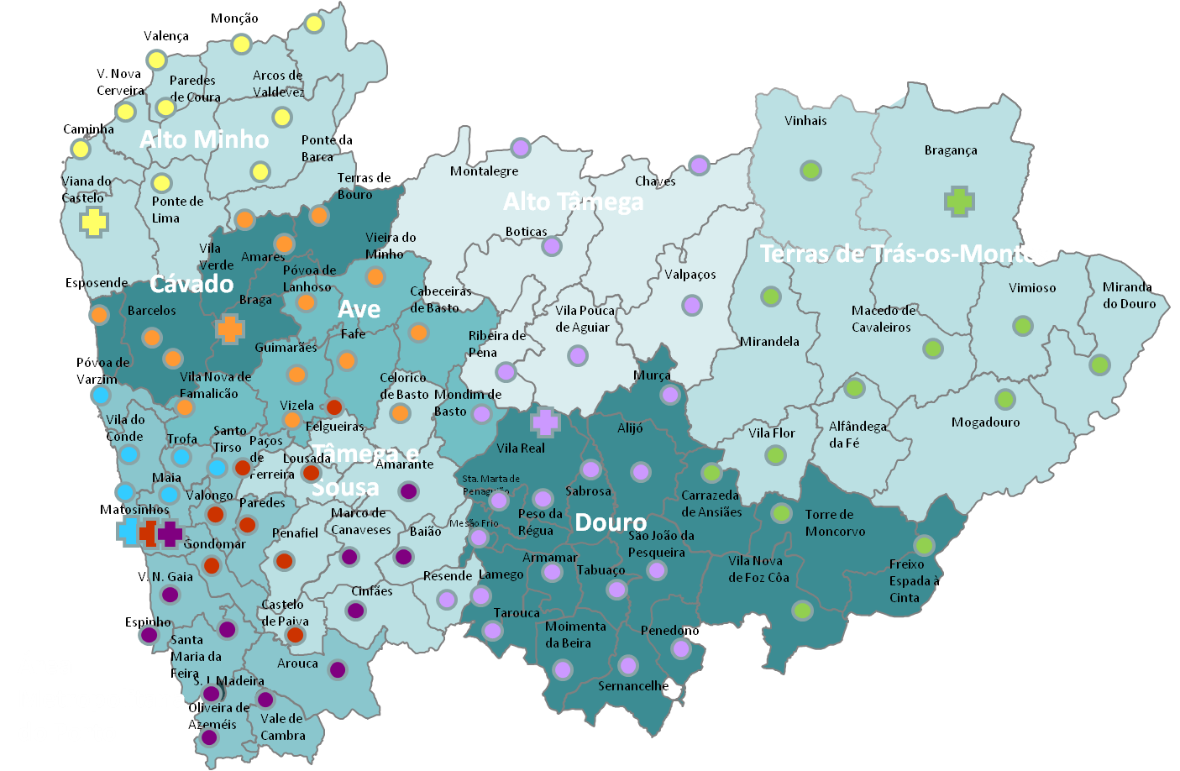
HEALTH SERVICE NETWORK NORTHERN PORTUGAL
Hospital
Primary Health Care Unit
 | CRI Braga
 | CRI Viana
 | CRI Bragança
 | CRI Porto Central
 | CRI Porto Ocidental
 | CRI Porto Oriental
 | CRI Vila Real
Notes:
Primary health care services
Specialized intervention centres for alcohol and drugs
Hospital services

Slide 4
LEVEL I
LEVEL II
LEVEL III
INTEGRATED RESPONSE CENTRES (PREVENTION, TREATMENT,
HARM REDUCTION AND
SOCIAL REHAB)
EMERGENCY ROOMS
MENTAL HEALTH SERVICES (HOSPITAL)
PORTUGUESE HEALTH SERVICE REFERRAL NETWORK FOR PEOPLE WITH ALCOHOL AND/OR DRUG CONSUME
HOMELESS PERSON
INPATIENT TREATMENT CENTRES/ THERAPEUTIC COMMUNITIES
Primary Health Care Services
ALCOHOL TREATMENT CENTRE
OTHER MEDICAL SERVICES (HOSPITAL)
INPATIENT DETOXIFICATION UNIT
ALCOHOL TREATMENT CENTRE
Outreach Services
Non-residential services
Other NGO and Assotioations
(SICAD, 2014)
Notes:
Level I: Alarm signs like behaviour change, somatic pathologies, or even disfunctional patterns of use (low risk and risk)
Level II: Situations in which it becomes evident that there ar negative consequences of the drug/ alcohol use (health, familiar, social comorbilities): abuse, or even dependency
Level III: Dependency and/or severe comorbility

Slide 5
HOMELESS PEOPLE WITH SUBSTANCE ABUSE: PREVENTION, TREATMENT, SOCIAL REHAB AND HARM REDUCTION
Planning integrated intervention of DICAD units/ teams

Slide 6
Typology of people at risk of homelessness in Portugal (ENIPSSA, 2018)
ENIPSSA, 2018

Slide 7
Sistema de Informação Multidisciplinar (SIM)
Notes:
Mapa região Norte com as unidades!

Slide 8
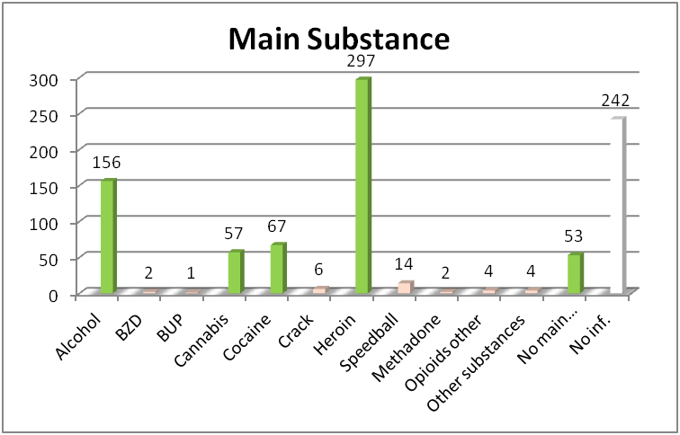
Sistema de Informação Multidisciplinar (SIM)
Notes:
Mapa região Norte com as unidades!

Slide 9
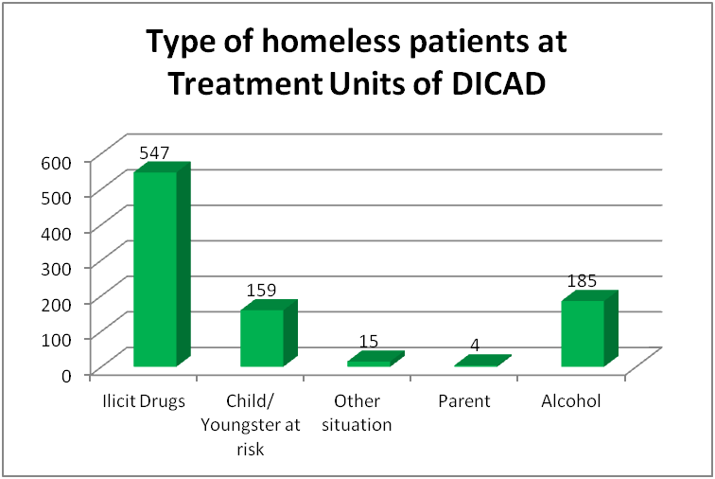
Sistema de Informação Multidisciplinar (SIM)
Notes:
Mapa região Norte com as unidades!

Slide 10
Ongoing Interventions
Supervised drug consumption facility in Porto (harm reduction)
Cofinanced outreach and residential services (harm reduction)
Training for professionals and peer groups (harm reduction)

Slide 11
Recommendations
Use of ENIPSSA risk typology for adequate and eficient referral to health services network (prevention)
Strenghthen articulation of health and social security services (bottom-up) to improve social reintegration and housing (residential services)
Give people with gambling and gaming disorders the same opportunities (prevention, treatment)
Joint Action Plan for Metropolitan Area of Porto (political and technical stakeholders)

Slide 12
Thank you!
kerstin.hoffmeister@arsnorte.min-saude.pt
http://www.arsnorte.min-saude.pt

