Slide 2
ENIPSSA 2017-2023 The Portuguese National Homelessness Strategy
Isabel Baptista
European Observatory on Homelessness

Slide 3
OVERVIEW
From 2009 to 2017 – lessons from a winding trajectory
The National Strategy for the Integration of People Experiencing Homelessness 2017-2023 – from continuity to innovative elements
Key implementation steps
Challenges ahead

Slide 4
From 2009 to 2017 – lessons from a winding trajectory
ENIPSA 2009-2015 – a breakthrough in Southern European approaches to tackling homelessness
Lessons-learnt from both successes and failures as a solid basis to re-launch the policy making process
The role of civil society organisations and the emergence of a “welcoming” political agenda facilitated by personal and institutional engagement at the highest political level

Slide 5
The National Strategy for the Integration of People Experiencing Homelessness 2017-2023 – from continuity to innovative elements
The new S – preserving the initial vision and main principles
The definition – evolving understandings of homelessness in Portugal
The approach – embracing EU evidence-based perspectives
Strategically addressing homelessness: i) knowledge; ii) intervention; iii) coordination, monitoring and evaluation
Innovative elements – developing a clear legal framework, reinforcing the housing dimension, strengthening the governance structure and enhancing accountability.

Slide 6
ENIPSSA 2017-2023 KEY IMPLEMENTATION STEPS
Wide dissemination of the National Strategy’s definition of homelessness (80% of the municipalities use the official definition)
Building up of a common statistical reference for the collection and monitoring of data on homelessness
Launching of a national wide survey aiming at identifying existing local information on homelessness situations based on the full range of ETHOS Light categories
Regular survey to be carried out on an annual basis aiming at identifying the total number of homeless people (ENIPSSA definition), and their main characteristics

Slide 7
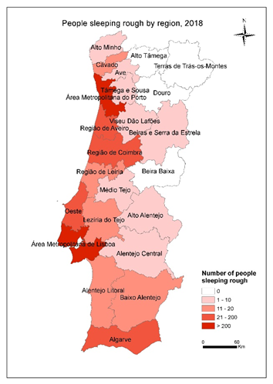
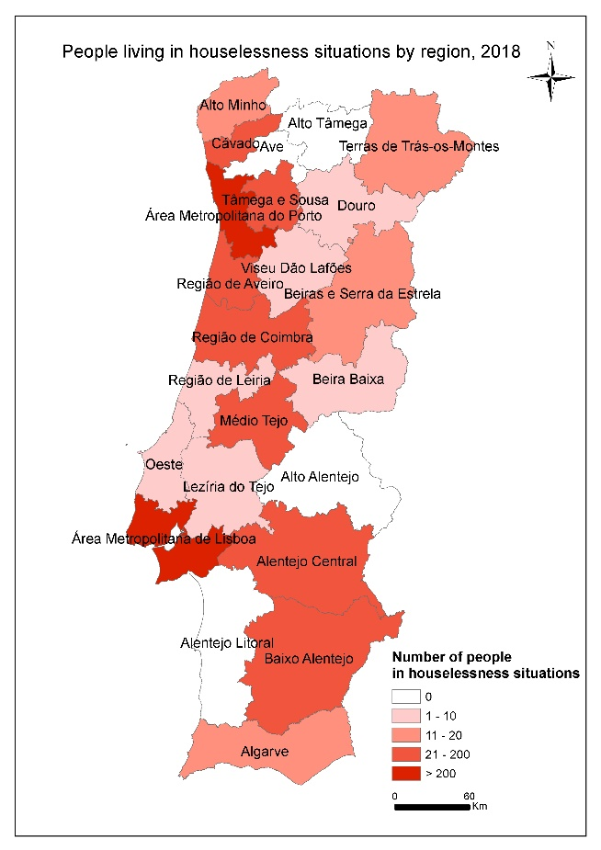
People sleeping rough and people living in houselessness situations by region in mainland Portugal, 2018
3,396 people either roofless or houseless
1,443 people sleeping rough
1,953 people in different forms of temporary accommodation
11,113 people living in some form of insecure or inadequate situation (risk categories)

Slide 8
ENIPSSA 2017-2023 KEY IMPLEMENTATION STEPS
Signature of a tripartite protocol aiming at establishing a partnership for promoting increased permanent housing solutions for homeless people, through the celebration of lease contracts
Establishment of a dedicated working group on health aiming at the definition of access and referral procedures to all levels of health care services
Development and piloting of a training programme targeting professionals of the Local Homelessness Units
Development of guidelines for the identification of homelessness risk situations
Setting up, launching and regular updating of a dedicated ENIPSSA webpage
Setting-up and operation of the Interministerial Committee
Strengthening the representation of the NPISA within the GIMAE structures, based on a proposal by the existing NPISA representatives
Organisation of the first national seminar of the local homelessness units

Slide 9
CHALLENGES AHEAD
Strengthening the production of regular, reliable and robust data on homelessness
Reinforcing the role of housing support services in tackling and preventing homelessness by prioritising housing solutions that promote access or maintenance of permanent accommodation
Enhancing the provision of comprehensive and flexible support according to people’s support needs
Critically assessing and revising the existing funding model for service provision, ensuring that it enhances organisational cooperation and the integration/complementarity of services, rather than competition

Slide 10
CHALLENGES AHEAD
Enhancing the level of commitment of all public authorities in the implementation of the ENIPSSA
Ensuring a clear allocation of resources enabling the implementation of the ENIPSSA activities and their actual effectiveness
Comprehensively integrating homelessness into the new basic law on housing
Ensuring that homelessness is carefully considered in any efforts to correct the imbalances of the housing market in Portugal

Slide 11
THANK YOU OBRIGADA
Isabel Baptista
imrpsb@gmail.com

