Slide 1


Slide 2

Better Health – for all?
“We are inviting the most vulnerable EU migrants to EU funded projects – but what's next?”

Slide 3

Better Health I & Better Health II
Better Health was a FEAD funded project between 2015 – 2018
Better Health II have started in January 2019 and will continue to at least December 2020
The basic idea is that vulnerable EU migrants staying in Gothenburg and Stockholm shall get information and support about health
The main target group are women but in the new project we also address men but we always meet men and women in separate groups
Better Health II also work transnational with strategy workshop’s

Slide 4
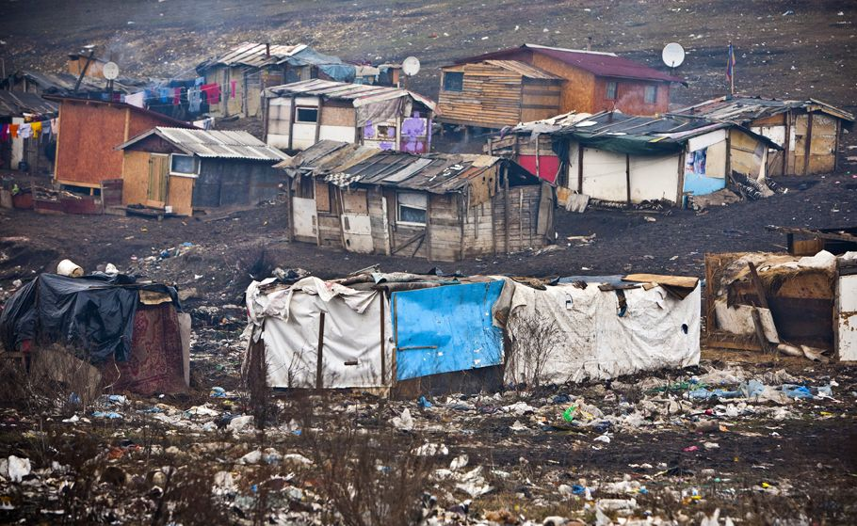
From one poverty…
Discrimination and poverty in eastern Europe force many groups to try to found an income in western Europe
The most vulnerable groups don’t even have the possibility to try to travel abroad

Slide 5
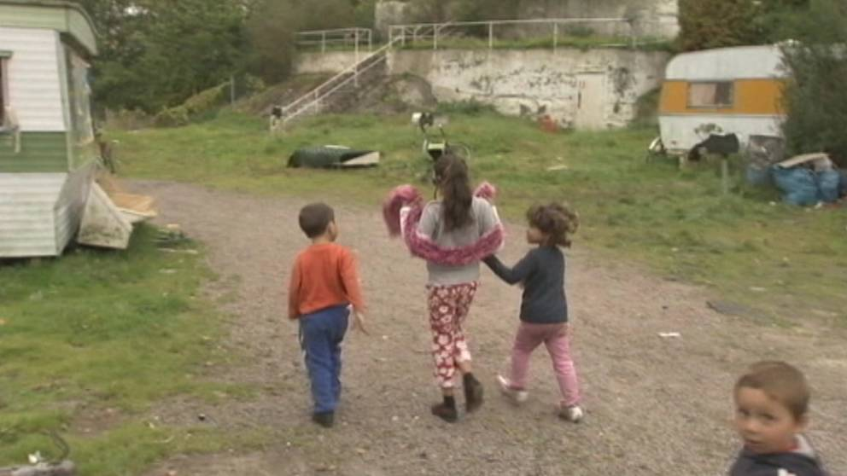
…to another poverty
But the possibilities to get a job or a roof over your head is also very poor in Sweden when they try to come here
The discrimination and poverty, risk of trafficking or other kinds of exploitation is huge

Slide 6
Transnational news in Better Health II
Better Health II use the arena of trust that we built together with the EU migrants, the Salvation Army, the health experts and the project personal
Next step is to go to the towns in Romania and Bulgaria where the groups have their roots, try to have a critical friend meeting and a workshop with the administrations of social welfare and planning and to have empowerment meetings with the local community of Roma and other excluded groups
First two meetings is planned for 2019 and at least two more for 2020 and we expect to continue the dialogue over skype and hopefully more meetings to come

Slide 7
Are we naive?
We believe that things can change and to make that happen you have to take an active part of the change itself
The more organisations; global, national and local authorities, NGO’s, EU institutions that work against discrimination and poverty the bigger success factor we will reach
It will take time, it will not be a project result where everyone live happily ever after, but all effort matters and everyone have a choice to take an active part in human history and social development or not

Slide 8
Close history
The first families from eastern Europe that came to Gothenburg 2007
Many of these families live and work in Gothenburg today and a few have travelled back to their home villages
2011-2012 a larger group of EU migrants starts coming to Swedish cities and their main income is begging
The politicians in Sweden tries different paths to stop begging but so far there is no change
If you don’t address the real problems of poverty and discrimination nothing will change

Slide 9

Believe in the possibilities of change
Domestic Roma in Sweden have been discriminated through history without possibilities to have there own homes, always forced to move and always excluded from democratic and human rights
But the laws have been rewritten, the national white paper where the government confessed what they have done through history have been published
In Gothenburg we have had an ESF project with an education and an exhibition about the discrimination of Roma’s but also on Roma culture and history
Today they have their own citizen office for information and help

Slide 10
ESF+
What it should be:
Risks that it will be:
What we need is possibilities to work with the inhabitants that actually are present in our cities.
We need to address all kind of social problems not only the labour market issues.
Homelessness and housing should be the main priority - the base for human dignity is to have a descent place to call home.
One fund but no possibility to work cross sectoral – still boxes with no possibility to be innovative for real.
Still target groups that exclude groups from participating.
Lack of transnational possibilities
Local problems will not be addressed in the calls for proposals the way we need.

Slide 11
Better Health
Louise Stiernström
Developing Manager for International Affairs
louise.stiernstrom@socialresurs.goteborg.se

