Slide 1

Learning About Europe’s Biggest Ethnic Minority - The Roma
5 Modules:
Roma history and discrimination against Roma in Europe: then and now
The role of the Roma civil society in upholding Roma rights
Intersectional oppression experienced by Roma women and LGBTI
Roma in migration: Experiencing poverty and homelessness
Good practices and projects in supporting Roma mobile EU citizens experiencing homelessness
This material has been prepared by Marina Csikós (csikosmarina1993@gmail.com) in the context of PRODEC project.
April 2023
Notes:
Hello and welcome to our newest tool for professionals supporting destitute mobile EU citizens.
This is a series of five training modules focusing on Roma history and culture, designed for professionals working to protect and promote the rights of destitute mobile EU citizens, among who many have a Roma background. Each module focuses on a particular topic.
The first covers the history of Roma and the discrimination they have faced in the past and at present. Module number two explains the role of Civil Society Organisations in upholding Roma rights. The third deals with the intersection of being Roma with other factors of discrimination, like gender and sexual orientation. Module number four goes deeper on the particular challenges that Roma who migrate to other European countries are faced with. Finally, the last of these modules presents good practices in supporting Roma mobile EU citizens who are experiencing homelessness.
We hope you will enjoy the modules and find this tool useful!

Slide 2
Module 1
Roma history and discrimination against Roma in Europe - then and now
Notes:
In this first module, we will address the discrimination that Roma people have faced in the past, and that they continue to face now. To this end, an overview of Roma history will be provided.

Slide 3
Who are the Roma?
“The term ‘Roma’ refers to Roma, Sinti, Kale and related groups in Europe, including Travellers and the Eastern groups (Dom and Lom), and covers the wide diversity of the groups concerned, including persons who identify themselves as gypsies.” - (CoE Glossary of Terms relating to Roma, 2012)
Roma/Sinti/Kale as ethnic group vs. others who sometimes share same lifestyle but do not have same ethnic origin or language – e.g. Yenish and Irish Travellers
Europe’s largest minority → 10-12 million Roma estimated in Europe (6 million est. within EU) - however, in many countries collecting data on ethnic origin is not allowed
Notes:
Firstly, who are the Roma?
“The umbrella term “Roma” refers to Roma, Sinti, Kale and related groups in Europe, including Travellers and the Eastern groups (Dom and Lom), and covers the wide diversity of the groups concerned, including persons who identify themselves as gypsies” (CoE Glossary of Terms relating to Roma 2012).
The European Commission currently uses the following definition: “The reference to ‘Roma’, as an umbrella term, encompasses a wide range of different people of Romani origin such as: Roma, Sinti, Kale, Romanichels and Boyash/Rudari. It also encompasses groups such as Ashkali, Egyptians, Yenish, Dom, Lom, Rom and Abdal, as well as Traveller populations, including ethnic Travellers or those designated under the administrative term ‘gens du voyage’ and people who identify as g*psies, Tsiganes or Tziganes, without denying their specificities”.
Roma are Europe’s largest minority. An estimate of almost 10-12 million Roma live in Europe, 6 million of which live within the EU. However, it is difficult to know the precise number since collecting ethnic data can sometimes be challenging. Some of the challenges may result from:
Fear that ethnic data will be misused and can cause harm for the Roma community; a fear deeply rooted in historical persecution. For instance, during the WWII national state institutions (such as schools, hospitals, and municipalities) collected data about their Roma citizens, which was later used to deport and kill them.
Roma people many times have strong national identities as well (Bulgarian, Romania, etc.) and when declaring their identities they do not include Roma as an ethnic identity.
Some countries do not see the importance of collecting ethnic data at national level.
For more information: http://www.errc.org/cikk.php?cikk=1935

Slide 4
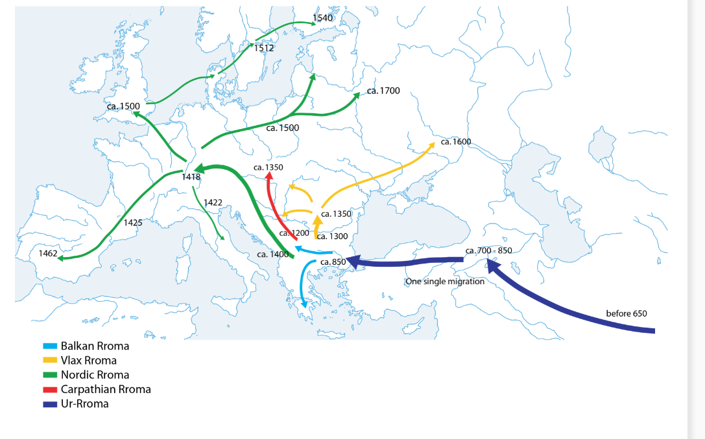
Notes:
The Romani people’s Indian origin is uncontested. By analysing Romani, the language of the Roma, and comparing it with other languages, it could be shown that the Roma migrated from Central India to the Eastern parts of Northern India, and probably stayed there for some time. Then, they possibly moved via Persia and Armenia to the Byzantine Empire, to Asia Minor and later on to Greece.
Linguistic findings point at a fairly homogenous group which arrived in the Byzantine Empire, because all groups of Roma existing today have a common linguistic basis, which also includes parts of lexicon and grammar taken from Greek language. Also, according to more recent preliminary findings of population genetics, the Roma’s ancestors were Indian. These were supposedly part of a relatively small homogenous group, as shown by analyses of blood groups. Differentiations within this group probably only occurred at the time of their arrival and their early spread into Europe.
The Romani language has many features of the so called Central Indo-Aryan languages, like Hindi-Urdu, Panjabi, Gujarati or the Rajasthani group, but it also shares features with Northern Indo-Aryan languages like Kashmiri. Based on this and other considerations, it has been concluded that the Roma’s ancestors originally lived in Central India. The precise time when the Roma left India is unknown. Linguistic data cannot provide precise dates, and there are no contemporary documents about the Roma’s migration through the Middle East.
Image: https://rroma.org/roma-history/migration-map/

Slide 5
Marginalisation of Roma over the centuries: Becoming the Other
Homogeneity of European societies until the 10-12th century
Growing tendencies of migration across countries and continents (arrival of Roma to Europe)
Roma becoming the Other – early marginalization practices
Notes:
When discussing discrimination, it is important to underline the historical processes that led to the structural and deep-rooted racism against Roma within current European societies.
Until the 10-12th century, European societies (at this time we cannot talk about nation states yet) were quite homogenous. However, due to different developments such as wars, persecution, and developing travel routes, migration across continents (in the case of Roma from Asia to Europe) started to take place.
When Roma started to arrive in Europe, people did not know where they came from, and did not understand their language(s). They looked somehow different from what Europeans were used to. Roma people immediately became ‘the Other’. At this time, we cannot talk about racism yet, since ‘race’ as a concept was not used until 16th century. However, discrmination based on visible racial features, differences in lifestyle, language, culture, etc., hugely contributed to racism later.
While some people appreciated the different skills Roma brought to their communities, in general Roma were not welcomed in the European societies. They were pushed to live in the worst places, could not enter villages without special permission, and, in general, were not provided with the same rights as the local population. Anti-Roma laws were implemented across Europe, as we will show in the following slides.
Becoming the Other essentially meant being pushed to the margins of society. Therefore, when we want to understand the current situation of the Roma, and why poverty and marginalisation are still huge problems, we have to take into consideration the discrimination and oppression that Roma communities have been facing for many centuries.

Slide 6
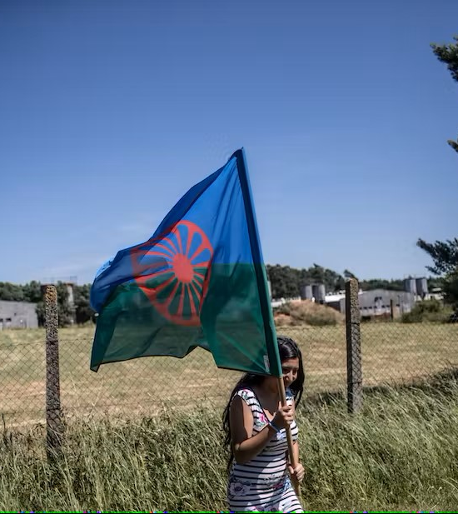
Marginalisation of Roma over the centuries: anti-Roma laws & policies (I)
18th century – internment in Spain
Forced assimilation laws in Austro-Hungarian empire
Slavery of Romani people abolished mid-19th century in Romania; deprivation and possession of land
Second wave of migration – second half of 19th century Roma groups from Central and Southeast Europe moved to all regions of Europe and overseas
Notes:
To better understand the historical discrimination and oppression of Roma within Europe, the following slides will present different anti-Roma laws and policies adopted across European countries throughout different periods of time.
In Spain, the persecution of the Gitano culminated with what is now referred to as the Great “G*psy” Round-up or “The Black Wednesday”, a day when more than 10,000 Roma were rounded up in a well-planned military-police action in 1749. The purpose, according to a leading clergyman who advised the government, was to “root out this bad race, which is hateful to God and pernicious to man”. The result was devastating – deportations, detentions, forced labour, and killings which destroyed much of the original Roma culture. For more information: https://rm.coe.int/the-great-g*psy-round-up-in-spain-factsheets-on-romani-history/16808b1a7d
Forced assimilations in the Austro-Hungarian Empire happened during the 18th century, when rulers applied a policy of enforced assimilation. Among the measures applied during this period, Roma children were taken from their parents, and no Roma was allowed to marry another Roma. The Romani language was banned. This last policy was brutally enforced and use of the language was punishable by flogging. For more information: https://rm.coe.int/austro-hungarian-empire-factsheets-on-romani-history/16808b19ed
Photo source: A woman holding a Roma flag, at a protest in Lety, Czech Republic, the site of World War II Romani genocide. Martin Divisek/EPA (https://theconversation.com/anti-roma-stigma-of-czech-president-milos-zeman-threatens-progress-over-romani-rights-88437)

Slide 7
Marginalisation of Roma over the centuries: anti-Roma laws & policies (II)
Second wave of migration – second half of 19th century Roma groups from Central and Southeast Europe moved to all regions of Europe and overseas
Roma Holocaust – Porajmos (Genocide of the Roma in Romani language)
Situation of Roma under communism
Forced sterilizations - Norway, Slovakia, Hungary
Third wave of migration – collapse of Soviet Union & former Yugoslavia → east-west migration of Roma as victims of war, poverty driven migration → recent waves branded as “economic refugees”
Notes:
In the mid-19th century, a second migratory movement took place, which changed the Roma population worldwide. Kalderaš, Lovara and other Roma groups from Central and South-Eastern Europe moved east and westward and even reached America and Australia. This second migration, so-called after the first wave of Roma migration in Europe around the year 1400, was caused by far-reaching social changes, particularly the abolition of slavery in Wallachia and Moldavia, and emerging industrialisation. For more information: https://rm.coe.int/second-migration-factsheets-on-romani-history/16808b1a86
Roma oppression and assimilation continued under communist leadership.
The end of the Second World War saw the emergence of what was officially called the “Socialist Bloc” over a large part of Europe, where a considerable number of European Roma lived. In line with the new communist ideology, overall social and economic changes took place in these countries, affecting the entire population, Roma included. Despite the common ideological parameters, the policies towards “g*psies” were not identical across countries but based on historical models and on national strategies. The main aim was integration into society, which in some countries reached the stage of striving towards assimilation. In most countries, the so called ‘integration’ has resulted in a partial or total lost of Roma identity and ethnic and cultural characteristics, as any manifestation of this was prohibited, including speaking Romani.
For more information: https://rm.coe.int/state-policies-under-communism-factsheets-on-romani-history/16808b1c58

Slide 8
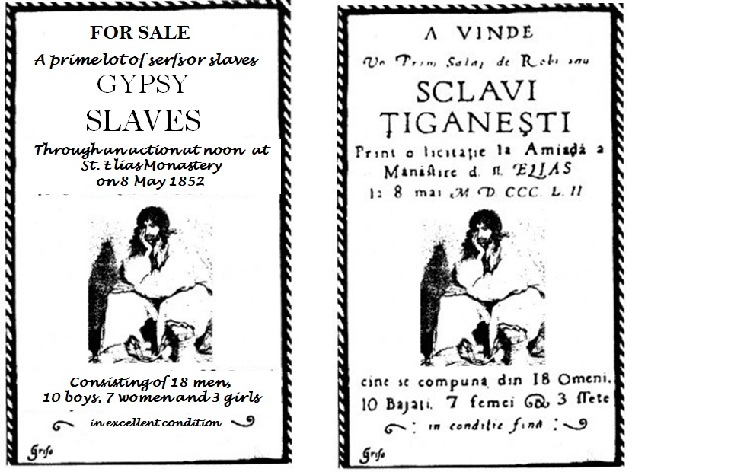
500 years of slavery in Romania (I)
Europe as the origin of slavery?
“There was slavery only in the U.S.” - European Exceptionalism
500 years-long slavery of Roma people in Wallachia and Moldavia (in today’s Romania) begins around the 14th century
Roma slave owners were the Crown (the state), monasteries (the Orthodox church) and the nobility (or the boyars)
Notes:
Unlike in any other European regions, the Roma in former Wallachia and Moldavia (today‘s Romania), have lived in slavery for five hundred years. Contrary to the theory that slavery existed only in the U.S., the history of Roma migration into Europe was abruptly brought to a halt for those who arrived in the Romanian territories of the Southern and Eastern Carpathian Mountains. Roma who arrived in Wallachia and Moldavia in the second half of the 14th century were forced into slavery for five centuries, and their history was marked by a turning point comparable only to the enslavement of the Afro-American population in the United States.
“g*psies shall be born only slaves; anyone born of a slave mother shall also become a slave…” stated the code of Wallachia at the beginning of the 19th century. Roma were owned by the Crown (as “slaves of the State” – “țigănia domnească”), monasteries and private individuals who were from the nobility or so-called boyars. Selling, buying, and giving away whole families of Roma was common practice among the owners, who had unlimited rights over their slaves.

Slide 9
Status of the Roma slaves
Romanian law and slaves’ law were two different entities. Slaves had their own legal status that was different from that of the Romanian population. Slaves’ law consisted of numerous norms that referred chiefly to the obligations of slaves to their master and to the State.
Slaves did not have the right to defend themselves before a tribunal and at the same time they could not be held legally responsible for damages caused to freemen, for which their masters were accountable.
In cases where a master killed somebody else’s slave, the former offered the injured party a slave in place of the one he had killed.
Slaves, theoretically, had no property of any kind; they were properties and belonged, with everything they had, to their master.
Notes:
In the early 19th century, the Moldavian Civil Code was designed primarily to guarantee the master’s rights over the slave. Chapter II of the Code provided that “there can be no legitimate union between free men and slaves”, and the slaves’ masters decided on the “most suitable” time and person for their slaves to be wed. Slaves were usually married very young, so as to have many children and increase the master’s wealth. If slaves escaped from a bad situation, the “slaves’ masters and their legitimate heirs, according to the custom of the country, always have the right to claim runaway slaves, from anyone, for there is no period of limitation for slaves in Moldavia”.
The Code of Wallachia, although more concise, contains the same principles: “g*psies shall be born only slaves; anyone born of a slave mother shall also become a slave; the master shall have no rights over his slave’s life; the master’s rights over the slave shall be confined to selling him or giving him away; g*psies without a master shall be slaves of the prince; marriage shall be recognised among slaves; a separation shall be declared when a marriage takes place between a slave and a free man without the master’s knowledge” .
These were the main conditions set down by the law until the abolition of slavery in the two Romanian principalities.

Slide 10
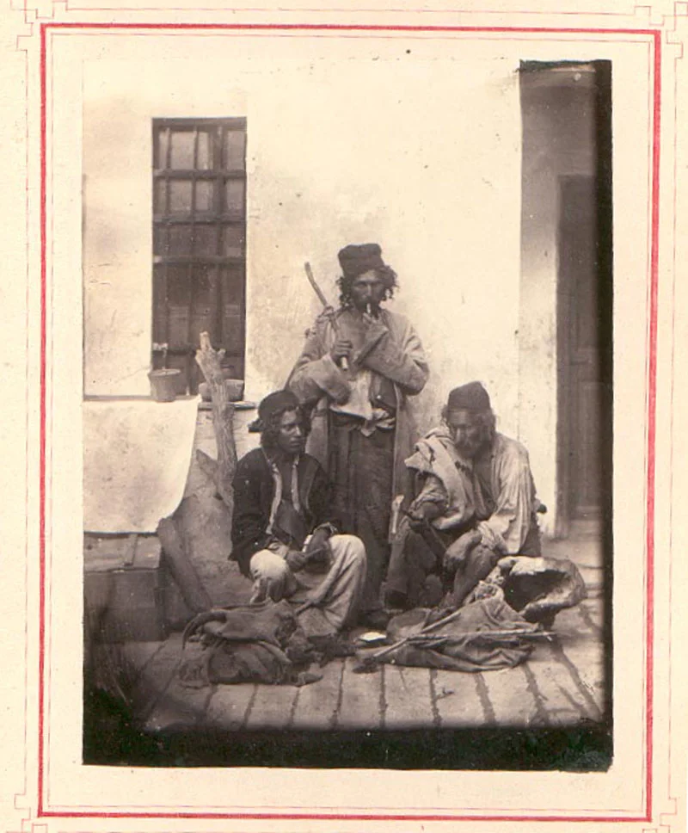
500 years of slavery in Romania (II)
Treating Roma slaves as materials/animals – inhuman conditions
Abolishment of the slavery – starting with middle of the 19th century
The abolition of slavery was done with compensation of the owners, while the newly freed people were left to wander.
→ exploitation of the Roma workforce
Source: https://www.europeana.eu/en/blog/roma-slavery-in-romania-a-history
Notes:
Towards the middle of the 19th century, an abolitionist movement emerged in Europe, joined by the young Romanian elite; the figure of the “g*psy” became a frequent subject in newspaper articles, poetry, literature, and plays while European intellectuals drew attention to the plight of slavery within the continent. Influenced by the wider access to education in the Principalities, as well as an increasing number of Romanians studying abroad, particularly in France where they were exposed to the French revolution ideas, at their return Romanian young nobility initiated the abolishment of slavery in the 1840s. The transition was slow and even continued after 1856, the year of the formal abolition.
Once the emancipation of slaves had been achieved, it raised – and still raises today – the issue of Roma people’s integration into the social and economic life of Romania.
Traces of slavery persisted in the memories of former masters and their slaves, and the period of slavery has marked relations between the descendants of these two social strata to this day. Furthermore, the abolition of slavery was done with compensation of the owners, while the newly freed people were left to wander – many returned to work for their former owners as they had no other means to support themselves. This resulted into exploitation of the Roma workforce.
In the mid-19th century, when slavery was officially abolished, a large number of Roma left the country and migrated to Central and Western Europe as well as to America.

Slide 11
Justification of Roma slavery
Economic:
Roma people were considered a very important source of income, and their skills in working with metals, wood and other materials were used by their masters.
Religious:
People with Roma background were often not considered Christians, therefore being included in the category of 'foreigners/enemies' together with pagans, Muslims and Jews.
Notes:
Scholars have analysed the history of slavery in Romanian Principalities, trying to identify how and why Roma were enslaved. Though there are different theories formulated, we find the following two explanations pertinent:
Firstly, the economic explanation that Roma people were considered a very important source of income. “Roma were the only ones who worked best with metals, wood and other materials in a professional manner.”
Secondly, the orthodox church and religion is considered to have played a major role. According to Roma historian Petre Petcuţ, the Orthodox Church played a crucial role in what he calls the “birth of the institution of slavery” in the Romanian principalities by exploiting the status of Roma as a highly skilled workers who were newly arrived in the territory, thus seen as outsiders, and especially not Christians (Petre Petcut, Roma: Slavery and Freedom, National Roma Culture Center, 2015).

Slide 12
The Genocide of the Roma during WWII - Porajmos 1935: Nuremberg Racial Laws and radicalisation of anti-Roma policy
Holocaust: 500,000 - 1.5 million Roma exterminated.
The ‘Law for the Protection of German Blood and Honor’; ‘The Citizenship Law’. Roma not mentioned explicitly in the main text but in the implementation decrees that followed the laws (Hans Globke).
March 1938: First official mentioning of “the final resolution of the g*psy Question on racial lines” (Werner Best, Head of Gestapo).
8th December, 1938: Himmler’s Decree for Combating the g*psy Plague.
“It is…necessary that in the final solution of the g*psy question racially pure g*psies and Mischlinge be treated differently”
Roma persecuted after 8th December, 1938 = “racially persecuted” according to German law.
Notes:
Roma persecution under the Holocaust resulted in between 500,000 - 1.5 million victims.
During 1939-1940, Reinhard Heydrich organised a series of conferences for the SS officers and police chiefs “in order to establish similar procedure for all units involved in carrying out the resettlement programmes decreed by Hitler”, in consequence of which “in short time the g*psy Question as regards Greater Germany will be radically resolved.” In 1940 deportations to the occupied territories of Poland (2,500 German Sinti and Roma) started, and were later postponed. Deportees who did not manage to escape were murdered in summary executions in 1942-1943.
In 1941, the deportations of the Austrian Sinti and Roma to the Jewish ghetto (a total of 5,000 persons) took place. In the ghetto, 500 persons died of typhoid. In January 1942, the remaining Roma were killed in Chelmno (Kulmhof) death camp by carbon monoxide in specially adjusted vans.

Slide 13
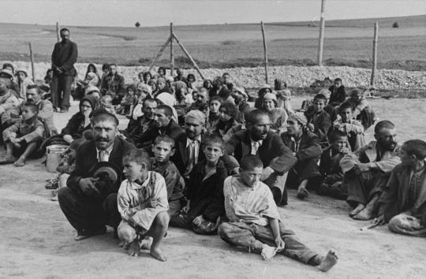
1943: Mass murder of Roma in Auschwitz
23rd March, 1943: ca. 1,700 Polish Roma transported from Białystok were murdered. These Roma had not been registered as prisoners of the camp. In February 1943 they were sent to barracks 20 and 22 of the Zigeunerfamilienlager which were isolated from the rest of the camp. They were murdered mostly in the gas chamber and crematorium II in Birkenau.
25th May, 1943: 1035 persons were murdered (507 men and 528 women). They were Polish Roma from the Białystok region and Austrian Roma/Sinti brought to the Zigeunerlager on 12th May, 1943.
Notes:
Several events lead to the mass murder of Roma in Auschwitz. On 16th December 1942, Himmler’s “Auschwitz Decree” was issued announcing deportations of German Sinti and Roma to Auschwitz. This was followed by a similar decree regarding Sinti and Roma from the Protectorate of Bohemia and Moravia, occupied Poland and Western European countries. The decrees also contained exemptions: “racially pure” Sinti, Sinti and Roma legally married to persons “of German blood,” “socially adjusted Sinti and Roma.” The exempted (except the “pure”) were to be sterilized.
On 15th January 1943, a conference took place at the main office of Criminal Police regarding the implementation of the Auschwitz Decree in practice: deportation lists were made by local commissions which often disregarded the Decree and decided about deportation of whoever they wanted to be deported. The role of science in this decision was important, as racial scholarship produced “definitions” of Roma; according to one of them a Roma is a person who had at least one Roma great-grandparent (1/8 of “Roma blood”). In result, some people deported to Auschwitz learned that they were Roma in the moment of arrest.
The so called Zigeunerfamilienlager was the “G*psy family camp” at Auschwitz. As opposed to other parts of the camp, families were not divided; men, women, and children remained together. Their clothing, money, and baggage were not confiscated. At first, their heads were not shaved. They did not wear striped camp uniforms; on the left side of their clothing, they only had a triangle of black cloth sewn on, facing down, which was the insignia used in the camp to mark prisoners regarded by the Nazis as asocial (Asoziale). To the right of the triangle was the letter Z (for “Zigeuner”).
Image: Holocaust Memorial Day Trust | 2 August 1944: Roma Genocide Remembrance Day (hmd.org.uk)

Slide 14

16th May 1944 - International Romani Resistance Day
Intensively commemorated by Roma activists as “Romani Resistance Day” every year on 16th May
Constitutes part of the social frames of memory developed by the Roma political movement
In these frames, active resistance, the struggle of Roma and Sinti against the genocidal policies of the Nazis and their allies is emphasized
Notes:
In the spring of 1944, prisoners of the Zigeunerlager who were young, healthy and able to work began to be transferred to labor and concentration camps in Germany. During one of the selections, prisoners who believed it to be the beginning of the liquidation of the camp, decided to resist. Roma prisoners barricaded themselves in their barracks and did not come out when called by the guards who, therefore, had to change their plans.
In the next days, the selection of prisoners of the Zigeunerlager continued and the young and physically strong were chosen. Finally, this group consisted of more than 1,500 persons who on 23rd May 1944 were marched to Auschwitz I and put in blocks 9 and 10. A little over 200 persons from this group were sent to camps in Germany the following day: KL Flossenbürg (82 men) and KL Ravensbrück (144 women).
This event is currently intensively commemorated by Roma activists as “Romani Resistance Day” (16th May) and constitutes part of the social frames of memory developed by the Roma political movement. In these frames, active resistance, the struggle of Roma and Sinti against the genocidal policies of the Nazis and their allies is emphasized.
Image: 16 May 1944 – a day to remember - Roma and Travellers (coe.int)

Slide 15
Towards the liquidation of Zigeunerlager – 2nd August, Roma Genocide Remembrance Day
On 2nd August 1944, 1,408 Roma were brought from Auschwitz I back to Birkenau and made to stand by a freight train waiting at the railroad ramp bordering the Zigeunerfamilienlager on the south.
After the departure of Roma and Sinti who were able to work, the remaining prisoners (mainly women, children, and elderly) were put on trucks and brought to the gas chambers of crematorium V, where they were murdered and their bodies burnt.
2nd August 1944, 2,897 persons were murdered → latest research shows the number of victims was higher: 4,200—4,300 persons (the State Museum Auschwitz-Birkenau).
Notes:
On 2nd August 1944, 1,408 Roma were brought from Auschwitz I back to Birkenau and made to stand by a freight train waiting at the railroad ramp bordering the Zigeunerfamilienlager on the south.
After the departure of Roma and Sinti who were able to work, the remaining prisoners, mainly women, children, and the elderly were put on trucks and brought to the gas chambers of crematorium V, where they were murdered, and their bodies burnt.
Until now it has been accepted that in the night of the 2nd of August 1944, 2,897 persons were murdered. However, according to the latest research by historians from the State Museum Auschwitz-Birkenau, the number of victims was higher: around 4,200—4,300 persons.
The end of the “g*psy camp” was not, however, the end of the murder of Roma and Sinti in Auschwitz-Birkenau. On the 26th of September 1944, 200 Sinti children were deported from the Buchenwald concentration camp to KL Auschwitz and murdered in gas chambers immediately upon their arrival. In October 1944, almost 2,000 persons brought from other camps were murdered in the gas chambers. Included within this number were many Roma and Sinti who earlier had already been prisoners of KL Auschwitz. Altogether, between gas chambers, hunger, diseases, and the murderous experiments by Dr. Mengele, more than 20,000 Roma and Sinti perished in KL Auschwitz.

Slide 16
Forced sterilization practices throughout Europe (I): Forced sterilization of Roma during the WWII
Rapid development of eugenics during the Nazi ideology
14 July 1933 - Law for the Prevention of Progeny with Hereditary Diseases
Roma having DNA deformation; stopping Roma from having a growing population; medical experiments; building of the racial ideology.
Notes:
Soon after Hitler took power, the Nazis fulfilled long-held aspirations of eugenics proponents. Eugenicists believed the human race could be improved by controlled breeding. In an effort to further the Nazi vision of a biologically "pure" population and to create an "Aryan master race," on the 14th July 1933, the German government promulgated the “Law for the Prevention of Progeny with Hereditary Diseases” (Gesetz zur Verhütung erbkranken Nachwuchses). This law mandated the forced sterilisation of certain individuals with physical and mental disabilities or mental illness.
Although the law did not explicitly target the Roma, as a deeply discriminated group they were particularly vulnerable under the Sterilisation Law, and many hundreds were forcibly sterilised in the years leading up to the second world war. The number of procedures escalated after war broke out, however, and by the end of the war around 3,000 Roma had been sterilised. Several Norwegian Roma women were subjected to such abuse while in Auschwitz-Birkenau.

Slide 17
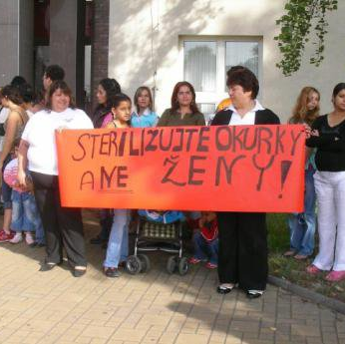
Forced sterilisation practices throughout Europe (II): After WWII
Medical mistreatments during birth giving; child-care/social worker threatening Roma women
“Cleaning of the society” in Sweden
Coercive and cruel sterilisations in the Czech Republic
Forced sterilisations have been happening in most of the European countries! - not single cases
Notes:
The forced sterilisation of Roma women continued after the war, and it is still happening nowadays. Mistreatment of Roma women based on racism is still an urgent issue in most of the European countries. Testimonies of victims and legal procedures have revealed countless cases, however it is still hard to grasp the real number. Roma human rights organisations, such as the European Roma Rights Center (ERRC), provide targetted legal support to Roma women who were victims of sterilisation.
Female sterilisation was a state policy in Czechoslovakia until 1993 when the Sterilisations Directive was abolished. However, the practice of sterilising Romani women and women with disabilities against their will did not end with the abolition of the legislation allowing it. This continued throughout the 1990s and 2000s, with the last known case occurring as recently as 2007.
The European court found that the Slovakian authorities had displayed “gross disregard for [V.C.’s] right to autonomy and choice as a patient.” The sterilisation procedure was neither immediately necessary, from a medical point of view, nor did V.C. give her free and informed consent to it. This amounted to ill-treatment. Slovakia had failed to put in place effective safeguards to protect V.C.’s reproductive health as a woman of Roma origin. The court awarded V.C. €31,000 in compensation.
https://www.coe.int/en/web/impact-convention-human-rights/-/forced-sterilisation-of-roma-woman-leads-to-stricter-rules-on-consent-to-treatment
Picture and more information: https://www.opendemocracy.net/en/can-europe-make-it/racisms-cruelest-cut-coercive-sterilization-of-roman/

Slide 18
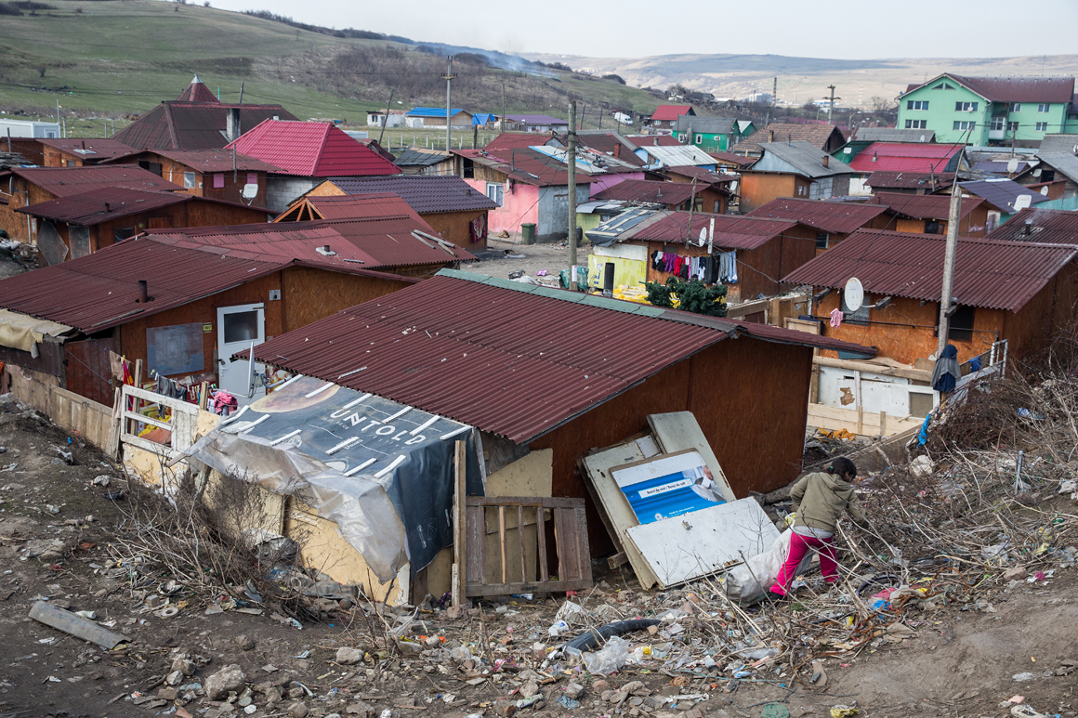
The Situation of the Roma today
80% live at risk of poverty
29% of Roma children live in households where someone went to bed hungry at least once in the previous month.
25% of Roma declared discrimination was experienced in the past year in everyday situations (e.g., looking for work, at work, housing, healthcare and education) (Fundamental Rights Agency, 2022)
10 - 15 years lower life expectancy
Infant mortality comparable with 1970s rate (European Public Health Alliance)
Notes:
The oppression and marginalization of Roma throughout centuries in Europe bears its marks on the situation of Europe’s biggest ethnic minority today: Roma people are the poorest people in all EU countries. According to the latest report from the Fundamental Rights Agency, 80% of Roma continue to live at risk of poverty across Europe.
This is a consequence of historical and ongoing acts of discrimination and segregation as explained in the previous section of this module. Institutional and every day racism continues to push Roma into deep marginalisation and denies their chance to exit destitution, preventing Roma from accessing public services on equal footing with the non-Roma.
The following slides will present the current situation of Roma communities in relation to racism, access to education, housing, employement and health.
Photo: https://ejatlas.org/conflict/pata-rat-landfill-cluj-napoca-romania

Slide 19

Harassment and Hate Crimes Against
Roma
“Until we are able to gas them like the Nazis, the Roma will infect the nation.”
(Source: https://www.dor.ro/roma-and-the-ethnicization-of-covid-19-in-romania/ )
Almost half of Roma and Traveller respondents (44%) say that they experienced hate-motivated harassment in the 12 months before the survey.
About 7% of respondents say that they were physically attacked because of being Roma or Travellers in the 12 months before the survey.
Notes:
‘Hate crime’ and ‘hate speech’ are growing problems across Europe. ‘Hate crime’ and ‘hate speech’ are ubiquitous but not (or not strictly) legal terms or concepts. Hate speech covers many forms of expressions which spread, incite, promote, or justify hatred, violence, and discrimination against a person or group of persons for a variety of reasons. Hate crime, also known as bias-motivated crime, is a criminal act motivated by bias or prejudice towards particular groups of people.
Hate-motivated harassment affects Roma at a high level - almost half (44%) of Roma and Traveller respondents to a FRA survey from 2019 declared that they experienced this in the previous year. About one in ten Roma and Traveller respondents (11%) were stopped by the police in the 12 months preceding the survey with ethnic profiling. Moreover, about 4% of the survey respondents indicate that they were physically assaulted by a police officer because of their Roma or Traveller background in the past five years.
Hate speech against Roma has been enacted at all levels in society and by representatives of national and European institutions: ANTI-ROMANI SPEECH IN EUROPE'S PUBLIC SPACE - THE MECHANISM OF HATE SPEECH. Dangerous levels were reached more recently during the COVID 19 pandemic, as reported by the United Nations.
Despite this, not reporting hate-motivated incidents is common: 93% of hate-motivated harassment and 88% of physical attacks that happened in the past five years were not reported anywhere. More than half (53%) of respondents who did not report the most recent hate-motivated physical attack believed that nothing would happen or change if they reported it. Meanwhile, 16% did not know where to go or whom to contact about it.
Photo source and more about the Dosta! Campaign on fighting hate speech against Roma: https://civicamobilitas.mk/en/vesti-od-go/let-s-meet-the-roma-through-the-campaign-dosta/

Slide 20
Antigypsyism/Anti-Roma Racism
According to International Holocaust Remembrance Alliance:
  Antigypsyism/anti-Roma discrimination is a manifestation of individual expressions and acts as well as institutional policies and practices of marginalization, exclusion, physical violence, and devaluation of Roma cultures and lifestyles, and hate speech directed at Roma as well as other individuals and groups perceived, stigmatized, or persecuted during the Nazi era, and still today, as “gypsies”. This leads to the treatment of Roma as an alleged alien group and associates them with a series of pejorative stereotypes and distorted images that represent a specific form of racism.
  (Resource: https://rm.coe.int/adi-rom-2020-27-final-antig*psyism-causes-prevalence-consequences-poss/1680a6d053)
Notes:
The International Holocaust Remembrance Alliance acknowledged that the neglect of the genocide of the Roma has contributed to the prejudice and discrimination that many Roma communities still experience today. To advance on countering such forms of racism and discrimination the IHRA adopted a definition of antigypsyism in 2020. But defining antigypsyism is not an easy task. Academics, activists, and institutions have provided different definitions, while no international definition has been legally agreed upon. A common element of the different definitions is that antigypsyism is a form of racism. However, such a definition must provide details about the content and the mechanism through which racism operates, as without such details the definition is tautological.
IHRA’s definition is a compromise between the positions adopted by participating governments in relation to the use of a historically pejorative term for Roma. While certain governments supported the use of the term antigypsyism, the delegations of US and Canadian governments insisted on using the term “anti-Roma racism”. In fact, in a footnote to the definition, the participating governments specify the geographical scope of the use of each term. This compromise led to the equating of antigypsyism with anti-Roma discrimination, which is inaccurate, as antigypsyism comprises a larger range of practices than just discrimination. One of the challenges with the definitions of antigypsyism provided by international organisations and academics is their implementation, that is, how to measure antigypsyism.
One way to define antigypsyism (as used by the author of the modules) is as a special form of racism directed towards Roma and those stigmatised in the public imagination as “g*psies”, which has at its core the assumption that Roma are inferior and deviant, thus justifying their oppression and marginalisation. Other preconceptions of antigypsyism are that they are nomadic, of oriental origin, rootless, and backward. As such, antigypsyism represents a historical system of oppression of Roma whose consequences are clearly apparent in the current difficult situation of Roma, in the dominant narratives on Roma and in the continuous stigmatisation of Romani identity in public statements.

Slide 21
The Situation of the Roma today – Education (I)
Only about half (53%) of Roma children between the age of four and the starting age of compulsory primary education participate in early childhood education. ​
On average, 18% of Roma between 6 and 24 years of age attend an educational level lower than that corresponding to their age. ​​
The proportion of Roma early school-leavers is disproportionately high compared with the general population. School segregation remains a problem in countries like Romania, Bulgaria, Czech Republic, Slovakia or Hungary.
Roma children fall behind their non-Roma peers on all education indicators. ​
Notes:
The cruel reality of today is that Roma children continue to fall behind their non-Roma peers when it comes to education, with many being denied equal access (from early childhood education to high level studies). The school environment is hostile to Roma children, teachers, and pupils rejecting them. Roma children continue to be racially discriminated in school systems all across Eastern Europe also through the physical separation, mainly by one of three means: being placed in ‘special needs’ schools; classroom segregation in the same school; or school segregation, as a result of residential segregation, where non-Roma parents do not send their children to schools within Roma populated areas. As a continuation of the history of oppression presented in the previous slides, these following factors lead to poor educational outcomes among Roma:
1. Lack of quality early childhood education services - The low educational achievement among Roma can in large part be attributed to poor quality or non-existent institutions and support for the development, care, and education of very young children. Roma chidlren face triple burden: First, they are subject to the stigma and discrimination that are associated with poor Roma communities. Second, like other young children who are dependent and voiceless, they too are most likely to have their needs and rights overlooked as countries in Central and Eastern Europe cope with social and economic transition and sectoral reform. Third, mainstream early care and educational institutions are conventionally insensitive to the cultural and linguistic background of Roma communities; this reinforces Roma young children’s exclusion from service provision, thereby deepening disparities and increasing marginalization and vulnerability. The problems are compounded by the fact that a majority of the Roma parents have themselves received an inadequate education, making them less empowered to claim the right to quality education for their own children.
Resource: Roma and Travellers in six countries | European Union Agency for Fundamental Rights (europa.eu)

Slide 22
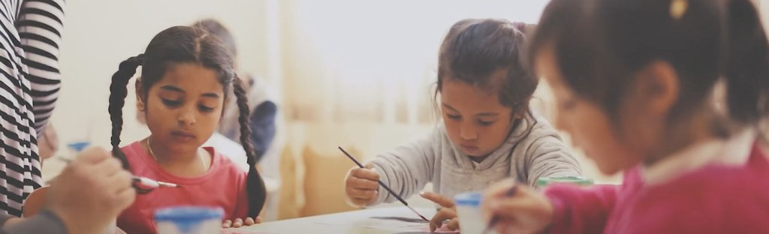
The Situation of the Roma today – Education II
  53% in Early Childhood Education and Care
  18% attend educational level lower than that corresponding to their age
  50% completed primary, 20% completed secondary
  Segregation in schooling (61%)
Notes:
2. Prejudice against Roma - Negative assumptions about the intellectual inferiority of Roma children are widespread across the region as well as disregard of parents towards education. Stereotypes held by teachers lower their expectations and inspire weaker instruction. For example, 47% of teachers in Slovakia believed that Roma children could not succeed in school, and 88% believed that Roma children are less capable than their non-Romani peers. In a survey conducted by the European Roma Rights Centre, children testified that teachers systematically ignore them in the educational process. Verbal and physical castigation of Roma classmates by majority students is not uncommon. According to a survey of Hungarian schoolteachers, Roma are the least preferred students out of all minorities. Under these conditions, it is not surprising that Roma children suffer from lower self-esteem, academic performance, enrolment and retention rates, and a poorer ability to transition between levels of education. Many Roma parents feel reluctant to send their children to school, perceiving it as a hostile place that offers little of value for their children, particularly as the high unemployment rates among their communities serve as a disincentive to the need for formal qualifications.
3. Segregation – Segregation of Roma children takes different forms. Segregation between schools means that certain schools will be dominated by Roma and other ones by non-Roma (majority) children even within one neighbourhood. In most of the cases non-Roma parents decide to remove their children from a school where there any many Roma students and enroll them into more well-developed and modernised schools (also know as the ‘white flight’ phenomenon). In these well-developed schools Roma students are not allowed to enroll and are denied to even enter the premises of the school. The Roma-dominated schools tend to be less equipped, they struggle with shortage of teachers, lack of funding. Segregation within schools means that, for example, within one common school, Roma children are denied to sit in the front rows in the classrom and are pushed to back of the classrooms or are placed in a separated section of the school (for instance in classes or on entire floors where only Roma pupils are placed).
Photo source: https://www.flickr.com/photos/193092213@N08/51468122439

Slide 23
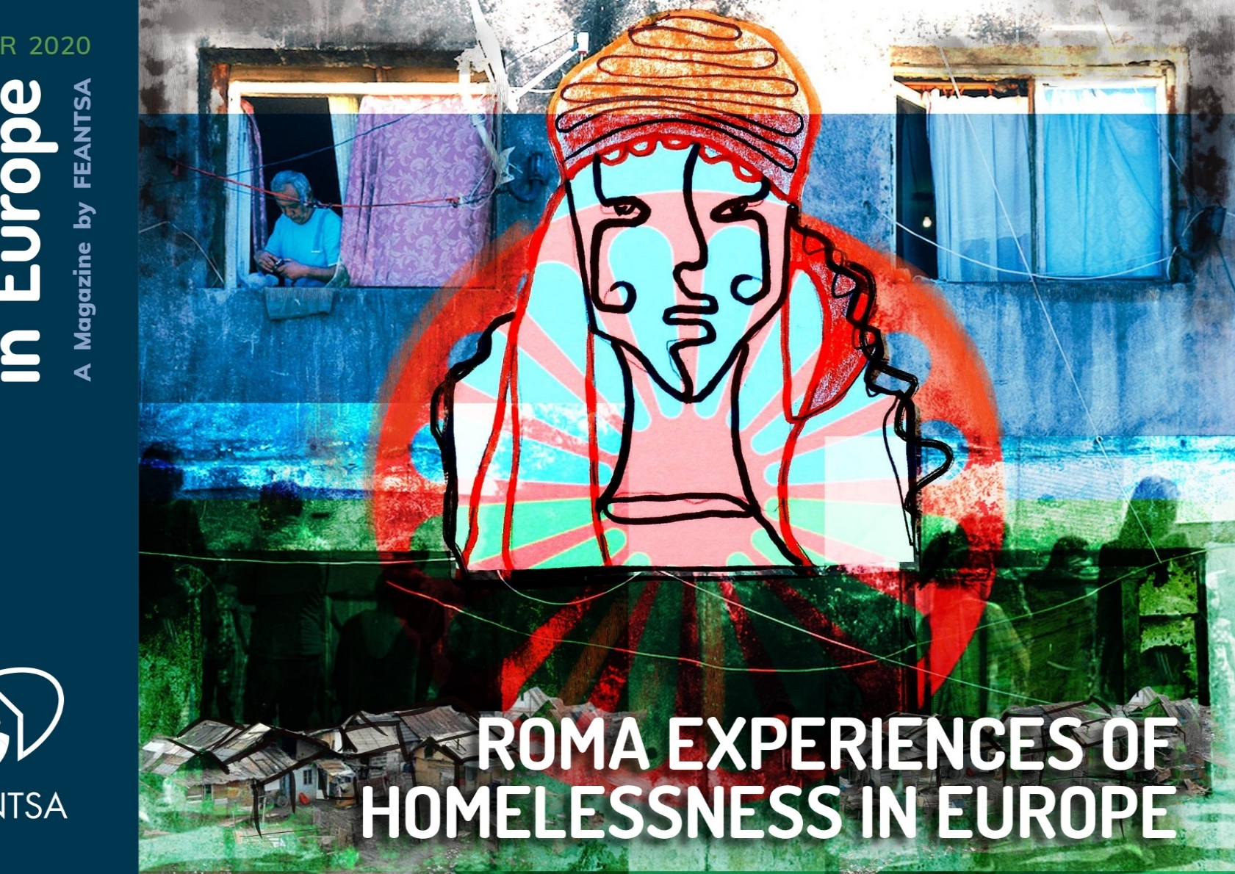
The Situation of the Roma today: Housing and Homelessness
61 percent of Roma experience housing deprivation.
78 percent of Roma live in overcrowded housing.
43 percent of Roma are discriminated against when trying to buy or rent housing.
Many Roma mobile EU citizens experience rough sleeping when arriving in a host country.
Notes:
According to the latest evaluation at EU level on Roma inclusion, housing is the area with the least registered progress in the past ten years which requires continuous investment and political engagement.
After a decade of work under the previous EU Roma framework, an evaluation of the housing situation of the Roma shows that “Especially due to inadequate and segregated housing, the housing situation remains difficult.” (source: Communication from the Commission to the European Parliament and the Council. A Union of Equality: EU Roma strategic framework for equality, inclusion and participation, Brussels, 7.10.2020 COM(2020) 620 final.)
The issues that Roma communities face with regard to housing and homelessness are complex and involve the demolition of property; the impediment of the legalisation of informal settlements; forced evictions; environmental racism; energy poverty; residential segregation; discrimination in accessing housing or housing deprivation, and overcrowding.
For more information :
ERGO Network, Snapshot on Housing and Assistance for the Homeless (2021)
FEANTSA, HOMELESS IN EUROPE MAGAZINE WINTER 2020 - ROMA EXPERIENCES OF HOMELESSNESS IN EUROPE (2020)

Slide 24
Employment
On average, 43% of Roma aged 20 to 64 in the countries surveyed were in paid work in 2021.
Only 28% of Roma women aged 20 to 64 are in employment in comparison with 58% of Roma men in 2021. This gap is similar to that observed in 2016.
The gender employment gap reached on average 31 percentage points in 2021 . This is a negative trend compared with 2016, as the gender gap was, on average, 27 percentage points in 2016.
On average, even more Roma aged 16–24 were NEET in 2021 than in 2016
One out of three Roma older than 16 had experienced discrimination due to being Roma when looking for work in the last 12 months before the study.
Notes:
According to the FRA report from 2022, the access to the labour market for Roma remains limited. On average, 43% of Roma aged 20 to 64 in the countries surveyed were in paid work in 2021 – that is, in full-time work, in part-time work, doing ad hoc jobs, in self-employment or occasional work – or had worked in the past four weeks. The situation has not changed since 2016. The majority of working age Roma in Central and South-eastern Europe do not have a job and many have been out of work for a considerable length of time. Growing numbers of Roma, especially of young people, have never had a job.
The mass-unemployment of working age Roma is most often perceived as a labour market supply - side issue and the high level of unemployment is attributed to Roma’s inability to find employment because of their low levels of education, out-of-date work skills, and detachment from the labour market. Additionally, large segments of the Romani community lost out during the economic and industrial restructuring that occurred during the transition from Communism. Undoubtedly, these factors create very real barriers that reduce employability and exclude many Roma from work. But there is another dimension to add to this: discrimination. This significantly aggravates the situation and causes systemic exclusion from employment for vast numbers of working-age Roma.
Discrimination is rejected as a major factor behind Romani unemployment, and when the issue is raised there is often strong resistance to discuss the subject or denial that the problem is sufficiently severe to demand attention. Employment discrimination against Roma is not considered a major determinant in the employment (or more importantly the non-employment) of Roma by the key actors in the labour market. Nonetheless, every third Roma older than 16 experienced discrimination due to being Roma when looking for work in the last 12 months before the FRA study.

Slide 25

Health
Roma populations have a markedly lower life expectancy than the general population in Europe: in 2014, their life expectancy was estimated to be between five and 20 years less than the average.
On average, Roma women live 11 years less than women in the general population, and Roma men live 9.1 years less than men in the general population.
On average, 75% of Roma report that they had health insurance in their country of origin, in 2021.
Roma were hit the most by the Covid-19 pandemic; resulting from the stigmatisation of Roma municipalities/police closing entire settlements, discrimination in the health care systems, lack of financial means to buy medicine, etc.
Notes:
Lower life expectancy is a huge issue when it comes to the Romani population in Europe. Due to poverty, Roma people are more subjected to difficulty when buying nutritious food or having the recommended number of meals daily. This factor contibutes to an unhealty lifestyle, which is a key reason behind lower life expectancy. Moreover, due to the mental distress which social exclusion causes, Roma people are also more likely to suffer from addictions, such as drugs and smoking.
According to the FRA Roma Survey from 2021, of those who had used healthcare services in the previous 12 months, more Roma women (16%) experienced discrimination than Roma men (13%). Respondents aged 16–24 report the lowest share (10%) of discrimination experiences when accessing health services, followed by the oldest (65+) age group (13%). Those in the 25–44 and 45–64 age groups report higher levels of discrimination (16%). Because of discrimination and centuries long mistreatment, Roma people have trust issues to turn to doctors and health care workers for help. This also contributes to hardened access to health services and a higher level of self-medication among Roma communities.
In more recent years, the Covid-19 pandemic has affected the daily lives of Roma and Travellers living in marginalised communities and suffering from social exclusion and poverty. The data collected in the FRA survey confirms that marginalised Roma and Travellers are amongst the most affected and impacted by Covid-19, mainly due to their devastating living conditions and exclusion, triggered by widespread discrimination. During the pandemic, many Roma and Travellers living in poverty found it very hard to protect themselves from getting the virus due to their lack of access to water and sanitation. This was even harder for those living in segregated and informal settlements and/or improvised shelters.
For more information on the situation of Roma in healthcare: https://epha.org/roma-health/

Slide 26
Resources
Council of Europe – Roma history factsheets
Adrian Marsh, video Roma 101: Roma Identity, History and Historiography, ERIAC, 2020
Video, Roma Slavery: History, Legacy, Reparations, Margareta Matache, ERIAC, 2021
We Call Ourselves « Roma » . Scholar Margareta Matache explains significant moments in the history of the Roma people.
Video Ian Hancock, Parrajmos: The Romani and the Holocaust with Ian Hancock, Holocaust Living History, 2014
Video, A Surge in Violence against Roma People in Ukraine, Hromadske International, 2018
Fundamental Rights Agency:
FRA Roma survey 2011
EU-MIDIS II survey 2016
Roma and Travellers in six countries 2020
ERRC:
Coercive and Cruel – Report
Report reveals that Romani Women were sterilised against their will in Sweden
Nothing About Us Without Us, European Roma Rights Center, 2015
ERGO- The impact of Covid-19 on Roma communities in the European Union

Slide 27


Thanks for reading! for further questions or comments please contact us at simona.barbu@feantsa.org
Notes:
We have reached the end of this module.
In the next module, we will go into detail about the role of the Roma civil society in upholding Roma rights.
Thank you for reading our training modules! You can find all the modules on FEANTSA’s website (insert link).

