Slide 1
Spotlight on: Germany
FEANTSA FORUM 2023:
United in Times of Crisis
Werena Rosenke, Director BAG Wohnungslosenhilfe, Berlin

Slide 2
BAG Wohnungslosenhilfe (BAG W): Structure and Tasks
Exchange between public sector and NGO-sector
Lobby for National Legislation
Social policy development für homeless
Conferences
Communication, campaigning, Public Affairs
Publications
Documentation and Statistics
Support of scientific research
International Networking

Slide 3
Organisationsstruktur BAG Wohnungslosenhilfe e.V.
Projektgruppe Migration
Projectgroup Housing First
EC Präsidium (5)
Vorsitzende/r und 4 stellvertretende Vorsitzende
korporative Verbandsmitglieder
DCV, Diakonie Deutschland, DPWV, AWO, KAGW, EBET
Hauptausschuss
(Advisory Board)
Mitglieder:
das für Sozialhilfe und SGB II zuständige Ministerium
das für Wohnungsbau und Stadtentwicklung zuständige Ministerium
Deutscher Städtetag German Association of Cities
Deutscher Landkreistag German Association of Counties
BAG der überörtlichen Träger der Sozialhilfe
Bundesagentur für Arbeit
Konferenz der Sozialminister
Vorsitzende der FA
Sprecher:innen der Arbeitsgemeinschaften
private, frei- gemeinnützige oder öffentlich-rechtliche Vereinigungen, Körperschaften, Behörden
sachverständige Persönlichkeiten
wählen
Expert Committees
Work and qualification
Personal assistance, social planning
Women's Coordination
Health
Social law
Housing
Statistics/Documentation
AC Vorstand mit
- entsandten (6)
- gewählten (6)
Mitgliedern
entsenden
berufen
entwickeln fachliche Empfehlungen, Positionspapiere etc.
wählen
AG Med Health Projects
AG SEW Inpatient facilities
FAG Partizipation
GA Mitglieder (nur juristische Personen) [230 Mitgliedsträger mit 1013 Mitgliedseinrichtungen]
Mitgliederversammlung
Geschäftsführung Director
(besonderer Vertreter nach § 30 BGB)
nimmt an den Sitzungen aller Organe mit beratender Stimme teil
Geschäftsstelle Office
Erarbeiten eigener Stellungnahmen

Slide 4

Social Media Streetwork (SoMS)
– Multilingual initial Information, Orientation and Advising in Social Media Against Marginalisation
Nationwide pilot partner project by Minor and the BAG Wohnungslosenhilfe e.V.
Part of the ESF-Plus program “EhAP Plus – Eingliederung hilft gegen Ausgrenzung der am stärksten benachteiligten Personen”
Funded by the Federal Ministry of Labor and Social Affairs & the European Union through the European Social Fund Plus (ESF Plus); co-financed by the EU Equal Treatment Office at the Federal Government Commissioner for Migration, Refugees and Integration
Project duration: 01.10.2022 – 30.09.2026
Target groups:
  Disadvantaged newly immigrated EU citizens (mainly addressed by Minor) in English, Romanian, Polish and other languages
  People experiencing homelessness and people at risk of homelessness (mainly addressed by BAG W) in German
  … and their children unter the age of 18.

Slide 5
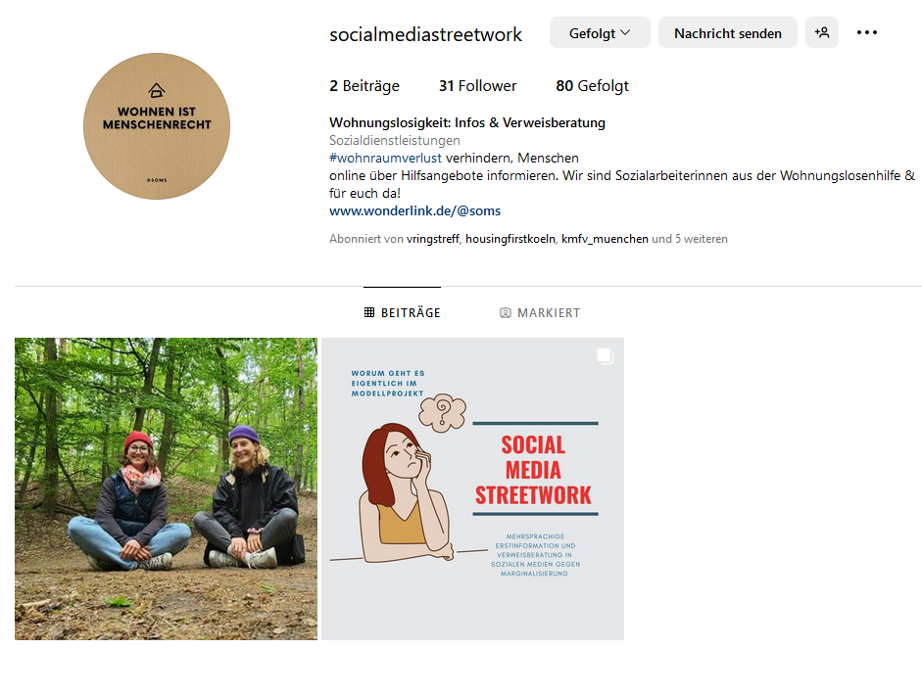
Social Media Streetwork (SoMS)
– Multilingual initial Information, Orientation and Advising in Social Media Against Marginalisation
Project idea:
  The target groups communicate actively on social media which is why they shall receive information there
  will be referred to local EhAP Plus projects and/or local help services.
  At the same time, incorrect information (“fake news”) shall be diminished.
More information: www.bagw.de/projekte/soms
You can find us here:
Instagram: @socialmediastreetwork
Facebook: @Wohnungslosigkeit: Infos & Verweisberatung –Social Media Streetwork
Questions?: soms@bagw.de

Slide 6

battered women's shelter [SOZIOL.]
Definition: All people who do not have their own rent-secured housing
(or home ownership) are considered homeless.
Estimation of the BAG W:
Germany (2020) Annual total:
Ca. 416.500 homeless people
…davon ca.:
161.000 successful asylum-seekers
255.500 in the homelessness sector
  157.000 adult man (61 %)
  78.000 adult woman (29 % )
  20.000 children, youth young adults (8 %)
  45.000 „on the streets“ (6 % )
Homeless/
Without shelter
Living on the streets
staying with friends/acquaintances/relatives
in therapeutic facilities, institutions & homes
in support services provided for homeless people in Articles 67f of Book XII of the Social Welfare Code
police-assigned or emergency accomodated
Trends and Challenges
Increase in the number of people affected
Qualitative shifts: Heterogenization of the people
Impoverishment of EU citizens living on the street
successful asylum-seekers in accomodations for refugees
in battered women‘s shelters
in (cheap)guest houses/ hostels
In temporary housings
Notes:
Folie 6
Definition: Als wohnungslos gelten alle Menschen, die nicht über eigenen mietrechtlich abgesicherten Wohnraum (oder Wohneigentum) verfügen.
obdachlos: weitläufig: Personen, die ohne Unterkunft auf der Straße oder nur vereinzelt in Notunterkünften (z.B. Angebote der Kältehilfe) unterkommen
(Aber: keine allgemeingültige Definition: im Verwaltungssprech sind alle obdachlos, obwohl untergebracht; (z.T. Begriff als abwärtend ganz gemieden)→ im folgenden so nutzen
Obdachlose sind Teilgruppe der Wohnungslosen
Wichtig: OL nur die Spitze des Eisberges, der Großteil ist (irgendwie) untergebracht
Grundlegend zwei Gruppen
Sozialhilferrechtlich von Freien Trägern untergebracht
Ordnungs/polizeirechtliche Unterbringung (n. Polizeirecht der Länder),
sehr unterschiedliche Qualität: mangelhafte Mehrbettunterkunft bis „eigene“ Wohnung,
der Kommune selbst oder von Privaten angemietet,
festes Bett nicht selten müssen Personen tagsüber raus,
wichtig: formal haben alle unfreiwillig Wohnungslose ein Recht auf ordn.rechtliche Unterkunft (intern. einmalig)→ in der Realität sieht es leider anders aus weswegen der Satz „In Deutschland muss niemand ol sein, falsch ist“ (EU-Bürger(Ausschlussgesetz), andere Lücken im soz. Sicherheitsnetz, oft: Verweigerung der Kommunen)
Gruppe der anerkannten Geflüchtete werden wohnungslos mit der Anerkennung, verbleiben in Aufnahmeunterkunft(sog. „Statuswechsler/ Fehlbeleger“)
Trends und Entwicklungen
Bislang keine emp. Gesicherten Zahlnen, daher Schätzung der BAGW, erste Erhebung in 2022
Lange Zunahme, insbes. Der Aufnahme von geflüchteten Menschen 2015ff., Rückgang der Zahl der Betroffenen in den letzten vier Jahren v.a. aufgrund des Rückgangs wohnungsloser Geflüchteter
Qualitative Verschiebungen: Heterogenisierung des Klientel→ Frauen, Migranten, Junge und Alte, Familien, Person in Lohnarbeit
Verelendung der auf der Straße lebenden Menschen , v.a. EU-BürgerInnen
Ausschluss der EU-Bürger aus Sozial- und Krankenleistung (RoBu-Gesetz)→ Zunehmend Migranten auf der Straße in katastrophalen Verhältnissen, keine Ärztliche Behandlung außer Notfall
Verwaltungen versuchen kommunale Unterbringungspflicht zu negieren mit den Argumenten:
Die Person sei nicht freiwillig obdachlos (v.a. bei Ausländern mit eingetragenem Wohnsitz) (Hamburg)
Die Person hätte keinen sozialhilferechtlichen Anspruch (z.B. Berlin)
Die Person sei woanders (in einer andere Kommune) obdachlos geworden und diese Kommune sei für die Abwendung der Obdachlosigkeit zuständig (z.B. Hannover 2018)
→ alle drei Begründungen sind fachlich falsch (v.a. Nr. 2 und 3) (s. Gutachten RUDER), dies muss aber immer erst aufwändig durchgeklagt werden, fehlende Anwaltschaft

Slide 7
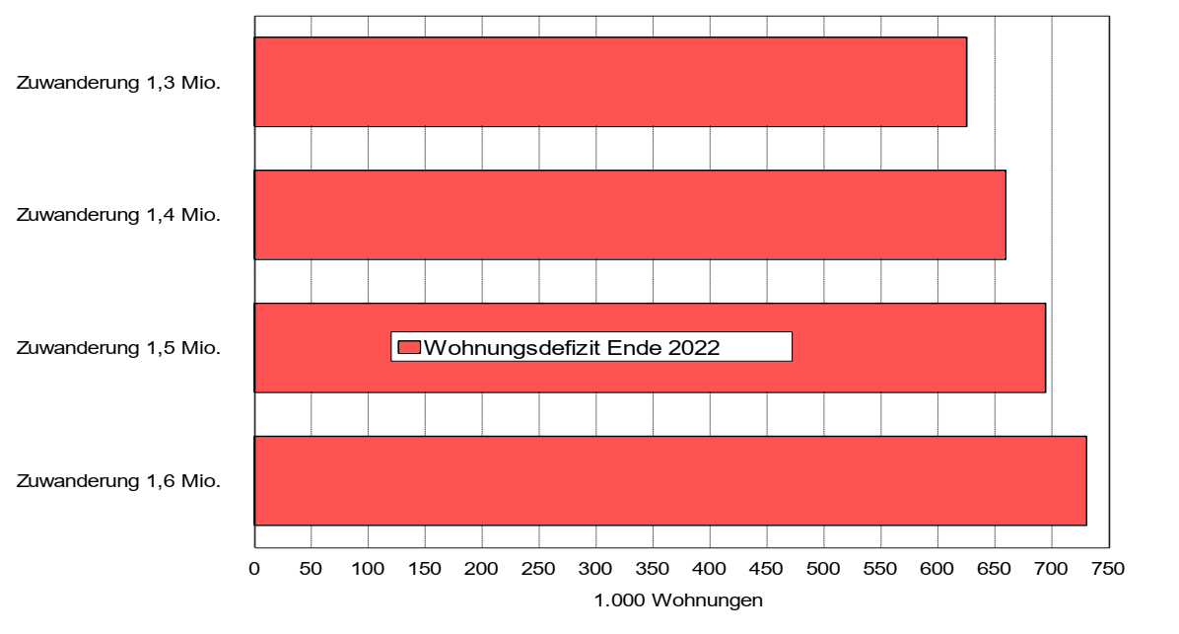
Housing Deficit 2022
in dependence on immigration
Source: Bauen und Wohnen in der Krise. Aktuelle Entwicklungen und Rückwirkungen auf Wohnungsbau und Wohnungsmärkte.
beauftragt vom Verbändebündnis „Soziales Wohnen“, erstellt durch Pestel Institut gGmbH Hannover und Arbeitsgemeinschaft für
zeitgemäßes Bauen e. V. Kiel, Hannover, Januar 2023
Government`s housing targets 400,000 flats per year, of which 100,000 are social housing not achieved
In 2022 around 290.000 units were built, of which only around 21.000 are social housing
Accommodation sector in Germany is at full capacity, many
homeless people spend
years in (emergency)
accommodation

Slide 8
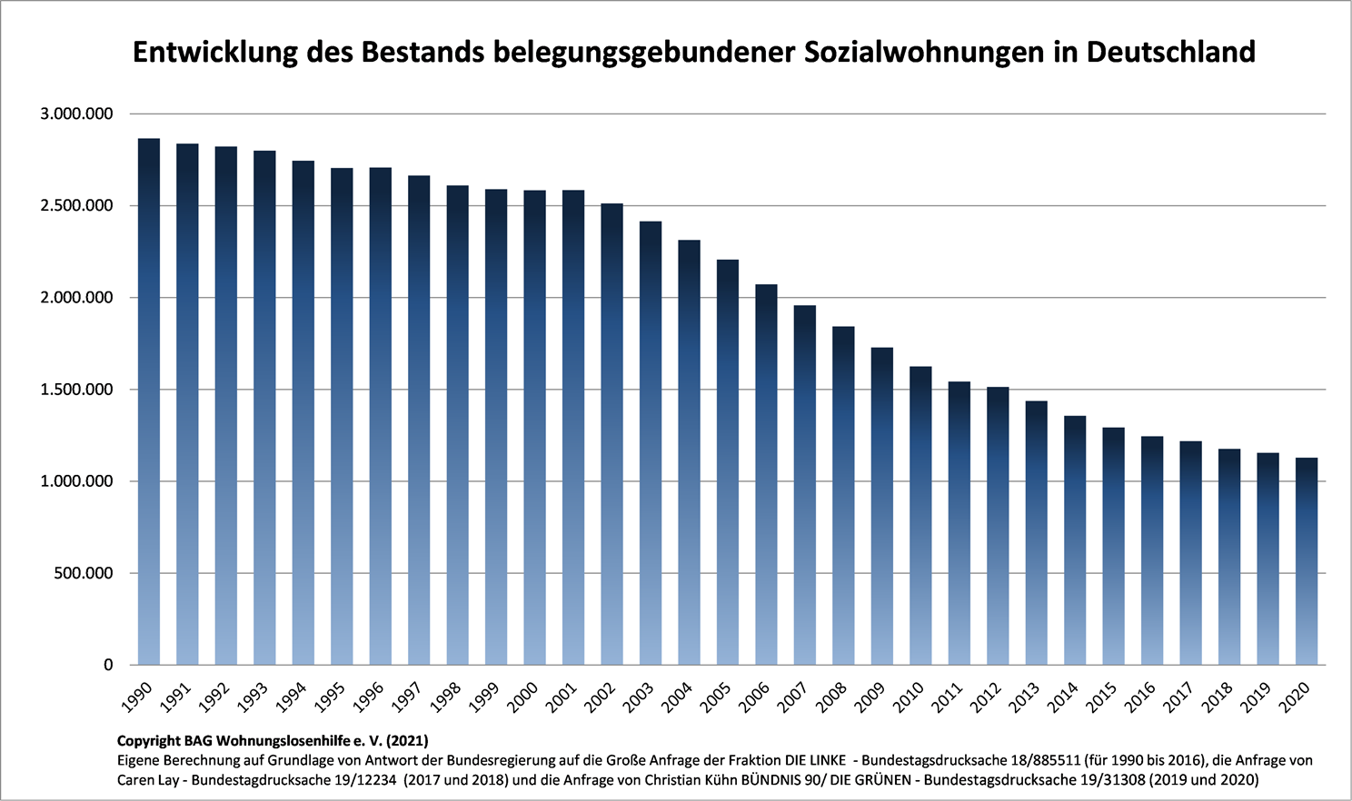
Causes for the rise in homelessness and housing exclusion
(Dokumentationssystem zur Wohnungslosigkeit d. BAG W 2022)
Development of the stock of social housing in Germany

Slide 9
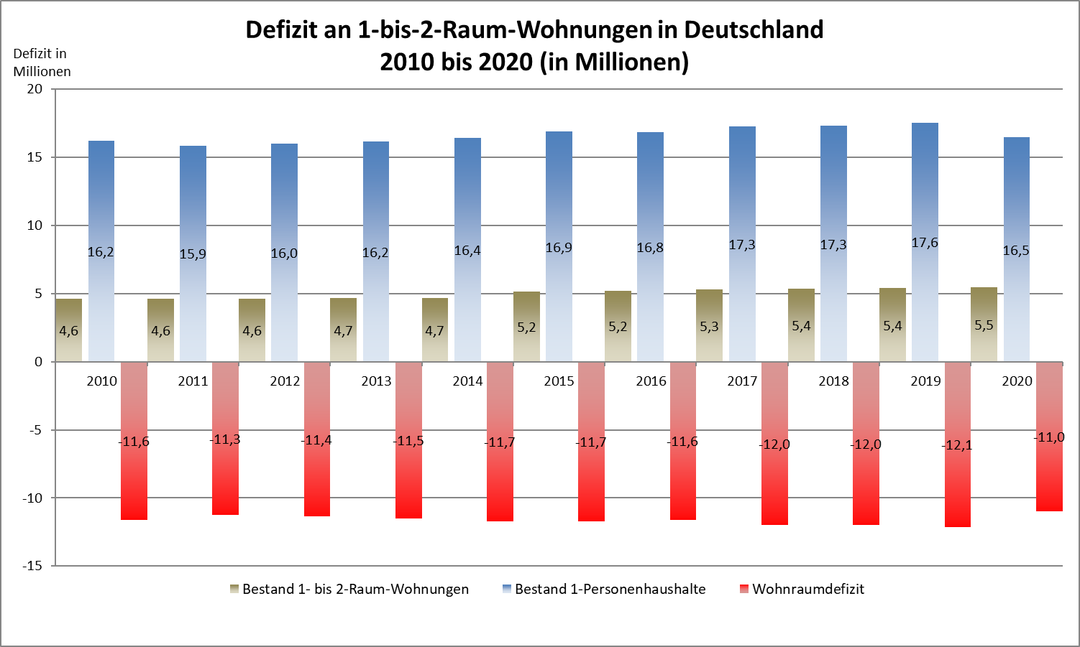
Causes for the rise in homelessness and housing exclusion
(Dokumentationssystem zur Wohnungslosigkeit d. BAG W 2022)
Deficit of one- to two-room apartments in Germany
2010 to 2020 (in millions)
stock one- to two-room apartments
Single-person households
Housing deficit

Slide 10
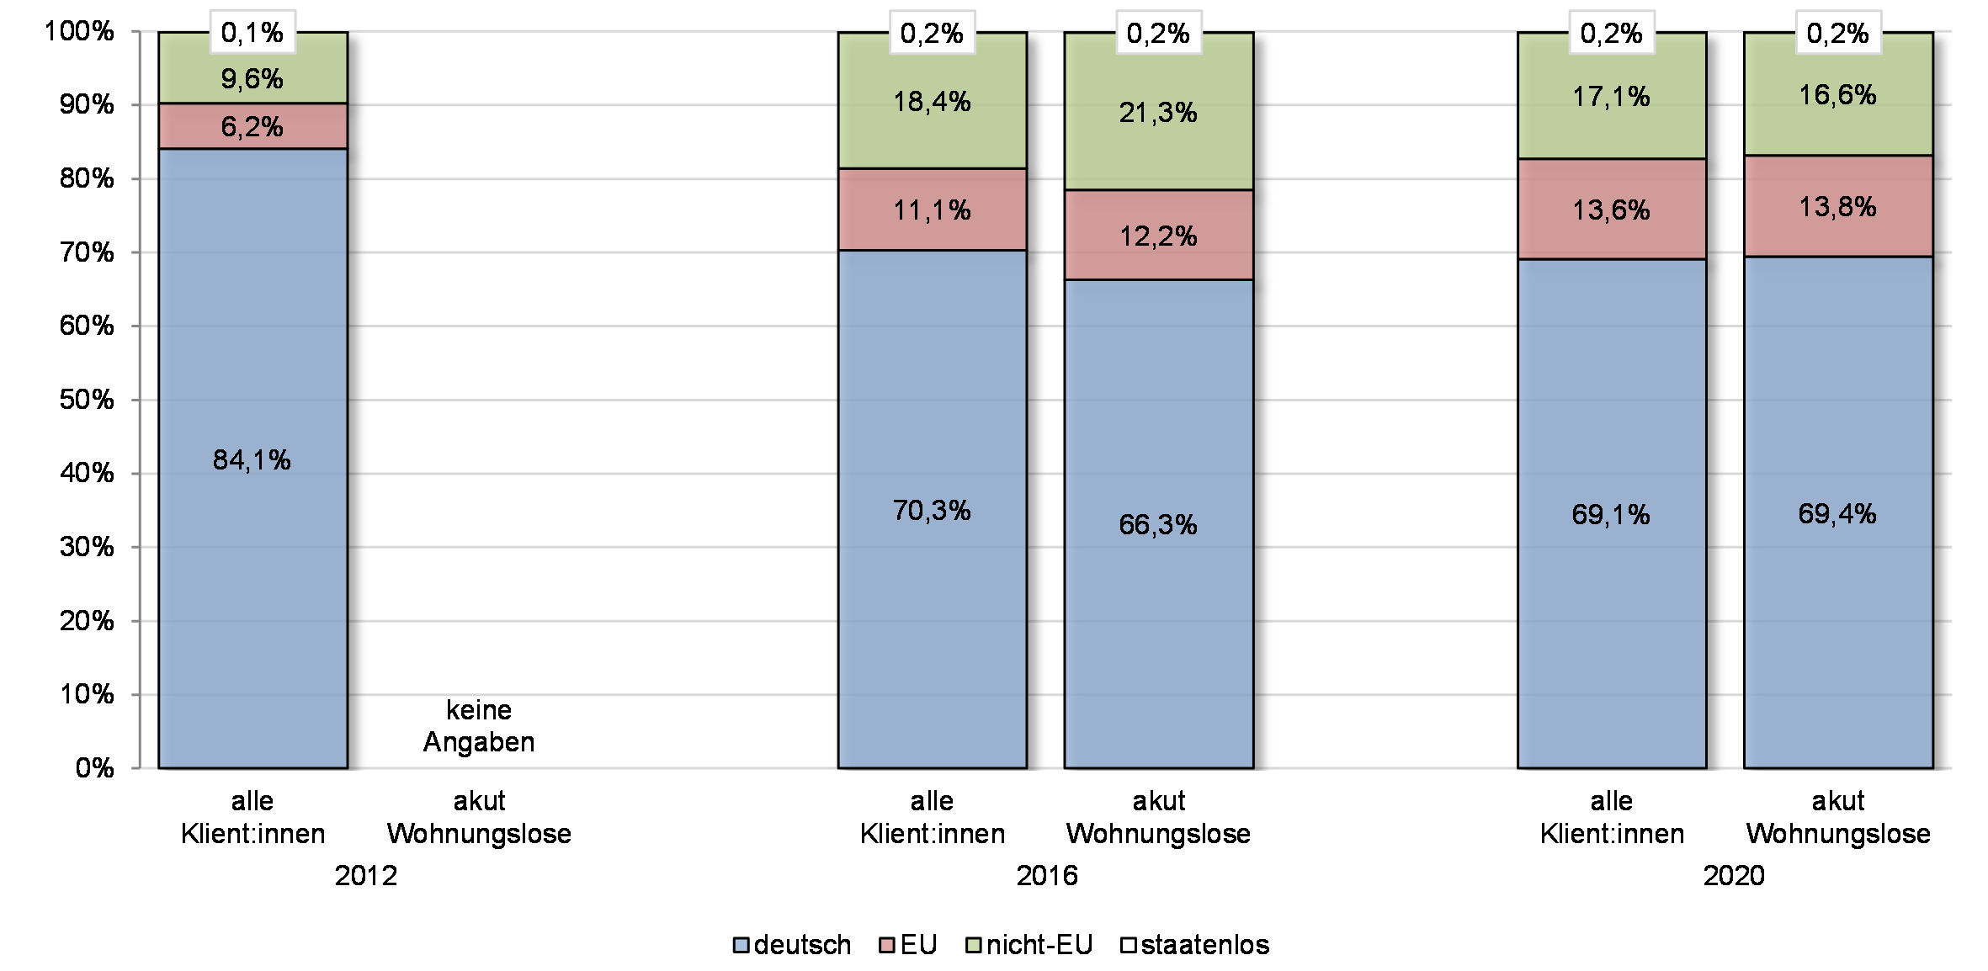
Nationality of clients of the NGO homeless sector
(BAG W-Statistics Report „On Living Conditions of Homeless People and of People at Risk of Homelessness in Germany“ )
Increasing number of homeless mobile EU citizens, especially in low-threshold services for the homeless (main countries of origin: Romania, Bulgaria, Poland)
Large number of refugees from Ukraine, Syria, Afghanistan, Iraq

Slide 11
Why people lose their home – legal level
(BAG W-Statistics Report „On Living Conditions of Homeless People and of People at Risk of Homelessness in Germany“ )
 | 2020
 | Male | Female | Total
Notice of Termination by landlord | 32,0% | 29,2% | 31,3%
Action for eviction | 4,1% | 7,6% | 5,0%
Eviction (if landlord needs estate for her-/himself) | 0,8% | 1,2% | 0,9%
Eviction rent arrears | 9,4% | 10,5% | 9,7%
Eviction due to other problems | 4,7% | 4,2% | 4,6%
Expiration of the tenancy agreement | 3,0% | 2,8% | 2,9%
Judicial order due to Protection against violence act | 1,1% | 0,7% | 1,0%
tenant moved out without Notice of Termination | 17,1% | 16,5% | 16,9%
Quitting | 27,8% | 27,3% | 27,7%
Total % | 100 % | 100 % | 100 %

Slide 12
Why people lose their home – personal level
(BAG W-Statistics Report „On Living Conditions of Homeless People and of People at Risk of Homelessness in Germany“ )
 | 2020
 | Male | Female | Total
Domestic Violence | 0,5% | 7,3% | 2,4%
Change of location / tenancy chagneover | 16,3% | 13,6% | 15,6%
Job loss/ Job change | 6,1% | 3,3% | 5,4%
Hospitalization | 1,4% | 1,1% | 1,3%
Imprisonment | 8,8% | 2,9% | 7,2%
Separation/divorce | 15,7% | 16,3% | 15,9%
Moving out of the parental home | 7,7% | 8,5% | 7,9%
Force majeure | 1,1% | 1,1% | 1,1%
Violence by a third party | 1,0% | 1,8% | 1,2%
Rent or energy debts | 17,5% | 18,6% | 17,8%
Conflicts in the living environment | 16,8% | 16,0% | 16,6%
change in household structure | 3,9% | 6,3% | 4,6%
institutional non-help | 0,8% | 0,7% | 0,8%
illness | 2,4% | 2,4% | 2,4%
 | 100 % | 100 % | 100 %

Slide 13
Homelessness and Housing Needs on the Political Agenda
Nationwide statistics on homelessness continuously
demanded by BAG W since the 1990s
2020 Homelessness Reporting Act:
  official statistic of homeless persons (emergency) accommodated by local authorities or service providers
  accompanying reporting every two years on homeless people without accommodation (living rough) and hidden homeless people (temporarily with family and friends)
2022 First Reference Date Census (31 January 2022) first accompanying reporting.

Slide 14
„Homelessness Census“ by the Federal Statistical Office of Germany
(Wohnungslosenbericht „Ausmaß und Struktur von Wohnungslosigkeit“ BMAS 2022)
Types of homeless people* | Male | Female | Total
homeless persons in (emergency) accommodation | 66 % | 71 % | 178.100
Homeless people without accommodation (living rough) | 17 % | 8 % | 37.400
Homeless minors without accommodation |  |  | 1.100
Hidden homeless people (temporarily with family and friends) | 17 % | 21 % | 49.300
Hidden homeless minors |  |  | 5.500
Total % | 100 % | 100 %
 |  |  | - 8.800
Total (Reference Date) |  |  | 262.600
93.300 People without
accomodation or hidden homeless
people
Double Counting
Nearly twice as many people are in emergency accommodation as unsheltered homeless or hidden homeless
Males make up the majority in all three groups:
Accomodated 62 % M 37 % F 1 % Unknown
Not accomodated 79 % M 19 % F 1 % Non-binary
Hidden homeless 60 % M 40 % F
In the group of accomodated homeless people, 26% are younger than 18 years old

Slide 15
Homelessness report "Extent and structure of homelessness" by the Federal Ministry of Labour and Social Affairs, BMAS 2022
Types of homeless people* | German Citizenship | Foreign Nationals | Countries of Origin
homeless persons in (emergency) accommodation 41% single households 46% household with children (single parent, couple household with children) | 31 % | 69 % | Europe 17% Asia 36 % of these are from Syria 16% Afganistan 11% Iraq 5% Africa 12%
Homeless people without accommodation (living rough) 79% single households | 66 % | 33 % | From these are from EU 27 69% Poland 29% Romania 17% Bulgaria 5%
Hidden homeless people (temporarily with family and friends) 71% single households | 74 % | 24 % | From these are from EU 27 44% Rest of Europe17% Africa 16% Asia 23%

Slide 16
Homelessness and Housing Needs on the Political Agenda
2021: Homelessness in the Coalition Treaty between SPD, Bündnis90/Die Grünen and FDP; 24.11.2021):
  Germany has set a goal to end homelessness and housing exclusion by 2030 and is launching a National Action Plan to achieve this. With the coalition agreement of the new federal government, the long-standing demand of the National Federation for the Homeless in Germany (BAG W) for a “National Strategy against Homelessness and Poverty in Germany” (BAG W 2013) is set as a task for the legislative period 2021-2025.
  A working group of the Federal Government and the Federal States (Bundesländer) is to be set up to deal with the homelessness of mobile EU citizens
  Access to health insurance - especially for homeless people - will be examined and clarified in the interest of those affected,
  Supporting young homeless people / care leaver with Housing First concepts

Slide 17
Homelessness and Housing Needs on the Political Agenda
2022: „Alliance for Affordable Housing“ of the Federal Minister for Housing, Urban Development and Building, Klara Geywitz
The alliance declaration states, among other things:
  "Decisive for the elimination of housing and homelessness, as European comparisons show, is the sufficient
  provision of affordable housing. Therefore, it should also be examined whether a share of social housing can
  be provided for homeless households."
And the preamble of the Alliance Declaration states:
  "The loss of one's own home and the associated life on the street, in shelters or in hidden homelessness affects the poorest and most vulnerable in society with negative consequences for existential areas of life such as gainful employment, education, training and health. Homelessness and rooflessness are not an unavoidable fate. The federal government has set itself the goal of overcoming homelessness in Germany by 2030. The Alliance members support the cause and will accompany the development and implementation of a National Action Plan to overcome homelessness.“
The BAG W demand for a quota of social housing to provide homeless people with their own
home could be placed in the Alliance for Affordable Housing

Slide 18
Homelessness and Housing Needs on the Political Agenda
Core demands of BAG W for the National Action Plan
In addition to the basic demand for a sufficient stock of affordable housing and permanent social housing, the BAG W has already submitted further concrete proposals:
Quotas / a share of social housing to provide homeless households with housing,
transparent housing allocation practices that take into account the urgency of individual living situations,
a support programme "From the Street into Housing" to help roughsleepers into housing,
a support programme for the dissolution of communal shelters and emergency accommodatione and their conversion into normal social housing for homeless households.
Acquisition of flats from housing companies and private landlords by the municipalities with the aim of renting them to households that are particularly excluded from the housing market.
cooperation agreements between municipalities and housing companies in order to provide guarantees and to achieve a risk shield against rent defaults by the companies (e.g. general tenant model).
a funding programme for the nationwide establishment of systematic prevention of homelessness by the local authorities with the involvement of the homelessness sector
a „Pro Housing – Programme“ to establish a network of private landlords or housing companies with municipalities and NGOs of the homelessness sector to prevent homelessness and to to acquire housing for homeless people on the housing market

Slide 19
Homelessness and Housing Needs on the Political Agenda
Core demands of BAG W for the National Action Plan
Housing policy solutions are necessary but not sufficient on their own. BAG W calls therefore for cross-sectoral cooperation, because the problem of homelessness and housing exclusion is usually linked to different dimensions of social exclusion (e.g. unemployment, education and skills, health, or social support networks).
Germany’s characteristic federal system makes political
action to overcome homelessness and housing exclusion
necessary at all political levels, i.e. the Federal Level, Länder
and local level.

Slide 20
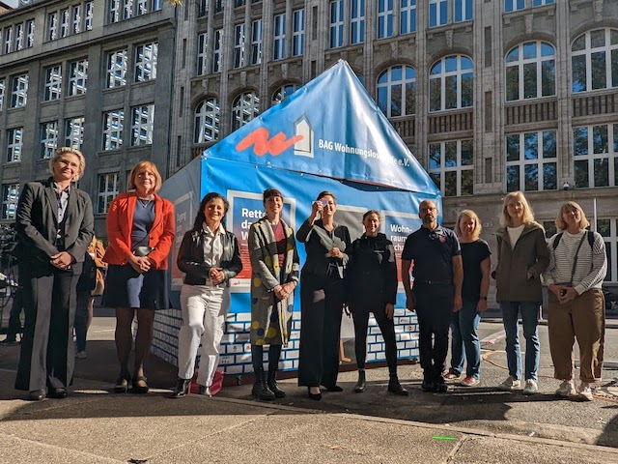

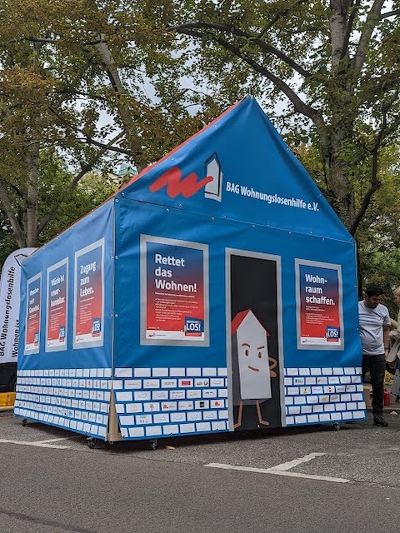
Homelessness and Housing Needs on the Political Agenda

