Slide 1
Evaluation of the Blue Door INNclusion Program for 2SLGBTQ+ Youth in Ontario, Canada
Dr. Alex Abramovich
Scientist, Centre for Addiction and Mental Health (CAMH)
Assistant Professor, University of Toronto

Slide 2

Contents
Introduction to 2SLGBTQ+ youth homelessness
York Region, Ontario, Canada
Blue Door, INNclusion Program
Our approach: Developmental Evaluation Framework
Preliminary results
  What is working
  Areas for program improvement
6. Recommendations
7. Closing statement

Slide 3

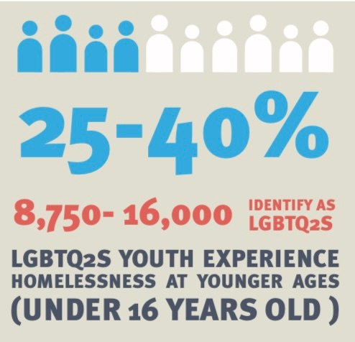
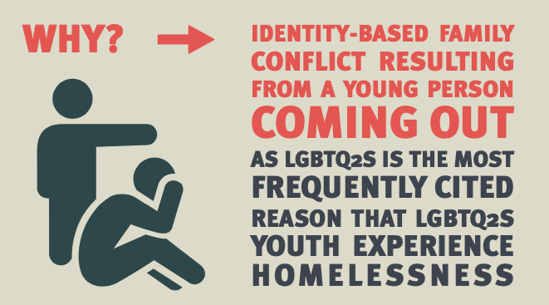
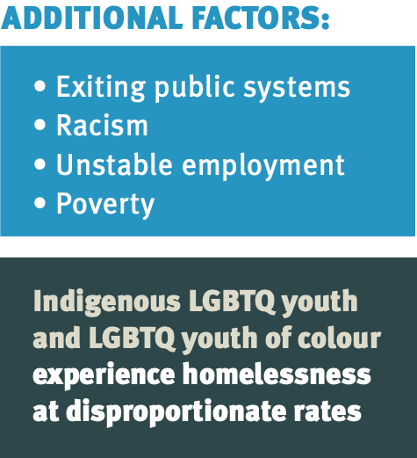
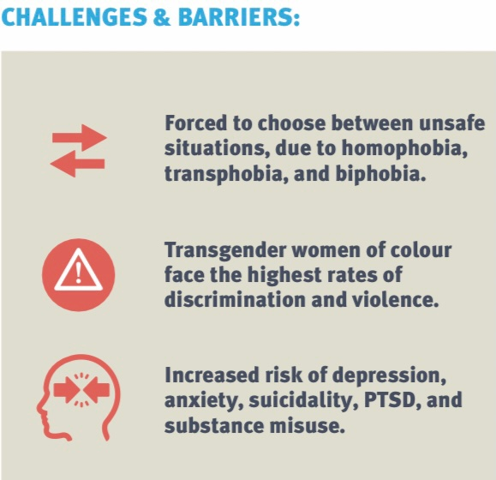


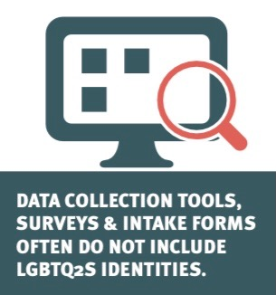
2SLGBTQ+ Youth Homelessness in Canada

Slide 4
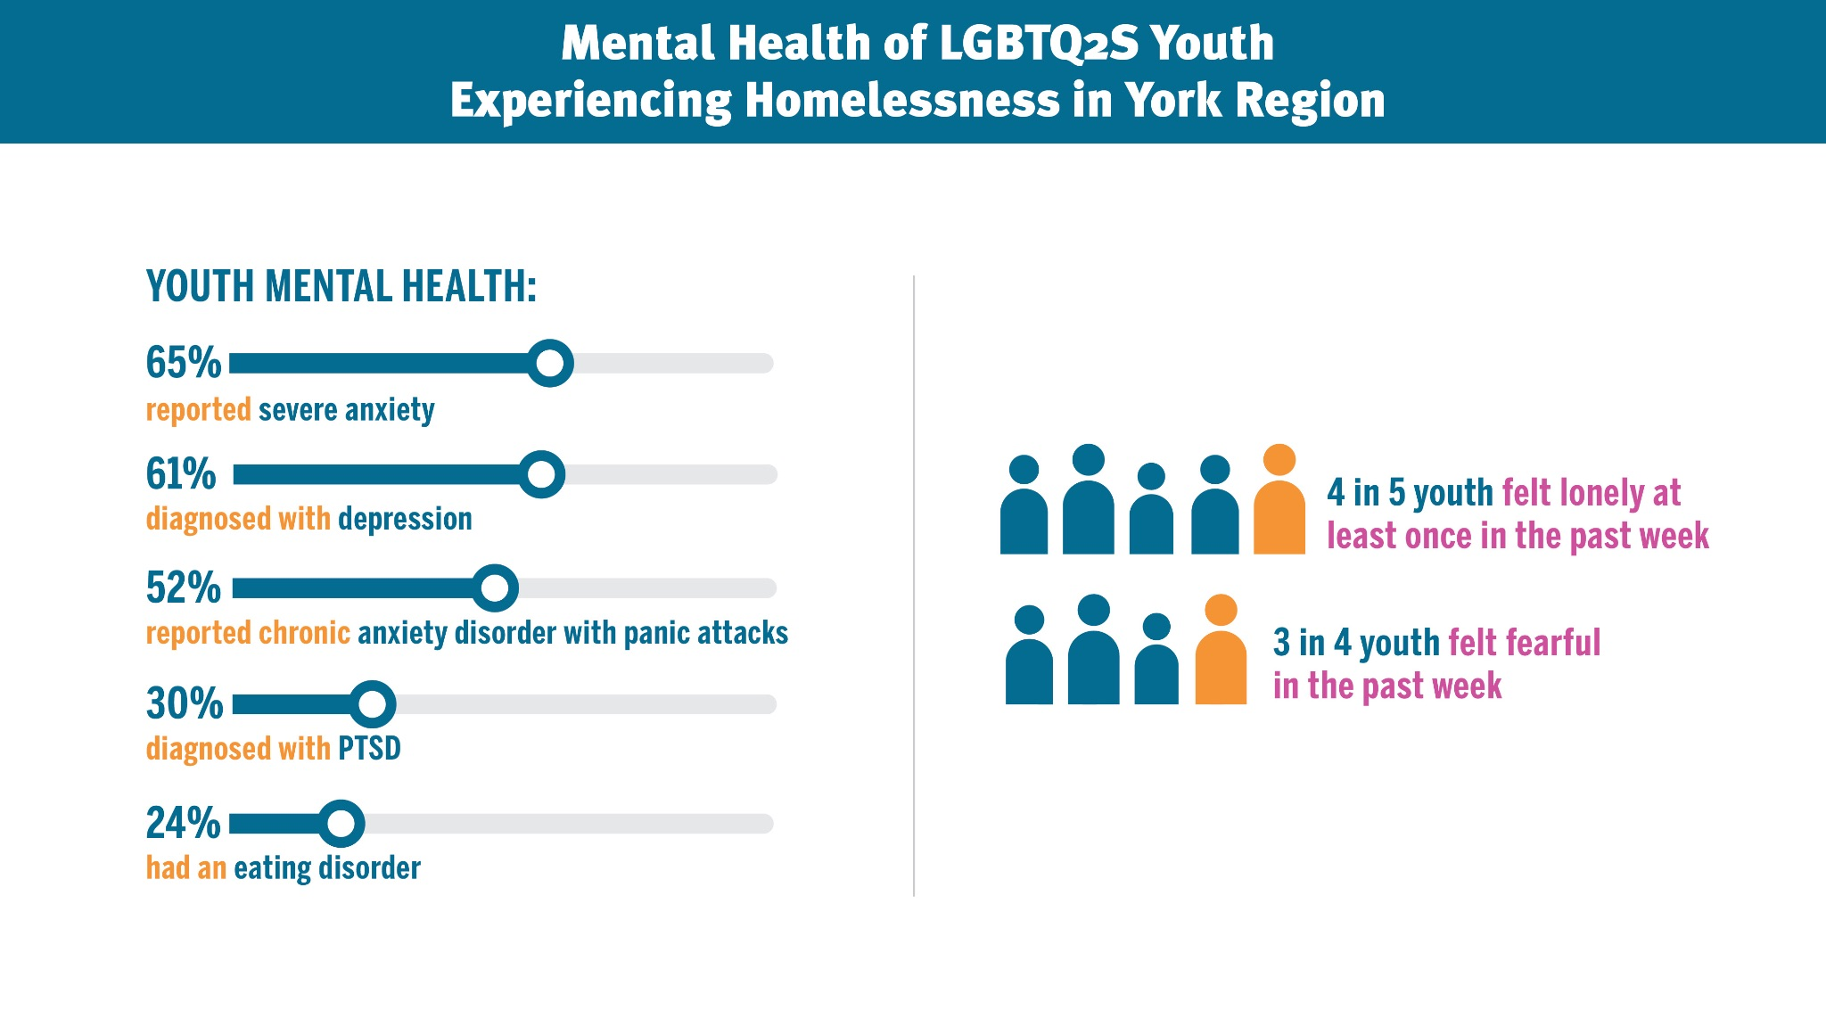

Slide 5
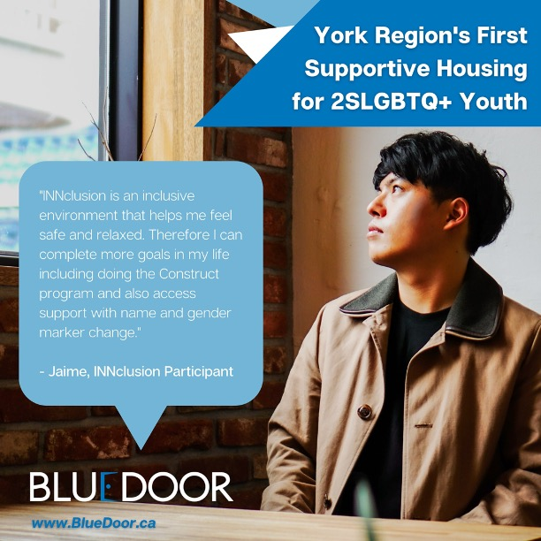
Blue Door, INNclusion Program
York Region’s first population-based housing program for 2SLGBTQ+ youth
Supportive housing program serving 4 2SLGBTQ+ youth at a time
Single occupancy bedrooms
Pet friendly
Youth are supported by a Peer Mentor
Flexible length of stay (approximately 1 year)

Slide 6

Key Evaluation Objectives
1. Document the experiences and perspectives of program residents and staff.
2. Assess and measure changes in mental health, alcohol and substance use, community participation, housing stability, employment status, and school enrollment.
3. Determine the strengths and gaps of INNclusion programming, and provide recommendations to ensure that 2SLGBTQ+ youth will be able to transition into safe, stable, and independent housing.

Slide 7
Developmental Evaluation Framework
Characterised by repeated cycles of data collection, feedback, reflection and adaptation.
Feedback is looped back to the organization in a timely manner, allowing for results and recommendations to be implemented quickly.
We work closely with program residents and staff on an ongoing basis, while respecting and sustaining the independent nature of the program.
Principal Investigator meets with Program Manager every 3-4 months to discuss findings and recommendations.
2-3 interim reports per year and a final report at end of project.

Slide 8
Data Collection
Youth/INNclusion residents: Surveys & one-on-one interviews (every 3-4 months), & monthly check-in surveys while they are living at INNclusion
Youth who move out: Follow youth for 1 yr after they move out of INNclusion with surveys & one-on-one interviews (every 3-4 months)
INNclusion program staff & management: Focus groups & one-on-one interviews
External youth & population-based housing programs: One-on-one interviews

Slide 9

INNclusion residents are invited to:

Slide 10
Community Advisory Board
Created at start of project, meet virtually every 4 months (3 times/year)
14 members (individuals with lived experience, frontline shelter staff and management, educators, social workers)
Advise on various aspects of the project: feedback and testing of data collection tools, interpretation of findings and recommendations, knowledge translation activities

Slide 11
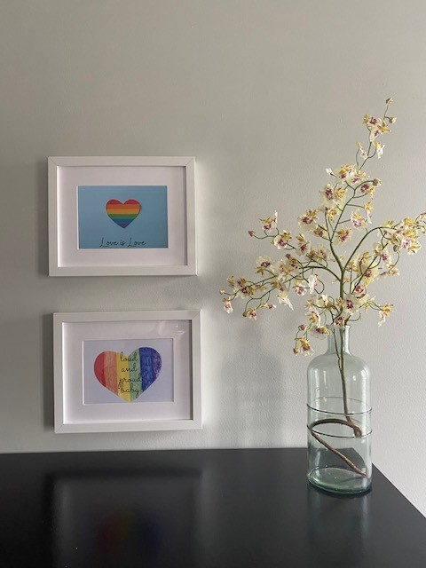
What’s Working?
Housing
  Safe and stable environment
  Location (proximity to resources)
  Independent and hands-off approach
Representative Staffing
  By us for us
Feedback Loop
  Integration of residents’ feedback into the program

Slide 12

Areas for Improvement
Food Insecurity
  Accessibility and availability
Mental Health Support
  Unmet needs
  Uncertainty about available resources
More Staffing
  Broader expertise across staff members
Housing Post INNclusion
  Support transitioning out of housing programs

Slide 13

Recommendations
Implementing regular feedback
Mental health supports
  Providing recommendations
  Crisis planning for youth
Ensuring food security
  Readily available and accessible
Provide structured programming

Slide 14
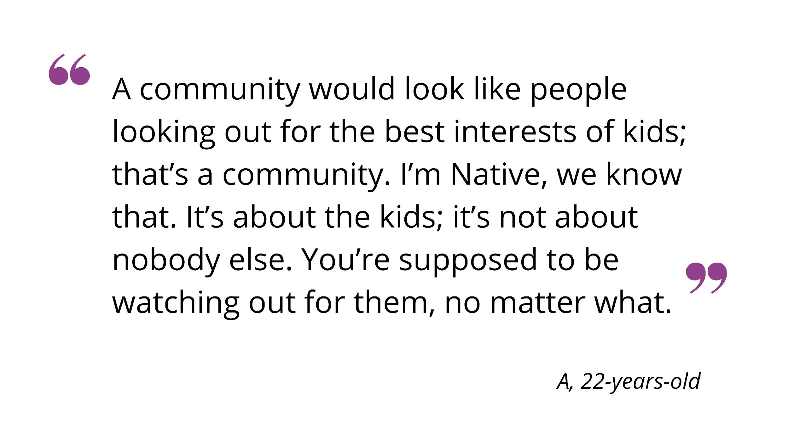
Thank you!
For any comments or questions:
Email: Alex.Abramovich@camh.ca
Twitter: @IAlexAbramovich

