Slide 1
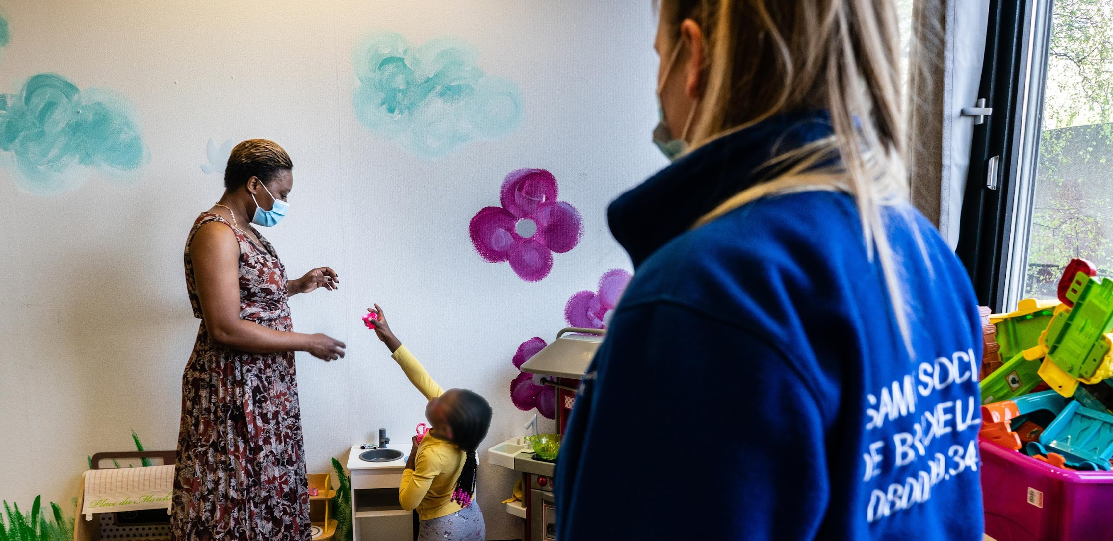

A public association in charge of shelter
for homeless and asylum seekers in Brussels
Notes:
VW:
petits commentaires,sur l’ensemble :
Cette présentation me paraît très dense pour tout le monde ( pas forcément besoin de toutes ces informations), ne faudrait-il pas une présentation simplifiée pour les équipes? Surtout si les premières infos sont d’une heure seulement ( je peux essayer une proposition?)
Je trouve que ça manque d’explications sur l’articulation entre organigrammes Louise et terrain , je trouve que ça donne du sens de se dire que cet organigramme vient aussi en réponse à certains changements déjà mis en oeuvre dans les centres
Peut être aussi les grandes conclusions de l'évaluation des resp de centre sont à mettre en avant pour justifier un peu plus?
Peut-être aussi une timeline sur les prochaines échéances pour expliquer que les changements vont certainement prendre une certaine temporalité avant un modèle abouti

Slide 2
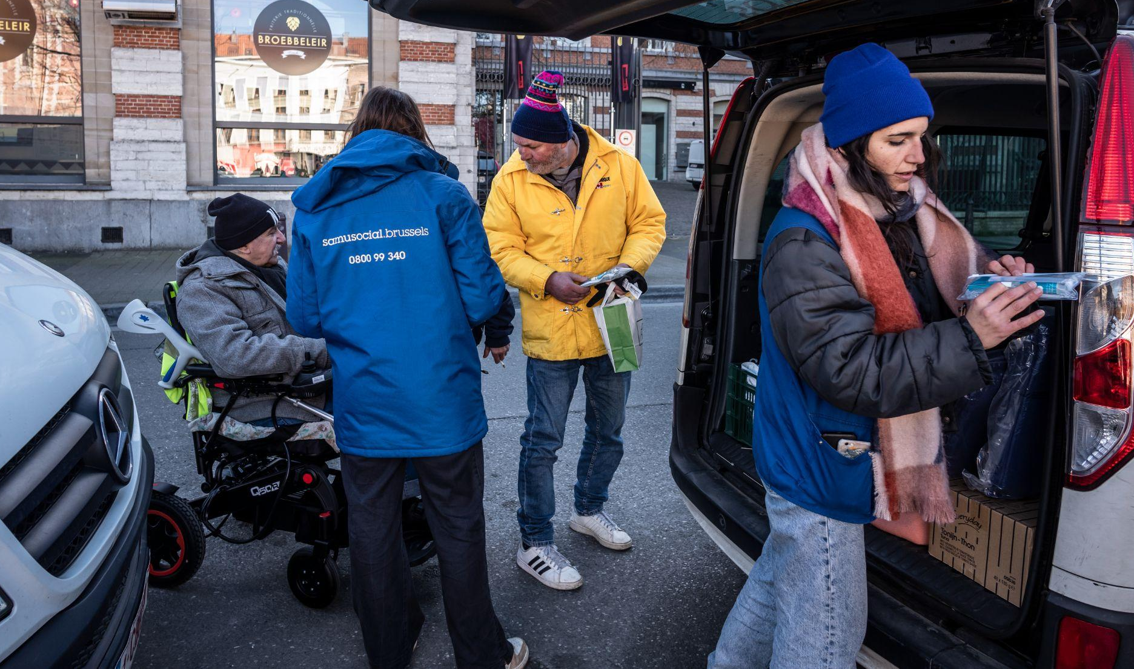
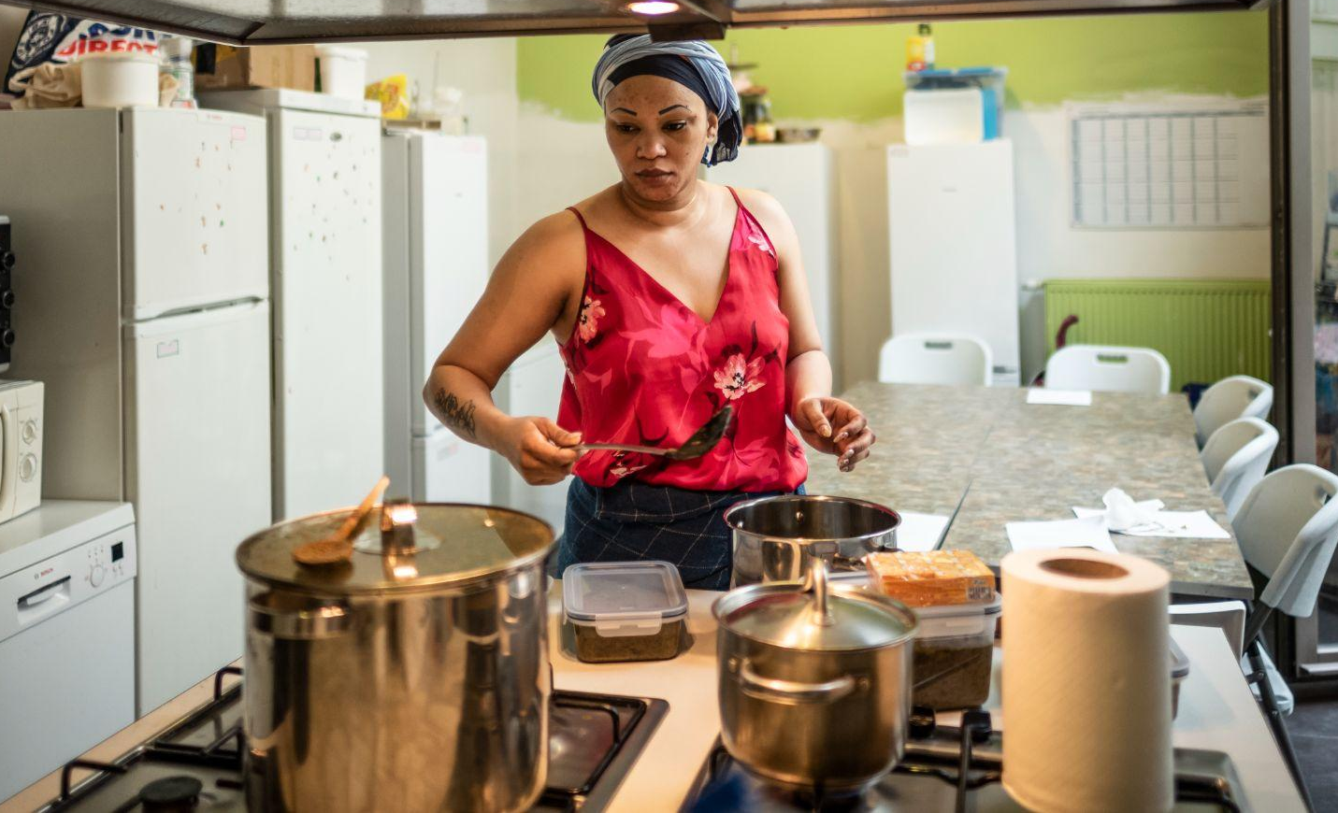
MOBILE TEAMS
(7/7 and 24/24 teams for Ukrainians, asylum seekers and homeless)
HOUSING PROJECT
(Housing first, insertion housing project...)
SAMUSOCIAL
CONTEXT OF INTERVENTION
ASYLUM SEEKERS
(800 persons per night)
HOMELESS PERSONS
(1000 persons per night)
UKRAINIAN TEMPORARY PROTECTION
(100 persons per night)

Slide 3
BELGIAN CONTEXT : 4 LEVELS OF DECISION
1
European Level
                Automatic Temporary protection for Ukrainians
                Directive of the European Parliament laying down standards for the reception of applicants for international protection
2
Federal Level
      Organizing the sheltering + psycho-medical-social and juridical support for applicants for international protection
3
Regional Level
3 Regions in Belgium : Flanders / Wallonia and Brussels Capital
Regions are in charge of sheltering and reinsertion of homeless people
Regions are in charge of organising sheltering + support for Ukrainian people
4
Local Level
Mayors are in charge of security and relationship between sheltering organisations and neighbourhood

Slide 4
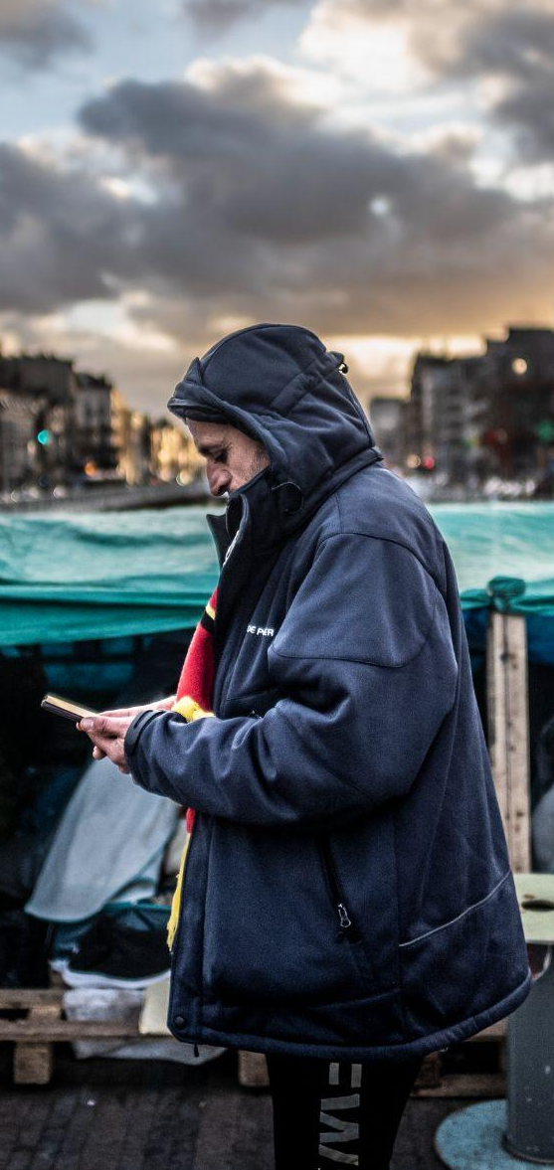
BELGIAN CONTEXT: THE ASYLUM CRISIS
Important increase of incoming asylum seekers since the change of government in Afghanistan in August 2021
1
Belgian state condemned 8600 times by judicial system including the European court for not providing accommodation to asylum seekers and not respecting the European Law (168 millions of penalties)
More than 3000 people waiting for accomodation in Belgium
Difficulties for the Belgian State to accelerate the « out » system and the decisions providing refugee status
No State agreement to have a repartition plan of the asylum seekers leading to a kind of competition to block « collective centres »
Public opinion is pushing to restrictive access conditions in Europe
2
3
Federal Belgian State not in capacity to open new places in reaction to this increase
The registration center for asylum seekers is in Brussels. It results in a situation where the majority of asylum seekers waiting for an accomodation are sleeping rough in the Belgian capital
The asylum seekers without accommodation concentrate in different places: metro stations, empty buildings (squat strategy), on a couch, etc.
4
An agreement between the federal state and the Brussels Region has been signed to help the Brussels Region to open new accomodations for the migrants left without any solution

Slide 5
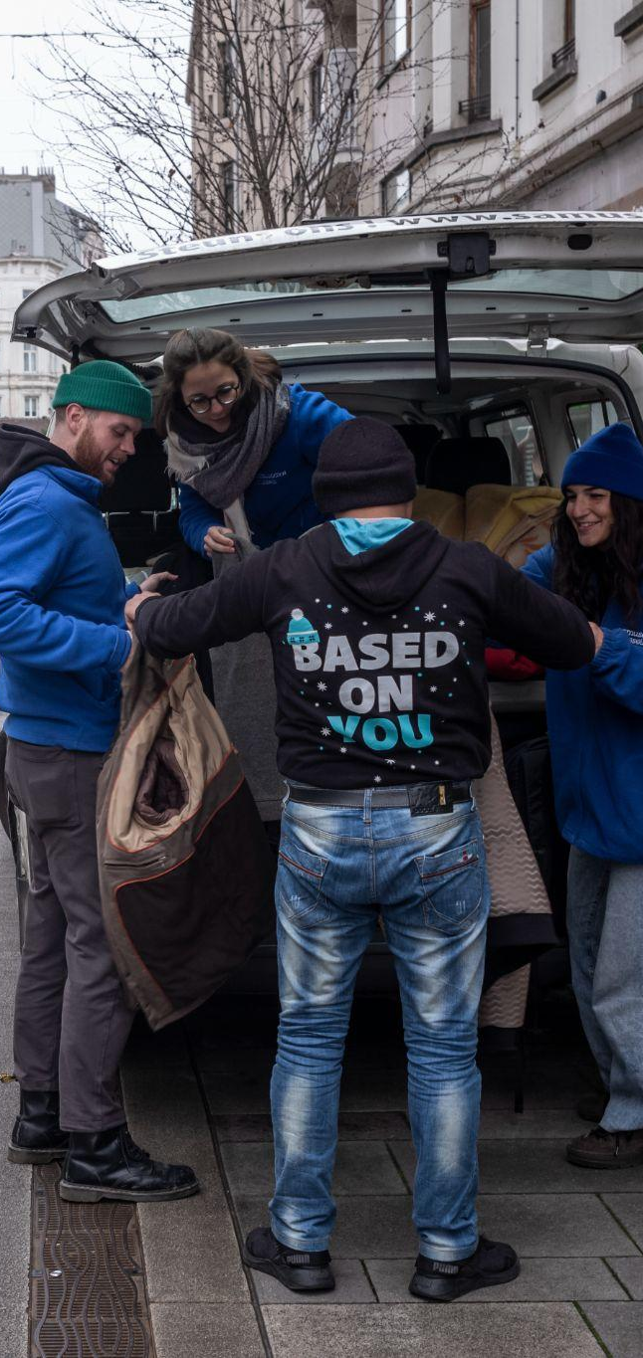
BRUSSELS CONTEXT: HOMELESS SITUATION
1
5300 homeless people registered at the last census
Since many years, despite important efforts to increase the number of sleeping places in the city, there is not enough places in Brussels
A specific budget is dedicated to collective accommodations for Ukrainians with no other solution
In Brussels, 60% of the persons accommodated in the emergency shelters don’t have access to the international protection or had been denied access to refugee status (the so called « sans papiers » = undocumented people)
In conclusion,
  asylum seekers start as homeless because of the incapacity to put enough shelter in place at arriving
  When access to refugee status is denied, majority stays in Brussels without solution and becomes homeless.
2
3
4

Slide 6
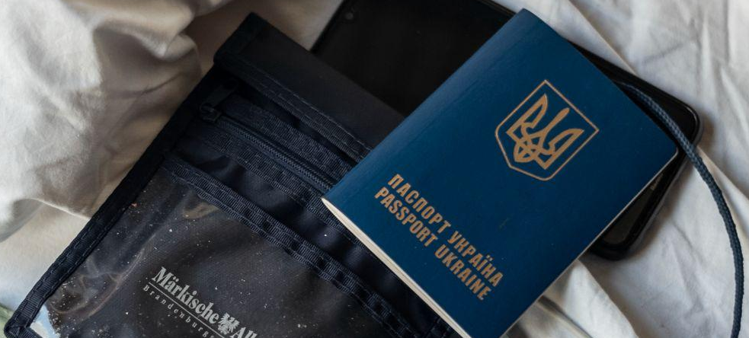
BRUSSELS CONTEXT: UKRAINIAN REFUGEES
The Regions are responsible for the solutions offer to Ukrainians. There is a repartition plan between the 3 Regions
Support to Ukrainian refugees answers to a specific strategy:
Ukrainian has a systematic access to temporary protection
Specific mobile teams to welcome Ukrainians in the stations
Specific emergency accommodations dedicated to Ukrainians
An important specific budget is dedicated to collective accomodations for Ukrainians with no other solution
At Regional Level, the Minister in charge in charge of accommodation for Migrants is also in charge for Ukrainians
Conclusion
                Huge increase of people in demand of accomodation and sheltering in Brussels since 2022 because of:
The Ukrainian war
The Asylum crisis
Structural lack of options for the so called “sans papiers”

Slide 7
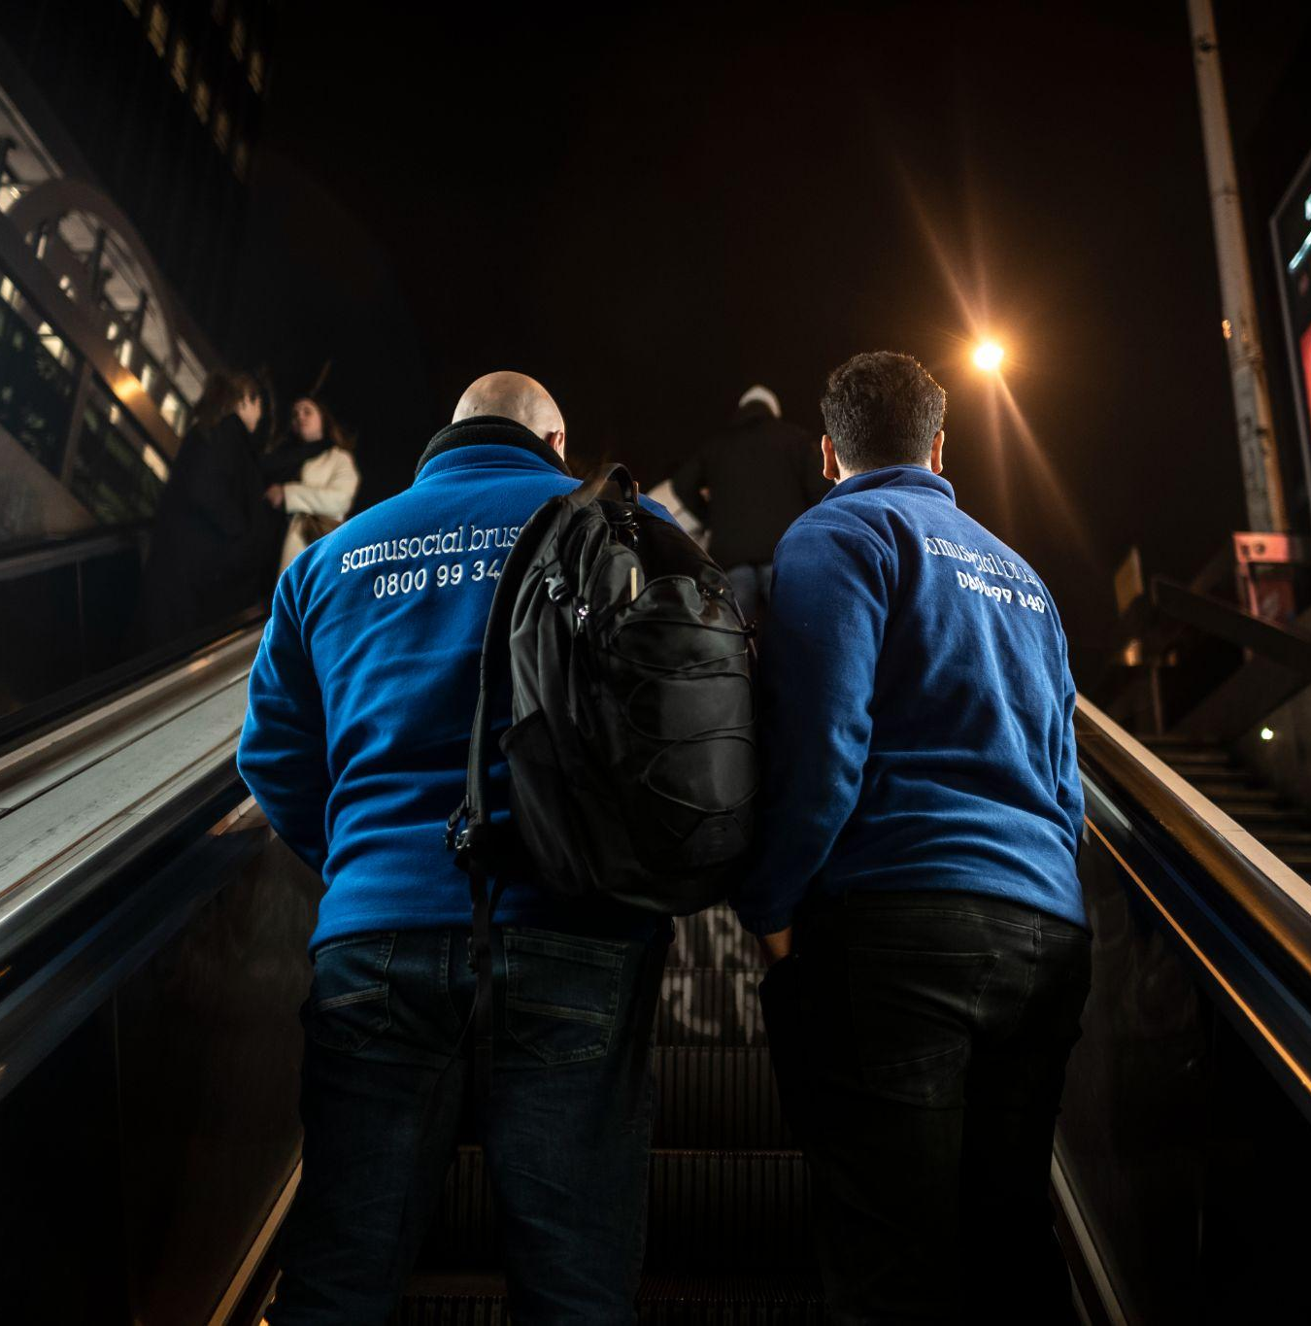
OPERATIONAL STRATEGY TO ANSWER THE EVOLUTION OF THE CONTEXT
4 pillars to develop actions :
Opening new collective accommodation through strong partnership with each level of authority (Migrants, Ukrainians, homeless)
Building a buffer strategy to be as reactive as possible in case of crisis
Strengthening mobile teams to answer the needs of people left outside
Lobbying strategy of all the operators to obtain public decisions
1
2
3

Slide 8
OPERATIONAL STRATEGY
1
OPENING NEW COLLECTIVE CENTERS
Investment in long term rentings of ex retirement homes after the COVID.
    Long term contracts allow to invest in the quality of the buildings
    Long term contract could present risks in terms of subsidies durations
Local authorizations are very difficult to obtain because of the resistance of the population (NIMBY phenomena).
Fireman are more and more demanding in terms of security.
Each targeted public answers to different quality sheltering criteria, rules and to different types of subsides (federal or regional,…). We avoid as much as we can mixity although it could lead to a perception of double standards.
Administrative processes to open new collective accommodations take time and require important investment budget. As it takes long, it is not the strategy to answer to emergency requests.

Slide 9
OPERATIONAL STRATEGY
2
A BUFFER STRATEGY TO ANSWER EMERGENCIES
What is a buffer strategy ?
    It is a strategy aiming to keep places available for emergency situations in existing and appropriate buildings:
      These places are paid at a lower price when inactivate
      They are « ready to use » places (beds, bed sheets…)
      They are available in existing building providing already accommodations
Objective of a buffer strategy:
                React quickly to any type of emergency (asylum crisis, COVID 19…)
                Allow to avoid long lasting opening and identification of new buildings
Risks and disadvantages:
                Requests subsides to maintain these places in non emergency situations
                Supposes to not use the full capacity of our building in non emergency periods

Slide 10
OPERATIONAL STRATEGY
3
STRENGTHENING MOBILE TEAMS TO ANSWER THE NEEDS OF PEOPLE LEFT OUTSIDE
Putting in place a Ukrainian mobile team:
Team speaking Ukrainian and culturally close of the targeted public
Schedules of the teams aligned on the arrival of Ukrainians at central places (stations, etc.)
Importance to be able to provide accomodation, answer to emergency needs and give informations about the belgian processes
Reinforcing the teams able to visit the different squats :
Health and prevention approach
Put in place specific teams to build trust
Importance to be present in the evening/night
Build partnership to have a global understanding of the publics
Investigate new needs through mobile teams:
Importance to understand where the target groups are and to put in place specific answers
Importance to remain connected to activists organisations
Reinforce the mobile teams for homeless:
Stress on the importance to not underestimate the chronicle homeless
Avoid double standards to not favorize one public towards the other.

Slide 11
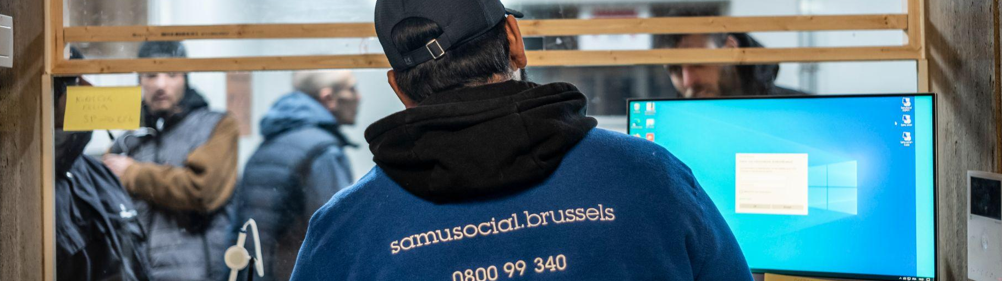
CONCLUSION: RISKS AND OPPORTUNITIES
LOBBYING AND COMMUNICATIONS
Importance to have a lobbying / communication strategy to underline the gaps noticed at the different levels (field, other actors…): propose practical solutions to avoid political debates, communicate in the press, uses good practices (Ukrainians…)
Internal perceptions of double standards, resistance of the teams if too much is done for one public vs an other group (ex : deal for Ukrainians).

Slide 12
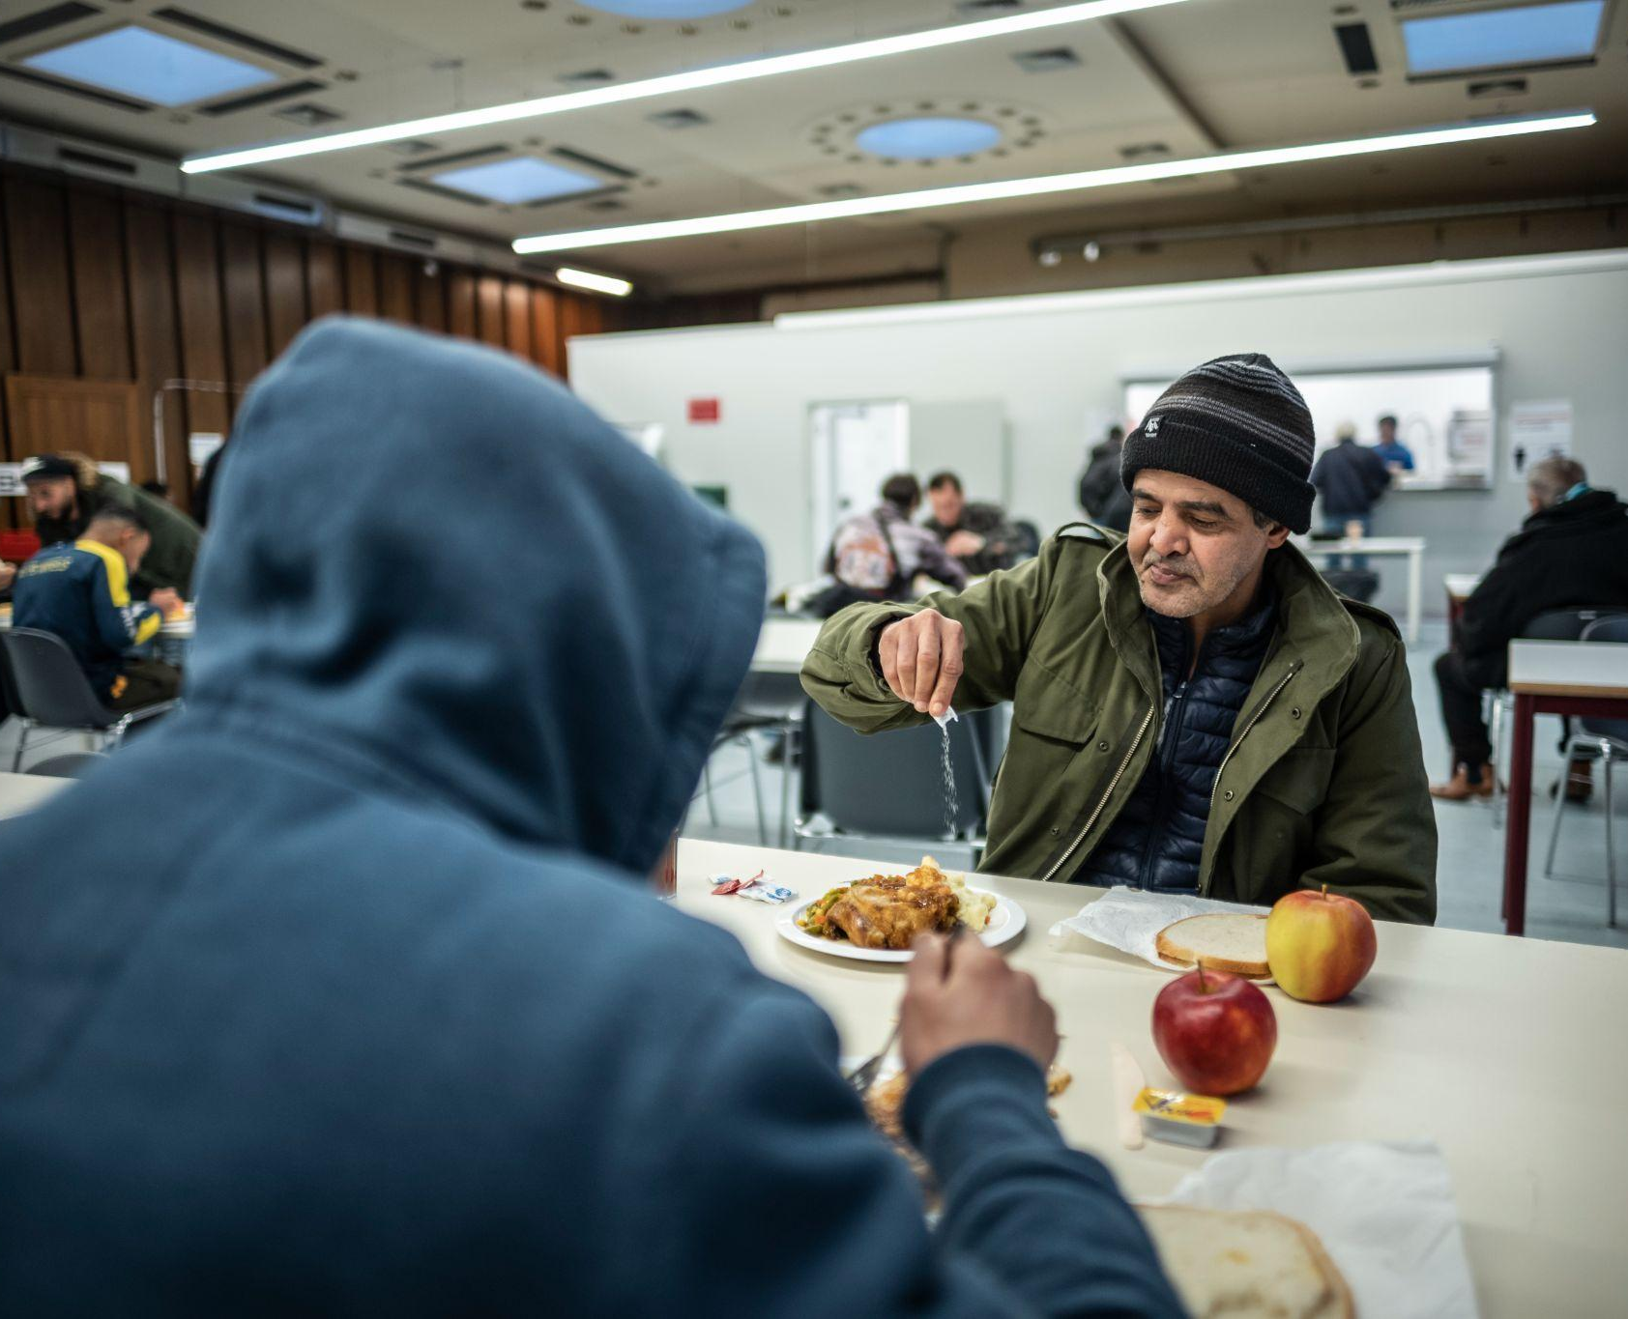
CONCLUSION: RISKS AND OPPORTUNITIES
FINANCIAL RISK FOR OPERATIONAL ACTORS
Finance mechanism are usually done to push field actors to take some risks (on buildings, investments, HR contracts…)
Difficulties to convince donors to finance non activate buffer places
DIFFICULTIES TO HAVE TRANSVERSAL ANALYSIS
Each public is taken in charge by one Minister. It makes the global and transversal analysis complicated.
Quality and accomodations norms are different for each public (homeless, asylum seekers, Ukrainians)
Complexity to have the linear story of individuals: homeless becoming asylum seekers becoming homeless.

Slide 13
ANY QUESTIONS?

