Slide 1





Key Elements in Strategies to End Homelessness by 2030
Eoin O’Sullivan
Trinity College Dublin, Ireland

Slide 2
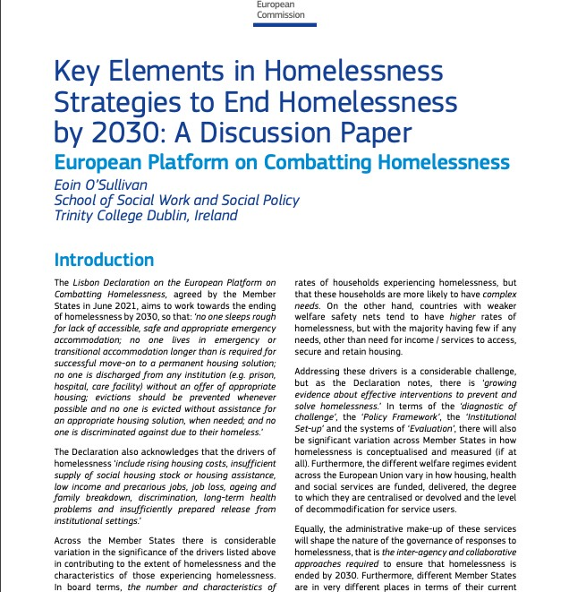
Aim
The aim of this discussion paper is to provide a conceptual framework of the dynamics of homelessness, drawing on key lessons from research, and how these lessons can inform, through mutual
learning and collaboration, the configuration of practices and policies in Member States, while reflecting and respecting their diversity, in devising integrated strategies to end homelessness.
The Framework identifies where
homelessness can be prevented in the first instance, and for those that enter
homelessness, to minimise the duration of that experience by ensuring rapid exits to secure accommodation.
FEANTSA FORUM 2023
2

Slide 3
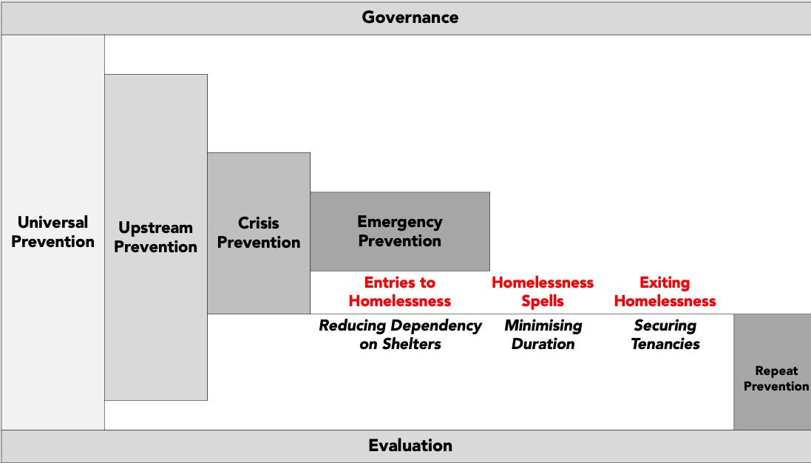

Slide 4

Index of Homelessness at a Point-in-time in Selected Countries, 2008-2022
300.0
250.0
200.0
150.0
100.0
50.0
0.0
2008 2009
Austria
2010
Finland
2011
2012
2013
Denmark
2014 2015
Norway
2016
Sweden
2017
2018
2019
England
2020
2021
Netherlands
2022
Ireland
Scotland

Slide 5
Index of Homelessness at a Point-in-time in Selected Countries, 2008-2022
250.0
200.0
150.0
100.0
50.0
0.0
2008
2009
2010
2011
2012
2013
2014
2015 2016
Sweden
2017
2018
2019
2020 2021
Netherlands
2022
Austria
Finland
Denmark
Norway
Scotland
England

Slide 6

Measuring Homelessness in Europe
Many more households experience homelessness over a year than are measured at a point-in-time, and their profile is significantly different from those at a point-in-time.
Understanding the dynamics of homelessness is crucial to intelligent policy design.
The pilot project on a European Homelessness Count aiming at: identifying a common
operational definition of homelessness and a
a to
common data collection methodology is significant development can contribute
providing the data necessary to determine the progress made to end homelessness by 2030, and to inform effective policy decisions.

Slide 7
Understanding Homelessness
Social science research demonstrated, using a variety
has clearly of different that the
The size of this disadvantaged population is driven by the extent of poverty and social exclusion, housing affordability and the degree to which labour markets are constricted. Thus, the larger this population of disadvantaged households, the greater the number of households that will experience homelessness over time.
The uniquely methodologically robust Australian Journeys Home longitudinal data, has consistently highlighted the low predictive power of personal characteristics in explaining homelessness entries.
robust research methodologies,
experience of homelessness is a dynamic process and the outcome of the interaction of macro and micro circumstances.
Those who experience homelessness are not
randomly distributed across the population’,
but are part of a larger population of disadvantaged households,
and ‘for whom is
‘housing insecurity
pervasive,
semipermanent feature of life’.

Slide 8
However, not all disadvantaged households will experience homelessness, and this may be determined by the stock of social, financial, and emotional resources available to disadvantaged individuals and families.
It is difficult to predict which households will experience homelessness from the larger pool of disadvantaged households, but for example, single-parent households are less likely than dual-parent households to have the financial capital to buffer them against unexpected events and hence more likely to experience an episode or episodes of homelessness.
Individual level risky behaviours such as excessive or persistent use of psychopharmacological substances also increase the risk of homelessness.
Those households who do experience homelessness are, in O’Flaherty’s (2004) formulation, those who experience a conjunction of adverse structural (macro) and personal circumstances (micro), that is, being the “wrong person in the wrong place.”

Slide 9
For those households that do experience homelessness, it is a process where they enter various forms of residential instability, such as using emergency accommodation, or staying insecurely with family and / or friends.
The duration of the stay varies considerably, but for the majority the stay is once-off and brief.
The vast majority of households experiencing homelessness will exit, but some will experience a cycle of repeated, often short spells, and others, an experience of prolonged homelessness.
The evidence highlights that the single most important public policy response is the provision of an adequate supply of affordable and secure housing.
Such provision can substantially reduce
the number of households who will experience homelessness, and for those that do, will ensure a rapid exit.
Given the robust research evidence on the success of housing programmes for those with complex needs, the contention “that most homeless people were too sick to be housed” is not credible.
FEANTSA FORUM 2023
9

Slide 10
Prevention
There is evidence that there are a range of interventions at the different stages in the typology that have the potential to significantly reduce the flow into homelessness, but all effective interventions require a sufficient level of affordable and secure housing.
In the absence of a sufficient level of affordable and secure housing, prevention options may be constrained and operate to ‘gatekeep’ households from accessing the services required to obtain affordable and
secure housing, and temporarily alleviating instability.
hence only their housing

Slide 11
Entry to Homelessness Services
Despite extensive critiques of the limitations of congregate temporary and emergency accommodation as a response to residential instability, this form of congregate accommodation remains the single most significant intervention in the lives of people experiencing homelessness in the majority of Member States.
Managing homelessness through the provision of temporary and emergency accommodation is also extraordinarily expensive, and a minority of shelter users also make extensive use of other expensive emergency health and criminal justice services as they traverse through and ‘institutional circuit’ of short stays in various services without ever resolving their residential instability.

Slide 12
However, for some Member States, it is likely that emergency accommodation will remain a feature of responses to homelessness in the short-to-medium term.
Such shelters can be also understood as Emergency Prevention which ensures that the vast majority of those who lose access to housing do not find themselves unsheltered.
While individual and collective acts of kindness and compassion in assisting those rough sleeping are well intentioned, they are largely ineffective, with research increasingly suggesting that they can be, in fact, counterproductive.
Purposeful assertive street outreach, with the provision of suitable accommodation, is an effective means of meeting the needs of entrenched rough sleepers, particularly those with complex needs.

Slide 13
Duration
The duration of homelessness is typically either long-term, episodic or transitory. Approximately 80 per cent of shelter users are transitional users, in that they used shelters for very short periods of time or a single episode and did not return to shelters.
Ten per cent were episodic users of shelters and the remaining 10 per cent were long- term users of shelter services. Although a relatively small percentage of single homeless people, long- term users occupied half of all bed nights.
Most households who experience homelessness will successfully exit and will not experience further spells.
For those that get ‘stuck’, explanations often focus on the individual characteristics of those in emergency accommodation, or that longer spells of homelessness reduce the likelihood of exiting or simply ‘bad luck’, but to-date researchers haven’t been able to disentangle these explanations empirically.
However, the aforementioned Journeys Home data indicates that individual risk factors commonly associated with entering homelessness “are completely unrelated to the length of time people are likely to remain without adequate housing.”

Slide 14
Exits from Homelessness
secure exits, that is exiting to social housing tenancies provided by municipal authorities
and to a lesser degree, not-for-profit housing bodies. Those exiting emergency accommodation to this form of housing are
unlikely to return to emergency accommodation due to high levels of secure occupancy.
quasi-secure exits to tenancies provided in the private rented sector, where security of tenure is weak to moderate.
insecure exits, that is returning to family, staying with friends or families, or moving to other institutions such as prison or a hospital
and these exits are inherently unstable with a
high likelihood that those who exit via this route will return to emergency accommodation.
Some households will require supports to maintain their tenancy, but for the majority, no
additional supports other than financial ones are necessarily required.
For those with complex needs, Housing First
has demonstrated a high level of housing retention compared with treatment as usual as evidenced by Randomised Controlled Trials in, for example, Canada and France.
Research increasing demonstrates that concur
that whatever interaction of personal and structural factors that led to their entry into homelessness, by and large does not predict their likelihood of exiting homelessness and
have argued for the “relative importance of
tenure and support over personal characteristics” in exiting homelessness.

Slide 15
Governance
Given the understanding of homelessness highlighted in earlier slides, it is therefore not surprising that a recent area of research has focused on changing the ‘homelessness system’ rather than ‘changing people‘
This is driven by an evidence-based understanding that homelessness is a solvable issue, rather than unresolvable ‘wicked problem’, and that crucial to ending homelessness is designing integrated models of service provision, especially housing, and funding.
The objective of effective homelessness systems should be to prevent entries to homelessness in the first instance.
For those that do experience homelessness, the objective is to minimize the duration of that experience by rapidly exiting households to secure affordable housing, with support if required, thus reducing the likelihood of a further experience of homelessness and allowing for the reduction of costly emergency accommodation and the alleviation of the individual trauma associated with a spell of homelessness.

Slide 16
There is a consensus that integrated strategic approaches are effective at successfully preventing homelessness and responding rapidly to exit households when it does occur.
Further key issues include:
that governance structures must be stable and consistent,
that strategy needs to be sustained, as well as
comprehensive and integrated,
and that Housing-led and Housing First services are less effective outside an integrated strategy.
the importance of leadership, stability, and continuity within relevant homelessness governance structures for evidence-based policymaking.
The formulation of national or local strategies should involve all stakeholders and ensure all stakeholders ‘buy in’.
A negotiated process of consensus building amongst all stakeholders, in particular those with lived experience, is crucial to developing and sustaining what can often be difficult and complex journeys of system transformations.

Slide 17
Thank You (Go raibh maith agat)

