Slide 1
Webinar on COVID-19 vaccination campaigns for people experiencing homelessness across Europe
Case study from Hungary

Slide 2
Experiences – about us: Budapest Methodological Centre of Social Policy and Its Institutions
10 hostels – 1551 beds
6 shelters – 1060 beds
6 day centres (4 together with shelter)
! 155-175 beds on the average
1 hospital, 0-24 Health Centres for homeless people, psychiatric and dermatological services

Slide 3
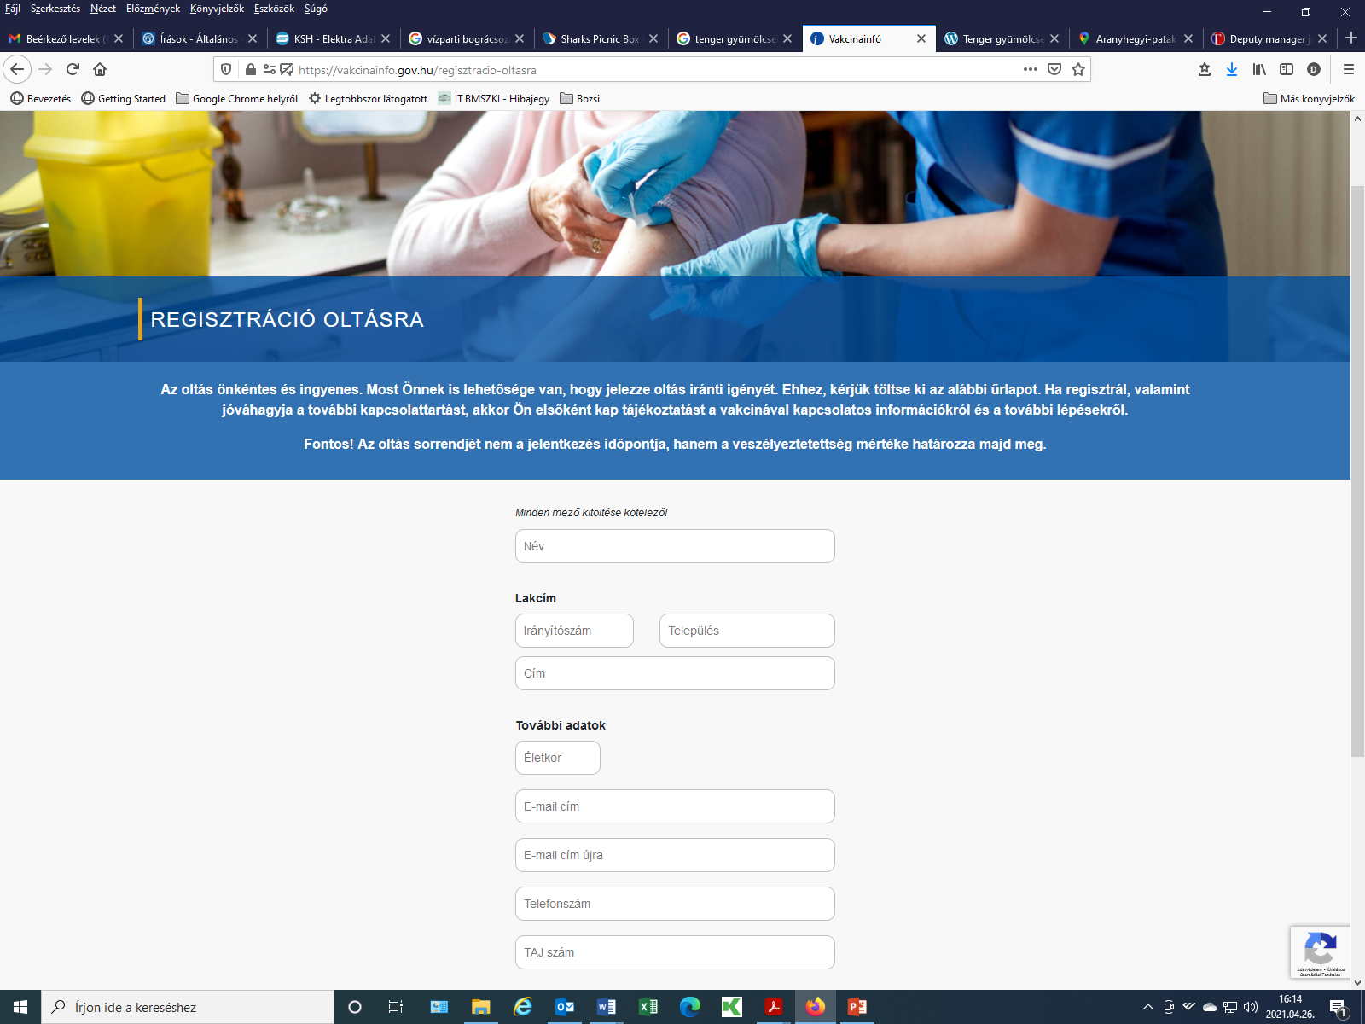
How do you get vaccine in Hungary?
Government vaccination strategy
Registration
I. Health care workers
II. Clients and workers of social services
60+ population - REGISTRATION
….

Slide 4
II. Clients and workers of social services
Pandemic 1st and 2nd waves affected seriously homes for elderly, which are residential care institution.
Later COVID-against actions – such as obligatory infection control measures, vaccination - targeted all residential care services.
Both hostels and shelters are residential care institutions (Act III of 1993 on the administration of the social security system)
Data collection in December 2020 for health care workers towards Government Office of the Capital City Budapest
In January 2021 for clients and workers of social services

Slide 5
Vaccination in our institutions
1st round: 29-30-31 January
Vaccine, doctors, assistants, equipment, etc. provided by the Government Office – Pfizer, special storing conditions
1068 clients, 334 workers (excl. health care workers)
Take-up rate: lower in shelters; 55% average (workers: 83%)
2nd round: 19-20-21 February
Enormous efforts in shelters to find clients
Take-up rate: 95%

Slide 6
Vaccination in our institutions
New data collection for a new 1st round in middle of February
Moderna vaccine, delivered to our hospital
Further 205 clients, 65 workers
Take-up rate increased to 65%
Weekly reports on COVID – 1 client in hospital this week
Vaccination for those who are far away from institutions?

Slide 7
Our experiences with the immunization
In the last two months we have collected blood from workers to check their immunization status
Nearly 200 workers (and some of their relatives) has joint to this status assessment
Our first impressions about that research:
  Approximately 80% of the clients have got the vaccination before the blood sampling – only 1 of them did not have adequate immunization
  Approximately 20% of the clients were pre-infected (and not vaccinated yet) – most of them did have adequate immunization, but their immunoglobulin levels were ten to twenty times lower

Slide 8
Lessons learnt
Pfizer: 6 doses per vial
Moderna: 10 doses per vial
Make sure your clients will be available for the 2nd round
Give reminder documentation after the 1st vaccination
Make reminder warnings before that 2nd round

Slide 9
Thank you for your attention
Dr Magor Papp, Lead Family Doctor
Istvan Dande, Health Service Deputy Manager

