Slide 1
Housing First for Youth in practice
Notes:
Lisa can you introduce.

Slide 2
Focus Ireland
Limerick
Waterford

Slide 3
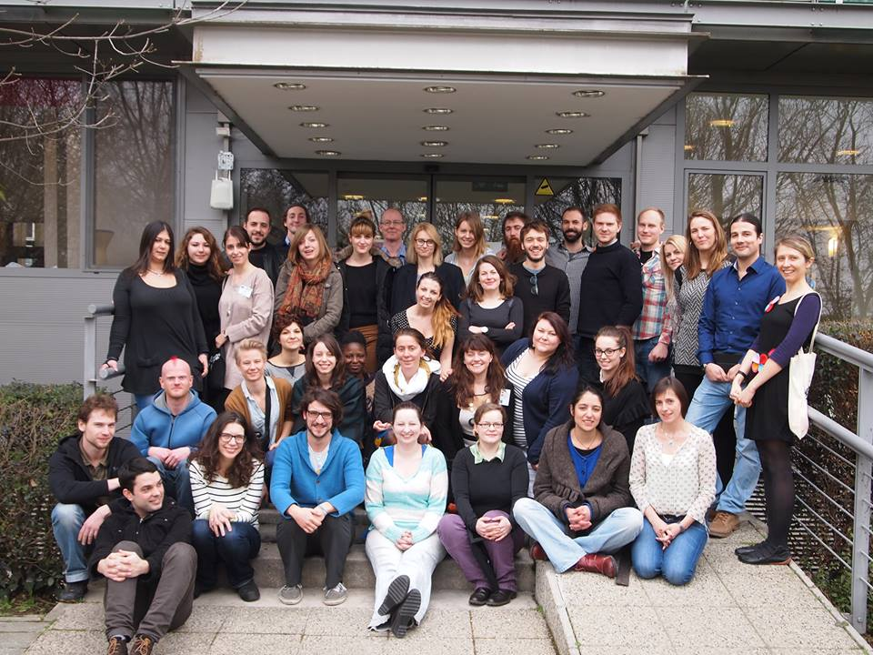
The beginning ………

Slide 4
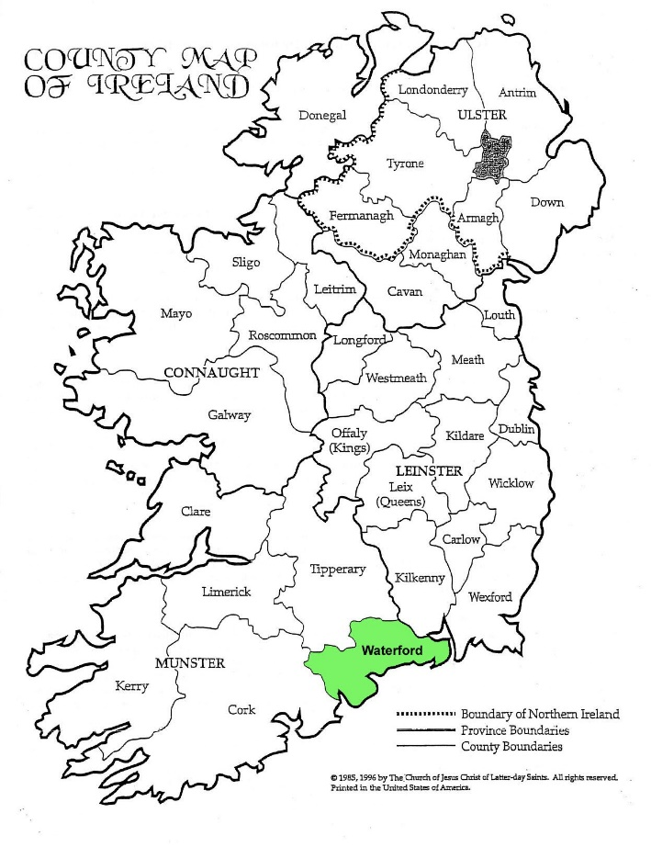
Waterford : 53,504 people live in the city, with a wider metropolitan population of 82,963.

Slide 5
Setting Up the Service – Why & How ?
Funding
Local Government - municipality
Statutory Health Service
Mentoring
Feantsa -
Service Model Details
Target Group : Young people aged 18-26 yrs. of age who are in unstable or emergency accommodation and for young people at risk of homelessness coming from state care.
Notes:
How did you start the service?

Slide 6
Base :Our base is an apartment block in the city centre that is made up of five apartments in one building and a building adjoined to the service which has three apartments . We run the aftercare service, funded by Tusla and HSE( Social Inclusion) alongside the youth housing from this office.
Tools to Service Delivery :
P.I.E. – Psychologically Informed Environment
T.C.I. – Therapeutic Crisis Intervention
Restorative Practices
Intensive Case Management

Slide 7
Types of Housing
Supported housing
Transitional Housing
Step down housing
Long term housing
Privated Rented
Notes:
Talk to me about the housing. Big issue for people. How do you offer?

Slide 8


Challenges and Remedial actions
Housing
Access
Flexible & Secure Tenancy

Slide 9

Social and Community Integration
Nimby ( Not in my back yard)
Negative perceptions and prejudice

Slide 10

Timeframes and Expectations
Young people
Society
Other professionals

Slide 11
Case Study : Customer Profile
27 year old female
Social work involvement from an early age
Family history of drug dependency
First contact with Focus Ireland through Aftercare Service at 18 years old (not using heroin)
Re-referred to HFY4 in 2016
Housed by HF4Y in 2018
Notes:
Can you take us through a real case of someone who has been through the system.

Slide 12
Experience of homelessness
After leaving care supported by Focus Ireland into private rented accommodation.
She recognised that managing family, brothers in particular was going to create issues for her tenancy.
Unplanned disengagement from service.
Next contact she was in active heroin addiction(WCC referral)
Residing as part of transitional programme (not Focus Ireland)
Spent time in RSU(Rough Sleepers Unit)

Slide 13
Steps taken by Housing First for Youth
Principles outlined by Gaetz (2013)
Immediate access to housing with no preconditions – Housed without requirement for abstinence.
Youth choice and self-determination – Offered secure gated accommodation to support manage visitors which she accepted
Positive youth development orientation – Challenges in this area due to addiction and peer associations
Individualised and client-driven supports –Supported to maintain her tenancy and engage with substance misuse and mental health services.
Social and community integration – Major challenges in this area
Notes:
Samara mentioned the principles, can you apply those for us?

Slide 14
Challenges
For the customer | For the service
Integration into community(appearance/judgements) Managing visitors Managing addiction (usage/offending) Budgeting Peers Family | Customers engagement (sporadic engagement) Supporting to attend appointments. Presenting substance affected Remaining focused on tenancy/support plan Maintaining positive relationships with external agencies(local letting agents) Staff risk assessment double cover Maintaining tenancy

Slide 15
Our Response
No preconditions – engaged with while under the influence
Tailored support plan to meet needs of Customer
Ensuring general safety of staff and customer
Warnings issued
Advocacy on behalf of the young person
Customer then needed to be moved
0% discharge into homelessness – moved customer into other property and maintained engagement and individualised support
Community integration – Opportunity for second chance

Slide 16
Lessons learned
Complex needs of Customers are not understood by private management companies (judgements based on appearance/fear)
Decision to move rather than NOT (notice of termination)
Location
Not our role to manage addiction

Slide 17
Outcomes of Service to date
Since 2015 we have worked with 42 Young people
32 young people got tenancies
96 % Sustainment Rate – includes early intervention and house moves
Zero Discharge to homelessness – working with 3 young people currently in prison. One young person disengaged from the service .
13 young people accessing education and employment
Gender balance : 48% male and 52% female
21 Young families
Notes:
Can you talk us through some of the results from the HF4Y so far?

Slide 18
Thank You
Questions ?

