Slide 1
TOGETHER, LET’S END
HOMELESSNESS !

Slide 3
INTRODUCTION
We mobilize public authorities, others organizations and citizens to design substainable solutions together.
We help the most vulnerable people get off the streets.
Our levers: hygiene and care, self developpement, networking and housing.
Street Nurses is a medical and social organization active in Brussels since 2006 and in Liège since 2019.
Notes:
In Brussels and in Liège, we provide these people with long-term medical and social follow-up.
Our ultimate aim is to help them off the streets and back into sustainable, worthy and appropriate housing, such as an individual apartment or a care home.
In our field team, we have nurses, social assistants, social workers, housing-hunters, peerworker
The purpose of Street nurses is to rehouse homeless people in order to give them acces to healthcare, welbeing and also self esteem and the possibility to have future projects.
Housing promotes wellbeing but it’s also a treatment.
How does it work with us?
We have a team of 60 people. There is 3 field team Street, housing, My Way.
The street team works on hygiene, and rebilding a person’s self esteem to motivate them to take care of themselves and help them bring about a change and the desire of housing.
We have nurses in our teams but our goal is not to provide care in the street but to redirect people to the existing network.
Then the housing team performs a housing first follow up.
and then there is the MW team wich help peoples create a future vision of themselves. They’re already stable in their housing and we see that thereare possibilities to create new desire, new dreams.
We also have other teams notably for political lobbying, raising awareness among the public decision makers to promote an end to homelessness.

Slide 4
STREET NURSES
Highly vulnerable people : who combine the following criteria of vulnerability ; hygiene, addictions, age, gender, multi morbidity, years of street life, no network, isolation, chronical physicall illnesses et mental health problems
Substainable reintegration of homeless people through hygiene, health and talent development.
Impact: 169 people in housing.
Vision: a world without structural homelessness
Notes:
We have chosen to have a focus on the highly vulnerable people on the streets.

Slide 5
ACTION : THE PATIENT
Notes:
Pre-follow-up
This is the phase in which we register all of the people that our network and individuals have reported to us. We establish a relationship of trust with our patients, which starts with us paying great attention to their personal health and hygiene. We work to bring out their own inner resources and positive characteristics.
Follow-up
Care means carefully looking after the person – this is the core of our work. It starts in the streets and continues until the patient is placed in accommodation where he or she will continue to benefit from support from professionals and Street nurses’ volunteers regularly, but less frequently. This avoids a relapse and a return to the streets.
Follow-up in accommodation
We do more than simply take care of moving these people from the streets to stable accommodation. Once the patients have been rehomed, we continue to follow them closely for a while.
Post-follow-up in accommodation
In the first 10 years of our organisation’s work, we took people off the streets who had been surviving there for eight years or more (between 8 and 25 years). These were extremely vulnerable people, with very complex problems. Those working in the medical and social sector had given up hope that these people would ever live in accommodations.

Slide 6
ACTION : NETWORKING
Presence within existing networks
Presentation
Awareness
Trainings by and for the network
Immersion
Consultation meeting
Mixed team
Inter-exchange
Outreach
Allow collaboration and coordination between services to ensure continuity and quality support for the patient.
Notes:
We try to work as much as possible with the existing network. we make presentations in hospitals, in social services to raise awareness among our public, explain our work to have a good collaboration

Slide 7
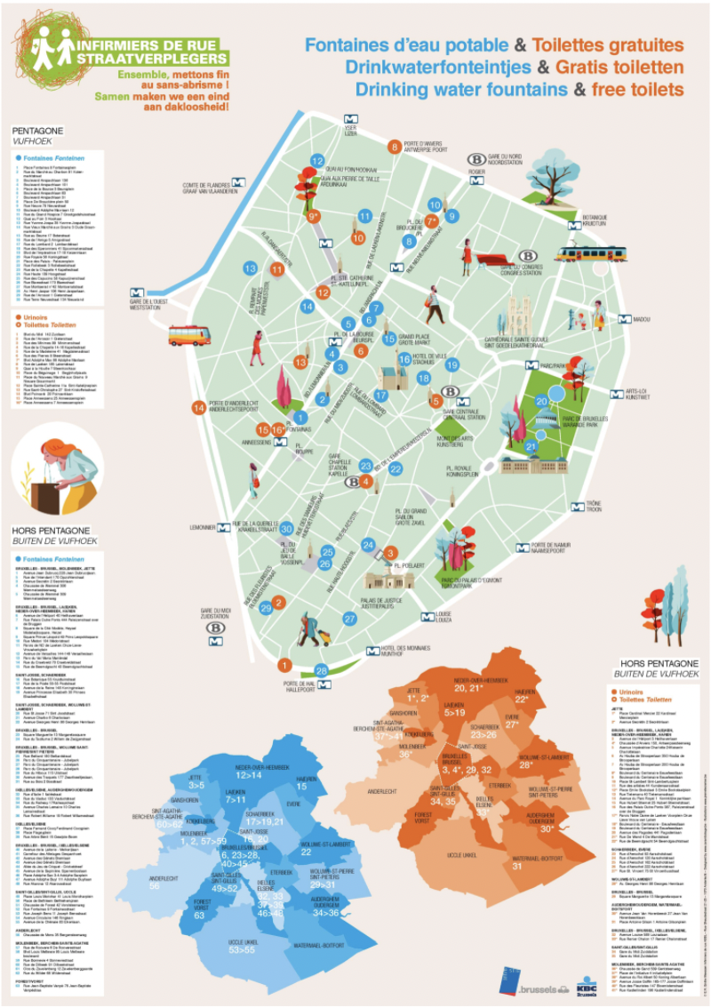
ACTION : VALUE AND CREATE TOOLS
Valorize existing tools :
Mapping of drinking water fountains and free toilets
Mapping of showers and accessibility conditions
Notes:
We create prevention and information tools to make homeless people aware of the importance of their hygiene and health, but also to improve their access to care and facilitate their reintegration in the medium/long term.
In addition, some tools are designed to raise awareness among the general public about the situation of homelessness.

Slide 8
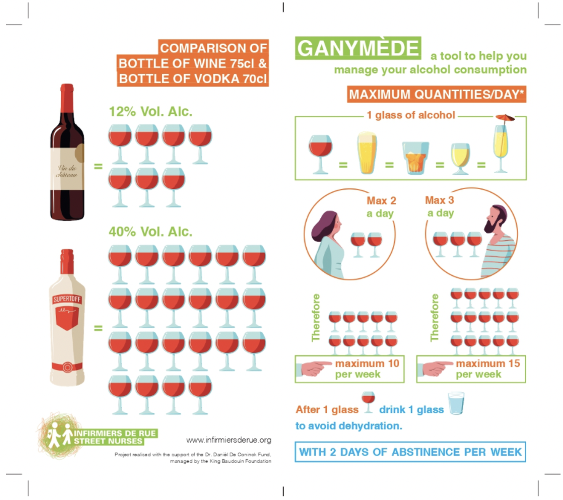
ALCOHOL
Notes:
We have here the ganymede, it is a tool to help professionals and patients to have a better idea of the consumption of alcohol, it realy is a tool af risk reduction
We have developed the Ganymede tool to help professionals to better assess the alcohol consumption of their patients. It is intended to be visual, simple to use and efficient in the transmission of information. Tool of risk reduction
Through a series of illustrations, it also allows patients to assess their alcohol consumption and to better regulate it by presenting a standard as a reference point. The tool lists various drinks with varying degrees of alcohol and their equivalent in glasses of wine, gives advice on the quantities not to exceed per day and per week, and indicates the right reflexes to adopt for reasonable consumption.

Slide 9
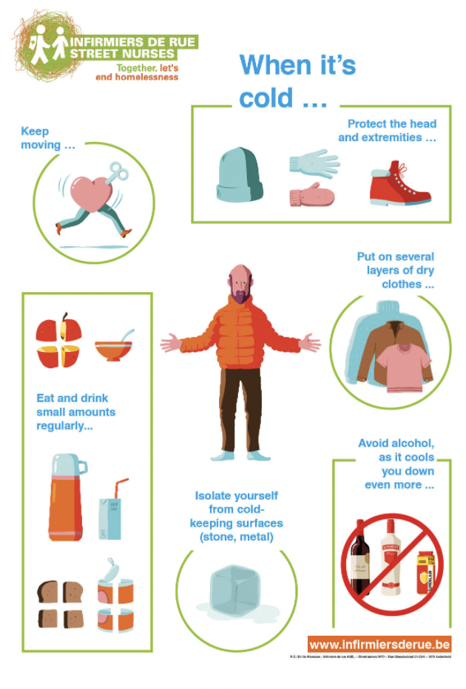
HYPOTHERMIA

Slide 10
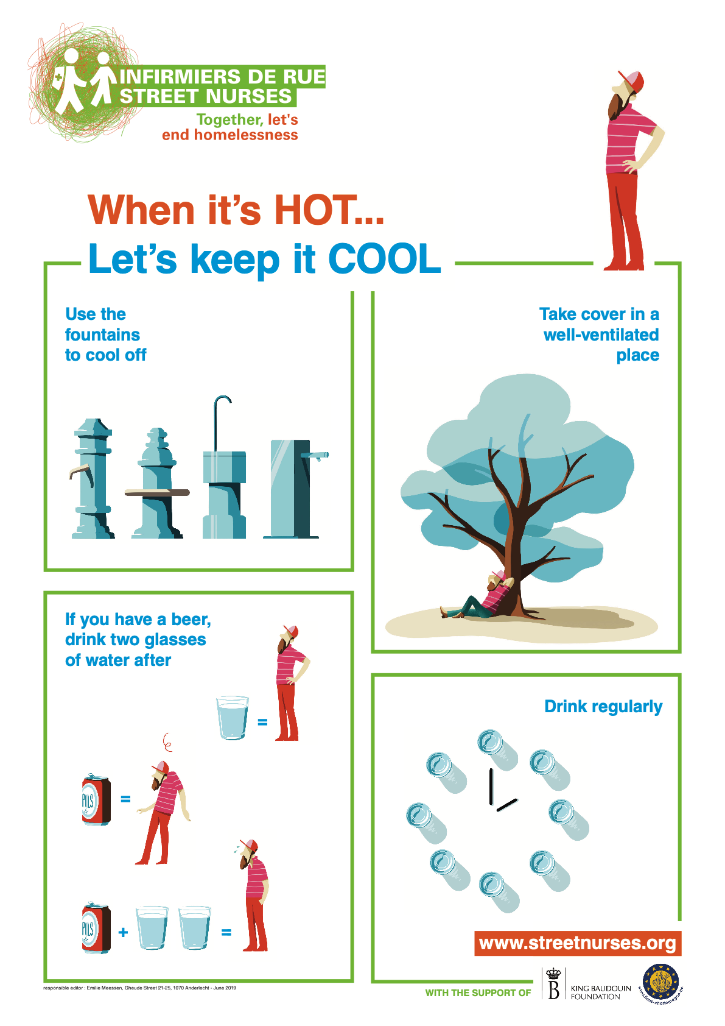
WARMTH

Slide 11
B.C.B
Notes:
The BCB (Body, Clothing, Behavior is an insertion scale for our front line workers. This tool was develop to assess from a distance the vulnerability of our public.
For each items , we put a score from 0 to 3. It can be established without direct contact with the person. It is made to have a better follow of the evolutions of the patient and to target to target the aspects that require the most attention.

Slide 12
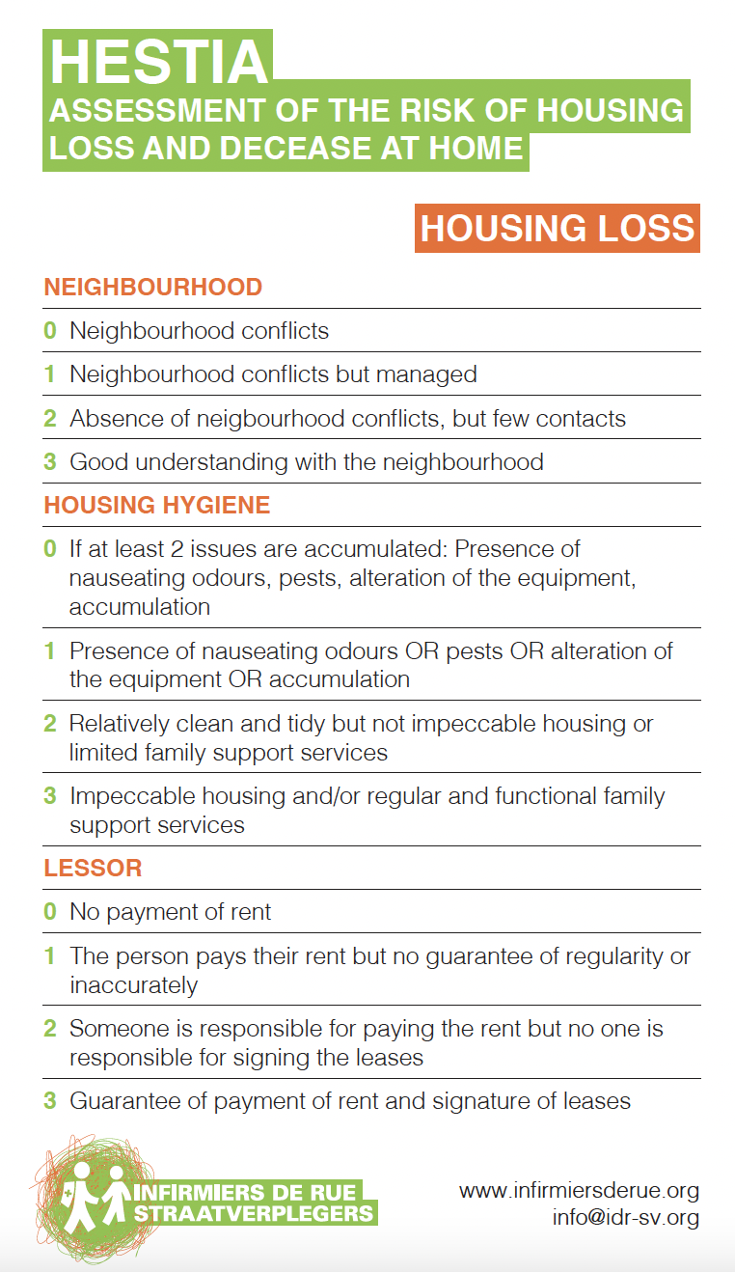
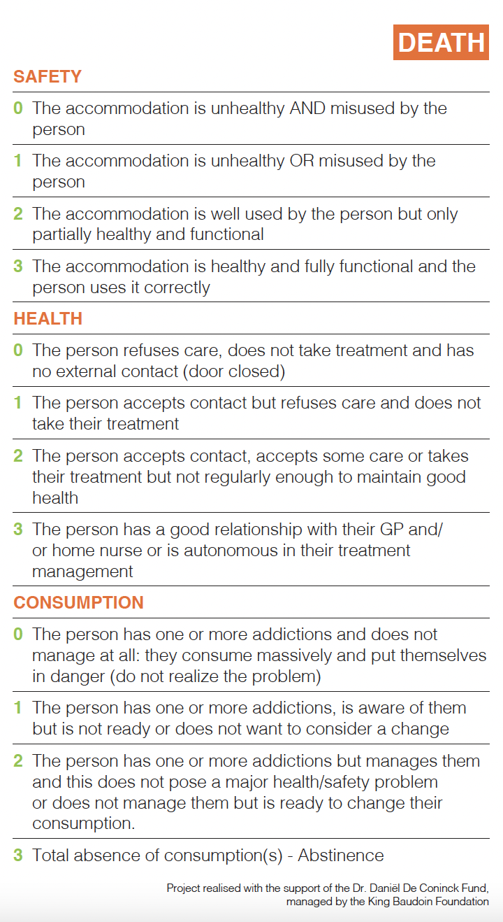
HESTIA
Notes:
The Hestia tool aims to prevent the risks of eviction and death in housing. This tool is divided into two evaluation scales that take into account a series of elements related, among others, from neighborhood relations, housing hygiene, to relations with the landlord. It also makes it possible to analyze safety, health and consumption in housing.
This scale can be re-evaluated in a similar way at each meeting with the patient thanks to the objective side of the criteria. The result does not depend on the feelings of the person carrying out the evaluation. It does offer the possibility to follow the patient's evolution and the way he or she adapts to his or her housing, and to anticipate a deterioration of the situation before it is too late. All of this is done in order to guarantee a sustainable and healthy stay in the home.

Slide 13
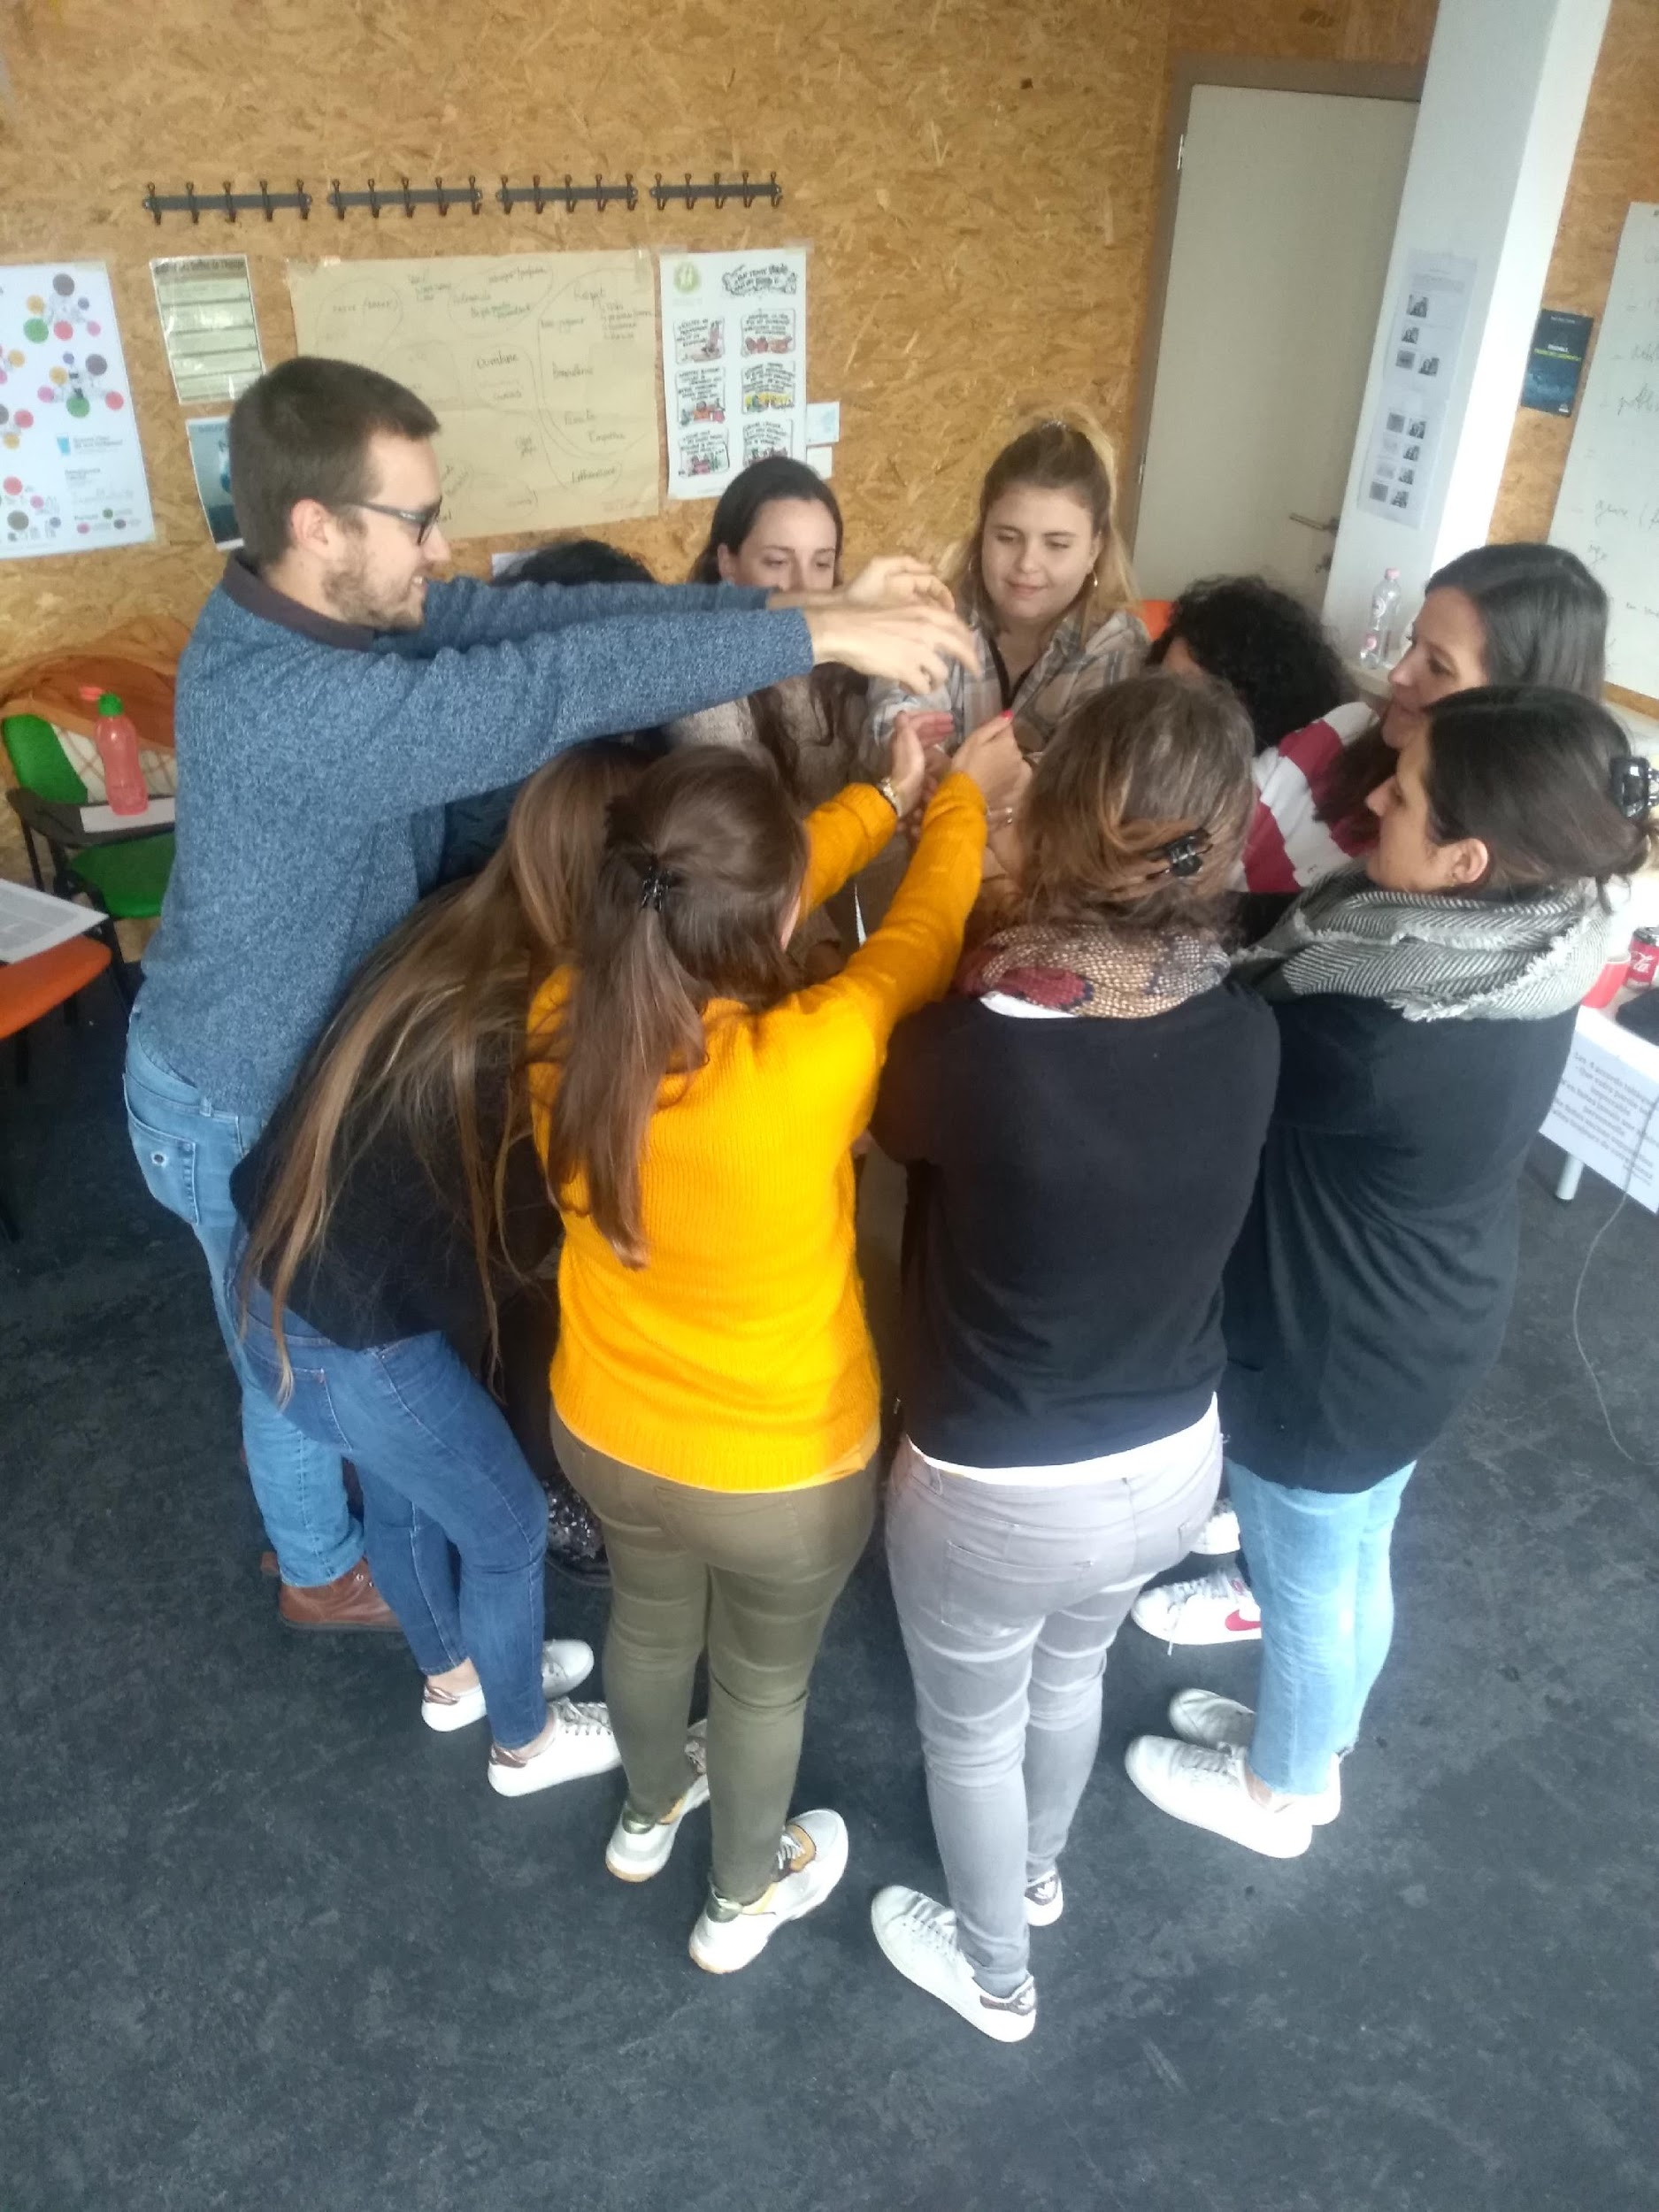
ACTION : PROFESSIONNAL TRAINING
Hygiene and poverty: how to use hygiene as a tool ?
Notes:
We also provide professional training about hygiene and poverty and how to use hygiene as a tool and break taboo about it.

Slide 14
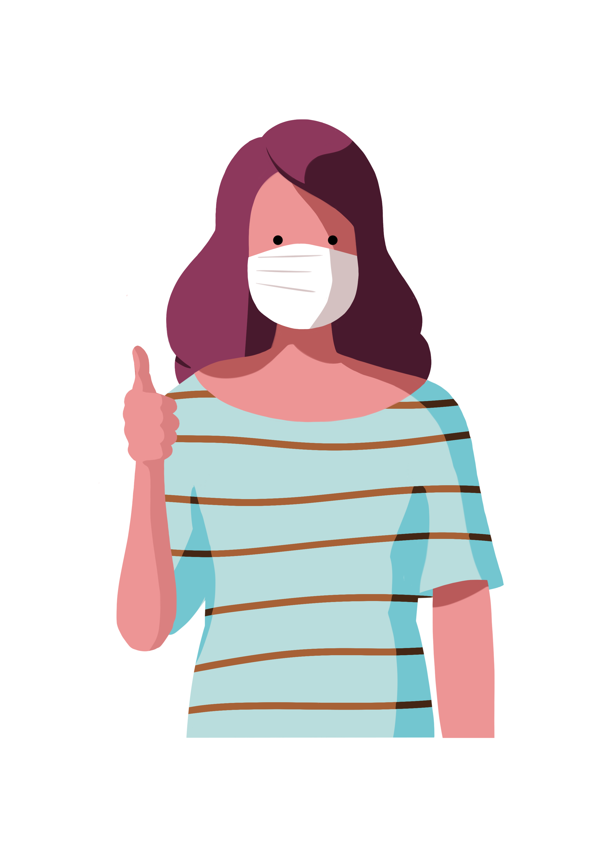
THANK YOU FOR
YOUR ATTENTION !

