Slide 1
Spotlight on Wales
Ruth Power and Jennie Bibbings
Shelter Cymru
02/06/2023

Slide 2
Contents
The Welsh statutory homelessness prevention duty, eight years on: where we are now
What have we learned about prevention? Some good practice examples
Where are we heading…
…and how will we get there?

Slide 3
Where we are now
Prevention duty (up to 56 days before homelessness)
Relief duty (up to 56 days after homelessness)
Final accommodation duty
The Housing (Wales) Act 2014 in practice
19,206 households assisted by local authorities in 21/22
67% of local authority prevention cases successful
34% of relief cases successful
69% of final accommodation duty cases successful

Slide 5
What have we learned about prevention?
Prevention must be everybody’s business
We campaigned on evictions from social housing, leading to a Welsh Government commitment to eradicate evictions into homelessness

Slide 6
What have we learned about prevention?
Prevention must be everybody’s business
We campaigned on evictions from social housing, leading to a Welsh Government commitment to eradicate evictions into homelessness

Slide 7
Source: Ministry of Justice mortgage and landlord possession statistics

Slide 8
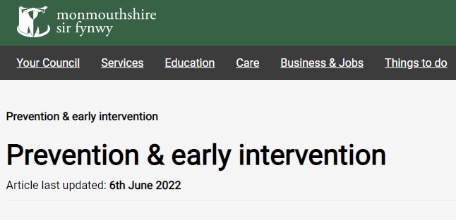
Prevention good practice examples

Slide 9
Reframing antisocial behaviour: the next stage in the journey to end evictions into homelessness

Slide 10
Where are we heading?
Wales is planning to end homelessness, not manage it
The Homelessness Action Group advised the Welsh Government on how to prevent and end homelessness.
The Welsh Government published the Ending Homelessness High Level Action Plan: https://www.gov.wales/ending-homelessness-wales-high-level-action-plan-2021-2026 and convened the National Advisory Board.

Slide 11
The Welsh housing emergency: context
88,948 households on social housing waiting lists, up 40% in 4 years
237,395 social homes across Wales: 882 completions in 21/22
Numbers in temporary accommodation increased 25% in a year
Evictions from private rented sector at unprecedented levels

Slide 13
Thank you for listening
Ruth Power
ruthp@sheltercymru.org.uk
Jennie Bibbings
jennieb@sheltercymru.org.uk
For our publications visit:
https://sheltercymru.org.uk/what-we-do/policy-and-research/
For our conference on 20 June visit:
https://training.sheltercymru.org.uk/events/

