Slide 1
Supporting Women out of Homelessness with the Support of an Expert by Experience
Riikka Tuomi, SuperNovat Project/ No Fixed Abode NGO
Pilvi Azeem, Suur-Helsingin Valkonauha NGO
FEANTSA Conference, Dublin 3rd June 2022

Slide 2
Content of our presentation
Riikka´s journey in and out of homelessness
Women specific work in housing unit and scattered housing
Importance of expert by experience in every step
Model of shared expertise

Slide 3
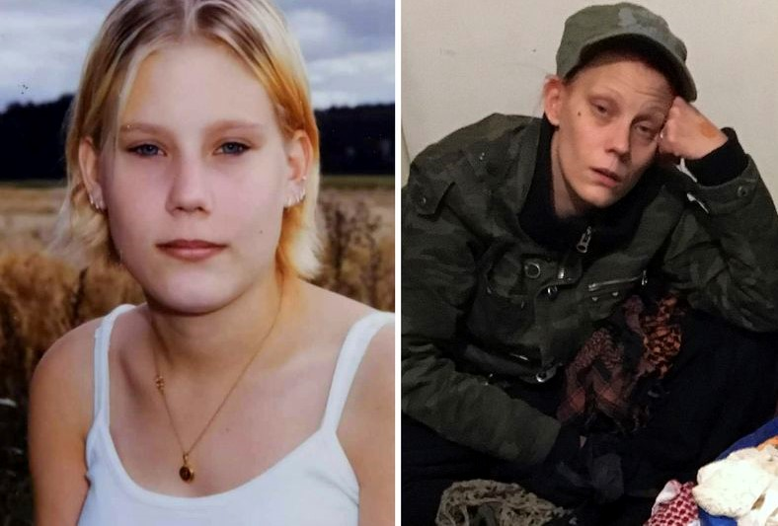
Hi, my name is Riikka
Task for you to do:
While listening to Riikka´s story please do write down in which situations and how expert by experience could have been involved .
In the end we will share these ideas together.

Slide 4
Let´s share together
Before homelessness
While being homeless and first steps towards own home

Slide 5
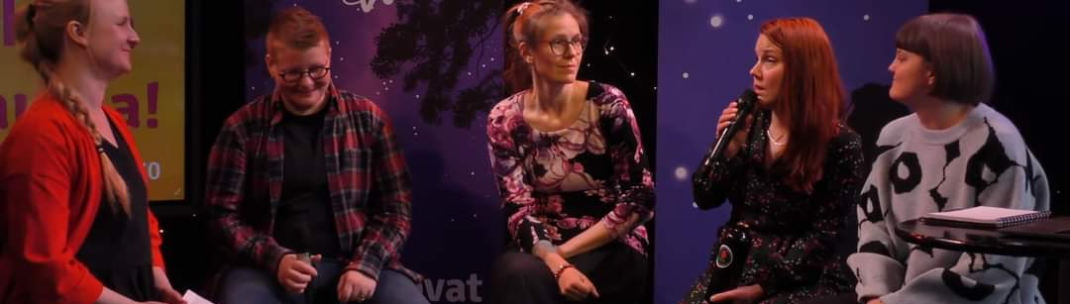
Where is Riikka now?
Expert by experience in SuperNovat Project

Slide 6
Supernovat –project
Supernovat is VVA’s & Naistenkartano’s mutual project (2021-2024) financed by
the Funding Centre for Social Welfare and Health Organisations (STEA).
The aim of the project
To support the well-being of women living on the margins of society through peer-based support groups.
To make it easier to seek and get help through low-threshold services.
To influence services to take better account of the specific needs of women.
The target audience
Women in prison, women with substance abuse issues, and homeless women.
Professionals and service providers who encounter these women in their work.

Slide 7
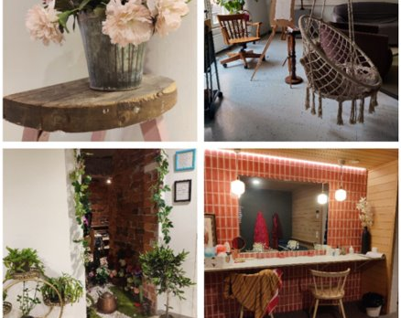
Women specific work in Suur-Helsingin Valkonauha NGO
NGO established 1928​
Supported living for women with problematic substance misuse since 1961 -> HF supported housing unit since January 2022​
2022 scattered housing support and two new units for women with problematic substance misuse

Slide 8
”Human being is at her/his best when she/he is being seen, heard and accepted just the way she/he is IN SAFETY”

Slide 9
Our Women Specific Work Housing First and Recovery Orientation - SAFETY
Hope – supporting empowerment​
Connection and interraction
Participation and community work​
Being active: individual and holistic
Team:
Housing service manager
Senior social care worker
Social care worker
6 social care assistants
1/5 nurse
Cleaner
24/7 service

Slide 10
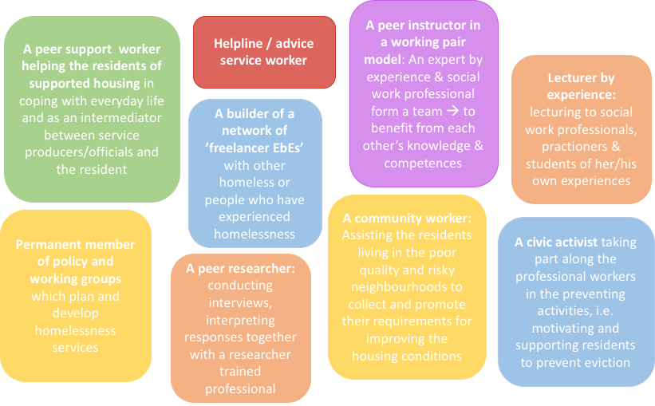

Slide 11
Expert by experience – an important member of work team
Training
Equal relationship with co-workers
Sensitivity – clear boundaries
Counselling
Proper salary

Slide 12
Kiitos Thank You
Riikka Tuomi and Pilvi Azeem
riikka.tuomi@naistenkartano.com
pilvi.azeem@suurhelsinginvalkonauha.fi

