Slide 1
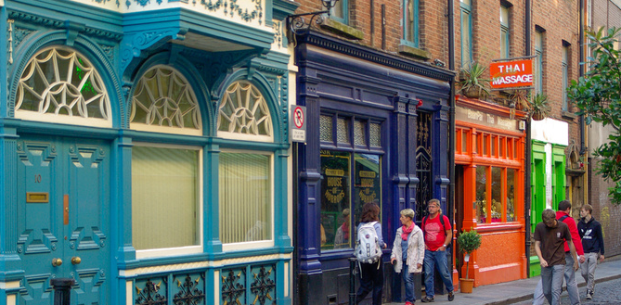
Who are the homeless sector?
FEANTSA POLICY CONFERENCE 2022
Towards a Vision for Ending Homelessness

Slide 2
Overview
Four studies conducted by the European Observatory on Homelessness
2018 – Homelessness services in Europe
2019 – The regulation and quality of homelessness services
2020 – Staffing homelessness services in Europe
2021 – Financing homelessness services in Europe
Also during 2021, EOH looked at the impacts that COVID-19 was having on the European homelessness sector

Slide 3
Diverse
Homelessness services
In design
In approach
In resources
In strategy
And in the situations in which they worked

Slide 4
Services 1
Northern EU: Denmark, France, Germany, the Netherlands, Ireland, Sweden (and in 2018 the UK)
Central and Eastern EU: Austria, the Czech Republic, Hungary, Poland, Romania and Slovenia
Southern EU: Italy, Portugal and Spain
In the North West and Scandinavia, more purpose built, fixed site supported housing, own bedrooms/studios, on-site staffing
And in Scandinavia, France, UK, Ireland, more housing-led and Housing First

Slide 5
Services 2
Emergency shelters everywhere
Daycentres everywhere
Food distribution everywhere
But more of these services in the South and East of the EU
Some Housing First in many countries, but quite small in scale back in 2018, also quite small now
Housing-led services also less common in the South and East
Prevention not widespread, some in the UK, Ireland, more organised in Finland and some other countries

Slide 6
Services 3
Big discrepancies in resource levels
A lot more being spent on services in the North West than in some Central and Southern European services
Major differences in the degree to which homelessness services were integrated into a wider homelessness strategy
This was much more variable, some countries, e.g. Finland, Denmark had highly integrated strategic responses in which homelessness services had a clear role
In a lot of countries, homelessness services were much less coordinated with health, social services (social care), addiction, housing and criminal justice services and practice was variable

Slide 7
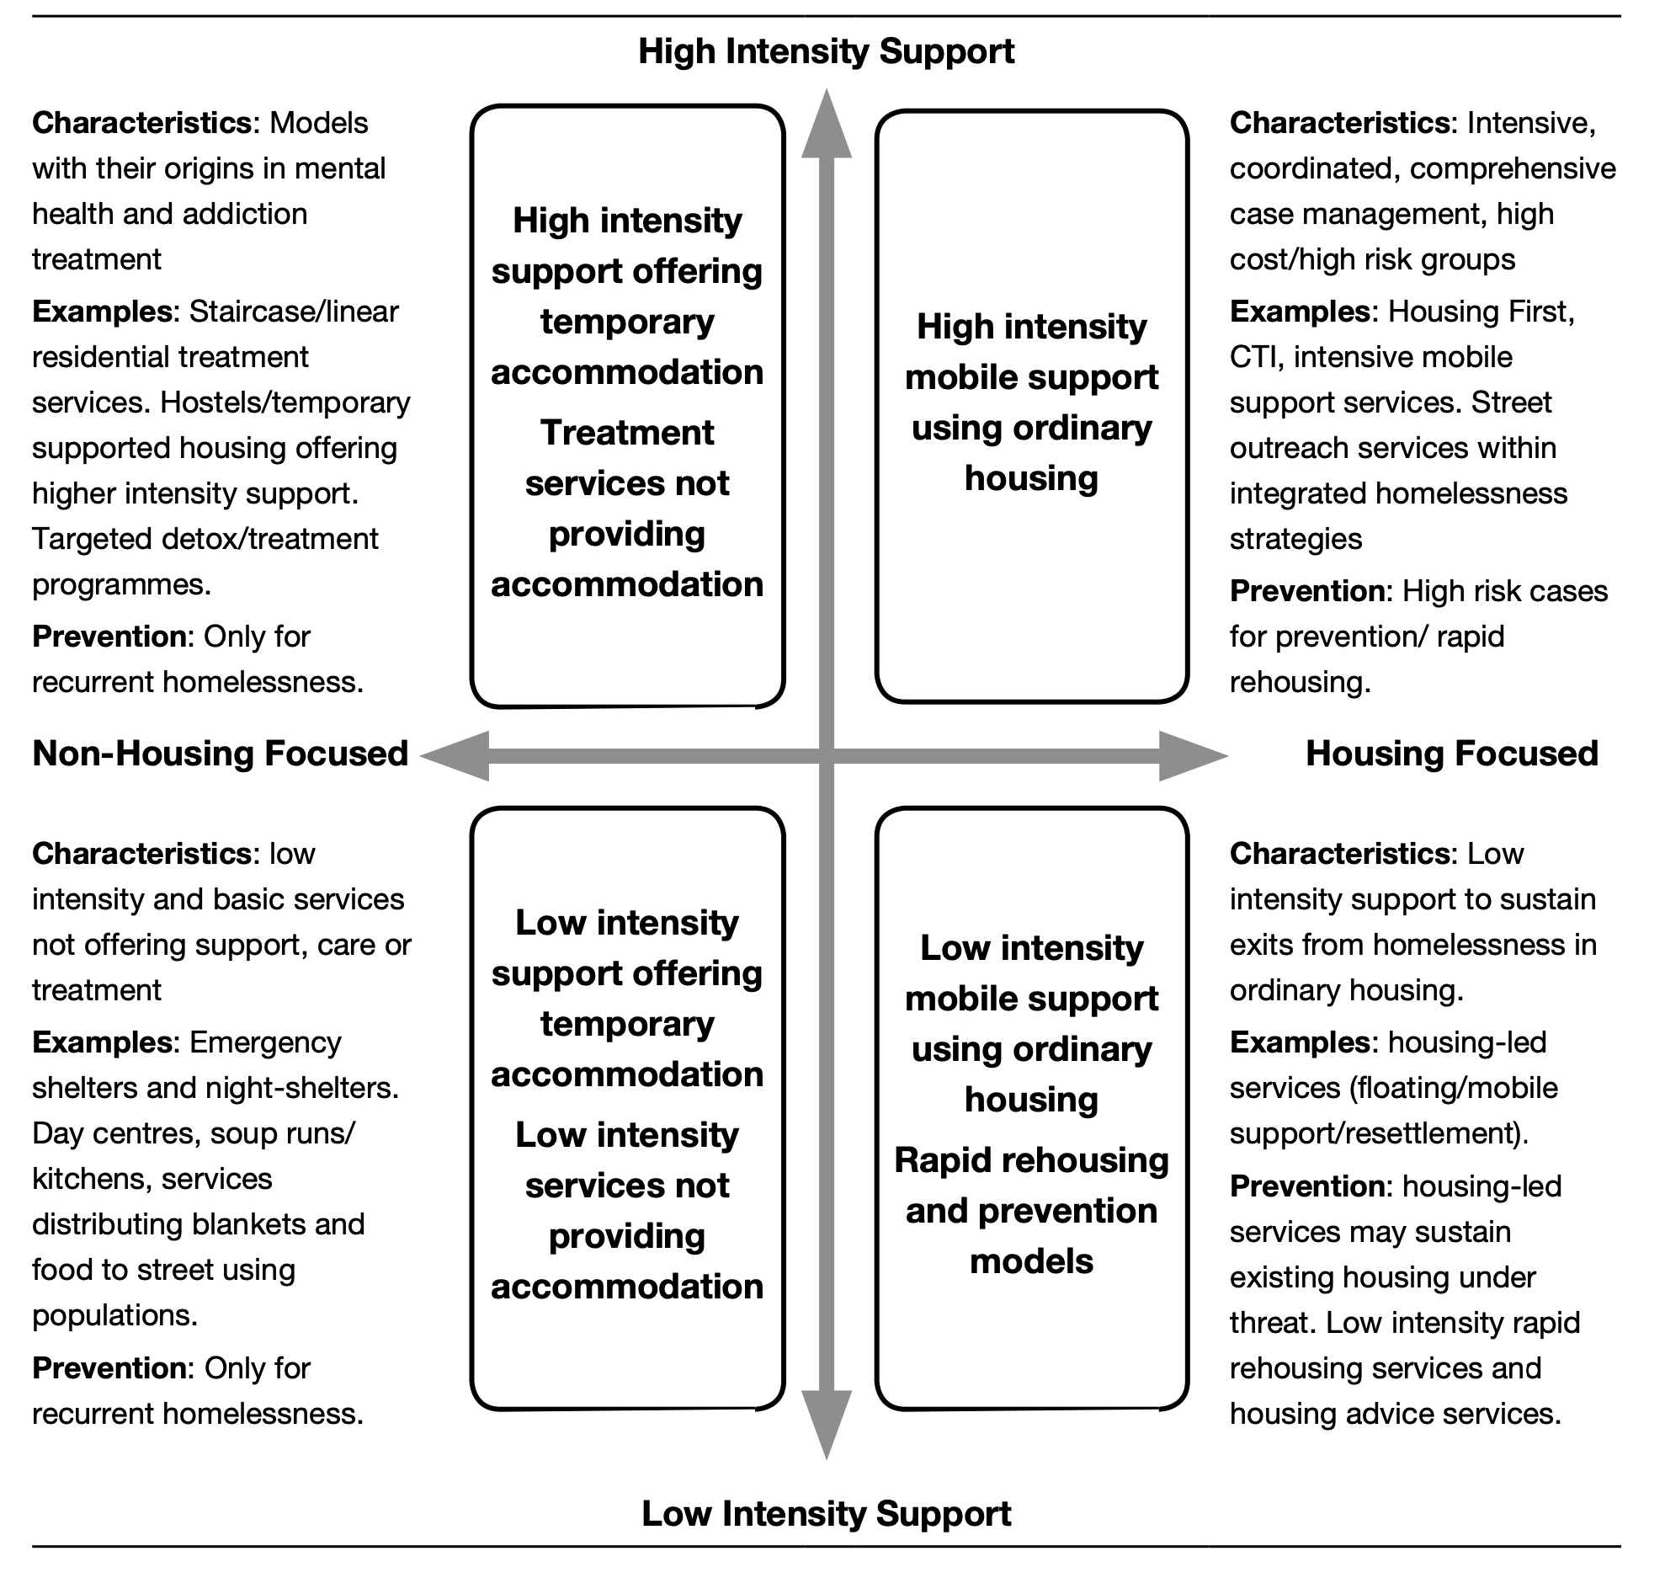
Trying to build a typology
Homelessness services

Slide 8
Later on…
Homelessness services

Slide 9
Diverse
Regulation and Quality
Legal frameworks
Regulation centred on other policy areas
Regulation and inspection
Contractual arrangements

Slide 10
Regulation 1
Austria, Croatia, the Czech Republic, Denmark, Finland, France, Germany, Hungary, Ireland, Italy, the Netherlands, Poland, Portugal, Romania, Slovenia and (still) the UK.
Statutory frameworks governing how homelessness services worked were unusual
Degree of regulation varied considerably
In Central, Eastern and Southern EU, services for people experiencing homelessness with multiple and complex needs provided through and regulated by social services (social work/care)

Slide 11
Regulation 2
Regulation and quality control through contracts, NGOs working via municipality/local authority funding, with conditions about quality and standards attached
Inspection arrangements varied
There was generally less control over who could set up and run a homelessness service than a service working with other potentially vulnerable people
Charitably/philanthropically funded services could simply open up in many countries, not be subject to the same inspection protocols as would be the case for care homes, social services (social care) or health services

Slide 12
Regulation 3
In the absence of regulation and quality standards being consistently applied the homelessness sector has organised itself to promote good practice
Internationally through FEANTSA, Housing First Hub Europe etc
But a lot of domestic examples, individual service providers promoting standards and federations like fio.PSD or Homeless Link
The homeless sector in Italy, Sweden and the UK promoted Housing First, rather than it starting with policy makers

Slide 13
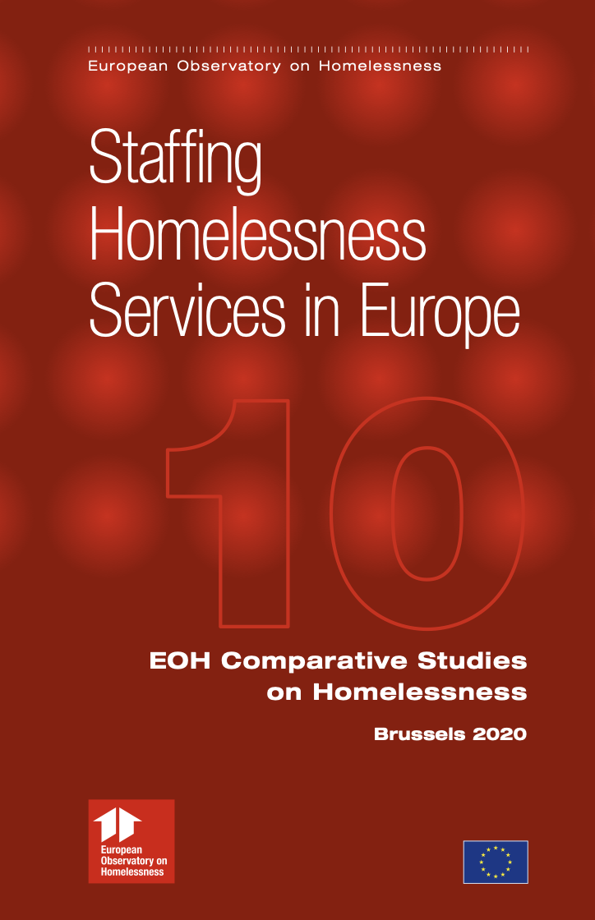
Diverse
Staffing
Some homelessness sectors are highly organised
Chance to build a secure career
But too often precarious, unstructured and with poor conditions

Slide 14
Staffing 1
Belgium, Croatia, Czech Republic, Denmark, Finland, Germany, Greece, Hungary, Italy, Netherlands, Poland, Slovenia, Spain and (still) the UK.
Experience of working across the homelessness sector was highly variable across Europe
Homelessness services in Denmark or Germany are often intensive, with relatively large budgets and use trained social workers as do state-run social services for people experiencing homelessness, as in Slovenia
But many services are emergency shelters and daycentres, much more mixed on qualification requirements etc

Slide 15
Staffing 2
Staff in emergency shelters with limited and precarious funding could be highly stressed, trying to process multiple and complex support needs, challenging behaviour and other demands on their time with limited resources
Pay was often not good, sometimes very bad
Contracts were sometimes secure, but quite often not
Challenges existed in recruiting and (particularly) retaining staff in the homelessness sector
If a service had limited and insecure funding, it was more likely to have stressed, insecure and relatively poorly paid staff

Slide 16
Staffing 3
Burnout can be a significant issue in the homelessness sector across the EU
Staff are often making personal sacrifices to keep services running and going beyond a strict interpretation of their role
Only in a minority of EU member states does the homelessness sector offer the kind of security, pay and opportunities for advancement found in health or social services (social work/social care)

Slide 17
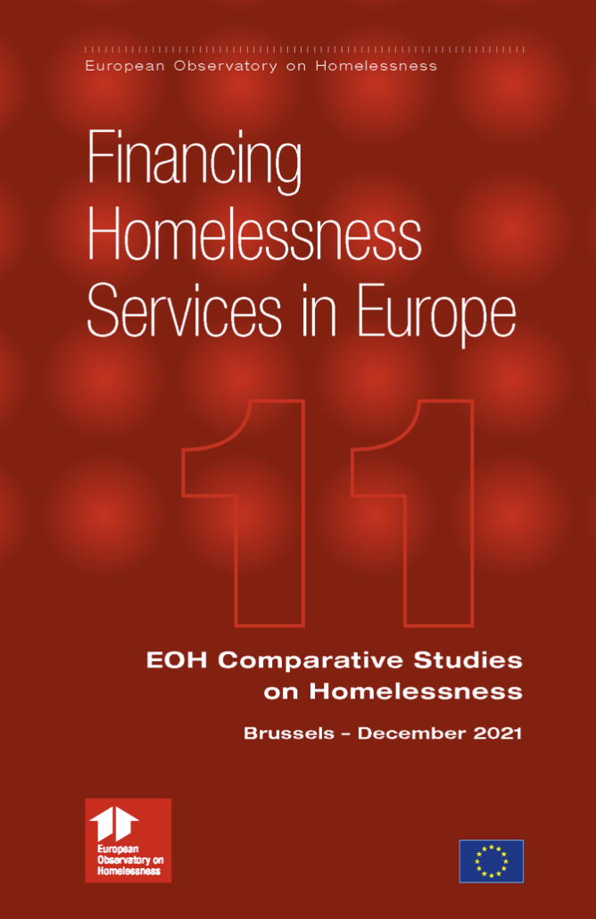
Diverse
Financing
Funding is often scattered across several sources
No two EU Member States are the same
Generally localized and often inconsistent
Variations in what is funded

Slide 18
Financing 1
Austria, Czech Republic, Denmark, Finland, France, Germany, • Hungary, Ireland, Italy, Poland, Portugal, Slovakia, Slovenia, Sweden and still, the non-EU, UK
Funding rarely existed in the form of a single, clearly defined budget, it was often scattered across multiple sources
Funding tended to be localised, run by municipalities and local authorities (sometimes regional authorities)
Some elements of funding were run by national government, particularly where support for people experiencing homelessness was part of social services (social care/social work)

Slide 19
Financing 2
A lot of discretion was exercised over regional and locally run budgets
This meant that the amount of money, what was expected and whether or not there was any money at all could vary between one municipality/local authority and another
Each EU member state organised the financing of homelessness services in a different way
Funding systems were often effectively uncoordinated, which meant they were not necessarily following national homelessness strategy, one municipality might, another one might not…

Slide 20
Financing 3
Innovation did not have a clear funding stream, there were lots of short-term pilots of Housing First, there were local authority/municipality funded services and national programmes
Legacy systems were still operating, designed around emergency shelters and daycentres, even where strategy was supposedly housing-led/Housing First and preventative
Before COVID some countries were spending a lot on ‘overflow’ services (Ireland, France, UK), mainly emergency/temporary accommodation because their formal homelessness services were overwhelmed

Slide 21
COVID-19
THE HOMELESSNESS SECTOR STRUGGLED TO KEEP PEOPLE SAFE
MANY LIVES WERE PROBABLY SAVED BY HOW QUICKLY THE EUROPEAN HOMELESSNESS SECTOR REACTED
AND VERY OFTEN DID
BUT IT HAS ADDED TO QUESTIONS ABOUT ‘SHARED AIR’ HOMELESSNESS SERVICES

Slide 22
THANKS
The studies would not have been possible without the collaboration of many people acting as experts and completing the questionnaires
Thanks to all of them
I’ve spoken today but the studies are a team effort by the European Observatory on Homelessness
Thanks for listening

