Slide 2
Unconditional right to shelter in Poland
Jakub Wilczek Polish National Federation for Solving the Problem of Homelessness

Slide 3
2015 Ammendment to Social Assistance Act
Came into power in 2016
Introduced shelter services standards (applicable since 2021)
Defined different kinds of shelter services (reinforcing the staircase model)
warming-up stations
overnight shelters
hostels
Introduced „open door” policy (unconditional shelter)
but only in basic services
Services free of charge
in hostels only if social assistance criterion met (€166/month)
Forced closer cooperation between municipalities & NGOs
Strict supervision and administrative fines for service providers (up to €5,000)
No focus on housing services development

Slide 4
Typology of shelter services
Warming-up station – overnight intervention (mostly in winter), up to 25 people in a heated room with seats only, no additional services
Overnight shelter – overnight intervention (all year), up to 20 people per room in bunkbeds, limited additional services
Hostel – reintegration (theoretically…), 24 hrs stay, intensive services
Hostel with care services (introduced in 2018) – for people who are not fully self-reliant due to their age, health or disability; considerably higher standard
Other specialised services (mothers with children, crisis intervention, domestic violence victims) – available also for people who do not fulfill Polish defininition of homelessness (ETHOS 1, 2, 3.1, 4, 11)

Slide 5
Structure of shelter services in 2016
Providers | Warming-up stations |  | Overnight shelters |  | Hostels |  | Other specialised services
 | Facilities | Seats | Facilities | Beds | Facilities | Beds | Facilities | Beds
Municipalities | 25 | 499 | 46 | 1,322 | 45 | 1,874 | 188 | 2,204
NGOs commisioned | 26 | 648 | 54 | 1,600 | 167 | 8,377 | 53 | 856
NGOs not commisioned | 2 | 65 | 16 | 399 | 103 | 4,975 | 33 | 770
TOTAL | 53 | 1,212 | 116 | 3,321 | 315 | 15,226 | 274 | 3,830
Source: Ministry of Family, Labour and Social Policy, 2017

Slide 6
Unconditional right to shelter
Art. 48a sect. 8 of Social Assistance Act:
Assistance granted in the form of a temporary shelter in a warming-up station or an overnight shelter does not require a social interview procedure, nor an administrative decision, and expenses incurred for the assistance provided are not refundable.
Only in low threshold services (ca. 19% of services available):
warming-up stations
overnight shelters (but…)
Access to hostels & specialised services requires:
social interview
administrative decision
signing a social contract
local connection or agreement with the municipality of the last registration

Slide 7
But what if a hostel is the only service?
The ammendment assumes that a full staircase model works in every municipality
Very far from reality
Small municipalities with only one service or no service at all
Intervention in hostels or reintegration in low threshold institutions
Forced to cooperate with other municipalities or NGOs in other municipalities
Lots of beaurocratic issues
Large municipalities (Warsaw!) with not enough low threshold services
Migrating homeless people are being refused services (even if living in Warsaw for several years)

Slide 8
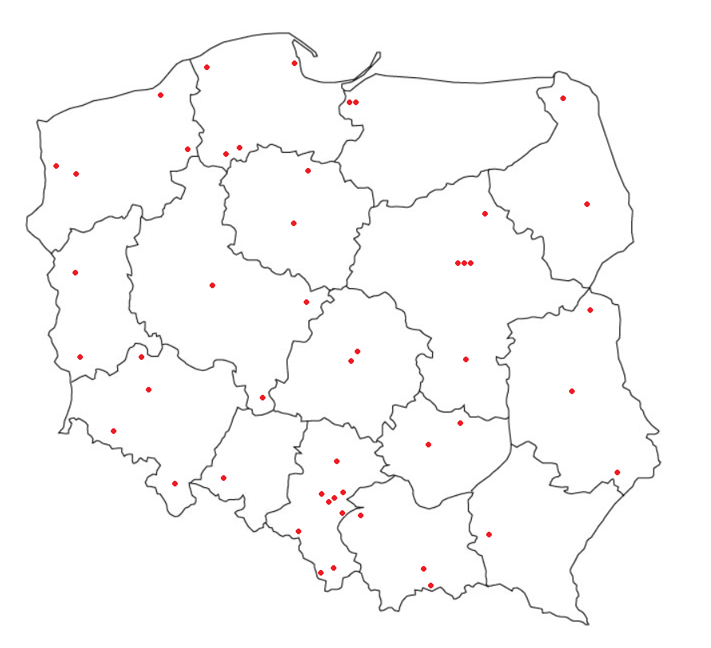
Unconditionality surveyed
Unconditional access to warming-up stations was always natural
Most overnight shelters had access conditions before 2016
An online survey was performed in May 2019 – 49 overnight shelters answered (42.2%)
Questions concerned:
conditions of access
alcohol ban
pressure from commisioning municipalities

Slide 9
Open access with… conditions?
No overnight shelter requires an administrative decision procedure (because that’d be directly against Social Assistance Act provisions)
but…
31 require meeting with an employee before admission
16 require a referral or other document issued by a local municipal social assistance centre („acknowledgement of homelessness”)
12 require meeting with a municipal social worker before admission
1 requires staying in another shelter before admission (staircase)
6 have other requirements incl. bath, health&disabilities (GP’s diagnosis!), local connection, sobriety
Only 5 declared that there are absolutely no admission conditions

Slide 10
We do not serve…
People with minors in their custody (26 answers)
People with certain disabilities – mostly wheelchair users (19)
People who do not look homeless or declare they have some place to dwell (18)
People who were removed in the past due to their behaviour – e.g. „punitive” temporary ban (18)
People with mental disorders (13)
People without required paperwork (9)
People with last address of registration in another municipality (6)
People without ID (4)
Only 7 declared that they provide service to anyone in need of shelter

Slide 11
…and we have an alcohol ban
Art. 48a sect. 6 of SAA imposes a strict alcohol (and other substances) ban on hostels and overnight shelters
Only warming-up stations are allowed to admit intoxicated individuals
but there are only 53 of them (2016) with ca. 1,200 seats
The ban may be lifted in exceptional cases (e.g. in winter)
but there are no procedures defined for lifting the ban – the risk is on the provider
some shelters declare they cannot lift the ban because it would have a negative impact on other residents who stay sober

Slide 12
So can I use your shelter being drunk?
No, never (25 answers)
Yes, but only in certain weather condidtions (20)
Yes, but only if your intoxication is very low (9)
Well, kinda – we always decide that individually (8)
Yes, but we will not let you into a dorm until you’re sober (7)
Yes, unconditionally – 0

Slide 13
Other choices for intoxicated individuals
Sobering-up station in the same municipality (23 answers)
Another homeless facility in the same municipality (warming-up station or overnight shelter) (9)
Another homeless facility in the same municipality but only in winter (20)
Another homeless facility or sobering-up station in other municipality (5)
usual solution in small municipalities, known „rides” up to 150 km (!)
Emergency room in a hospital (5)
Police custody (14)

Slide 14
People who are not self-reliant
Art. 48a sect. 5 of SAA forbids admission of people who due to their age, health or disability are not fully self-reliant into homeless institutions
After some pressure from NGOs a new kind of institution was defined in 2018 for this kind of clients – hostel with care services
The numer of such institutions is still very low (est. ca. 20-25)
The admission is restricted similarly to usual homeless hostels
Therefore, there are no intervention institutions for this kind of clients
The government claims that in intervention cases such clients may be admitted to other kind of institution, but the risk is on the provider

Slide 15
Pressure from the municipalities
The municipalities are not happy about changes introducing „open door” policy in overnight shelters
they are losing control
they must pay for services for people from other municipalities
The open door policy means that a municipality should pay for overnight shelter’s readiness for service, regardless of the numer of service users
yet, 15 declared that they are still being paid for each user,
1 respondent declared that their overnight shelter was closed due to the changes,
4 overnight shelters were turned into a hostel with access conditions,
1 declared the numer of beds was halved,
1 declared the opening hours were shortened,
6 declared they feel threatened with closure or turning into a hostel

Slide 16
Conclusions
Lack of understaning for right to shelter among providers and municipalities
It’s not easy to give up control
Overbeaurocratisation of introduced changes
Plus „risk on the provider” issues & administrative fines
Alcohol ban – a major problem to be solved
Warming-up stations and sobering-up stations are not enough
Social centres for intoxicated individuals – a good practice from Gdańsk replicated in a few other municipalities
There is no social permission for „wet shelters” (also among providers/municipalities)
People who are not self-reliant – another major issue
The network of hostels with care services needs time to grow
Is housing (first) the answer?

Slide 17
Thank you for your attention jakub.wilczek@bezdomnosc.pl www.bezdomnosc.pl

