Slide 1
EMERGENCY ACCOMMODATION IN EUROPE
IS NOT UNCONDITIONAL
Notes:
The chapter on EA focuses on two aspects: first, EA in EU is not unconditional. Access to shelter is a basic human right, it’s closely linked to the right to life and to human dignity. But this basic human right is not implemented for everyone; access to EA is conditioned by a lot of barriers – that’s what I am going to present now. The second focus, which will be presented by Sarah, will be on quality of EA accross the EU.

Slide 2
EMERGENCY ACCOMMODATION IN EUROPE IS NOT UNCONDITIONAL
Weather-response management:
How the public response to homelessness is part of the problem
A difficult route to admission, subject to the intervention of diagnostic experts
Admission criteria and prioritisation:
The selectiveness of the right to accommodation
Notes:
1 – Weather response management: in a few days, winter plans will come to an end in lots of EU countries. It means: massive amounts of people back to the street with the closing of winter shelters + new evictions of vulnerable households from their homes, leaving them at risk of homelessness, in countries where evictions are banned during winter.
2 – A difficult route to be admitted in EA services, with diagnosis often done without the participation of the users & heavy administrative procedures
3 – Because of saturation of services, obligation for lot of services to prioritize specific groups – this is done through the implementation of formal & informal admission criteria

Slide 3
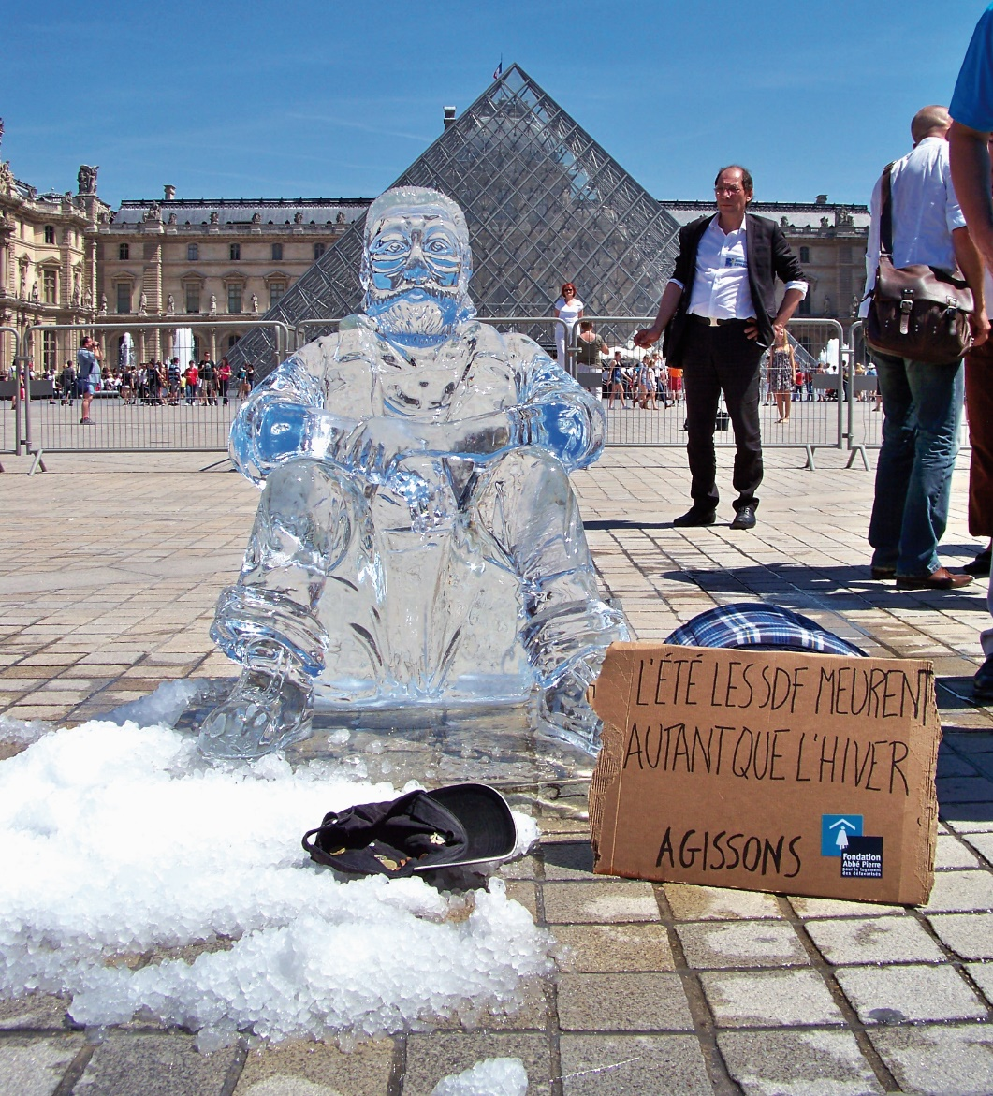
EMERGENCY ACCOMMODATION IN EUROPE IS NOT UNCONDITIONAL
Weather-response management:
How the public response to homelessness is part of the problem
Fondation Abbé Pierre
Notes:
By managing homelessness as though it is a seasonal problem, European public policy makes access to accommodation dependent on the time of the year and on the weather.
Winter plans failure & saturation of EA services during the year = first barrier in the access to shelter
Ex. FR: 36% of winter shelters users were without any accommodation solution at the end of the winter plan 2017-2018
In France, mortality peaks are observed in October, January and during the summer time.
In England, only 27% of service users surveyed obtained more stable accommodation at the end of Severe Weather Emergency Protocol 2017-2018, while 28% returned to the streets and, notably, 45% were not followed up on.
The dire lack of emergency accommodation throughout the entire year is the first obstacle to accessing accommodation.

Slide 4
EMERGENCY ACCOMMODATION IN EUROPE IS NOT UNCONDITIONAL
A difficult route to admission, subject to the intervention of diagnostic experts
“With being in and out of the hospital, this idea that everyone is sharing everything really bothered me. [...] When we return somewhere, we want to say ‘stop, I'm here now. Let’s move forward.’ But no, they keep bringing up your past failings.” Danièle
“The sense of being infantilised, of being sent from one service to the next, of being discussed when you're not even there; all this contributes to feeling socially excluded. Everything happens as though exclusion was not a transitional phase in the life of an ordinary person, but a state that keeps them outside of our collective experience of humanity. The person's experience is not seen as a scandal but as the typical situation for someone of their social standing. »
Atlantide Merlat
Notes:
People who want to access emergency accommodation services must go through an admission process that can sometimes be long and complex, in particular if prior authorisation from an organisation, public authority or a professional is required.
Role of social workers; consequences of deshumanization/complexity of staircase approaches
Similar to « job interviews », procedures avoided by some people with complex needs (therefore they are made invisible), work in silos

Slide 5
EMERGENCY ACCOMMODATION IN EUROPE IS NOT UNCONDITIONAL
Admission criteria and prioritisation
Criteria that can hinder the access to emergency accommodation in EU
Needs
> Being considered as « too self-sufficient »
> Being considered as not enough « self reliant »
> Not being considered having « priority needs »
Behavior
> Being considered as « intentionally homeless »
> Consuming drugs / alcohol
> Having been formerly convicted/in prison
> Having a domestic animal
Status
> Not having an ID document
> Not having a legal administrative status to stay in the country
> Not having a local connection with the area of the service
Health
> Having mental health problems
> Having disabling physical health problems
Notes:
Selectiveness of the right to EA
(sometimes Financial contribution)
Criteria are formal (legislation) / informal (practices) / often arbitrary and flexible, fixed because of the saturation of services & targetting specific groups (not to say avoiding others…):
Priorisation according to level of needs: ex. being considered as too self-sufficient can be a barrier to access EA in several EU countries (NL) / « priority needs » in UK
Behavior (sometimes also linked to « social reputation ») : « antisocial » behavior, drug/alcohol consumption, « intentionnally homeless », having a dog…
Administrative status, ID documents, local connection…
Having physical, mental health issues can be a barrier to access EA
+ Age, gender, nationality criteria
Focus box (by Mauro), quick comparative study on the access to shelter for irregular migrants
This leads to a kind of sordid competition of who is the most vulnerable: in Paris during the winter of 2017, for example, due to overcrowding in the services offered by the 115 phone line, a family with a child over three years old was no longer considered a priority.
Services where the access is not subject to such criteria: lottery systems / FL: importance of low-threshold services as an alternative

Slide 6
Is there an unconditional right to shelter in European and international law?

Slide 7
Right to shelter for all, a soft international law
UDHR of 1948 : right to an adequate standard of living
OHCHR | Committee on Economic, Social and Cultural Rights: social security
Charter of Fundamental Rights of the European Union : fight against poverty and social exclusion
European Committee of Social Rights : unconditional right to shelter
The European Pillar of Social Rights : adequate shelter and services

Slide 8
Right to shelter for vulnerable people, a hard international law
Geneva Conventions : international humanitarian rights
International Convention on the Rights of the Child
DIRECTIVE 2013/33/EU of 26 June 2013 laying down standards for the reception of applicants for international protection
Jurisprudence of the ECHR

Slide 9
Towards recognition of economic vulnerability ?
An attempt to dignity and a violation to prohibition of inhuman treatment
A tool to fight poverty and social exclusion?

Slide 10
Thank you for your attention.
Sarah Coupechoux – Fondation Abbé Pierre
scoupechoux@fap.fr

