Slide 1
FEAD-project: Vulnerable Homeless Migrants in Copenhagen, Denmark
Kompasset Kirkens Korshær

Slide 2
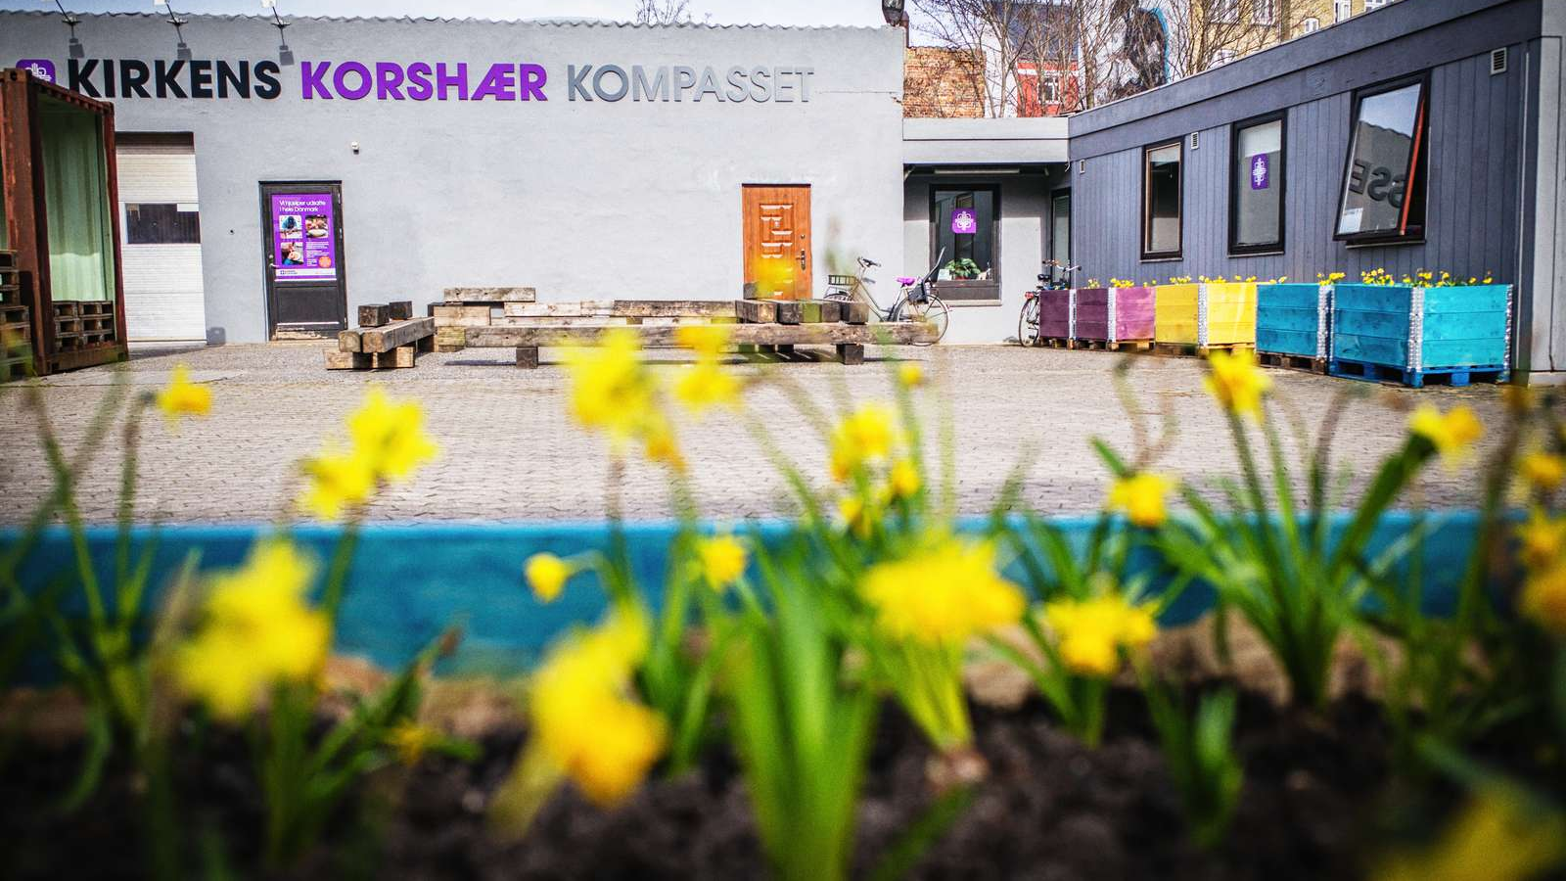
Vulnerable Homeless Migrants in Denmark
Susannah L. Sønderlund
Kompasset
Notes:
What and who we are. Presentation will consist of.. FEAD-project, lessons learned, challenges and proceeding to next program period

Slide 3
Kirkens Korshær & Kompasset
Run day and night shelters all over DK (Dan Church Social)
Largest provider of services for unregistered homeless migrants in Copenhagen
Kompasset: set up to relieve pressure on other services
Mixed public/private funding
FEAD funds 40% of Kompasset’s expenses 2016-19

Slide 4
Main problems
No night shelter
Only emergency health care
Misleading information re. rights and registration
Services spread out - different locations
Notes:
Characterized by

Slide 5
Merging services
To accomodate a broader group of homeless migrants
We wanted to:
create a comforting, respectful community
prevent destitution and marginalization
object to the humiliating conditions homeless migrants are met with
Expertise:
=> coherent and interdisciplinary service and target group specialization
Notes:
The dream: a migrant house, combining all services and expertises

Slide 6
FEAD Denmark
CRITERIA
To ensure the most vulnerable homeless people a more stable, healthy and safe life
Social outreach programs
Counselling
Social inclusion
Notes:
Program was very delayed in DK. We waited two years until the FEAD was finally opened spring 2016. App 900.000 EUR granted for three years, 2016-19. two projects selected total in DK.

Slide 7
FEAD-project 2016-19
Goal: to diminish social destitution through:
Inclusion, sound advice & information => the holistic approach
Night shelter
Outreach
Counselling
Notes:
Characterized by combining services in order to reduce social downfall. Night shelter mandatory to maintain oneself, information and inclusion to make destitute migrants able to make a decision for their own lives

Slide 8
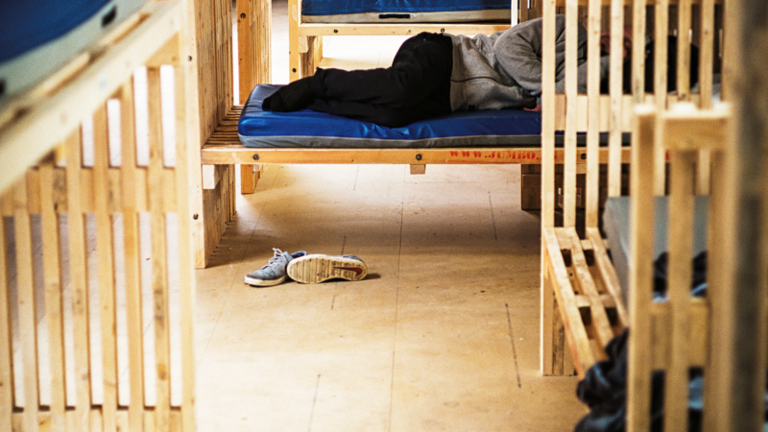
Notes:
The night shelter was going to be at Kompasset but due to building permissions and municipal bureaucracy we could not open for the night at Kompasset’s new location.
We moved the FEAD-funding to Kirkens Korshær’s night shelter for the most vulnerable citizens. 25 p per night, full, specialized staff every night of the year. You must have a referral in order to get one night’s rest. Hospitals, health authorities, outreach workers etc call ahead on behalf of destitute rough sleeper. Most users suffer physical or psychiatric conditions. Opening hrs 21-07 and then you’re on your own.

Slide 9
Night shelter
provides peace and quiet + a chance to recharge
change of plans => more specialized shelter for the most vulnerable
25 persons/night all year
physical bad condition, mental health, addiction
Hellig Kors emergency shelter established; extra not FEAD
Notes:
Not original plan, moved from Kompasset to Stengade. Finanzed own emergency shelter in local church for three seasons, only 6-7 months of the year. FEAD only Stengade

Slide 10
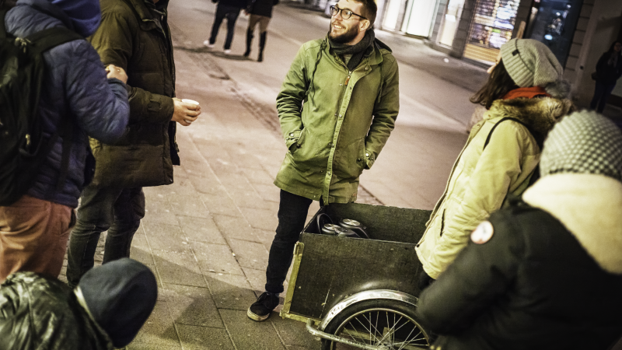

Slide 11
Outreach
multilingual team to establish contact with most destitute vulnerable migrants in the streets
intention to create connection to Kompasset, but..
coffee-users vs counselling
street magazine Strada/Illegal
accompaniment & fines
Notes:
Move around in ‘freight bicycle’, based on Istedgade/Maria church. Mostly Romanian users. Many fines and complaints. Dealing with freightened rough sleepers.

Slide 13
Counselling
multilingual and multicultural employees and volunteers offer independent guidance and mentoring
provide sound advice
assist with registration and job search
exploitation and complaints
comfort and support but also killing dreams
Notes:
Continuation of prior project to provide sound information to homeless migrants in Cph 2013-16. Solely counselling but no other services. Only reached the better top of target group. With correct information and clear advice each individual must make his own decision for his life and future. Many myths and hopes are high. We are very honest and make a point of explaining how hard it is to reach a better life/job w/o Danish language skills, network and knowledge of the Danish bureaucracy. Many vicious circles and a very structured labour market.

Slide 14
Lessons learned
demanding documentation
monitoring: has the FEAD had sufficient impact?
budget was off
adjusting to harsh legislation has made the work harder
it takes practice to merge and combine services
many new experiences have been gained
Notes:
Very time-consuming, new procedures to the Danish administrators, we hadn’t budgetted correctly e.g. applied for sufficient project management => self-financed.
We know a lot more now about merging and combining services. It’s harder than it seems. Do we reach the right group? Measuring success – how? We assist many diff people but how much matters? The people who succeed rarely return to tell us the output

Slide 15
Next steps..
FEAD II July 2019-December 2021?
benefit from three years of experience
the need is still evident – app. 800 new users per year
the holistic approach works and we reach a broad group
there are no other alternatives for these destitute people
Notes:
We hope to continue the needed project and redevelop after three years of experience. Problem: again delay in finalizing the Danish prog. Deadline was May 23rd and we won’t know till end of June. All contracts terminate June 30. Project continuation is in danger. The uncertainty is damaging and work moral is low.
Migrants still around, stable numbers but conditions are worse. Health and social downfall bad

Slide 16
susannah@kirkenskorshaer.dk +45 2335 6281
Notes:
Characterized by

