Slide 1


Slide 2
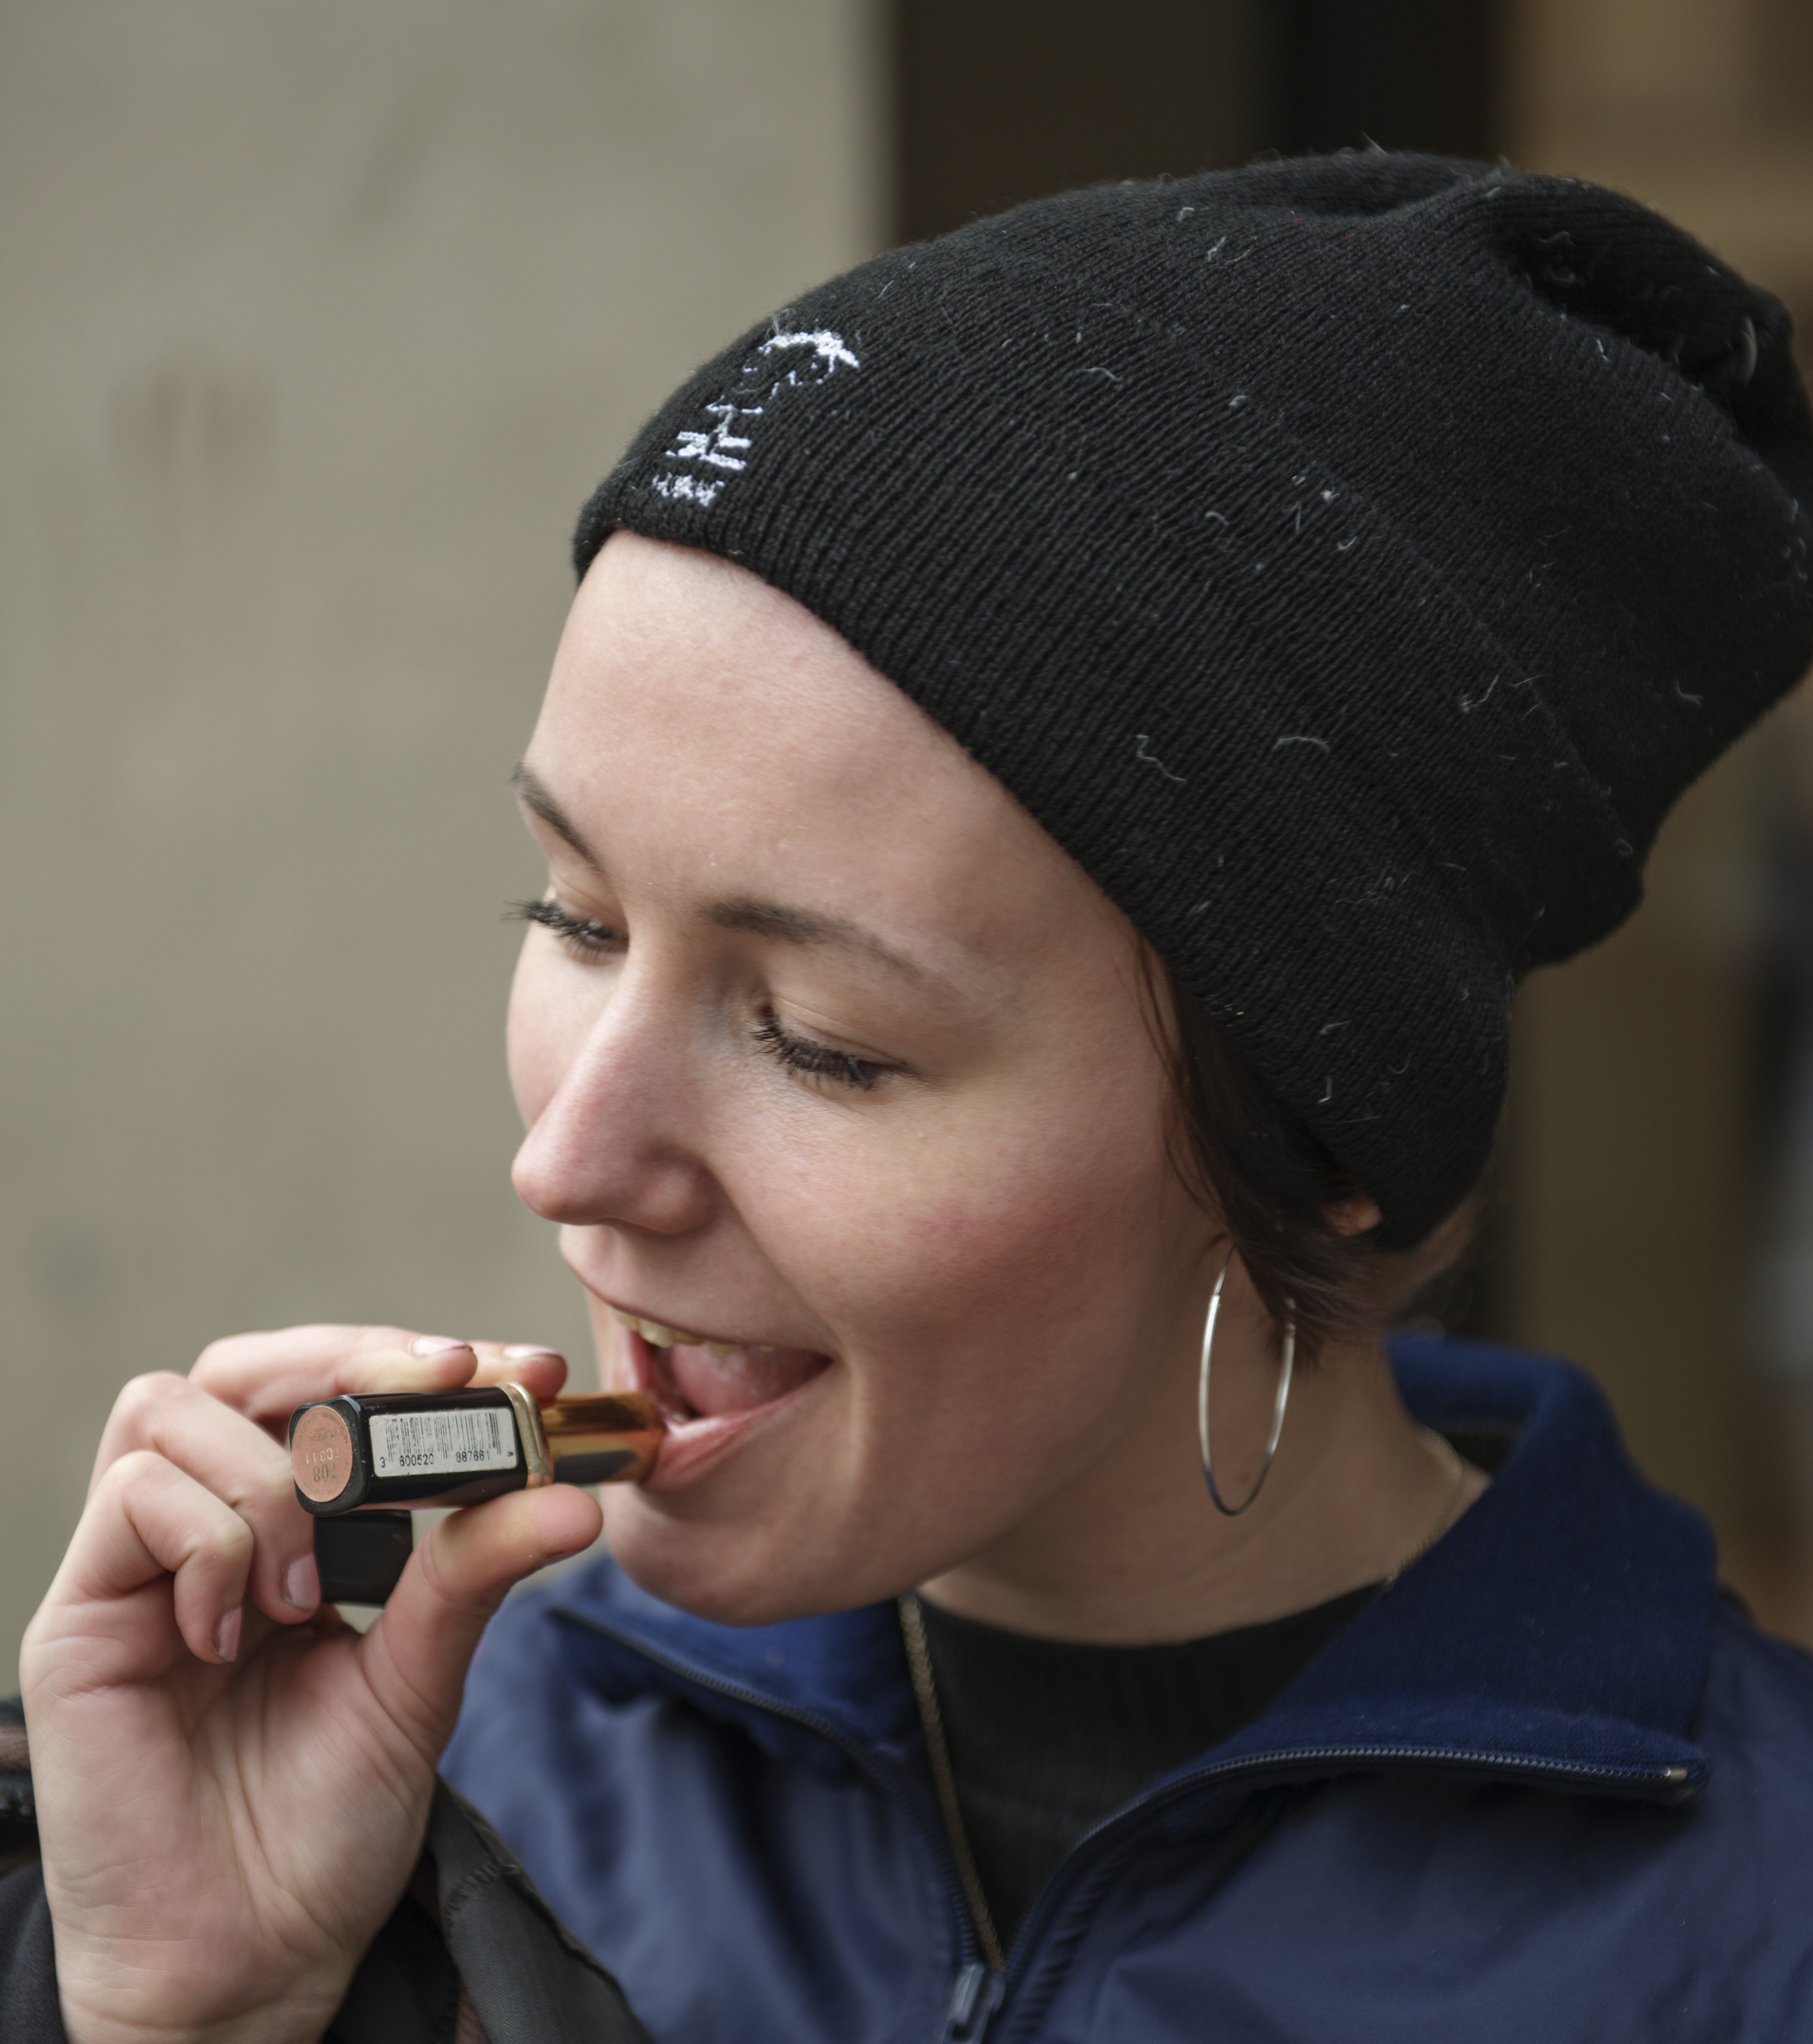
FEANTSA Policy Conference – May 31st 2019
Workshop Stream III – Bold Housing Solutions
The Student Housing Model
Notes:
Kort præsentation af Tom og mig. Og det vi vil tale om: the student housing model

Slide 3
1. Create affordable housing
2. Support holistic social support
3. Improve prevention work
Home for All
10 year
Strategic aim:
Stop youth homelessness
Notes:
Vi er med I alliance som har som mål at udryde hjemløshed. Vibe driver alliance. Tom repræsenterer den by I DK som mest systematisk arbejder efter housing first principperne. Sammen har vi skabt student housing modellen

Slide 4
From a focus on harm reduction
To a focus on what comes before and after
Prevention
Prevention
The acute:
Shelters &
Soup kitchens
The acute:
Shelters &
Soup kitchens
Housing
Housing
Notes:
Vibe: Formålet med alliance er på den lange bane at ændre hjemløshedspolitik og praksis I danmark

Slide 5
Our student housing model
Partners:
Philanthropic Foundations owners of student housing
Municipalities – e.g. Odense
Civil Society community organizers
Driver: Home for All
1
Private
Student
Housing
10 pct.
2
Co-
Living
3 pilot
testing
Youth-Actors:
Student Housing tenants committee
Young adults with lived homeless experience
3
Co-
Living
Scaling
Notes:
Udviklingsproces:
Først en stillingtagen til at unge hjemløse skal bo så normalt som andre – de er også bare unge mennesker. Beslutning om 10 pct.
Dernæst pilotprojekt i 3 byer – we work with social innovation proces – so from ideas to prototyping and then pilot test and scaling.
Nu skalering til andre

Slide 6

The ingredients:
Privately owned, permanent and Affordable Housing
Community building among tennants facilitated by NGO’s
Casemanagement – ICT – provided by local government
28
Bor i Guldborgsund
Notes:
Tom fortæller om
hvad de har gjort I Odense med Bikubenfondens kollegie.
Hvordan er samarbejdet mellem kommune, fond, hjem til Alle
Hvorfor ser Odense en pointe I at lave dette set-up. Hvad giver det
Vibe siger noget om behovet for Fællesskab – og at på et kollegie har der været eksterne NGO er inde for at skabe et bedre fælles miljø

Slide 7
The student community creates support but is also a stressful invironment
The role of the case manager can not be underestimated
The architectural design plays an active role
Close collaboration is key to success
Facilitating community for all residents
The question: 10, 20, 30 or 50%. What is the right mix of homeless young adults and students?
Experiences
and scaling
potentials

Slide 8

3 components
Designing
housing first for youth
Housing – co-living models
Social support – but with a broader scope and higher aim
Community building – access to ordinary community activities
Notes:
Dette er visionen: at unge bor dør om dør og har et fællesskab sammen

Slide 9

hjemtilalle.dk

