Slide 2
Europeans' opinions on homelessness: results from the HOME-EU citizen survey
Sandrine Loubière, Aurélie Tinland, Junie Petit, Owen Taylor, Pascal Auquier
Work package leader : Aix Marseille University (AMU)
Research unit: EA 3279: CEReSS, AMU School of medicine

Slide 3
Overview of Home-EU research
This project has received funding from the European Union’s Horizon 2020 research and innovation programme under grant agreement No 726997.

Slide 4
Overview of Home-EU – Homelessness as unfairness
Proposals focused on the effective reduction of extreme inequalities and with the aim of scientifically informing innovation in public policies in the European Union
José Ornelas (PI) and Marie Vargas Moniz (co-PI)
ISPA-Instituto Universitario
Lisboa, Portugal
European Program Horizon 2020
This project has received funding from the European Union’s Horizon 2020 research and innovation programme under grant agreement No 726997.
Notes:
Takle homelessness > inform policy makers with scientific evidence at the european level

Slide 5
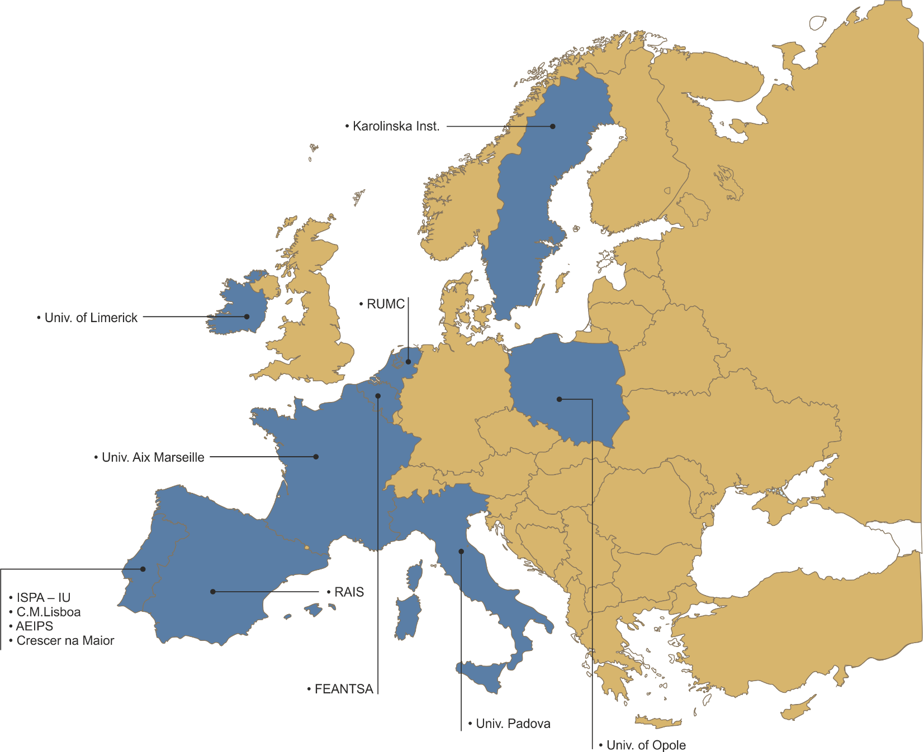
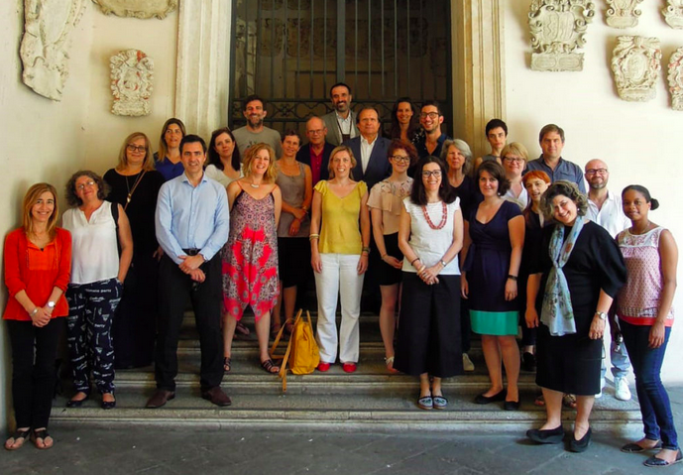
Overview of Home-EU – Homelessness as unfairness
42 researchers 12 structures
9 countries
Web site : http://www.home-eu.org/

Slide 6
Overview of Home-EU – Homelessness as unfairness
•Homelessness as a crucial Societal Challenge;
•Research & Intervention in Housing First
•Implications for Policy Development
European Program Horizon 2020
This project has received funding from the European Union’s Horizon 2020 research and innovation programme under grant agreement No 726997.

Slide 7
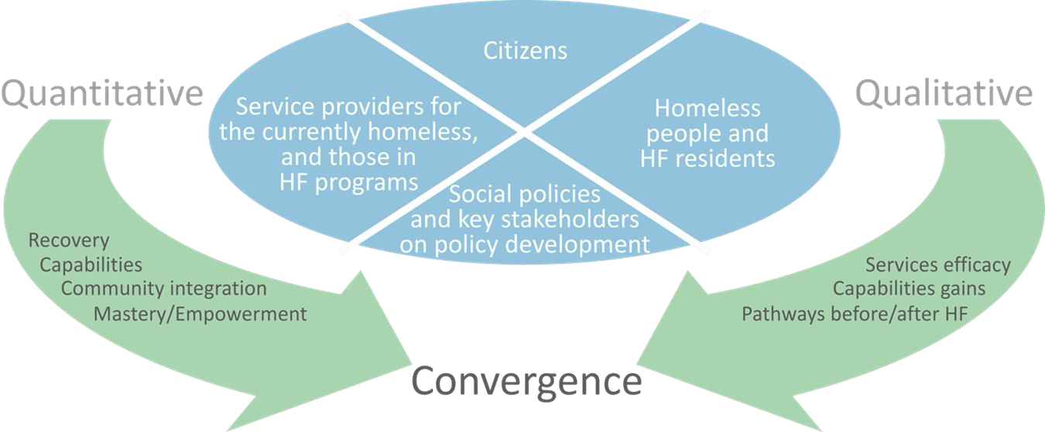
Overview of Home-EU
Research Design : Convergent Mixed Methods Design
European Citizens Perceptions
Individuals with current/past experience on Homelessness
Service Providers
Social Policies
Same protocols and measures
8 languages
This project has received funding from the European Union’s Horizon 2020 research and innovation programme under grant agreement No 726997.
Notes:
The same measures in 8 langages

Slide 8
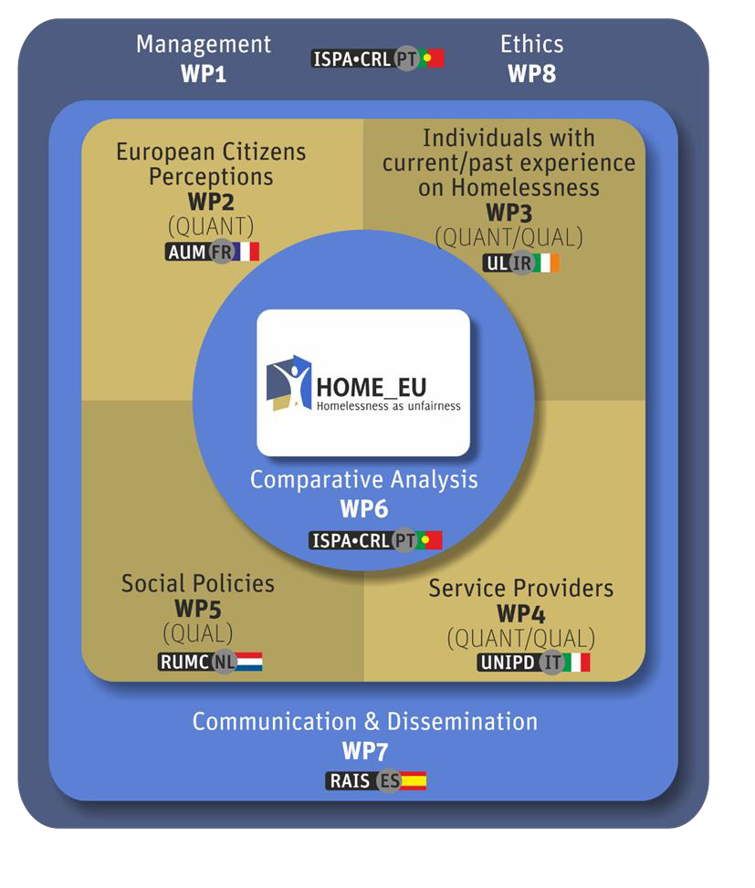
Overview of Home-EU: Perth diagram
This project has received funding from the European Union’s Horizon 2020 research and innovation programme under grant agreement No 726997.

Slide 9
Europeans' opinions on homelessness: results from the citizen survey
This project has received funding from the European Union’s Horizon 2020 research and innovation programme under grant agreement No 726997.

Slide 10
The WP2 and its objectives
To analyze:
*Europeans’ perception of homelessness (Knowledge, attitudes, and practices survey)*
Europeans’ willingness to pay for the Housing First model (Madrid 19/06/19)
Lifetime prevalence of homelessness within the general population of 8 European countries (Madrid 19/06/19)
This project has received funding from the European Union’s Horizon 2020 research and innovation programme under grant agreement No 726997.

Slide 11
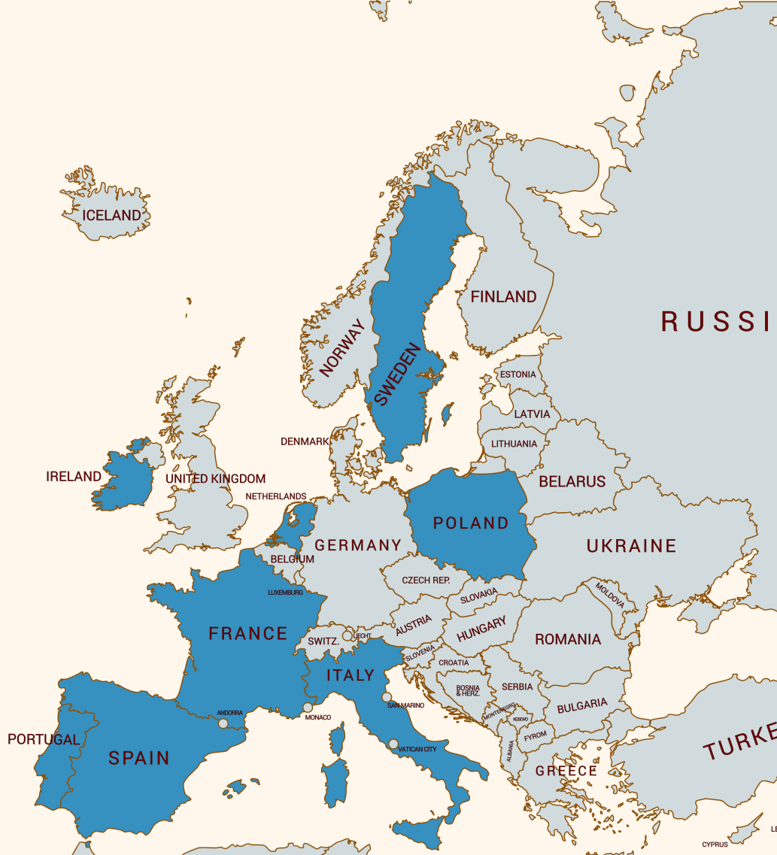
The Citizen Survey: method and implementation
Data collection period : March 2017 to December 2017
Desired number of respondents : 700/ country (5600 in total)
Survey implementation:
Landlines and mobile phones
42 interviewers recruited and trained (2 or 3 per country)
Programming survey on VOXCATI (Computer Assisted Telephone Interviews)
Data collection
Initial sample of 2,500 people per country ; Response rate of 30.4% to 33.5%
Total number of respondents : 5631
Final number of valid questionnaires: 5295
Weighted Samples

Slide 12
KAP Results from the Survey
Knowledge
Number of people who are homeless
Source of funding for social and healthcare services for people who are homeless
Attitudes
Perceptions of people who are homeless
Causes, capabilities, life conditions
Practices
Actions taken to address homelessness

Slide 13
1.1 Knowledge – Number of people homeless
Q: Could you tell me approximately how many homeless people there are in (country)?
Response value compared with official estimates

Slide 14
1.2 Knowledge – Funding of services
Q: In (country), who funds most social services/healthcare facilities for homeless people? A: Govt/NGOs/Churches DK/R

Slide 15
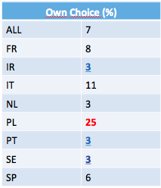
2.1 Attitudes – Causes
Q: In your opinion, what are the THREE reasons that best explain why people become homeless?

Slide 16
2.1 Attitudes – Causes – Comparison PT

Slide 17
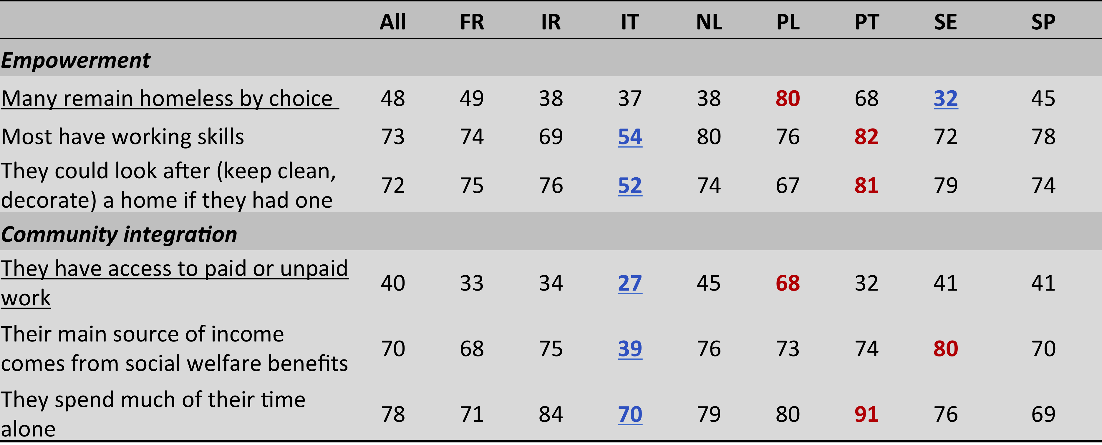
2 Attitudes – Lives of people who are homeless
Perceived limitations in power to act: % in agreement

Slide 18
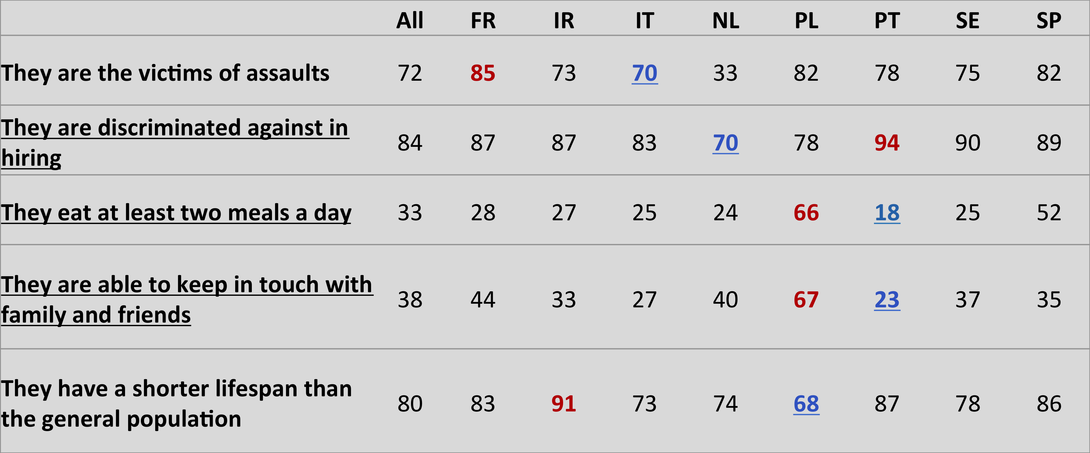
2 Attitudes – Lives cont.
Perceived limitations in capabilities : % in agreement

Slide 19
2. Attitudes – spending

Slide 20
2. Attitudes – spending cont.

Slide 21
2. Attitudes – Willingness to help
Q : To reduce homelessness, would you be willing to…?
(Yes/Know DK/Refuse)

Slide 22
3. Practices to adress homelessness

Slide 23
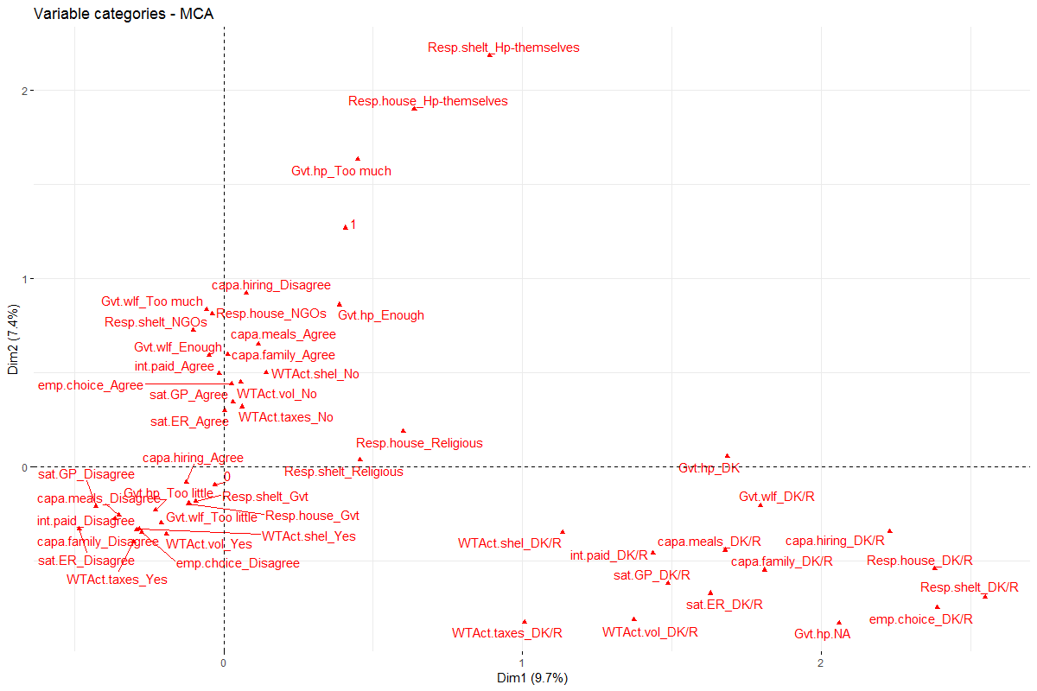
Cluster analysis on MCA
Red = Negative (30%)
Black= Positive (58%)
Green= Indifferent (12%)

Slide 24
Analysis
Relations between opinions and sociodemographics
Compiled three aggregate ‘attitude’ indicators:
Positive; negative; indifferent
Majority of people (58%) held positive attitudes towards people who are homeless
Older respondents; rural areas; respondents from France and Poland all less likely to report positive attitudes
Respondents with better knowledge scores were also less likely to report positive attitudes
Other sociodemographic indicators (gender, relationship status, etc.) not statistically significant indicators of attitudes

Slide 25
Conclusions
Knowledge
– generally poor
Attitudes
– generally positive; some significant negative perceptions; reluctance to pay more in tax
Practice
– generally high level of personal donations (food, money, clothing); generally low levels of voluntary work (except in Portugal)

Slide 26
THANK YOU!!! www.home-eu.org
This project has received funding from the European Union’s Horizon 2020 research and innovation programme under grant agreement No 726997.

