Slide 2
CASO (Consumers Associated Survive Organized)
Peer Work to promote health and citizenship among People Who Use Drugs and are in situation of homelessness, and… , …
Notes:
CASO appears in 2007 as an informal group that developed through the years of crisis and registered as a formal association in 2010. In the social bodies of the organization (General Assembly, Fiscal Council and Board) only people that have seen their lives impacted by the proihibition International Conventions system, can be elected Our mission is to promote health, human rights and dignity among people who uses drugs. We develop our attempt to represent and give voice to the interests of People Who Use Drugs taking into account the memory and experience of self-care among users when in the 80's the AIDS epidemic appeared and devastated our community. So, our vision is of developing a self-organized, self-regulated system where liberty, coexists with solidarity and responsibility. As a membership based organization we have privileged relationships with people that use and the contexts of using, which can easily be empowered to develop structured Peer Work.
So we found some needs in our daily contact with community:
- health promotion
- re-connection to health care services, social benefits, education/training/employment, housing, and all the different sectors of the state that are required to promote integrated answers that enables way for citizenship,
-self-acceptance and more accurate self-concept and self-esteem.

Slide 3
Peer Work – an example of community-based micro-projects
needs
health promotion
re-connection to health care services, social benefits, education/training/employment, housing, and all the different sectors of the state that are required to promote integrated answers that enables way for citizenship,
self-acceptance and more accurate self-concept and self-esteem.
Notes:
So we started with a capacity building action of 6 days for people that use drugs and know the contexts of using and are more organized in their self-care. In the end, the last 2 days were for designing micro-projects to develop in their own social housing neighborhoods with an open scene of drug consumption.
The targeted population was people who use drugs and are at circumstances of vulnerability, namely because of being in situation of homelessness, engaging in street sex work, with psychological disturbance prior and/or post using drugs, people that in their routines are not accessing the services of the state, people that are living and using drugs in unhealthy and degraded consumption spaces, thus being more exposed to diseases and violence than would be required by simple consumption.
The methodology was based in peer work, being there, feeling there and then from there improve conditions the best possible.
The implemented pilot-projects had a Peer monitor and all the team had weekly supervision.
Some of the results were: a clean room in an abandoned place that had syringe and needle kits, foil, and condoms and lubricant, 24h services; we engaged with more than 150 people regarding their health conditions, we articulated with services to facilitate access to care and protection. We took people to be tested and referred, we escorted and help people to complaint services or to mediate conflict or emergency situations, we try to be there and find the different layers these realities have. We had a bonus because a film director registered all this and produced a film of 17min about the project.
This is an example of a recent project, we're also involved in the European Network of People who Use Drugs (EuroNPUD) and at the same time in the local Consortium of NGO's that in Porto developed a proposal for Safe Consumption Spaces Program for the city.
We try to develop political advocacy but also concrete projects that provide better answers for people.
I hope this is of help for now, I'm going to work during the weekend and early week dedicated to provide the needed information and am available for any guidance or feedback you can give so I can use the best I can this opportunity.

Slide 4
Peer Work – an example of community-based micro-projects
Involved population: people who use drugs and are at circumstances of vulnerability:
being in situation of homelessness
engaging in street sex work
with psychological disturbance prior and/or post using drugs
people that in their routines are not accessing the services of the State
people that are living and using drugs in unhealthy and degraded consumption spaces, thus being more exposed to diseases and violence than would be required by simple consumption.
Notes:
We are the 1st to be there…
We are the most trustworthy…
We have ethics and want the best for our community…
Goals:
- 2030 goal of HCV elimination
- to promote, monitor and evaluate work done among Peers
- channel money to real people and their needs
needs
health promotion
re-connection to health care services, social benefits, education/training/employment, housing, and all the different sectors of the state that are required to promote integrated answers that enables way for citizenship,
self-acceptance and more accurate self-concept and self-esteem.

Slide 5
Structure
6 day training
6 months micro-projects implementation
Evaluation and dissemination

Slide 6
Some gains
People escorted to:
Testing and referral.
Formal complaining of some services
Help with personal documentation including ID
Improved knowledge on the different layers these realities may have.
Optimize cleaning in consumption spaces.
Secondary distribution of harm reduction materials 24h.
Re-connect people with public services and other servisse providers
Colaboration and articulation with different service providers

Slide 7
Some learnings
Careful not to underbudget with the will to move forward with solutions… invest in planning.
Importance of developing a good simple method to keep registering intervention.
Deepen the cooperativeand complementary work with servisse providers.
Resist, persist and never give up to promote citizenship and equitative access to services.
Protect Peers and contexts.
Promote self-development and emotional support to peers.

Slide 8
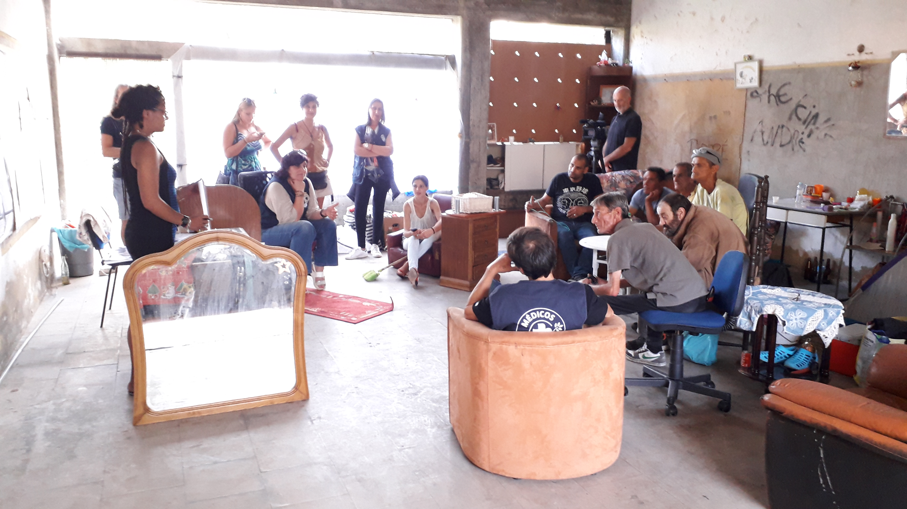
Peer Work – an example of community-based micro-projects

