Slide 2
Homelessness and Palliative care
Dr Caroline Shulman
GP in Homeless and Inclusion health
Kings Health Partners, University College London, Pathway
@carolineshulman

Slide 3
Overview
Homelessness and Health
Our research into palliative care
Challenges in palliative care access and provision
Recommendations
Training
Homelesspalliativecare.com
Current project
Twinning palliative care and homelessness services
Facilitating MDT working

Slide 4
Homelessness in London
Rough sleeping
There was an increase of 104% in the number of people seen rough sleeping on the streets of London between 2010-2011 and
2016 – 2017
Homeless hostels
9,186 bed spaces for single people who are homeless pan London in 2015-2016 (a 26% decrease from 2011-2012)
Temporary accommodation
54,280 households in temporary accommodation in London in 2016-2017
Hidden homelessness
Unknown

Slide 5
Underlying causes of homelessness
Many routes to homelessness – Structural and Individual
Inequality
Welfare
Adverse Childhood events
Domestic violence
Leaving care
Drug and alcohol problems
Poverty
Income policies
Head injury
Criminal justice
Mental health problems
Unemployment
Housing supply / affordability
Family / relationship breakdown
Immigration
No recourse to public funds
Relationship breakdown

Slide 6
Adverse childhood events / complex trauma
A child’s exposure to multiple traumatic events have wide ranging and long term implications for how they think, feel and behave
Impact
Low self esteem
Feeling unsafe
Mental health issues
Substance misuse
Self harm
Impulsive / hypersensitive / hyper vigilant / anti-social behaviour
Chaotic lifestyle
Herman, D. B., Susser, E. S., Struening, E. L., & Link, B. L.,1997: Adverse childhood experiences: Are they risk factors for adult homelessness? American Journal of Public Health, 87(2), 249-255.
Maguire, N.J., et al. 2009: Homelessness and complex trauma: a review of the literature. Southampton, UK, University of Southampton, accessed at: http://eprints.soton.ac.uk/69749/

Slide 7
Homelessness and Health
Complex needs & Tri-morbidity
Substance Misuse
Mental Health
> 60% history of substance misuse
70% reach criteria for personality disorder
Physical Health
>80% at least 1 health problem,
20% > 3 health problems
6 x more likely to have heart disease
5 x more likely to have a stroke
12 x more likely to have epilepsy
Onset of related functional impairment 10-15 years early
St Mungos (2010), Homelessness, it makes you sick, Homeless Link Research (n = 700)
Suzanne Fitzpatrick et al (2010) Census survey multiple exclusion homelessness in the UK (n= 1268)
Story, A. (2013) Slopes and cliffs: comparative morbidity of housed and homeless people. The Lancet. Nov 29. Volume 382. Special issue. S1-S105

Slide 8
Homelessness kills
Average age of death in the UK for single people experiencing homelessness:
44 for men 84%
42 for women 16%
https://www.ons.gov.uk/peoplepopulationandcommunity/birthsdeathsandmarriages/deaths/bulletins/deathsofhomelesspeopleinenglandandwales/2013to2017 Office of National Statistics 597 deaths in 2017
Thomas B. Homelessness Kills: An analysis of the mortality of homeless people in early twenty-first century England. London Crisis; 2012.
Morbidity and mortality in homeless individuals, prisoners, sex workers, and individuals with substance use disorders in high-income countries: systematic review and meta-analysis. R Aldridge, A Story, S Hwang et al, The Lancet Nov 2017

Slide 9
Causes of death
data from St Mungo’s
Primary cause of death
Multiple organ failure
Violence
Suicide
Accidents / Falls
4%
2%
Respiratory disease 15%
Other
Organ failure
Cancer
Circulatory disease 15%
Liver disease 64%
Undetermined intent
St Mungo’s Jan 07 – May 17 (n = 421)

Slide 10
Dying as a homeless person
Deaths are often sudden, untimely and undignified, with access to palliative care being very unusual
(Crisis report 2012)

Slide 11
Gemma
How can we improve palliative care for homeless people?

Slide 12
Our research
What are the challenges for palliative care for people who are homeless in London and what can be done to improve care for this group
Hostel and outreach staff
n=40
Currently homeless people
n=28
Health & social care
professionals
n=49
Formerly homeless people
n=10
Shulman C, Hudson B F, Low J, Hewett N et al (2018) End-of-life care for homeless people: a qualitative analysis exploring the challenges to access and provision of palliative care. Palliative Medicine 32(1): 36-45 https://doi.org/10.1177/0269216317717101
Hudson BF, Shulman C, Low J, et al. Challenges to discussing palliative care with people experiencing homelessness: a qualitative study. BMJ Open 2017;7:e017502. doi:10.1136/ bmjopen-2017-017502
Shulman C, Hudson B F, Low J, Hewett N et al (2018) End-of-life care for homeless people: a qualitative analysis exploring the challenges to access and provision of palliative care. Palliative Medicine 32(1): 36-45 https://doi.org/10.1177/0269216317717101

Slide 13
Palliative care & homelessness
“I think that people are just resistant to the concept of them [homeless people] being palliative patients. You are dealing with people who are still relatively young…it's difficult”.
Specialist GP

Slide 14
Uncertainty & complexity
…around who is palliative due to:
- disease trajectory - substance misuse / complex behaviour
Organ failure eg liver disease
Many deaths are sudden, but not unexpected
Functional state
Months/years
death

Slide 15
“I think everyone knew she was very, very sick. But… I sort of have an informal list of people…a “this isn’t good list”. But actually, then a third of them probably move up to my “this is really bad” list. But….how do you know out of those….?”
In-reach nurse

Slide 16
Where is palliative care being delivered?
Lack of options
Many people with very complex needs, at risk of dying, are in hostels or temporary accommodation with inadequate support & care.
WHY? Young age, challenging behavior, substance misuse

Slide 17
Challenges for hostels as a place of care
“…In the past we have tried to put people into hospice … one person [in his 40’s] we did get in there. And he was asked to leave because of his behaviour when drunk. And in the end he died in the hostel, he had cancer”- Hostel staff
“…so he's young & he’s got HIV. He lives in a hostel….he hates it…it's got 28 beds & 2 staff. He's incontinent... lives in complete squalor... But there is no more suitable place, there is no alternative. So the big question is 'where should he go?” - GP
“At least three times a shift we check she’s okay. It’s hard… when we only have two staff… it’s a big hostel [60 residents]… you really can only do so much … this isn’t an appropriate environment, but it’s the best we have” hostel staff

Slide 18
Challenges for hostels as a place of care
Hostels designed to provide temporary accommodation & focus on recovery
Hostel are supporting people with increasing complexity at a young age, with limited training and resources
Difficulty accessing social services or district nurse support
Chaotic environment / safeguarding concerns
Difficulty supporting individual needs (wet / dry)
Practical difficulties (methadone pick up / storage of medication)
Significant impact on staff / high rates of burnout
Challenges can be even greater for someone in temporary accommodation with less support

Slide 19
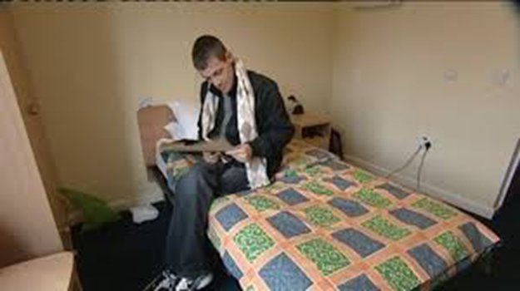
But what if the hostel is seen as their home?
It was his desire to remain here, he wanted to remain here, and …for me personally…I don’t think we should go against that….
Hostel worker
“People just need to be themselves.. at the end of life .. everything normal, like Dave; bargain hunt on the telly, can in one hand, cigarette in the other. He was happy. And people shouting? Not a problem, because its like “ I feel like I can be myself, right up to my last breath in here”.
Hostel worker

Slide 20
Barriers to Advance Care Planning
Uncertainty of prognosis
Lack of options to offer
Concern about fragility & removing hope
Lack of confidence
Denial - from all sides

Slide 21
Overcoming the challenges
©STIK

Slide 22
Recommendation 1: A shift in focus
End of life care
Advanced ill health
If you can’t predict, how do you plan?
Parallel planning supporting decisions, while keeping options open
Exploration of insights into illness, wishes and choices, not just warnings
Early & repeated conversations
Not just issues for the very end of life, but about living well.
Person centered - respecting choices even if we feel they are unwise.

Slide 23
Person centred care Support and concern mapping
Physical
Hopes for the future
Emotional
Place patient in centre
Locate important issues to address
Colour lines according to priority
Treatment
and Care
Social /
Practical
Patient / client
High Priority
Substance Use
Relationships
Low Priority
Difficult
Supporting staff to start from where their client is – work alongside them
www.homelesspalliativecare.com

Slide 24
Recommendation: 2. More support for hostels
In-reach (specialist nurse, palliative care, drug and alcohol)
Multi agency working (regular meetings discussing all clients of concern)
Training and support for all groups
High Risk Clients Review Meeting
GP
Surgery nurse
Key worker
Drug and Alcohol
Hostel Manager
Palliative care
Information sharing
Parallel planning
www.homelesspalliativecare.com
Coordinated Care planning

Slide 25
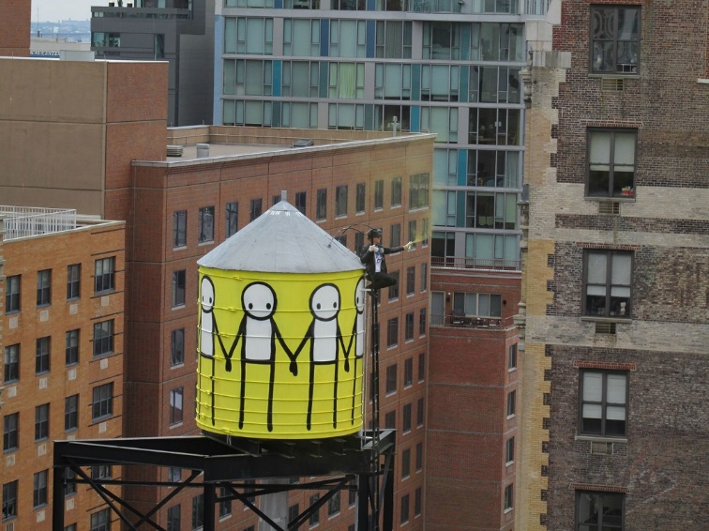
Recommendation: 2. More support for hostels
In-reach and MDT’s can help with:
Identifying people whose health is a concern
Having conversations – not just end of life, but living well
Supporting the development of care plans
Optimizing pain relief and other symptom control
Facilitating access to social services package of care
Training
Bereavement support
©STIK

Slide 26
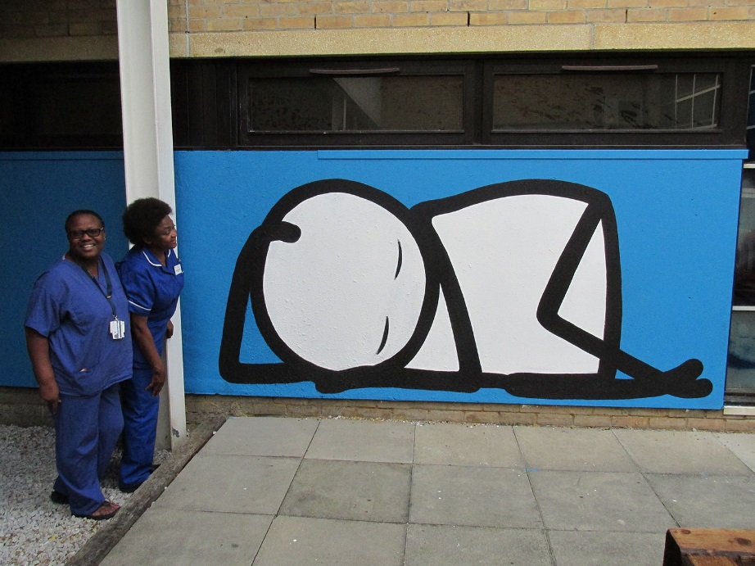
Recommendation 3: More choices including...
- A home – (not just temporary accommodation) ..
- A hostel based hospice:
A facility that Understands the needs of people who are homeless Acts as a step up from hostel or the street
Acts as a step down from hospital
Could provide adequate 24 hour support Offers respite AND/OR an acceptable, comfortable place to live until the end of their life
©STIK

Slide 27
..In the Meantime
While there are currently no alternatives, hostels may be best placed to provide support and care at end of life – but need additional training and multidisciplinary support
©STIK

Slide 28
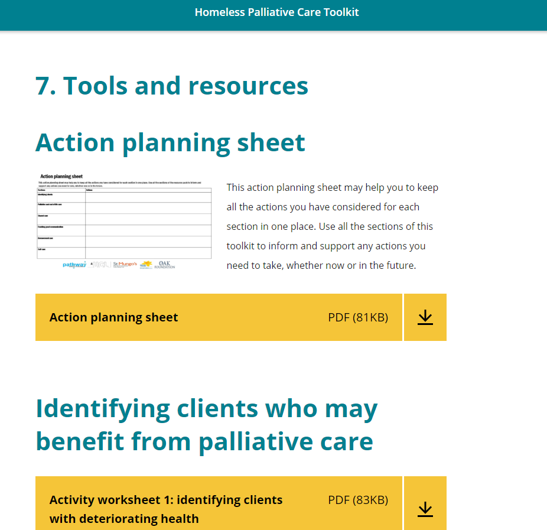
www.homelesspalliativecare.com

Slide 29
Hostel staff training:
When just you do training, it can be very difficult to implement… because you’re just one of many. Whereas if it’s all of us… the voices of many that’s going to push changes through.
Modules:
Identifying clients
Engaging clients and Person centred care
Shared Care
End of Life Care
Bereavement
Self Care
8 years of training… today was the first time any trainers have bothered about us. Its always been focused on client’s needs. Never about us, and if we are less stressed …the clients are going to get the best of us.

Slide 30
3 month follow up – qualitative findings
Impact
More discussion about end of life care within hostel
Some conversation tools being used
Memorials being used as a trigger for conversations
A section has been added to the agenda of team meetings to discuss clients of concern
GP planning to participate in multidisciplinary meetings at hostel
Yet to be established
Regular MDTs discussing clients of concern
Relationships with hospices for advice and support
Development of hostel policy around end of life care

Slide 31
Training alone is not enough
For lasting change, training needs to be accompanied by
multi disciplinary, multi agency support
May also need “champions” within teams to facilitate and sustain change by
developing relationships
connecting services
coordinating client focused meetings and actions
….very few people know what our lives are like in the hostel. We need someone who could support us… I think it could only come from a hospice.
If we had somebody that stepped up to come and give us the benefit of their experience. Or even on the end of the phone and we could call them, and say “so and so passed away this morning and its just so upsetting” or “I don’t know what to do about this”. that would be fantastic.

Slide 32
Current study
AIM: Embed training and support into hostels to improve access to high quality care and support for people with advanced ill health & reduce burden on frontline staff
Palliative care staff trained to provide in-reach support to hostels on a regular basis (approx. 2 half days per month for each hostel – part of their job plan)
This support might include:
Discussion / advice regarding individual clients
Advocating for care and support from other agencies and assist with referrals
Supporting development of regular MDT meetings to discuss clients of concern
Undertaking regular bespoke training with staff
Each palliative care team will be associated with 2 hostels
We aim to undertake this in 8 Boroughs – evaluating impact and adapting as we go

Slide 33
Project evaluation
Interviews and questionnaires (baseline and after 6 months) with
Champions from palliative care and homelessness service
Hostel staff/managers
Some hostel residents
Mixed methods evaluation to determine:
Impact on support and care received by residents,
Changes in utilisation of health services,
Staff morale,
Feasibility and effectiveness of multiagency working,
Challenges: what worked well and what didn’t, how could project be improved

Slide 34
Summary - What’s needed:
Joined up multidisciplinary person centred care for people with complex needs: addressing social care, housing, substance misuse, mental and physical health support in hospital and community
In hospital when planning for safe discharge
In outreach / day centres / street teams
In hostels
Choice and a range of options – no single solution
A hostel based hospice / respite care / step up step down
Residential care for “young olds”
Giving more voice to people with lived experience in the development and delivery of services

Slide 35
With thanks to
The Oak Foundation
Marie Curie Palliative Care Research Department, UCL: Dr Briony Hudson, Dr Megan Armstrong & Professor Patrick Stone
Pathway: Dr Nigel Hewett & Julian Daley
St Mungo’s: Niamh Brophy & Peter Kennedy

Slide 36
Publications
Faculty of Homeless and inclusion health: www.pathway.org.uk/services/end-life-care-homelessness
Training resources: www.homelesspalliativecare.com
Hudson BF, Flemming K, Shulman C, Candy B. Challenges to access and provision of palliative care for people who are homeless: a systematic review of qualitative research. BMC Palliative Care. 2016;15(1):96.
Shulman C, Hudson BF, Low J, Hewett N, Daley J, Kennedy P, et al. End-of-life care for homeless people: A qualitative analysis exploring the challenges to access and provision of palliative care. Palliative Medicine. 2017;0(0):0269216317717101.
Hudson BF, Shulman C, Low J, Hewett N, Daley J, Kennedy P, et al. (2017) Challenges to discussing palliative care with people experiencing homelessness: a qualitative study. BMJ Open 2017;7:e017502. doi: 10.1136/bmjopen-2017-017502
Shulman C, Hudson BF, Kennedy P, Brophy P, Stone P. Evaluation of training on palliative care for staff working within a homeless hostel. Nurse Education Today 71 (2018) 135-144
CQC & Faculty of Homeless and Inclusion Health (2017). A Second Class Ending. Exploring the barriers and championing outstanding end of life care for people who are homeless

