Slide 2
St Mungo’s - Working with Women
Catherine Glew
Women’s Strategy Manager, St Mungo’s

Slide 3
About St Mungo’s
Our vision is that everyone has a place to call home and can fulfil their hopes and ambitions. St Mungo’s:
Provides support directly to our clients, either to prevent them becoming homeless, or to respond to it and help them recover
Builds relationships with communities and the wider public, aiming to increase understanding of homelessness and empathy towards the people who experience it
Advocates for policy change by combining our clients’ voices with the experience we have about what works.

Slide 4
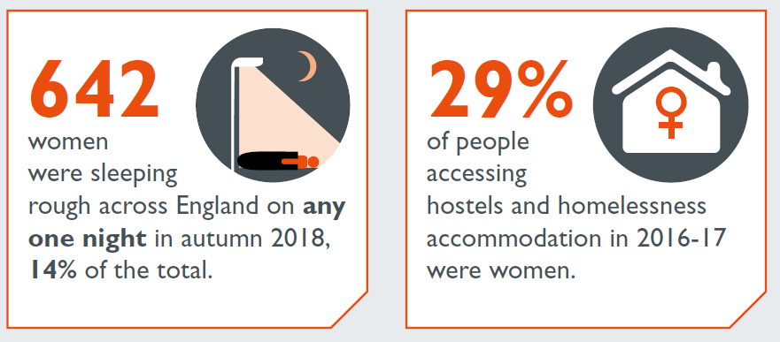
Women’s homelessness in England
Only 7% of homelessness accommodation projects in England offer women-only provision
Sources: MHCLG (2019); Homeless Link (2018)

Slide 5
Women at St Mungo’s
29% of St Mungo’s clients are women
44% of women are under 35
1,216 women in St Mungo’s supported housing during 2017/18
81% need support with mental health
51% need support with substance use, of whom 61% use crack cocaine, 53% use heroin and 46% are at risk of overdose
48% are mothers
35% are lonely or isolated
Around half of women have experienced domestic abuse

Slide 6
St Mungo’s Women’s Strategy
Why do we have a Women’s Strategy?
Developing the strategy
Recovery, gender and trauma

Slide 7
St Mungo’s services for women
62% of women in our supported housing live in mixed projects
38% live in women only projects

Slide 8
Our aims
Improve services
Interconnect with partners
Innovate and test new ways of working
Influence local and national government
Involve our female clients

Slide 9
Trauma in practice
Staff training on recognising and responding to trauma and domestic abuse – partnerships with women’s sector
Reviewing our response to sexual violence
Piloting psychologically informed environments
Safer space work with women in mixed settings
Women and trauma psychoeducational workshops

Slide 10
Catherine Glew, Women’s Strategy Manager catherine.glew@mungos.org

