Slide 2
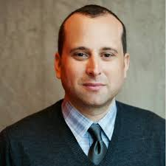
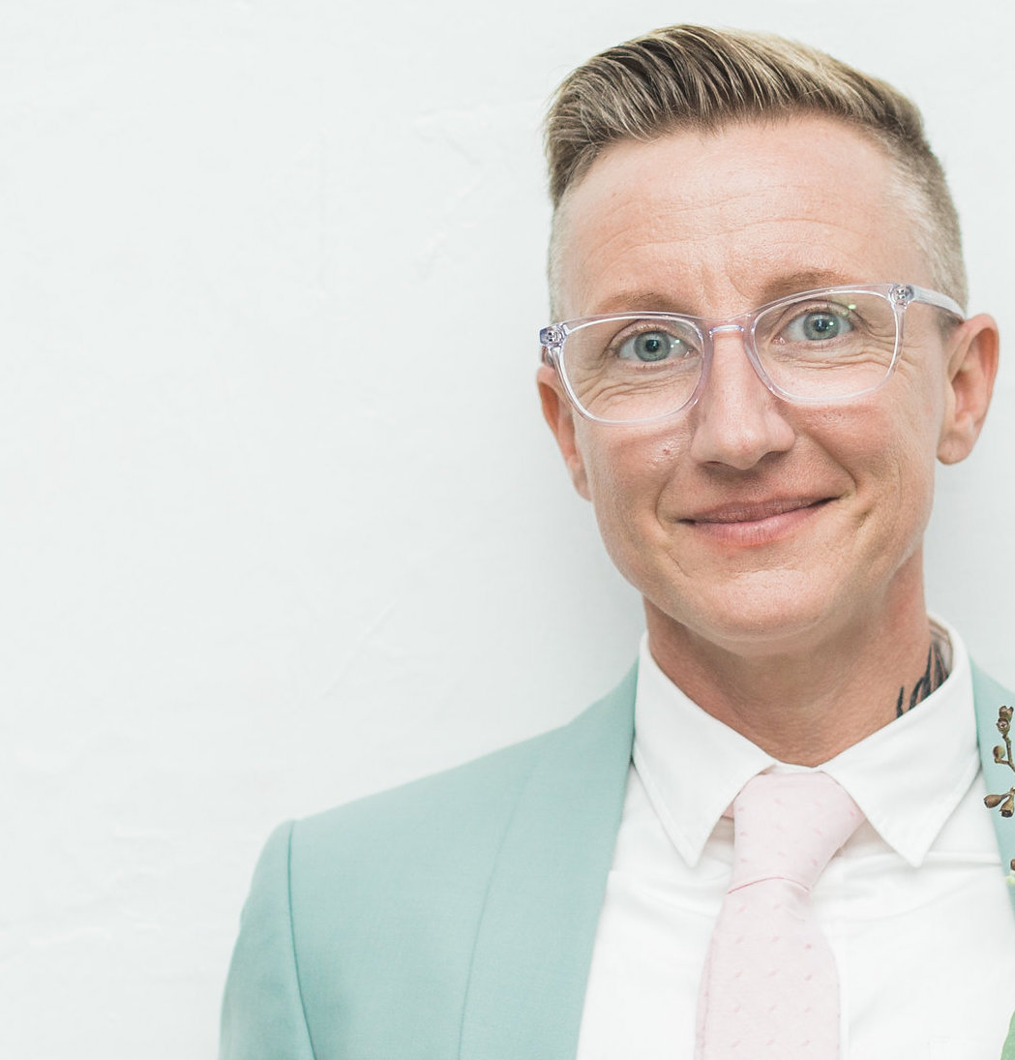
LGBTQ Youth Homelessness
Gregory Lewis
Executive Director & CEO | He, Him
True Colors United | gregory@truecolorsunited.org
Jama Shelton, MSW, PhD
Chief Strategy Officer | They, Them | True Colors United
Assistant Professor | Silberman School of Social Work
@PagingDrJama

Slide 3
“I can’t say who I am unless you agree I’m real.” --Amiri Baraka
“I feel like I most belong where—honestly wherever my feet take me at this point. I mean even, even if I know like I’m not wanted….Just look, you gotta look for the light in the darkness …”

Slide 4
In the U.S....
LGBTQ youth are 120% more likely to experience homelessness than non-LGBTQ young adults.
LGBTQ youth of color are disproportionately impacted by experiences of homelessness.

Slide 5
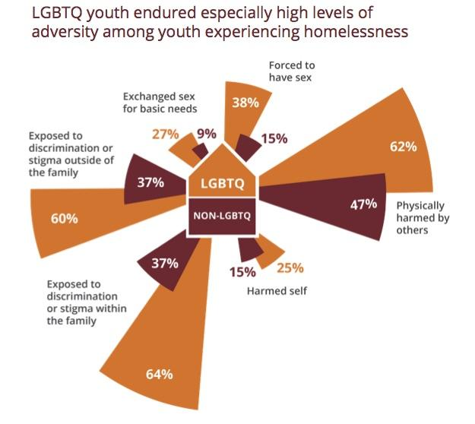
Why focus on LGBTQ youth?

Slide 6
When we center the experiences of those who have been most marginalized by our societal systems and institutions in the creation of policies, programs, and interventions, we create a more equitable system for all.
Why focus on LGBTQ youth?

Slide 7
What we do:
Training & Education
Advocacy
Youth Collaboration
Notes:
The True Colors United works within communities across the country to develop solutions that prevent and end youth homelessness in three ways:
Training & Education
We educate and collaborate with professionals working on the ground to ensure that lesbian, gay, bisexual, and transgender (LGBT) youth experiencing homelessness have access to the inclusive and affirming services they need.
Advocacy
We amplify the voices of lesbian, gay, bisexual, and transgender (LGBT) youth experiencing homelessness in government and media to ensure vital services and protections are in place to meet their needs.
Youth Collaboration
We provide lesbian, gay, bisexual, and transgender (LGBT) youth experiencing homelessness with leadership development opportunities that elevate their voices so they can play an active role in creating solutions.

Slide 8
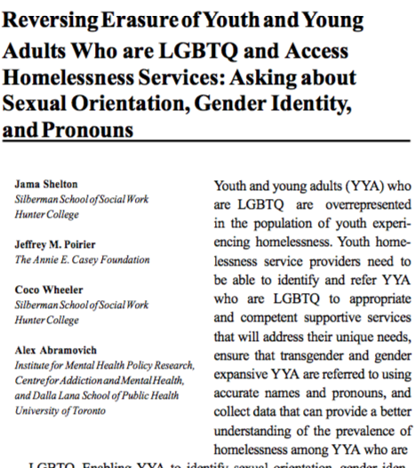
Our Research
Youth/
Providers
Policy makers/
Advocates
Researchers
LGBTQ Youth Homelessness: A National Research Agenda
Serving Our Youth
Asking SOGI &
Pronoun Questions

Slide 9
Our Research
LGBTIQ Youth Homelessness in Europe

Slide 10
Thank you!
Welcome:
Alex Abramovich
Gary McMillan

