Slide 1

Friday, May 31, 2019
Creating Safe, Inclusive and Affirming
Environments for LGBTQ Youth
Dr. Alex Abramovich
Centre for Addiction and Mental Health (CAMH)
University of Toronto
Toronto, Canada

Slide 3
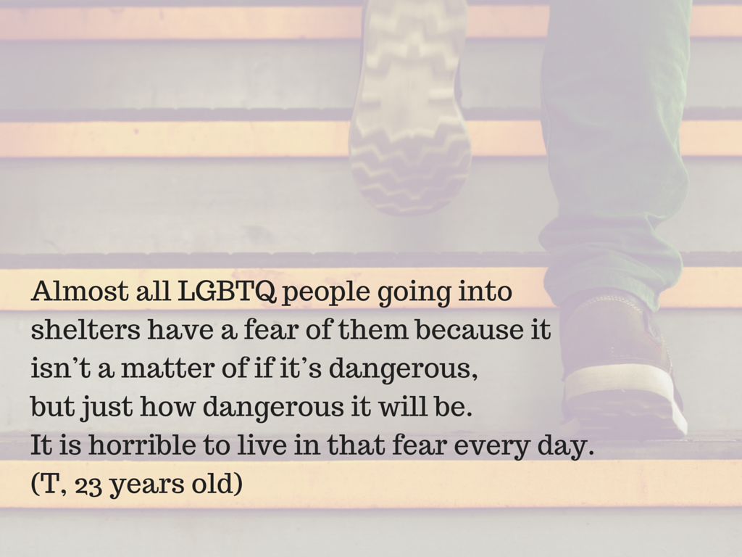

Slide 4
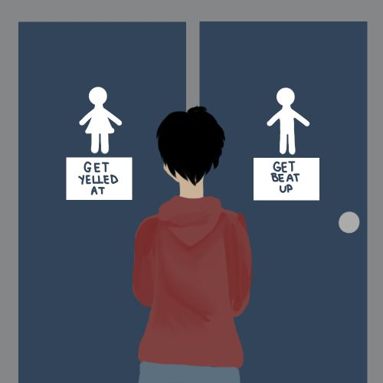

Slide 5
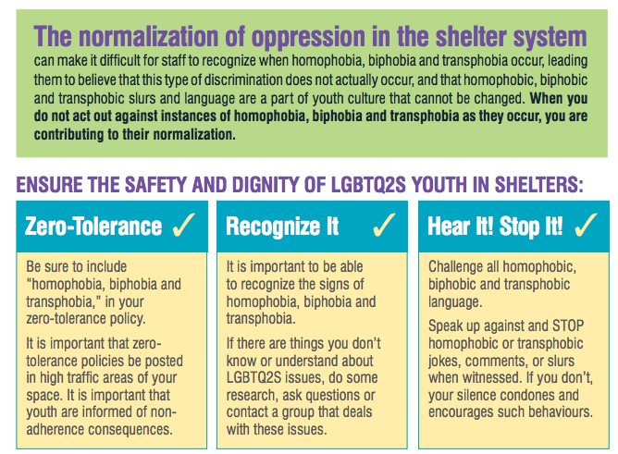
Notes:
Normalization of transphobic, biphobic, homophobic language makes it difficult to identify oppressive language as well as how to interrupt the language.
Previous exercise inside out helps to name some language commonly heard in shelter spaces.
Making spaces safer requires implementing zero tolerance policies, recognizing what transphobia, biphobia, homophobia looks/sounds/feels like
Then Stopping it

Slide 6
City of Toronto Shelter Standards
Shelter providers will ask all clients for their gender identity rather than assume.
Shelter providers will support the choices of trans clients to gain access to sleeping areas designated for the gender the client identifies with and/or that will best preserve their safety and dignity.
In instances where trans clients express concerns about their safety or dignity, shelter providers will accommodate requests for a bed in a gender neutral/private room, if possible, or in a sleeping area that the client believes will best preserve their safety and dignity, regardless of their gender identity.
Notes:
TSS 8.1 Intake and 10.3.3 LGBTQ2S Clients (https://www.toronto.ca/wp-content/uploads/2017/11/98e0-toronto-shelter-standards-2016-functional.pdf)
(a) Shelter providers will
(i) board-approved policy how services are provided to LGBTQ2S (ii) Submit a copy of the policy (iii) Provide a copy of the policy to clients upon request.
(b) will ask all clients for their gender identity rather than assume.
(c) will accept gender identity and gender expression as defined by a client.
(i) In all interactions, staff will use a client’s chosen name and pronoun.
(d) make their services accessible to transgender clients in their self-identified gender.
(e) Shelter providers will support the choices of transgender clients to gain access to sleeping areas designated for the gender the client identifies with and/or that will best preserve their safety and dignity.
(i) where transgender clients express concerns about safety or dignity, shelter(s) will accommodate requests in a gender neutral/private room, or in a sleeping area that the client believes will best preserve safety and dignity
(f-h) Toiletries and hygiene supplies
(i) Shelter providers will provide a minimum of one (1) washroom that is barrier-free, fully accessible and designated gender neutral in each shelter.
(j) Shelter providers will inform transgender and/or disabled clients of the availability and location of gender neutral and/or accessible washrooms.
(k) Shelter providers will take all reasonable measures to ensure that clients have privacy while showering.

Slide 7
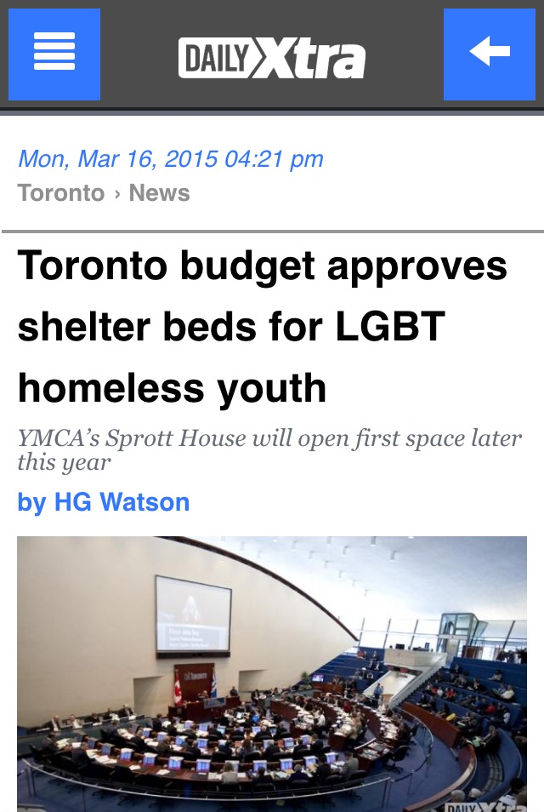
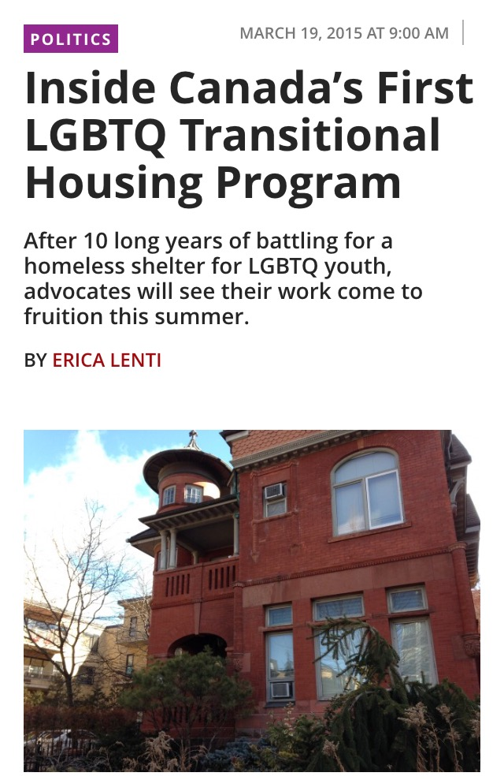
Abramovich 2015

Slide 9
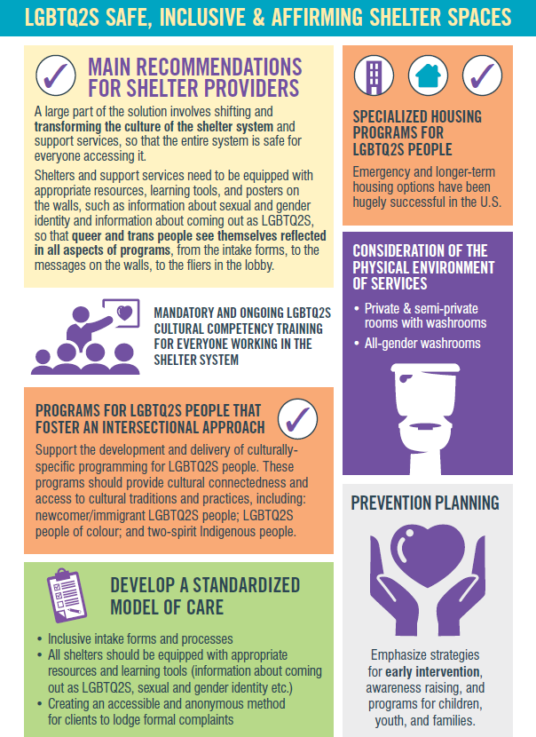
Notes:
Affirming Spaces, Intake, Welcoming Environment, Pronouns

Slide 10
Best Practices
Zero tolerance: homophobia, transphobia, biphobia (language and behaviour)
LGBTQ specific programing, and inclusion within all programming
LGBTQ inclusion posters, visuals, information available in shelter
Review intake processes and LGBTQ inclusion policies regarding access to services

Slide 11
Sexual Orientation & Gender Identity Questions
How do you describe your sexual orientation? (check all that apply)
[]Lesbian
[]Gay
[]Bisexual
[]Queer
[]Pansexual
[]Heterosexual/straight
[]Asexual
[]Two-Spirit
[]Identity not listed (please specify)_______
How do you describe your gender identity? (check all that apply)
[]Cisgender woman
[]Cisgender man
[] Transgender woman
[] Transgender man
[] Two-Spirit
[] Genderqueer
[] Gender fluid
[] Non-binary
[] Identity not listed (please specify)_____

Slide 12
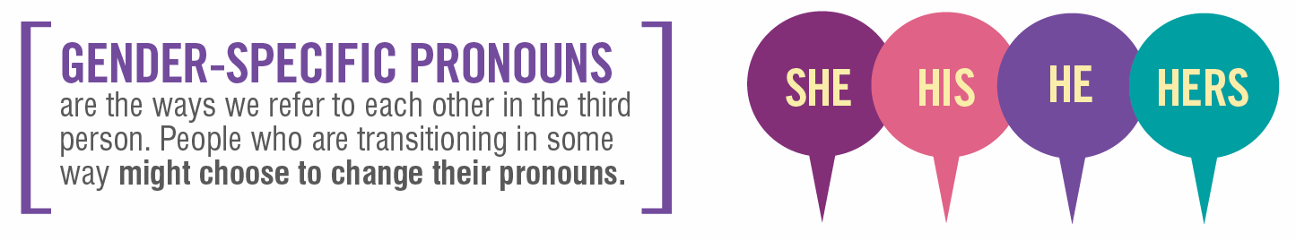
What’s a Pronoun?
A pronoun is a word that takes the place of a noun, for example a person’s name.

Slide 13


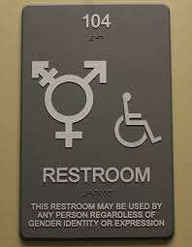
Gender-Affirming care
Washrooms

Slide 14






Slide 15

Thank you!
Email: Alex.Abramovich@camh.ca
Twitter: @IAlexAbramovich

