Slide 1
Social Housing Support – providing social housing in Czechia Porto 31. 5. 2019
Jitka Modlitbová
Social Housing and Social Inclusion Unit
Ministry of Labour and Social Affairs Czech Republic

Slide 2
Social Housing Situation in the Czech Republic

Slide 3
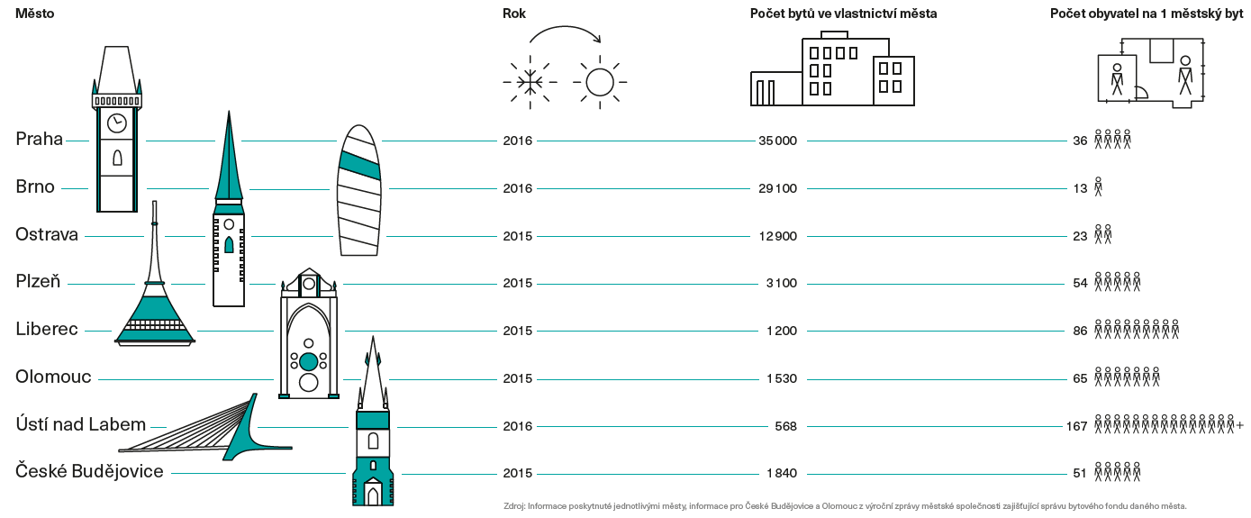
Differences in municipal housing funds in CZ
Zdroj: KPMG 2016 - Voice of Real Estate, Bytový fond hlavního města Prahy a jednotlivých městských částí

Slide 4
Social Housing Legislation in the Czech republic

Slide 5
Legislation
Municipality Law
Municipalities have a duty to care for their citizens in need
Social Benefits Legislation
Social Housing Concept of Czech Republic 2015 – 2025
Non-legislative material, though binding for ministries
Social Housing Bill
Ministry of Regional Development - responsible for the draft of the bill
August 2018 – works on the bill were terminated
Subsidy programme for municipalities
Affordable Housing Bill
Draft should be ready in March 2020

Slide 6
Who is eligible for social housing?
People in housing need
People paying a disproportionate part of their income for housing
People in vulnerable position:
Young families
People with disabilities
Seniors
People leaving institutions/care
People who were subject of discrimination on housing market

Slide 7
Three Pillars of Social Housing
Housing policies
Social work and social services
Social benefits
FLATS
SUPPORT
FINANCES

Slide 8
Main Principles of Social Housing
Housing in flats,
Individualised approach,
Nondiscrimination,
Housing according to needs of clients,
Nonsegregation,
Homelessness prevention,
Subsidiarity – role of municipalities,
Sustainability

Slide 9
Social Housing Support – Systemic project (ESF)

Slide 10
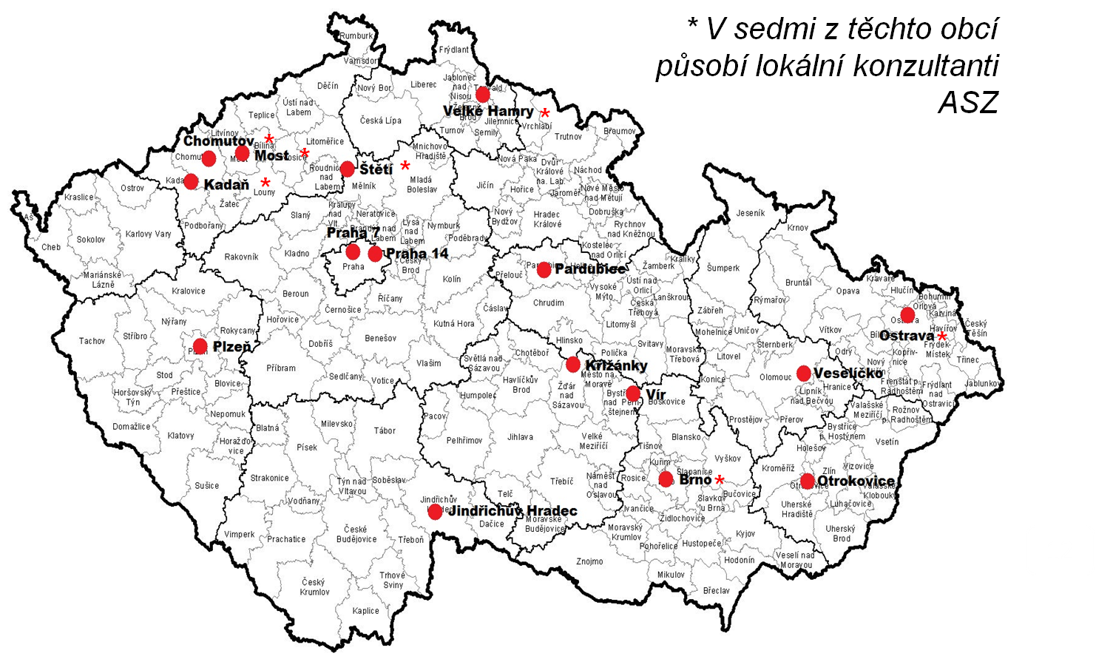
Spolupráce s obcemi
* V sedmi z těchto obcí působí lokální konzultanti ASZ
*
*
*
*
*
*
*
10

Slide 11
Contact Centre for Social Housing
Useful information and help for
Municipalities
NGOs
Academics
People in housing need
Consultation by phone, e-mail, or in person
Workshops on multiple topics
Expert group and working groups on social housing

Slide 12
Analyses and methodical materials
Analyses and surveys
Impact of inadequate housing on children
FAWOS and its transferability to Czechia
Structure of municipal housing funds and its use for social housing
Cost-benefit analysis of night shelters vs. social housing
Survey of neighbourly relations (cca 6/2019)
Census of homelessness – part 1(2019-2020)
Methodical materials
Identification of residentially segregated localities
Social work in social housing
Assessing inadequate housing and possible solutions

Slide 13
Other project activities
Newsletter
Webpage www.socialnibydleni.mpsv.cz
Facebook www.facebook.com/socialnibydlenivcr
Infocampaign – leaflets, brochures, radio, newspapers, TV
Evaluation
14 regional workshops on regional cooperation
Conference – Trauma and Homelessness (11/19)

Slide 14
Municipal Good Practice

Slide 15
Cooperation of Local Actors
Municipality
Social service providers
NGOs
Labour Office
Regional authority
Important housing stock owners

Slide 16
Situational Analysis
Housing fund
Demographics and tagret group needs
Local social housing concept
Capacities of social work

Slide 17
NGO cooperation
Work with specific target groups
NGOs as tenants sub-letting to clients
Paying for rent and utilities
Social workers not in charge of collecting rent
Housing benefits payed directly to the municipality (for a necessary period of time)

Slide 18
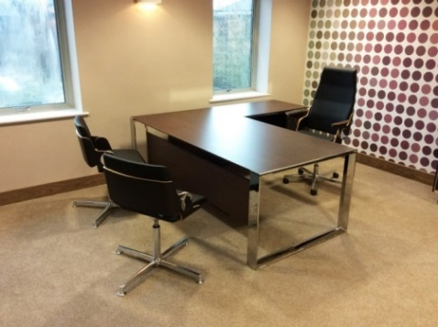
Finding a flat
Social Realtors
Estate agent cooperating with municipality
Special housing office – all necessary agenda combined
Crisis accomodation
For victims of domestic violence/other crimes/natural disasters

Slide 19
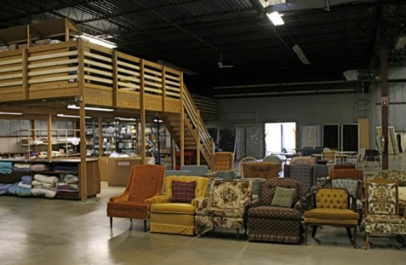
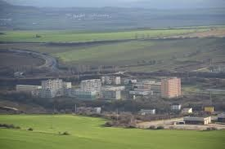
Furniture banks
Helping to furnish flats for new tenants
Solving debts
Cooperation between housing unit and social unit of municipality
Installment system
3-sided agreement – energy provider, municipality, tenant

Slide 20
Results so far
More than 2000 people supported
More than 470 flats provided by 16 municipalities
Housing first projects – so far 18 projects
Robust body of data for the new social / affordable housing legislation

Slide 21
Thank you for your attention jitka.modlitbova@mpsv.cz www.socialnibydleni.mpsv.cz
www.facebook.com/socialnibydlenivcr

