Slide 2
Praxis Homes
Maria Iglesias
Head of Services

Slide 3
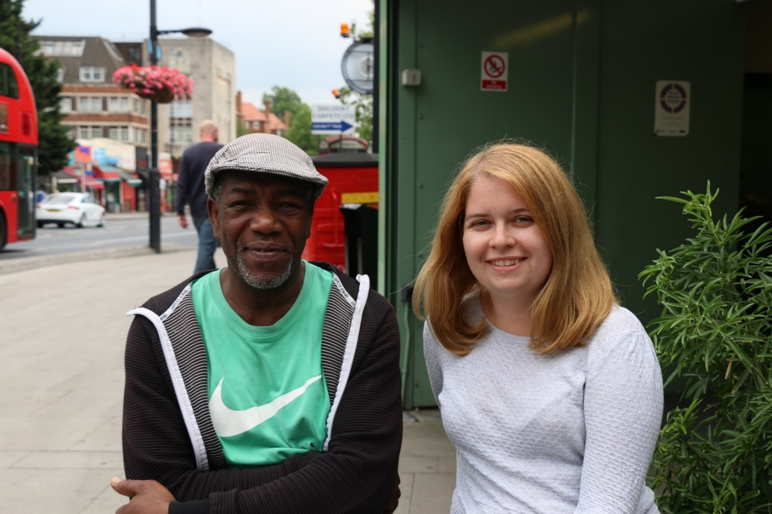
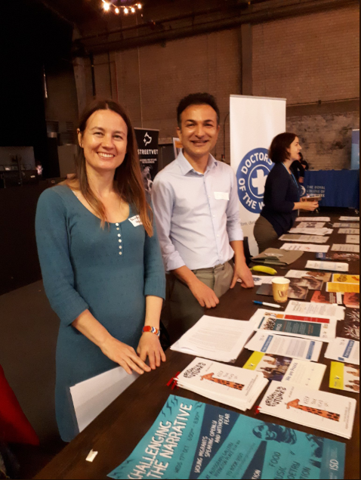
Praxis’ Aims and Priorities
Migrants at risk are able to access services that recognise their human rights and needs

Slide 4
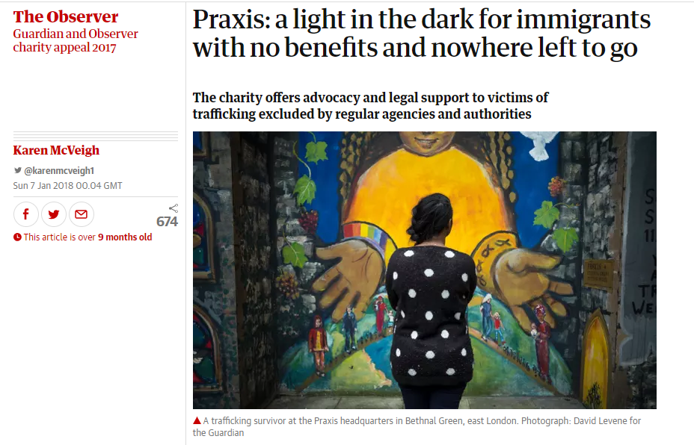
Praxis’ Aims and Priorities
The challenges faced by undocumented migrants and those with uncertain immigration status are more widely understood

Slide 5
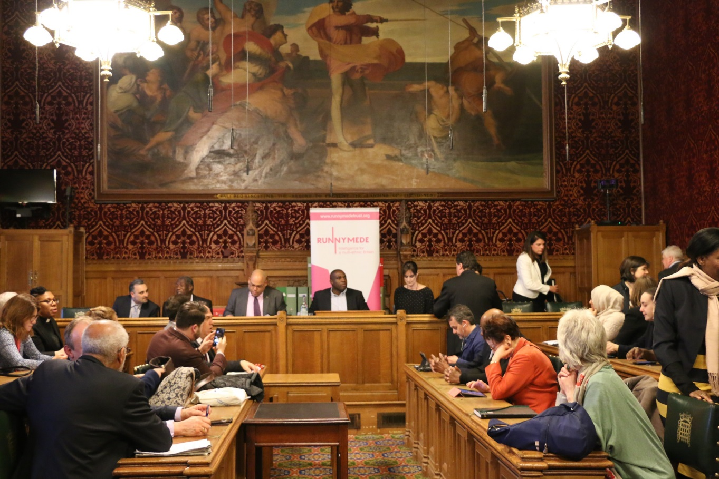
Praxis’ Aims and Priorities
The challenges faced by undocumented migrants and those with uncertain immigration status are more widely understood

Slide 6
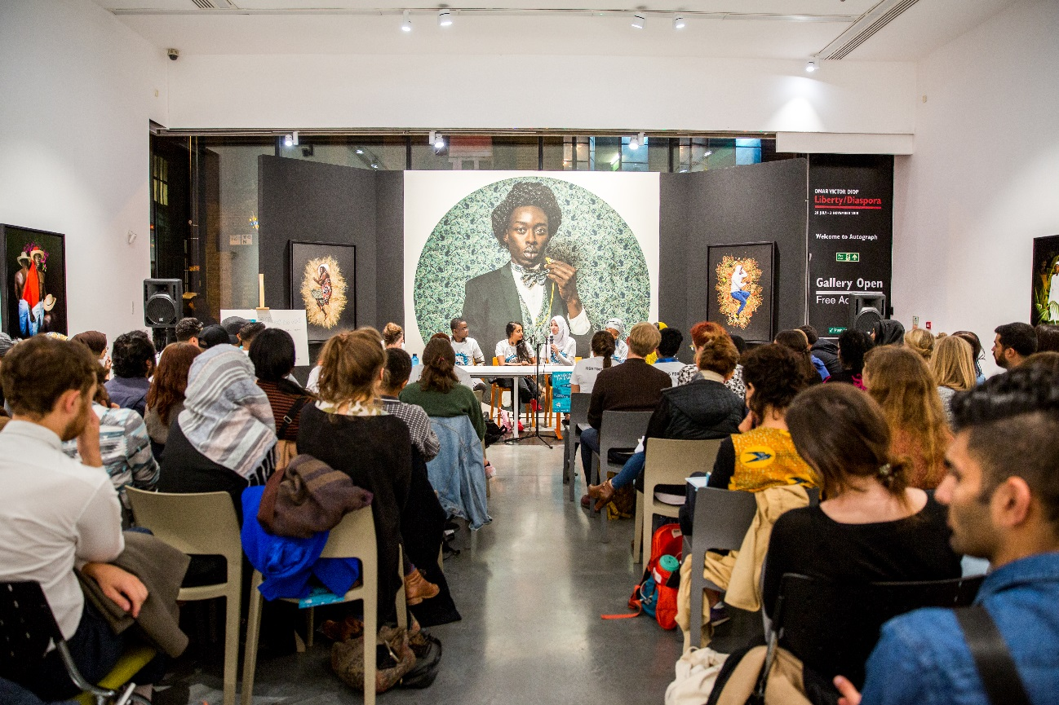
Praxis’ Aims and Priorities
Service Users find resilience, voice and sense of belonging

Slide 7
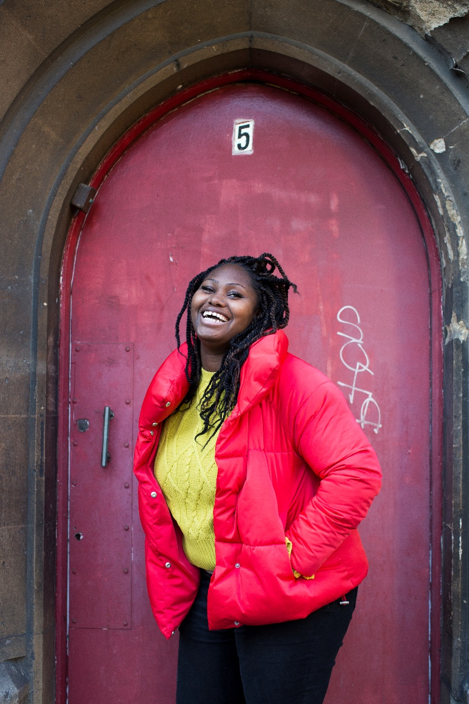
Praxis’ Aims and Priorities
Destitute Migrants are able to access safe accommodation and support

Slide 8
Praxis homes – beneficiaries
Two groups:
Destitute migrant families on No Recourse to Public Funds
Single women with an insecure immigration status and No Recourse to Public Funds (asylum seekers, victims of trafficking or domestic violence, and those seeking status based on human rights applications).

Slide 9
No Recourse to Public Funds
NRPF – single largest cause of migrant destitution in the UK
Since 2012 a growing number of people who do have status now also have a NRPF condition attached to their leave to remain in the UK.
In 2014-2015, 50,000 people with dependants were given leave subject to an NRPF condition
Problem more acute in London – chronic shortage of housing.

Slide 10
No Recourse to Public Funds
‘No Recourse to Public Funds’ (NRPF) is not an immigration status
It may be a condition of somebody’s permission to be in the UK (e.g. spouse or student visas)
It may be a default position because somebody does not currently have permission to be in the UK or lack documentation (i.e. Windrush)

Slide 11
What are public funds?
A range of benefits, generally related to lower incomes and housing support, including:
Job Seekers Allowance (JSA)
Housing benefit
Local authority homelessness assistance
Disability Living Allowance

Slide 12
Praxis homes- Problems & solution
Inadequate housing for destitute migrant families (section 17).
Provision of bed spaces for single women with NRPF
Immigration advice

Slide 13
Praxis homes
A portfolio of 7 properties (in outer London) – purchased using Social Investment and coordinated by Commonweal plus one extra house
18 bed spaces for families and up to 6 for single women
A commitment to shared accommodation
Immigration Advice
Holistic Support
Appropriate referrals from social services and for single women with NRPF
External Evaluation

Slide 14
Financial Model
Cross-subsidy Model
Financial risk – spot purchasing from Local Authorities for family referrals.
95% occupancy to make it work
Referrals from 7 different Local Authorities in London

Slide 15
Outcomes
46 households were placed in the 8 houses.
33 families & 14 single women.
Clients gained better understanding of their legal situation and status.
Family average length of stay is 9months.
95% positive resolution of cases where there has been a final immigration decision.
Better access to services, increased sense of wellbeing and social connection and greater confidence and positivity
Moving on was sometimes hard.

Slide 16
External Evaluation
Residents appreciate the holistic support and quality of accommodation.
Praxis immigration advisers have played an important role in most cases by supporting, advising and advocating, even when not leading on immigration cases.
Flexible holistic advice and support and a degree of housing stability helps immigration casework because there is a safe space to keep documents in order and plan and attend appointments more easily.
Holistic support offer is important to many clients. Group work and other Praxis based services have provided a lifeline to many otherwise isolated destitute families, including once they have moved on.

Slide 17
Current challenges
New HMO legislation.
Voids
Type of referrals – Domestic violence, big families.

Slide 18
Quotes from clients
“It’s the place that’s given me light. It made me know the value of living.”
“It has a bed!” - S, aged 4
‘‘Everyone is polite, we have security here, we are like one big family (…) we understand each others’ pressures but we are polite and calm’’.
“Praxis has been a light for me. It got me from a deep hole, a pit. (…) I used to live in fear but when I went to Praxis House it stopped ”
“I liked my time there very much, it was a change, it was a rest”

Slide 19
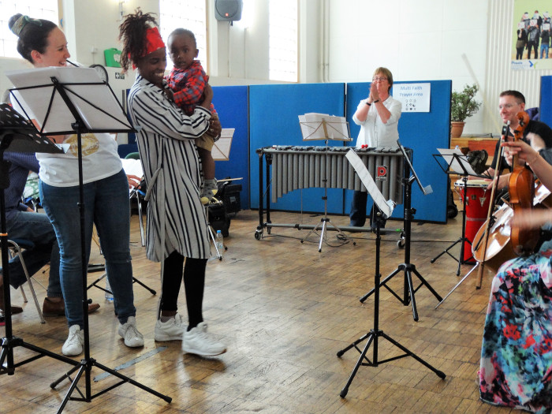
Lullaby Project with WINGS and Irene Taylor Trust

Slide 20
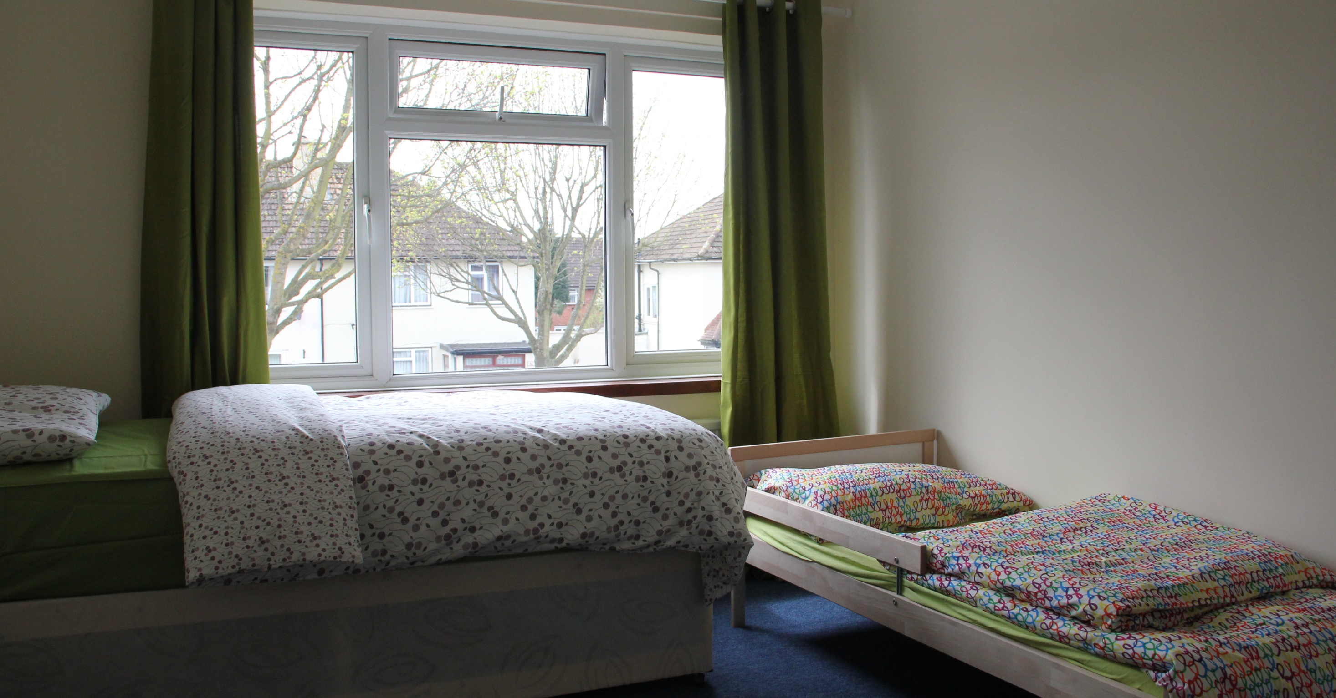

Slide 21
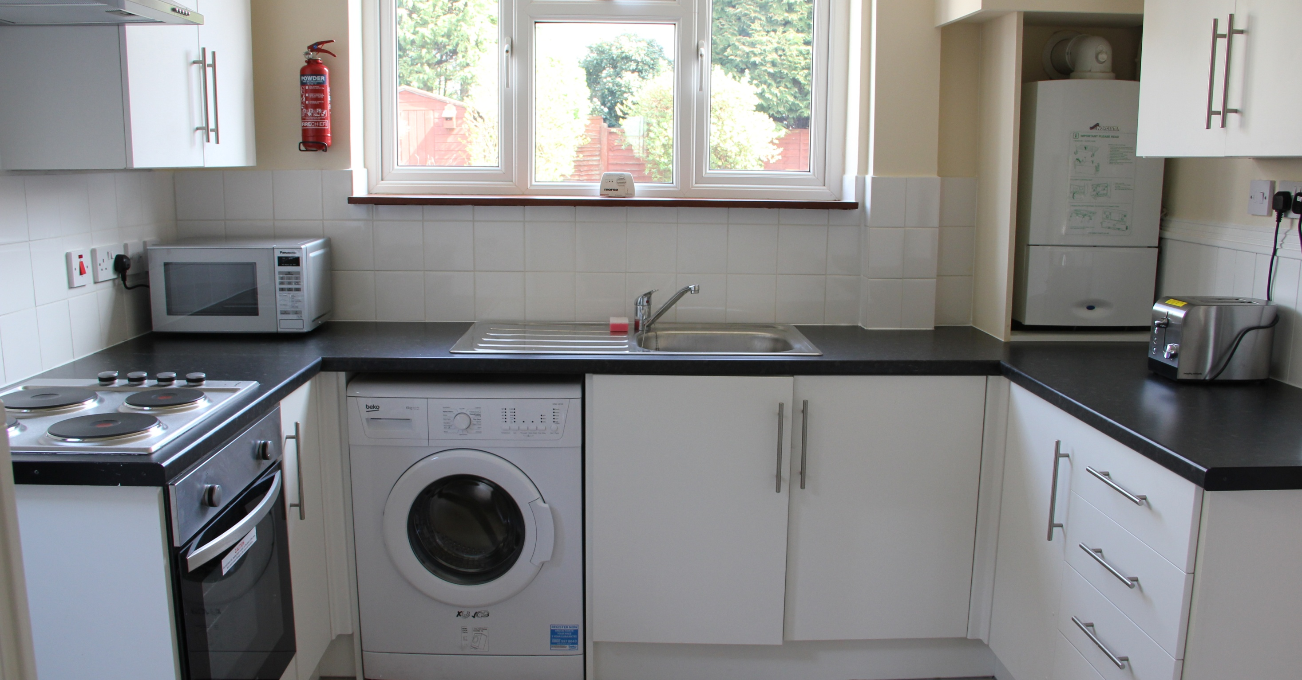

Slide 22
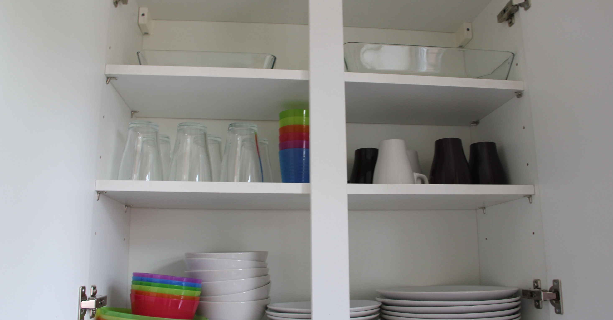

Slide 23
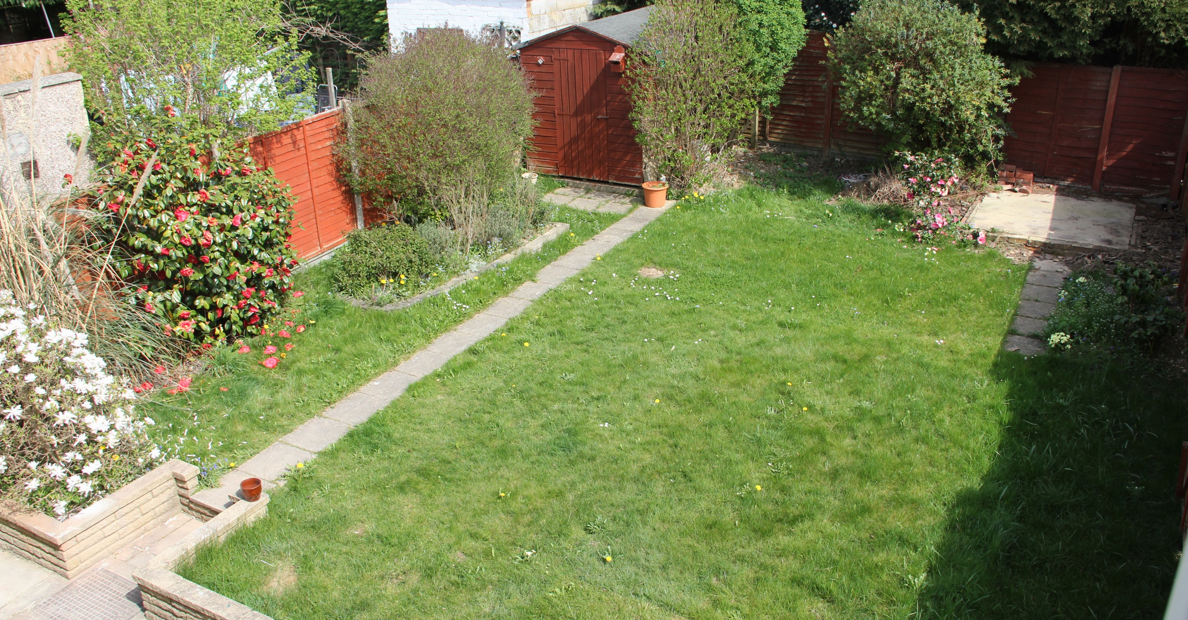

Slide 24
Maria.Iglesias@praxis.org.uk

